Slide 1
Lean Manufacturing & Six Sigma MSE 401 Engineering & Technology Management Professor Elias
Group # 2 ‘Vision’
Aydzhan Salim
Badr Saab
Christopher Hovsepian
Jing Yang
Saleh Alrosais
Sivaram Natarajan
December 3, 2012

Slide 2
Agenda
I – Introduction
1.Project overview
II - Data and Information
1. What is Lean Manufacturing?
1.1 History of Lean Manufacturing
1.2 Key concepts of Lean Manufacturing
2. What is Six Sigma?
2.1 History of Six Sigma
2.2 Key concepts of Six Sigma
III - Discussion & Analysis
1. Case Study of Baxter International Incorporated
1.1 Baxter international, Inc. overview
2. Implementation of Lean Manufacturing
2.1 Implemented Lean concepts
3. Results after Lean implementations in Baxter International, Inc. IV – Conclusion & Recommendations

Slide 3
I - Introduction
1.Project Overview.
Throughout this project presentation the definitions, history, and concepts of Lean Manufacturing & Six Sigma will be covered
Examples, analysis, and results of Lean implementations from a case study about Baxter International Inc. will be provided

Slide 4
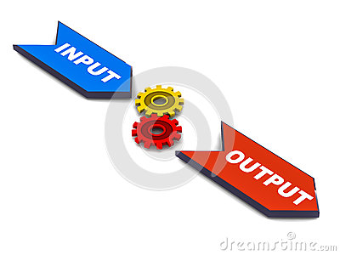
II - Data and Information
1. What is Lean Manufacturing?
Lean Manufacturing is reducing or getting rid of waste and/or non-value added from the beginning to the end of the manufacturing process
Implementing systematic
approach to improve productivity
And quality while possibly lowering
costs
Figure 1: Input, Process, Output model.

Slide 5
II - Data and Information
1.1 History of Lean Manufacturing
The concept of Lean is adopted from Henry Ford from the United States
Toyota production engineer Taiichi Ohno implemented the Kanban or just-in-time work principles
Ohno believed that a happy worker is the sole key to a healthy production

Slide 6
II - Data and Information
1.2 Key concepts of Lean Manufacturing
1.21 JIT/Kanban
Just-In-Time(JIT) is a production strategy based on eliminating all forms of corporate waste and variance and raising productivity
Benefits of JIT:
Zero idle inventory
Lowest total cost
Perfect quality
Kanban is one means through which JIT is achieved
A signal that provides an instruction to regulate the sequence and timing of production
Benefits of Kanban:
Visual production
Improved inventory control
Reduce wasted time looking for material/ floor space
No over production
Figure 9 : On-time

Slide 7
II - Data and Information
1.22 - 5S (6S) system
Mid 60’s, Japanese born Hiroyuki Hirano developed the 5S system through his Just-In-Time philosophy
The 5S English translation are Sort, Straighten, Shine, Standardize, and Sustain
Because of the national safety organization Occupational Safety and Health Administration (OSHA) Safety has been added to 5S making it a 6S system

Slide 8
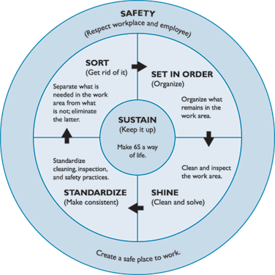
II - Data and Information
1.22 - 5S (6S) system
1.Sort-Identify & eliminate what is not needed
2.Straighten- Having a place for everything
3.Shine- An effective, organized environment
4.Standardize-Develop standards and stick to them
5.Sustain- Make 6S a way of life
6.Safety - Be visually aware of your surroundings
Figure 2: 6s System

Slide 9
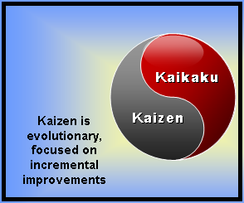
II - Data and Information
1.23 Kaizen Improvement
Continuous Improvement
Eliminate waste by improving
standardized activities and processes
Involves the entire workforce
Incremental small changes in groups creates significant compound improvement in quality for company
Initiated by small groups
Figure 3: Kaizen

Slide 10
II - Data and Information
1.23 Kaizen Improvement
Cycle of Kaizen activity:
Standardizing an operation and activities
Measuring the standardized operation (cycle times, inventory, etc.)
Gauging measurements against requirements
Innovating to meet requirements and increase productivity
Standardizing the new and improved operations
Continuously repeating this cycle of Kaizen activity

Slide 11
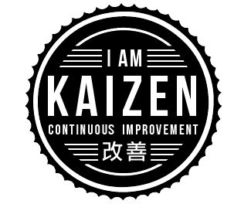
II - Data and Information
1.23 Kaizen Improvement
Main elements of Kaizen
-Management teamwork
-Increased labor responsibilities
-Increased management morale
-Quality circles
-Management suggestions for labor improvements
When these elements are applied continuously in a business and at all levels within an organization, they result in improvements for the process or activity by increasing its productivity
Figure 3: Kaizen

Slide 12
II - Data and Information
1.24 Kaikaku Improvement
Fundamental and radical change of a production process in order to see improvement (Kaizen Blitz)
Used when Kaizen activities stagnate
Four different types of Kaikaku projects:
Locally innovative and capital intensive
Locally innovative and operation close
Radically innovative and capital intensive
Radically innovative and operation close
Figure 6 : Lean Engineering

Slide 13
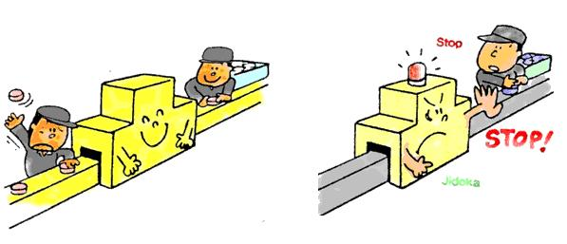
II - Data and Information
1.25 Jidoka
The use of automation as a feature of machine design (“intelligent automation”)
Quality control process that applies four principles:
Detect the abnormality
Stop
Fix or correct the immediate condition
Investigate the root cause and install a
countermeasure
Machines and workers are separated through mechanisms that detect product abnormalities
Figure 7 : Jidoka

Slide 14
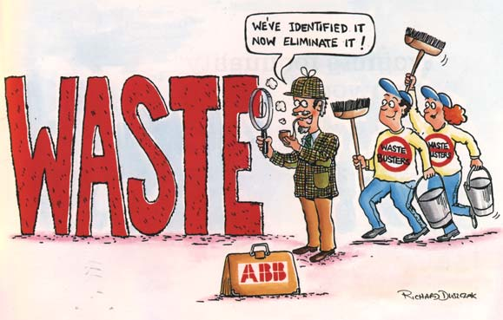
II - Data and Information
1.26 Muda
Japanese word which means “futility; uselessness; idleness; superfluity; waste; wastage; wastefulness.”
Improvement program which aims to reduce waste from a production process.
Seven types of wastes (mudas):
Transportation 5) Over-processing
Inventory 6) Over-producing
Motion 7) Defects
Waiting
Figure 8: Waste

Slide 15
II - Data and Information
1.27 Value Stream Mapping (VSM)
VSM is a Lean Manufacturing technique which has originated from the Toyota Production System; it is also known as “material and information flow mapping.”
Used primarily to identify, demonstrate, and decrease waste by creating a visual flow in the supply chain and manufacturing process
The key to VSM is to see the “big picture” as a sum of the parts

Slide 16
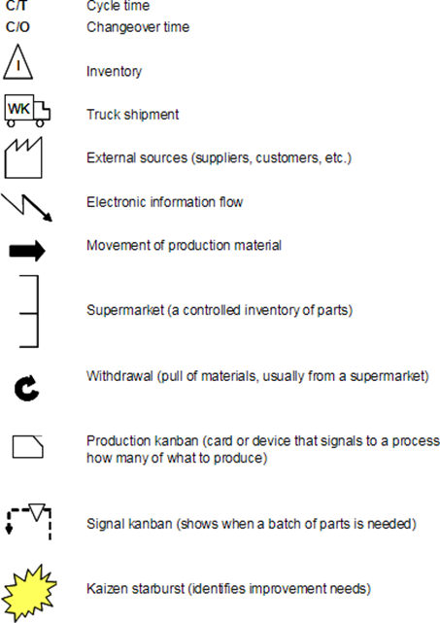
II - Data and Information
1.27 Value Stream Mapping
Visualization of different
types of activities, or a combination
of activities at multiple stages of the
manufacturing processes
Commonly used icons:
Figure 4: Common (VSM) Icons

Slide 17
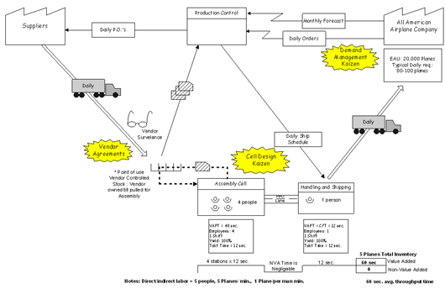
II - Data and Information
1.27 Value Stream Mapping
VSM Sample -A visual illustration of the flow of materials and information. An end-to-end system map
Figure 5 : Sample VSM

Slide 18
II - Data and Information
1.27 Value Stream Mapping
The creation of a VSM is divided into five basic steps:
Identifying the product -This step consists of indicating which specific product the VSM will focus on
Create a current VSM -An initial VSM of the current process is created
Evaluate the current map, identify problem areas - the team evaluates the processes and the steps involved to identify non-value added
Create a future state VSM – A future state of VSM is created with the change in the process
Implement the final plan -Implement the new ideas, which will create a more efficient lean manufacturing processes

Slide 19
II - Data and Information
1.28 Horizontal and Vertical Integration
Vertical Integration
Allows the company to expand and grow
Happens through acquiring or merging at different stages of production within the same industry
Possess the goal to control all the production and services aspects
Allows companies to have cost of production advantages with efficient distribution processes
Types of Vertical Integration
Forward Integration
Backward Integration
Figure 10: Integration

Slide 20
II - Data and Information
1.28 Horizontal and Vertical Integration
Horizontal Integration
An important strategic decision when they are considering business expansion
Involved in mergers and acquisitions at the same level of production in the supply chain
When a company producing a similar
product or providing a similar service
merges with another company
Figure 11: Integration

Slide 21
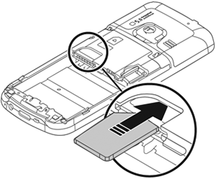
II - Data and Information
1.29 Poka Yoke
Japanese word which means “fail-safing” or “mistake-proofing”
Any method in a lean manufacturing process that helps in avoiding mistakes
Eliminates human-related errors
Example: a cell phone SIM card
Figure 12: Cell Phone Example

Slide 22
II - Data and Information
2. What is Six Sigma?
Provides continuous efforts to have a reliable and consistent manufacturing process that is beneficial to a company’s success
Statistical model for modeling processes
Attains low defect rates
Enhances management support
Figure 13: Six Sigma

Slide 23
II - Data and Information
2.1 History of Six Sigma
Developed in 1986 by Motorola
Created by Bob Galvin (CEO) & John Mitchell
Jack Welch of General Electric (GE) made it a central business strategy in 1995

Slide 24
II - Data and Information
2.2 Key concepts of Six Sigma
2.21 Two Six Sigma Philosophies
DMAIC: Define, Measure, Analyze, Improve, Control
Used for innovating current designs of manufacturing processes
DMADV: Define, Measure, Analyze, Design, Verify
Used for creating new processes and designs for manufacturing processes

Slide 25
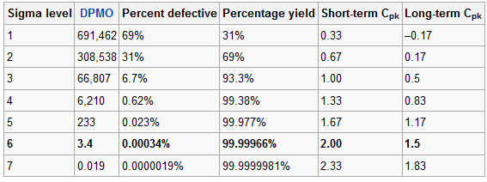
II - Data and Information
Chart showing Defects Per Million Opportunities (DPMO) with the Six Sigma Process
Table 1: Six Sigma Defect Ration

Slide 26
III – Discussion & Analysis
1. Case study of Baxter International, Inc.
1.1 Baxter International, Inc. overview
Baxter International is an American health care company that focuses on products to treat acute medical conditions
Baxter’s lean journey started in the mid-1980’s, but in that time the focus was only on JIT
Baxter International is recognized as a leading company in environmental performance and reporting due to their effective Lean implementations

Slide 27
III – Discussion & Analysis
2. Lean implementations in Baxter International, Inc.
2.1 Implemented lean concepts in four phases:
Process mapping
Dividing applicable work into easily measureable subtasks
Waste Identification
Defects, motion, over-processing, etc.
Process Improvements
Updating documentation and standard procedures in detail
Measuring Improvements
Removing processes, reducing risk, and saving money

Slide 28
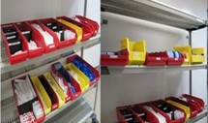
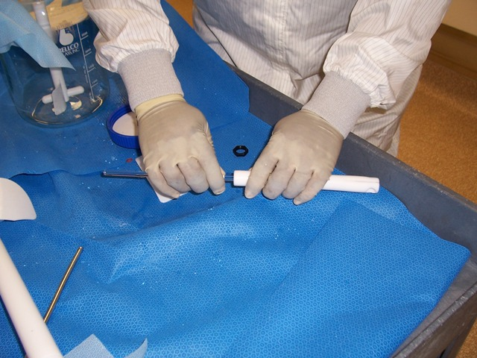
III – Discussion & Analysis
3. Results after Lean implementations in Baxter International, Inc.
Process time – One less inspection
Poka Yoke – Better diagrams
6S – Four more orders per day (8% increase)
Six Sigma - Develop Defect Free Process (DDFP) Table
Kaizen – Continuously monitoring
Figure 15: Case Study
Table 2: Results for 6 Sigma
Figure 14: Case Study

Slide 29
IV - Conclusion
Lean Manufacturing and Six Sigma are critical for the firm’s profitability and its survival in the current global marketplace
Since their origination, Lean Manufacturing and Six Sigma are determining the future of any firm or production facility by making them competitive in a fast paced marketplace

Slide 30
Thank you!
QUESTIONS?

Slide 31
Video of Lean Manufacturing
Lean Management - Get Lean in 90 Seconds

Slide 32
References
Figure 1: (Input, process, output model) http://www.dreamstime.com/royalty-free-stock-photography-input-process-output-image26790097
Figure 2: (6S System) http://www.epa.gov/lean/environment/toolkits/environment/ch5.htm
Figure 3: (Kaizen) http://iamkaizen.com/
Figure 4: (Kaizen) http://www.1000ventures.com/design_elements/selfmade/kaizen_vs_kaikaku_6x4.png
Figure 5: (Common VSM Icons) https://www.google.com/search?q=Value+Stream+mapping&hl=en&safe=off&client=firefox-a&hs=nDg&tbo=d&rls=org.mozilla:en-US:official&source=lnms&tbm=isch&sa=X&ei=j4q5ULCKLrHZigKChYBI&ved=0CAQQ_AUoAA&biw=1280&bih=921
Figure 6: (Sample VSM) http://www.technicalchange.com/value-stream-mapping.html
Figure 7: (Lean Engineering) http://test-pconsulting.com/wp-content/uploads/2012/05/Kaizen-Lean-Engineering-300x207.jpg
Figure 8: (Jidoka) http://dhiku.files.wordpress.com/2008/11/jidoka.jpg
Figure 9: (Waste) http://idyeah.com/blog/2012/02/eliminate-something/
Figure 10: (On-Time) http://www.oak-tree.us/blog/index.php/2009/08/07/time-drive2
Figure 11: (integration) http://www.ehow.com/info_8690654_advantages-disadvantages-vertical-integration.html
Figure 12: (integration) http://www.123rf.com/photo_9914945_background-concept-wordcloud-illustration-of-business-horizontal-integration-glowing-light.html
Figure 13: (Cell Phone Example) http://thedailyomnivore.net/2012/09/08/
Figure 14: (Six Sigma) http://www.wku.edu/online/grad-certs/lean-six.php
Figure 15: Case Study Appendix provided by Baxter Inc.
Figure 16: Case Study Appendix Provided by Baxter Inc.

