Slide 1
SCRM Student Customer Relationship Management
Integrating Loughborough University Marketing Communications, Student Recruitment and Admissions

Slide 2
Agenda
Who I am
What is CRM?
Why does Loughborough need it?
SCRM
Where will SCRM be used?
Who will use SCRM?
When will SCRM be happening?
How will SCRM involve you?

Slide 3
I am Remy Clarke
Student CRM Manager
Implement SCRM
Develop CRM Best Practice
Provide a framework for Integrated Marketing Communications

Slide 4
Misconceptions about CRM
CRM…
is a database
will do the work for us
is only for centralised functions
is an IT system

Slide 5
Customer Relationship Management
“A management approach that enables organisations to identify, attract and increase retention of profitable customers by managing relationships with them”
J Hobby (1999)

Slide 6
Dimensions of CRM Marketing
Targeting
Control
Interaction
Continuity

Slide 7
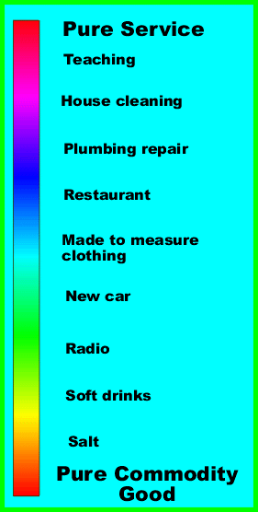
Education as a Product
Characteristics of Education
Variable
Intangible
Perishable
Inseparable
Service quality is always measured at “Moments of Truth” points in the service delivery

Slide 8
CRM in a Service Organisation
Reduce the Service Gaps to enhance the Moments of Truth
Increase the Moments of Truth opportunities during a service transaction
Provide timely and relevant information
Understand your customers better to predict future wants and needs

Slide 9
Why Loughborough needs CRM
Prospect expectations have been raised
Competition is fierce (and will increase!)
Market Agility is required
Informed Marketing and Recruitment planning
Better understanding of the Prospective Student Journey
Integrated Prospect communications

Slide 10
Enquiry received
Respond to Enquirer
Application received
Passed to Decision Maker
Decision Made
Send Prospectus
Open Day invite
Newsletters
Telephone call
Email
Clearing Applicants
Applicant sends outstanding documents
Response recorded
Applicants responds to offer
Decision communicated to Applicant
Decision recorded on system
Apply for accommodation
Online Registration
UKBA Registration
Police Registration
Department Registration
Library Registration
Relevant joining instructions sent
Pays Fees
Register
Apply for Visa

Slide 11
Current Enquiry Management
Enquiry Prospects
Applicant Prospects
Ghost Enquirers
NOT RECORDED
Prospectus Request
Database 1
Database D
Visit Day
Marketing
Brochure Request
Schools / Depts
Database 2
LUSI
Email / Telephone
UCAS
Various
Database 3
Open Day
SOAR
Database A
DIRECT
HE / UCAS Fair
SOAR
Database B
International Event
International Office
Database C

Slide 12
Current Enquiry Management
Enquiry Prospects
Applicant Prospects
Database 1
Database D
Database 2
Database 3
Database A
Database B
Database C

Slide 13
Future Enquiry Management
Enquiry Prospects
Applicant Prospects
Ghost Enquirers
Visit Day
SCRM
Prospectus Request
Brochure Request
LUSI
UCAS
Email / Telephone
Open Day
Various
DIRECT
HE / UCAS Fair
NOT RECORDED
International Event

Slide 14
Sample CRM Process Overview

Slide 15
Loughborough SCRM
CRM provided by Interactive Software
Focus on Prospective Students for 2015 entry
Requests for course information
Marketing and Recruitment Communications
Recruitment Enquiry Management
Open/Visit Day Event Management
Future development for Self-service portal(s) and Stakeholder CRM strategies

Slide 16
Benefits of a CRM strategy for Loughborough
Segment your markets
Target your communications more effectively
Identifies key sources of enquiries/applicants
Supports communications planning
Identifies strengths/weaknesses in course portfolio
Provides good management information
Saves time, money and effort

Slide 17
Keys to successful SCRM
Prospective Student records should be in the SCRM database
Timing is everything
Collaboration
Work
Make it easy for the customer (and users)

Slide 18
SCRM Student Customer Relationship Management
Integrating Loughborough University Marketing Communications, Student Recruitment and Admissions
Remy Clarke
Student CRM Manager
scrm@lboro.ac.uk Ext: 222844

