Slide 1
Select and Implement a Customer Relationship Management Platform
Enable marketing, sales, and customer service teams by successfully choosing and implementing a suite for customer relationship management.

Slide 2
ANALYST PERSPECTIVE
A customer relationship management (CRM) platform is the cornerstone of your technology portfolio for creating world-class customer experiences.
CRM platforms are the workhorses that provide functional capabilities and data for customer experience management. IT needs to be a trusted partner in CRM selection and implementation, but the business also needs to own the requirements and be involved from the get-go. Think of IT as a ‘conductor of the CRM orchestra.’
CRM selection must be a multi-step process that involves mapping target capabilities for marketing, sales, and customer service, assigning requirements across functional categories, determining the architecture model to prioritize criteria, and developing a comprehensive RFP that can be scored in a weighted fashion.
To succeed with CRM implementation, create a detailed roadmap that outlines milestones for configuration, security, points of implementation, data migration, training, and ongoing application maintenance.
Ben Dickie,
Senior Manager, Enterprise Applications Info-Tech Research Group

Slide 3
Executive summary
Customer relationship management suites are an indispensable part of a holistic strategy for managing end-to-end customer interactions.
After defining an approach to CRM, selection and implementation of the right CRM suite is a critical step in delivering concrete business value for Marketing, Sales, and Customer Service.
CRM platform selection must be driven by your overall customer experience management strategy: link your CRM selection to your organization’s CXM framework.
Determine if you need a CRM platform that skews towards marketing, sales, or customer service; leverage use cases to help.
Ensure strong points of integration between CRM and other software such as MMS. A CRM should not live in isolation; it must provide a 360-degree customer view.
Despite the importance of CRM selection and implementation, many organizations struggle to define an approach to picking the right vendor and rolling out the solution in an effective and cost-efficient manner.
IT often finds itself in the unenviable position of taking the fall for CRM platforms that don’t deliver on the promise of the CRM strategy.
IT needs to be a trusted partner in CRM selection and implementation, but the business also needs to own the requirements and be involved from the beginning.
Use “Phase 2: Vendor Landscape – Analyze CRM Requirements and Shortlist Vendors” to identify vendors in the marketplace that fit your organization’s needs based on your identified suite requirements and use-case scenario results.
CRM selection is a multi-step process that involves mapping target capabilities for marketing, sales, and customer service, assigning requirements across functional categories, determining the architecture model to prioritize criteria, and developing a comprehensive RFP that can be scored in a weighted fashion.

Slide 4
Framing the CRM selection and implementation project
IT applications directors tasked with selection and deployment of a core platform for customer relationship management.
Senior technology leaders that want a clear understanding of the major players in the CRM market and how they differ.
Business analysts tasked with collection and analysis of CRM business requirements.
Clearly link your business requirements to CRM platform selection criteria.
Select a CRM vendor that meets your organization’s needs across marketing, sales, and customer service use cases.
Adopt standard operating procedures for CRM deployment that address issues such as end-user adoption and data quality.
Executive-level stakeholders in the following roles:
Vice president of Sales, Marketing, or Customer Service.
Business unit managers tasked with ensuring strong end-user adoption of a CRM platform.
Understand what’s new in the CRM market.
Evaluate CRM vendors and products for your enterprise needs.
Determine which products are most appropriate for particular use cases and scenarios.

Slide 5
CRM platforms sit at the core of a well-rounded customer experience management ecosystem
Customer Experience Management (CXM)
Customer relationship management suites are one piece of the overall customer experience management ecosystem, alongside tools such as customer intelligence platforms and adjacent point solutions for sales, marketing, and customer service. Review Info-Tech’s CXM blueprint to build a complete, end-to-end customer interaction solution portfolio that encompasses CRM alongside other critical components. The CXM blueprint also allows you to develop strategic requirements for CRM based on customer personas and external market analysis.
Web Experience Management
Platform
Marketing Management
Suite
E-Commerce & Point-of-Sale Solutions
Customer Relationship Management
Platform
Customer Service Management Tools
Social Media Management
Platform
Customer Intelligence
Platform

Slide 6
Organizations that have implemented a CRM solution have greater organizational success
Organizations that have implemented a CRM solution observe 13% greater success than organizations that have no plans for a CRM solution or are planning on getting one in the next two years.
In fact, having a CRM solution has a significant impact on customer retention rates. Organizations that have implemented a CRM solution observe 17% greater success with customer retention rates.
+13%
+17%
The organizational success score was calculated by taking the average score of how well the organization performs the following activities: reaching target consumers, acquisition rates, customer retention rates, cost to serve, collaboration among Sales, Marketing, and Service, and 360-degree view of the customer.
Note: Respondents were asked how well their organization performs in terms of customer retention rates on a six-point scale. The responses were averaged and converted to percentages for each status of CRM solution.

Slide 7
Seize market opportunities by using a CRM suite to support multiple domains and customer interaction channels
CRM suites automate and synchronize processes that are essential for managing customer interactions – from basic account management to complex service resolution.
A CRM suite creates value across the three domains:
Assists marketing managers by identifying customer buying trends and behavior, while providing tools for managing campaigns.
Supports sales agents through lead automation, pipeline management, and advanced reporting. By using a common suite, the sales process is kept in sync with activities in Marketing and Service.
Provides customer service representatives with the tools to manage an integrated multi-channel customer support system. Knowledgebase management and self-service portals allow both service representatives and customers to find relevant solutions quickly and easily.
Customer
Service
Sales
Customer
Marketing
CRM is an organizational approach and set of enabling technologies that support customer-centric business processes (marketing, sales, and service).

Slide 8
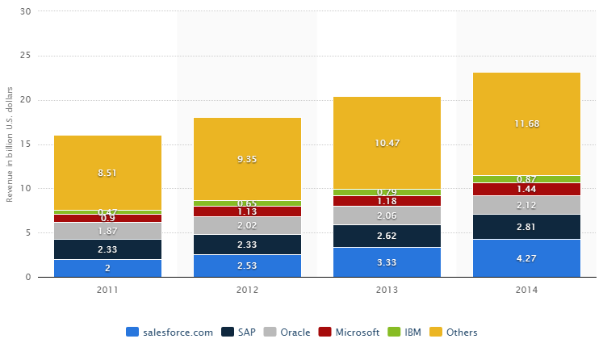
Global spend is growing as businesses capitalize on CRM value
Global revenue from customer relationship management (CRM) software by vendor from 2011 to 2014 (in billion U.S. dollars)
Source: Statista
The CRM market has been consistently growing, and with the emergence of the cloud the market share is evolving and allowing for new players.

Slide 9
SaaS CRM is the direction the market is speeding towards
Be aware of key market trends when selecting your CRM solution
Nearly three out of four of all CRM deployments are hosted in the cloud.
73%
80%
$150
Had their CRM fully operational in 18 months or less.
Average monthly CRM spend per user.
Source: Capterra

Slide 10
Schneider Electric moves its CRM platform to the cloud and achieves a 360-degree customer view
CASE STUDY
Industry
Source
Energy
Accenture
Schneider Electric
Schneider Electric is a $20 billion worldwide leader in energy management solutions with more than 100,000 employees in 120 countries. Headquartered in Rueil-Malmaison, France, Schneider specializes in electrical energy transmission and automation.
Customer Relationship Management Initiative
After investigating several tools, the company selected Salesforce.com's suite of cloud-based CRM applications based on its ability to deploy a unique CRM solution to the company’s 26,000 end users worldwide. Using a cloud technology such as Salesforce.com allowed the company to rapidly scale capabilities across Marketing, Sales, and Customer Service.
Results
The program enriched customer knowledge stored, structured, and shared across the company and enhanced day-to-day collaboration on key business data and standard business interactions and sales methodology.
The program also simplified reporting to improve sales representatives’ day-to-day activity and to identify strategic and operational key business indicators.
The Customer Relationship Management Initiative included the following components:
Case Management
Account Management
Business Intelligence
Opportunity Management
“...This project has already demonstrated a valuable ROI by increasing cross-selling and account coverage by more than 20 percent each and generating an impressive 70 percent adoption rate.”
Philippe Trichet
Senior Vice President of Customer Experience and CRM at Schneider Electric

Slide 11
Review the critical success factors for CRM across the project lifecycle, from planning to post-implementation
Executive management support is crucial. The number one overall critical success factor for a CRM strategy is top management support. This emphasizes the importance of sales, service, and marketing and prudent corporate strategic alignment. A strategic objective in CRM projects is to position top management as an enabler rather than a barrier.
Planning
Implementation
Post-Implementation
Overall
1
Appropriate Selection
Project Management
Top Management Support
Top Management Support
2
Clear Project Goals
Top Management Support
Project Management
Appropriate Selection
Top Management Support
Training
Training
Project Management
3
Business Mission and Vision
Effective Communication
Effective Communication
Training
4
Project Management
Supplier Supports
Appropriate Selection
Clear Project Goals
5
Source: Information Systems Frontiers

Slide 12
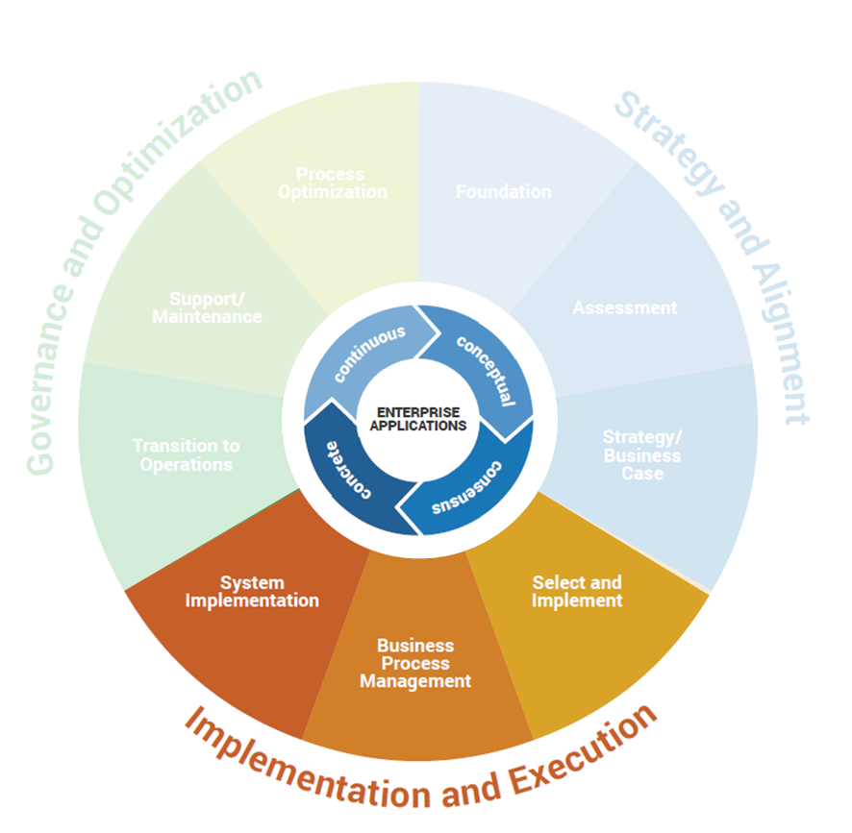
Follow Info-Tech’s methodology for selection and implementation
Prior to embarking on the vendor selection stage, ensure you have set the right building blocks and completed the necessary prerequisites.
Follow Info-Tech’s enterprise applications program that covers the application lifecycle from the strategy stage, through selection and implementation, and up to governance and optimization.
The implementation and execution stage entails the following steps:
Define the business case.
Gather and analyze requirements.
Build the RFP.
Conduct detailed vendor evaluations.
Finalize vendor selection.
Review implementation considerations.
1
2
3
4
5
6
A critical preceding task is developing a strategy that makes the case for the CRM procurement and creates alignment with corporate objectives. Use the CRM Readiness Assessment Template to ensure you have completed the necessary steps.

Slide 13
Use Info-Tech’s CRM framework to navigate the modules between core capabilities and adjacent functional areas
Core CRM functions are combined into a single, highly-integrated solution, simplifying operation and support. Advanced functionality builds upon the core to further enable functional capabilities specific to marketing, sales, and customer service use cases.
Marketing Automation
Customer Collaboration
Marketing Campaign Management
Core CRM
Customer Service Management
Account Management
Reports and Analytics
Customer Journey Mapping
Customer Information Management
Multi-Channel Support
Order History Tracking
Sales Enablement
Mobile Support
Customer Service Workflow Management
Lead Generation
Pipeline and Deal Management
Basic Pipeline Management
Lead Nurturing /Scoring
Customer Intelligence
Core
Strategic
Account Management | Pipeline Management | Campaign Management | Customer Intelligence

Slide 14
Use this blueprint to support your CRM selection and implementation
Launch the CRM Project and Collect Requirements
Phase 1
Benefits
Use the project steps and activity instructions outlined in this blueprint to streamline your selection process and implementation planning. Save time and money, and improve the impact of your CRM selection by leveraging Info-Tech’s research and project steps.
Select Your CRM Solution
Phase 2
Use Info-Tech’s CRM Vendor Landscape contained with Phase 2 of this project to support your vendor reviews and selection. Refer to the use-case performance results to identify vendors that align with the requirements and solution needs identified by your earlier project findings.
Get Ready for Your CRM Implementation
Phase 3
Not everyone’s connection and integration needs are the same. Understand your own business’s integration environment and the unique technical and functional requirements that accompany them to create criteria and select a best-fit CRM solution.

Slide 15
Info-Tech walks you through the following steps to help you to successfully select and implement your CRM
1.3 Gather requirements and document architecture
3.1 Create product specific architecture
1.1 Understand CRM technology
2.1 Analyze vendors in the CRM market
3.1 Plan configuration and deployment
1.1 Assess organizational readiness
3.1 Create governance plan
2.1 Shortlist vendors
2.2 Select your vendor
3.1 Develop CRM deliverables
2.1 Conduct a proof of concept and evaluate vendor solutions
1.2 Structure your project
3.2 Evaluate project metrics
Locate your starting point in the research based on the current stage of your project.
Milestones
Effort
Importance
Phase
Low
Average
Launch Your Project
Select Solution
Get Ready to Implement Solution
Greater
Major Milestone
High

Slide 16
Info-Tech offers various levels of support to best suit your needs
Guided Implementation
DIY Toolkit
Workshop
Consulting
“Our team has already made this critical project a priority, and we have the time and capability, but some guidance along the way would be helpful.”
“Our team knows that we need to fix a process, but we need assistance to determine where to focus. Some check-ins along the way would help keep us on track.”
“We need to hit the ground running and get this project kicked off immediately. Our team has the ability to take this over once we get a framework and strategy in place.”
“Our team does not have the time or the knowledge to take this project on. We need assistance through the entirety of this project.”
Diagnostics and consistent frameworks used throughout all four options

Slide 17
Select and Implement a Customer Relationship Management Platform – project overview
1. Launch the CRM Project and Collect Requirements
2. Select a CRM Solution
3. Plan the CRM Implementation
Best-Practice Toolkit | 1.1 Market overview and introduction to CRM 1.2 Structure your CRM selection project CRM Project Charter Template 1.3 Gather and analyze your CRM requirements CRM Use-Case Fit Assessment Tool | 2.1 CRM Vendor Landscape CRM Suite Evaluation and RFP Scoring Tool 2.2 Select your CRM solution CRM Vendor Demo Script Template CRM RFP Template | 3.1 Implementation considerations CRM Work Breakdown Structure Template 3.2 Measure metrics
Guided Implementations | Identify organizational fit for the technology. Create the project plan. Plan requirements gathering steps. | Discuss the use-case fit assessment results and the Vendor Landscape. Review contract. | Create an implementation plan. Discuss roll-out of processes and hand-over to operations.
Onsite Workshop | Module 1: Launch of Your CRM Selection Project | Module 2: Plan Your Procurement and Implementation Process
 | Phase 1 Outcome: Launch your CRM selection project. Development of your organization’s CRM requirements. | Phase 2 Outcome: Selection of a CRM solution. | Phase 3 Outcome: A plan for implementing the selected CRM solution.

Slide 18
CRM selection and implementation workshop overview
Contact your account representative or email Workshops@InfoTech.com for more information.
Day 1 | Day 2 | Day 3 | Day 4 | Day 5
Preparation | Workshop Day | Workshop Day | Workshop Day | Working Session
Workshop Preparation Facilitator meets with the project manager and reviews the current project plans and IT landscape of the organization. A review of scheduled meetings and engaged IT and business staff is performed. | Morning Itinerary Facilitation of activities from Launch the CRM Project and Collect Requirements phase, including project scoping and resource planning. Conduct overview of the CRM market landscape, trends, and vendors. Afternoon Itinerary Conduct process mapping for selected sales and marketing processes. Interview business stakeholders. Prioritize CRM functional requirements. | Morning Itinerary Complete process mapping with business stakeholders. Afternoon Itinerary Interview IT staff and project team; identify technical requirements for the CRM suite. Document high-level solution requirements. | Morning Itinerary Perform a use-case scenario assessment. Review use-case scenario results; identify use-case alignment. Review the CRM Vendor Landscape vendor profiles and performance. Afternoon Itinerary Continue review of CRM Vendor Landscape results and use-case performance results. Create a custom vendor shortlist. Investigate additional vendors for exploration in the market. | Workshop Debrief Meet with project manager to discuss results and action items. Wrap up outstanding items from workshop. (Post-Engagement): Procurement Support The facilitator will support the project team to outline the RFP contents and evaluation framework. Planning of vendor demo script. Input: solution requirements and use-case results.
The light blue slides at the end of each section highlight the key activities and exercises that will be completed during the engagement with our analyst team.

Slide 19
Use these icons to help direct you as you navigate this research
Use these icons to help guide you through each step of the blueprint and direct you to content related to the recommended activities.
This icon denotes a slide where a supporting Info-Tech tool or template will help you perform the activity or step associated with the slide. Refer to the supporting tool or template to get the best results and proceed to the next step of the project.
This icon denotes a slide with an associated activity. The activity can be performed either as part of your project or with the support of Info-Tech team members, who will come onsite to facilitate a workshop for your organization.
This icon denotes a slide that pertains directly to the Info-Tech Vendor Landscape on CRM technology. Use these slides to support and guide your evaluation of the CRM vendors included in the research.

