Slide 1
Reengineering Work: Don’t Automate, Obliterate
Harvard Business Review July-August 1990
By Michael Hammer
Taraneh Parvaresh

Slide 2
What is the problem?
Companies are not still prepared to operate according to nowadays technologies
Technology improves rapidly
When asset utilization is critical, inventory levels exceed many months to demand
Usual methods for better performance processes haven’t yielded the dramatic improvement according to company needs
Companies tend to use technology for automating old way of doing business
Speeding up the processes will not address fundamental performance deficiencies

Slide 3
What is the solution
We need to use computers to redesign, not just automate existing business processes
Instead of using outdated processes and softwares we should obliterate them and start over
We should reengineer our businesses

Slide 4
Ford’s story
In 1980s the American automotive industry was in a depression so Ford decided to cut their costs
What was the idea?
Ford’s account payable process was slow and cumbersome so management thought to rationalize processes and installing new computer systems to reduce the head count by 20%.

Slide 5
Ford vs. Mazda
FORD | MAZDA
400 clerks | 5 clerks
Why does Ford need 400 accounts payable clerks while Mazda have just 5 ?

Slide 6
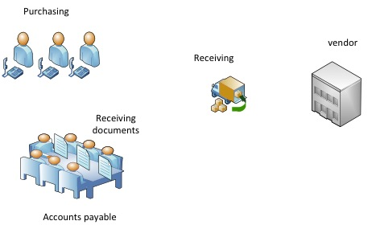
How the processes work in Ford
Purchase Order
Goods
Copy of Purchase Order
Payment
Invoice

Slide 7
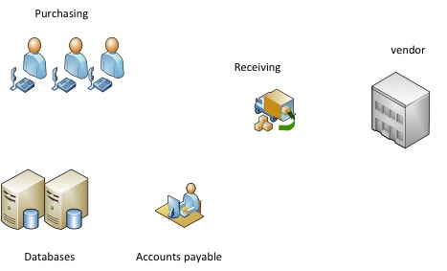
Ford reengineered the process
Purchase Order
Goods
Payment

Slide 8
Conclusion
Reengineering effort strives for dramatic levels of improvement
It should use information technology not to automate an existing process but to enable a new one
Creating new rules required new conceptualization of the business process
Rather than looking for opportunities to improve the current process, we should determine which of the steps really add value and search for new ways to achieve the result

Slide 9
Thank you ☺

