Slide 1
Government Process Reengineering
29th September, 2016
B Krishnamurthy (BKM)

Slide 2
Agenda
Introduction to Process Re-engineering
Context of Process reengineering with reference to Government services
GPR life cycle
Metrics to measure

Slide 3
Defining Business Process Reengineering (BPR)
BPR is fundamental rethinking and radical redesign of business processes to achieve dramatic improvements in critical, contemporary measures of performance, such as cost, quality, service and speed
Michael Hammer and James Champy
‘Changing’/’redesigning’/’replacing’/’eliminating’ the activities and/or sub-processes and/or processes related to a service to improve service quality i.e.
Minimize Time, Cost, Complexity
Improve Transparency, Convenience and Experience
GPR may address all or some of the service quality attributes
Government Process Re-engineering (GPR) has evolved from applying Business Process Re-engineering (BPR) concepts to Government Services

Slide 4
Need for GPR in e-Governance
IT enablement (without) GPR provides results to the stakeholders, but may not address all the attributes of service quality
In particular, IT enablement of an inefficient business process can only lead to ‘inefficient IT enabled process’ – delivering the same results with marginal improvement
GPR may support organizations in dramatic improvement of performance and application of IT on reengineered processes will yield better results for stakeholders
High
Dramatic Improvement through BPR
Performance Measure
Benefits through Typical Quality Initiatives
Low
Time

Slide 5
BPR/GPR success stories
Passport Seva Project
Passport Application and Issuance of passport
Physically going to the Regional Passport Office
Filling up and submitting form, at the counter
Verification of documents
Payment of requisite fee
Sending request to jurisdictional police station for verification
Physical verification by police at a later date
Sending of police verification report to RPO
Approval of passport and delivery through post office
Total time could be between 30 to 45 days from submission of application to delivery of passport

Slide 6
Government Process Re-engineering Can
Increase the speed at which document intensive processes are conducted and reduce associated costs and administrative burdens
Add flexibility to organisational processes, allowing your business to scale up or down as required by customer or internal demand
Help reduce capital expenditure by reducing the need to invest in the assets required to perform a service internally
Organise information and documents with electronic document management systems and processes, for example transition to electronic invoicing
Minimise document loss and information leakage
Utilise electronic document formats more often in internal and customer transactions
Improve operational efficiency and customer service levels
Mitigate risk by improving compliance to legal requirement

Slide 7
GPR In e-Governance Project Lifecycle
GPR
1. E-Governance Strategy Development
2. Current State Assessment
3. Future State Definition
4. Implementation approach and sourcing
5. Develop and implement IT system
6. Operate and sustain
Project Management Office/Unit
Change Management and Communications
GPR is undertaken during stages 2 and 3 of eGLC

Slide 8
Approach to GPR
Process Study and Documentation
Process Analysis
Process Reengineering & Defining To-be processes
Process implementation /IT enablement & validation
Problem Identification and Definition
Define vision and objectives for GPR
Problem Identification and Definition
Analysis of citizen grievances & complaints and pro-active Voice of Customer surveys
Analysis of issues raised
Identification of problem and defining unambiguous problem statements

Slide 9
Approach to GPR
Process Study and Documentation
Process Analysis
Process Reengineering & Defining To-be processes
Process implementation / IT enablement & validation
Problem Identification and Definition
Define vision and objectives for GPR
Define vision and objectives for GPR
Analyse services portfolio and undertake service prioritisation exercise
Define vision for GPR, from problems identified, service priority
Define measurable objectives for the GPR exercise

Slide 10
What is ‘Vision’?
Vision is a succinct and inspiring statement of what the organization intends to become and to achieve at some point in the future.
Before embarking on GPR initiative, make sure you have a vision that provides a roadmap and guidance for the GPR exercise
A vision statement takes into account the current status of the organization, and serves to point the direction of where the organization wishes to go
The vision statement provides the direction for the organization, while not inhibiting the approach or strategy to reach the desired goal
Vision is about ‘what’ will be achieved through GPR
To provide direction and guidance to the GPR
To clearly identify the measurable benefits from performing GPR
To clearly identify the actionable and measurable initiatives for achieving the stated goals/benefits

Slide 11
Why Vision for GPR?
4 Key Questions
Why are we doing this GPR for?
What are we going to do?
How will we know that we are successful (at the end of the project)?
How could we fail (& what must we do to avoid that)?
Why have a GPR Vision?
To develop a shared understanding of the desired end-state amongst the Organization and team
To drive achievement orientation in the organization
A good GPR Vision is one which:
Is in line with the organizational vision & e-Gov vision
Provides clarity to the organization and GPR team on goals and objectives
Sets goals

Slide 12
GPR Vision
A vision statement should:
Be clear, intuitive and simple
Reflect the specific conditions and ambitions of the organization
State what will be and will not be done
Consider needs and opportunities
Be aligned with overall development strategy
Involve consensus building by stakeholders

Slide 13
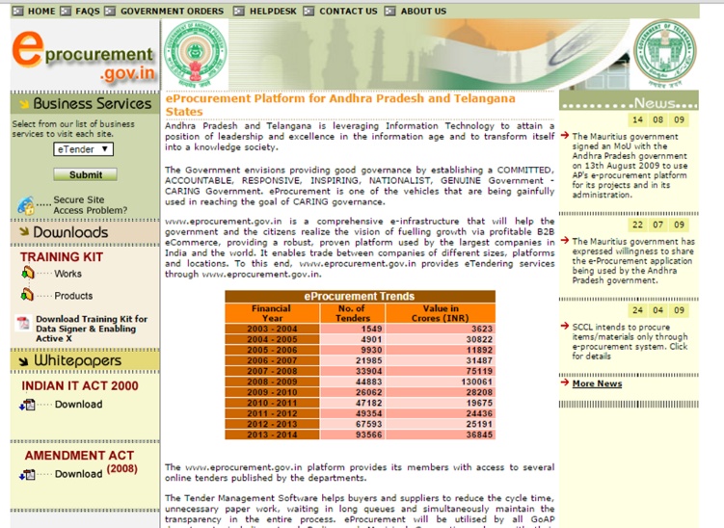
GPR Vision
Example
E-Biz India
Establish One-stop-service delivery centre for G2B Services in India, provide services in simplified and convenient manner and thereby improving the investment climate in the country
E-Procurement GoAP:
Establish common procurement platform for realizing the right value for the goods & services, minimizing the cost of procurement and providing equal opportunities for businesses

Slide 14
GPR Objectives
An objective is a specific and usually quantifiable statement of program achievement
It is a statement of measurable outcome which can be used to determine program progress towards the goal
Collectively, objectives represent a quantification of the program goal
GPR objectives translate the broad values within a GPR vision into more real and tangible outcomes, with stronger operational basis, reflecting actual process, procedures and measurable outputs
Should have measurable criteria for achieving success

Slide 15
GPR Objectives – bad examples…
To ensure that welfare benefits of government are reaching the eligible families
To ensure that Land records management framework provides ownership of the properties
To minimize time to receive the welfare benefits…

Slide 16
Approach to GPR
Process Study and Documentation
Process Analysis
Process Reengineering & Defining To-be processes
Process implementation / IT enablement & validation
Problem Identification and Definition
Define vision and objectives for GPR
Process Study and Documentation
Study process flow, actors, policies, process stages
Documenting as-is processes and creating Process Maps
Recording time and other data elements for each process step
Validation of process documentation from dept.
Identify and classify PIEs for the processes

Slide 17
Current State Assessment
To perform an in-depth assessment of business functions and services identified for coverage under e-Governance project to understand:
Current approach for performing the business functions and service delivery
The key challenges and to identify improvement areas
Stakeholder needs and expectations
Good practices and learnings from similar implementations in similar domains
Current systems (IT) implemented in the department, coverage and gaps
Organization structures and people capacities etc

Slide 18
Current State (As-Is) Assessment
As-Is Assessment is carried out along the following dimensions:
AS-IS ASSESSMENT
IT Systems
Business Processes
People

Slide 19
Current State Assessment
Key Outputs/Deliverables
As-Is
IT
Environment
As-Is Processes
As-Is
People Environment
Organizational structures
Roles and responsibilities
Capacities and skill sets
Change barriers..
Process maps
Pain points
Initial improvement areas
Stakeholder needs
IT Systems
Scope and functionality
Strengths and gaps
IT Infrastructure (network, security, data center)
Notes:
These are the key out puts and deliverables of the exercise on ‘current state assessment.
They provide an insight into ‘what is wrong’ in terms of the process, technology and people.
This opens up the directions for improvement

Slide 20
Process Mapping Understanding How Things Happen “Actually”
Why Process Mapping?
To understand “how do we actually work” as opposed to “how are we supposed to work”
To understand the four attributes of process:
Players
Process flow
Policies, Standards and Responsibilities
Phases with clear start & end-points and process time-lines
To identify the Critical to Process metrics
To identify “Quick Wins” in the process
To understand response time & cycle time
To determine process efficiency
Value-added activities
Non value-added activities
To estimate the cost of the process
The concept of waste
Notes:
1. Process mapping allows to ‘document’ the current process so that it could be analysed.

Slide 21
Types of Process Mapping
Process mapping can be done at various levels of detail
Value Stream Mapping
Mapping the entire value stream of the process on a single page
SIPOC Map (Supplier – Input – Process – Output – Customer)
Mapping the key constituents of the process and their interactions
Flowcharting
Detailed activity / task level graphical representation of the process

Slide 22
Flow Diagrams
" Draw a flowchart for whatever you do. Until you do, you do not know what you are doing, you just have a job.”
Dr. W. Edwards Deming

Slide 23
The Four Field Mapping Template
(1) Phase
(2) Standards / Policies / Templates
(3) The players involved in the process
(4) The actual process activity wise
Notes:
1. Explain the various sections of the template and their importance

Slide 24
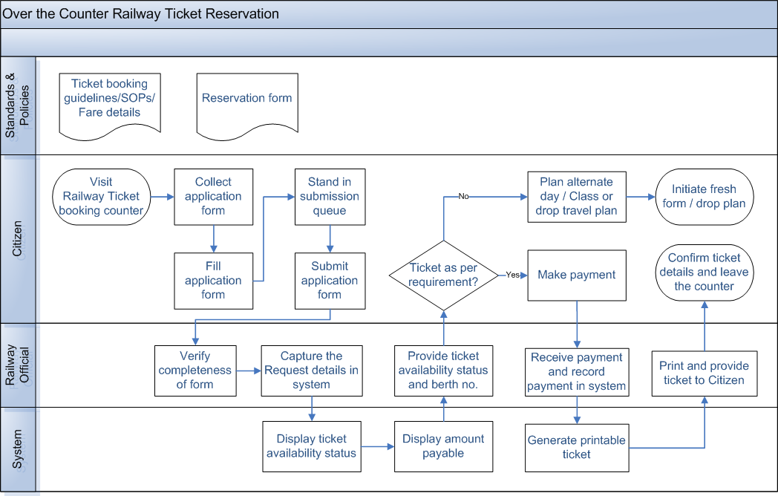
Sample Process Map with Problems, Issues & Expectations

Slide 25
Approach to GPR
Process Study and Documentation
Process Analysis
Process Reengineering & Defining To-be processes
Process implementation / IT enablement & validation
Problem Identification and Definition
Define vision and objectives for GPR
Process Analysis
Root cause analysis of process issues and identification of root causes
Analyzing process efficiency - Value Adding and Non Value Adding steps
Analyzing process complexity – Data entry points, Hands off points etc
Definition of key metrics and arriving at baseline indicators (TAT, error rate etc)

Slide 26
Indicators of Poor Process
Too much movement
Too much re-entry and or copying
Standard formats not easily available
Process too much disintegrated
Process needs many manual inputs requiring references from other documents
Customers need to provide same information and or data multiple times
Activities, information, data that does not serve any purpose and can be eliminated
Activities, information, data, documents that can be integrated
Activities, process can be simplified
Activities, process, information, data that can be automated
Process where 3 major benefits of Information Technology viz. Independence from PLACE, TIME & PERSON can be utilized.
The process is ‘MULTIPLE WINDOW’

Slide 27
Identify the Problems, Issues and Expectations with the process
Problems
Non-conformance to defined processes and procedures due to skill gaps, lack of common understanding, resource constraints, etc.
e.g. documentation not completed as per guidelines/checklist
Issues
Systemic gaps where processes and procedures are not defined or are ill-defined
e.g. lack of clarity of process
Expectations
Expectations that process owners, users and other stakeholders have from world-class best practices
e.g. Service delivery within minutes/self services/online services

Slide 28
Problems, Issues & Expectations (PIES)
After generating the PIEs for the process, they are logically grouped
The next step is to brain-storm ‘Quick Wins’ & change possibilities in the process
Key PIEs, especially related to process, are analyzed for root causes in the Analyze phase
Other PIEs are reviewed in the Improve phase to ensure that the new process addresses all or most of them
PIE Grouping
PIEs
Process
Policy
Skills
Structure
Infra.
IT
Notes:
One of the outcomes of the analysis of the flow process map is an understanding of the problems, issues and the expectations from the current delivery process.
The context in which the analysis needs to be done is in terms of technology, skills, policy, process it self, infrastructure needed etc.

Slide 29
Sample Process Map with Problems, Issues & Expectations
 | Process
 | Policy
 | Skills
 | Structure
 | IT
 | Infrastructure
Absence of token system
Physical presence required
Check done at final stage
Manual data entry

Slide 30
Non-Value Added activities
An activity that provides the business process with no competitive advantage
and which can be discarded without influencing the final outcome
Transport / Handling
T
Moving people, information and/or things from one location to another
Redundancy / Duplication
R
Rework; unnecessary or duplicate performance of a task
Inspect ion / Verification
I
Ensuring a task was performed correctly / Checking / Reviewing
Preparation
P
Getting ready to perform a task / Prepare to do work

Slide 31
Reengineering objectives
Integrate | I | Divisions, Customers (internal and external) & Suppliers
Automate | A | Repetitive tasks, data capture or entry & error check
Simplify | S | Forms, Procedures, Communication & Work Flow

Slide 32
Process Reengineering Principles (contd..)
Replacing processes completely;
Removing the process
Outsourcing the process
Automate the process

Slide 33
Approach to GPR
Process Study and Documentation
Process Analysis
Process Reengineering & Defining To-be processes
Process implementation / IT enablement & validation
Problem Identification and Definition
Define vision and objectives for GPR
Process Reengineering & Defining To-be processes
Elimination or automation of Non Value Adding / redundant activities
Identification of solutions (re-engineered process)
Evaluation and selection of best solution
Definition of To-be processes based on the evaluation
Finalization of To-be processes with department
Setting of target KPIs

Slide 34
Define Future State (To-be Definition)
To define how the identified business functions and services shall be performed going forward
To define the new business processes
To define IT solutions and services for automation of new business processes
To define people change management, capacity building and communication requirements for project implementation

Slide 35
Define Future State (To-be Definition)
To-be definition is performed along the following dimensions:
TO-BE DEFINITION
IT Systems
Business Processes
People

Slide 36
Define Future State (To-be Definition)
Key Outputs /Deliverables
To-Be
IT Environment
To-be
People Environment
To-be Processes
To-be business processes
New process KPIs/metrics
Changes to the legal and policy environment
Functional Architecture and Requirements specifications
Enterprise Architecture covering Application, data, network, security, data center architecture
Data digitization and migration strategy
SLAs
Institutional structures needed for project implementation
Training and Capacity building plan
Change Management Plan
Communications Management Plan
Notes:
These are the key out puts and deliverables of the exercise on defining the ‘future state’.
They provide an insight into ‘what needs to be doen’ in terms of the process, technology and people.
This leads the way for improvement

Slide 37
Process Reengineering Principles
Redesigning existing processes
Elimination of non-value added activities,
organize the process around the outcomes
Building quality in the source…
Reworking the way a process is executed;
process tasks and steps may remain largely the same but how and where the process is executed may be changed
E.g. where several different personnel who undertake different tasks in a process are located in different areas of a building, co-locating these individuals into work cells or work groups to facilitate closer cooperation, reduce errors and speed up throughput

Slide 38
Identifying Non-Value Add activities
Customer goes to
Railway Ticket
booking counter
Collection and filling of application form by customer
Waiting in queue by customer to submit form
Submission of filled application form to clerk at booking counter
Booking and printing of ticket on government stationary by clerk
Clerk receiving payment from customer
Checking availability
of ticket by clerk
Confirmation of ticket details from customer by clerk
Yes
No
Existing
Customer plans alternate ticket
Average time taken to book a ticket: 2 to 3 hours
Before

Slide 39
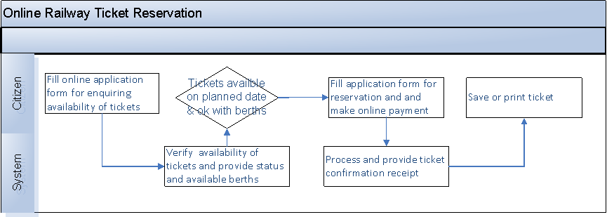
Definition of To-Be Business Process

Slide 40
Sample Process Map with Problems, Issues & Expectations

Slide 41
Definition Of Key Metrics
The key metrics (CTQs & CTPs) of the process acts as indicators of how the process has improved post GPR
From the data collected on the CTQs and CTPs, the baseline metrics can be obtained
Post roll-out of GPR, these metrics can be tracked for continuous improvement using Process Quality Information Systems (PQIS)
Notes:
Ensure early involvement by asking people for their expectations
Remove the word training from the slide
Convey our expectations to the group and dwell on them for a couple of minutes. Normal expectations will be
An interactive session, active participation, no holding back from asking doubts, speak out any apprehensions

Slide 42
Performance Indicators
Cost indicator
Time indicator
Demand indicator
Productivity indicator
A comparison of these measures for the old and redesigned process will show the improvement achieved in performance.

Slide 43
Thank you
bkm.krishnamurthy@gmail.com
bkmurthy@bkms.in

