Slide 1
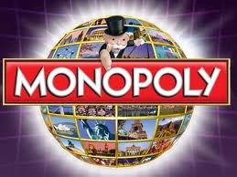

The Crisis of Intellectual Monopoly Capitalism
Innovazione Istituzioni Crescita
Siena, 6 Maggio 2014
Ugo Pagano
Universityof Siena
and CentralEuropeanUniversity

Slide 2
Focus on three issues linked to the research on State Capacity Building
Privatization of knowledge and nature of modern capitalism with particular reference to inequality and exclusion
The role of State Capacity under Modern Intellectual Monopoly Capitalism.
The role of International Organizations and the limits of National States.

Slide 3

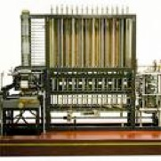
Vampires and Machines
In the Marxian tradition, under capitalism machines can have a perverse role. Since their owners employ labor, living humans become means for their valorization.
Embodying past effort, they behave like vampires: their dead labor sucks the living labor and the skills of the workers. “Machines’ skills” do not develop together with human capabilities but they tend rather to displace them.
Moreover, machines embody not only past labor but also past effort in science and ideas which also become oppressive powers ruling the labor process.

Slide 4
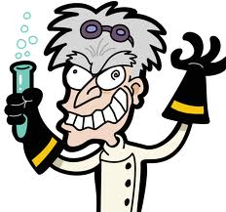
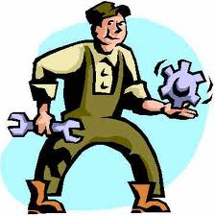
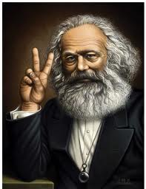
Science and Labor
It is a result of the division of labor in manufactures, that the laborer is brought face to face with the intellectual potencies of the material process of production, as the property of another, and as a ruling power. This separation begins in simple co-operation, where the capitalist represents to the single workman, the oneness and the will of the associated labor. It is developed in manufacture which cuts down the laborer into a detail laborer. It is completed in modern industry, which makes science a productive force distinct from labor and presses it into the service of capital.
(Marx 1967, ch. 14, section 5)

Slide 5
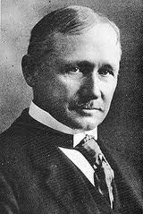
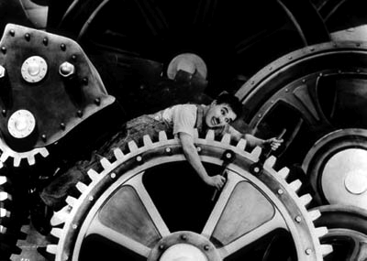
Scientific
Management
Braverman summarized the content of Taylorism in three different principles:
1) dissociation of the labor process from the skills of the workers.
2) separation of conception from execution.
3) use of monopoly over knowledge to control each step of the labor process and its mode of execution.

Slide 6

Machines vs. Workers
Excessive job de-skilling and capital up-skilling are salient characteristics of capitalism because this system involves well-defined property rights on machines and ill-defined rights over labor.
While the “skills” of machines can be clearly included among the assets of the firms, the firm-specific skills of the workers cannot be unambiguously included among these assets nor among those of the workers.
For this reason capitalism may have a similar tendency to over-invest in intellectual assets disembodied from the workers and make them a clearly defined part of the firms’ capital.

Slide 7
Intellectual MonopolyCapitalism.
Indeed one can well argue that, in spite of his considerable foresight, Marx could not see the most extreme and most meaningful step of this monopolization process:
the privatization of knowledge and its direct transformation into the most valuable proprietary asset of the firm.
This process, which characterizes the last two decades, motivates our addition of the word intellectual to the term monopoly capitalismused by Harry Braverman.

Slide 8

Land and Knowledge Enclosures.
While industrial capitalism was preceded by the enclosure of lands, intellectual monopoly capitalism has been made possible by the enclosure of ideas in privately owned fields.
Land enclosures may have even prevented the over-exploitation of natural resource (but there is some evidence against this thesis) .
No similar claim can be made for the case of intellectual enclosures. The fields of knowledge are not subject to overcrowding.
By contrast, the access to knowledge is seriously limited by the fields privatized by others. Many agents are forced to specialize in narrow fields is likely. The economy is likely to suffer a dramatic squeeze of investment opportunities.

Slide 9

Intellectual Monopoly
Intellectual property is a temporary intellectual monopoly, restricting temporarily the liberty of others to use the good .
This restriction involves always some inefficiency but it may be compensated by the incentives that the acquisition of a monopoly gives to the producers of new knowledge (incentive effect).
However, against this positive incentive effect, one should consider the negative effect that intellectual monopoly has on the intellectual investments of other firms (blocking effect).
Observe that when “intellectual property” is enforced with greater vigor, the incentive effect is immediate whereas the blocking effect comes later.

Slide 10

IPR as global tariffs
IPRs can be seen as global tariffs.
While a tariff limits the imports of the good in a single country, an IPR involves that the good cannot be produced by other firms and in other countries.
IPRs involve a new type of specialization and international division of labor in which countries may be forced not to specialize in the areas where they do not own IPR.

Slide 11
Global Patents and Investments.

Slide 12

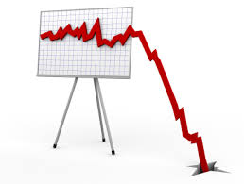
Dynamics of Intellectual
MonopolyCapitalism
While the some countries and firms may gain from intellectual protectionism, the overall restriction of investment opportunities generates a dynamic process shown in the preceding figure.
In the figure of the preceding slide, we can observe a total world increase of investments for about five years after the TRIPs but, after this initial phase, a continuous decline starting in 1999 and culminating with the recent global financial crisis.
The interactions between productive forces and production relations is likely to have produced two different dynamics of Intellectual Monopoly Capitalism, the first characterizing the roaring nineties and the second the much less glamorous first decade of the new millennium.

Slide 13

The Birth of the Institutions of
Intellectual MonopolyCapitalism.
The first phase (1990-1999) marked the expansion of the so-called knowledge economy.In the new world under American dominance, internet and computers – to whose development military and public research had substantially contributed – became cheaply and often freely available, opening up numerous new technological possibilities for the entire world economy.
However, this technological generosity did not last for long. The 1994 Marrakesh agreements marked the beginning of a new era of the world economy where few giant firms could own a disproportionate share of the global knowledge.
The creation of the WTO, with the associated 1994 TRIPs agreements, marked a structural break in the world economy that saw the birth of the institutions of intellectual monopoly capitalism.

Slide 14

The RoaringNinties.
The second half of the nineties could enjoy the past fruits of public investment in knowledge as well as the incentives of knowledge privatization.
The public availability of information and communication technology and the possibility of acquiring new secure private intellectual property rightsopened numerous investment opportunities.
The reinforcement of private intellectual property rights happened on a virgin territory that had just been fertilized by the ICT innovations which had been made publically available to everybody. The incentives of intellectual monopoly were strong while its blocking effects were weak.

Slide 15

The depressedbeginning of the newmillemnium
With the end of the nineties, the new gold-rush towards the acquisition of intellectual property rights (coupled by a decline of public investment in knowledge) started to have negative effects on investment opportunities and the blocking effects of intellectual monopoly became stronger than its incentive effects.
This substantial decrease in investments, in turn, explains the existence of global imbalances better than the hypothesis of a "saving glut", on which much emphasis has been placed to explain the 2008 financial crisis.
The “famine” of good productive investment opportunities, coupled with poor financial regulations, produced a flood of easy money that became both a cause and an effect of the housing bubble and of the following subprime crisis.

Slide 16


Financial Times of March 6 2009
“Our impression is that Opel has not freed itself from GM’s influence and that it is not being serious about becoming more autonomous as a business,” the insider said, confirming that both Mr. Guttenberg and Ms Merkel were losing patience with the companies.
Berlin has refused to assist Opel without cast-iron guarantees that the money will not flow to GM or be lost in the wake of a GM insolvency. Officials say Opel’s restructuring suggestions so far have failed to provide this guarantee.
The government suspects GM has provided some of Opel’s patents as collateral to the US Treasury in exchange for financial assistance. Berlin therefore doubts Opel would be shielded against an GM insolvency.”

Slide 17
http://www.alliedsecuritytrust.com/
Patent pools and pre-emptive patenting have created a situation in which only some large interconnected firms are able to limit the damage caused by intellectual monopoly and, in particular, by patent trolls.
Such firms, including Sun Microsystems, Motorola, Hewlet-Packard, Verizon Communications, Cisco Systems, Google and Ericsson, have become members of AST (Allied Security Trust), a joint trust which is a patent holding company that helps protect members against patent infringement lawsuits.
Allied Security Trust (2010) claims that:
AST operates under a “catch and release” model that is unique among defensive patent organizations. AST members purchase patents for defensive purposes, secure the necessary licenses to ensure freedom of operation, and then return the patents to the marketplace for sale. These sale proceeds help to reimburse AST members for their investment in acquiring a license. Under the rules of Trust, AST or its affiliated companies seek to sell all acquired patents within one year of the date of acquisition.

Slide 18
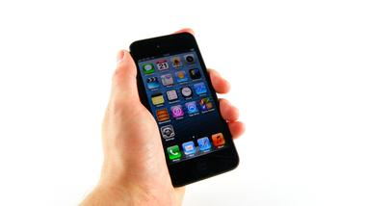
The ownership of round corners
According to Samsung:
“Apple could not claim the rights for all rectangles with rounded corners or other basic design used for phones or tablets”.

Slide 19

Privatizing disembodied knowledge.
The hypothesis that the knowledge-intensive economy should involve a fundamental discontinuity in the capitalist organization of the economy relies on the idea that, unlike physical goods, disembodied knowledge is a public good.
However, pure public goods are a mix of two ingredients: non-rivalry in consumption and impossibility of exclusion from consumption.
Disembodied knowledge is a public good in the sense that it is a non-rival good but exclusion of others from intellectual ownership is well possible.

Slide 20
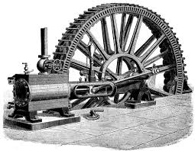
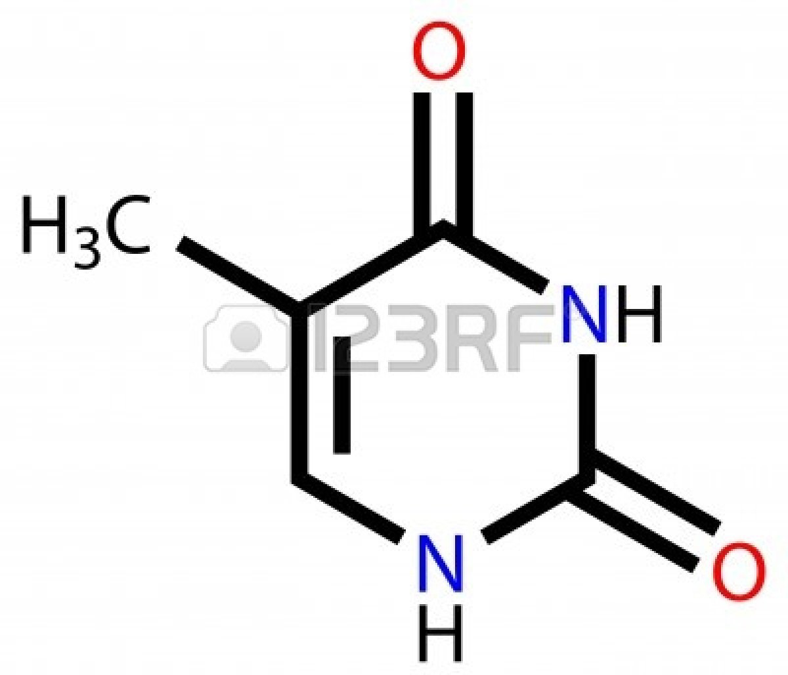
Privatization of knowledge and intellectualmonopoly
Excludability from knowledge is possible and has more dramatic consequences than exclusion from access to physical objects.
In the case of physical objects, both the definition and the enforcement of private property rights are specified at the local level. They are unlikely to have any relevant implication in distant locations.
The legal positions defining the private ownership of disembodied knowledgehave a global nature and involve restrictions for many individuals.
Thus, not only disembodied knowledgecan become capital but, when it becomes capital, it does necessarily become intellectual monopoly capital.

Slide 21

The Fate of Embodied Knowledge.
Private knowledge increases the agency costs of small labor-hiring-capital firms. This is true also in comparison to tangible capital. Thus the fate of embodied knowledge depends on the state of disembodied knowledge.
When knowledge is privatized, firm size matters:
Each unit of proprietary knowledge can be used an infinite number of times, involving a dramatic form of (firm-level artificially-restricted) increasing returns.
Knowledge complementarities involve huge economies of scope, limiting the anti-commons tragedy.
The greater the concentration of knowledge, the lower the unit cost of defending the exclusive ownership rights on each unit of knowledge. Legal economies to scale are an important characteristic of contemporary capitalism.

Slide 22

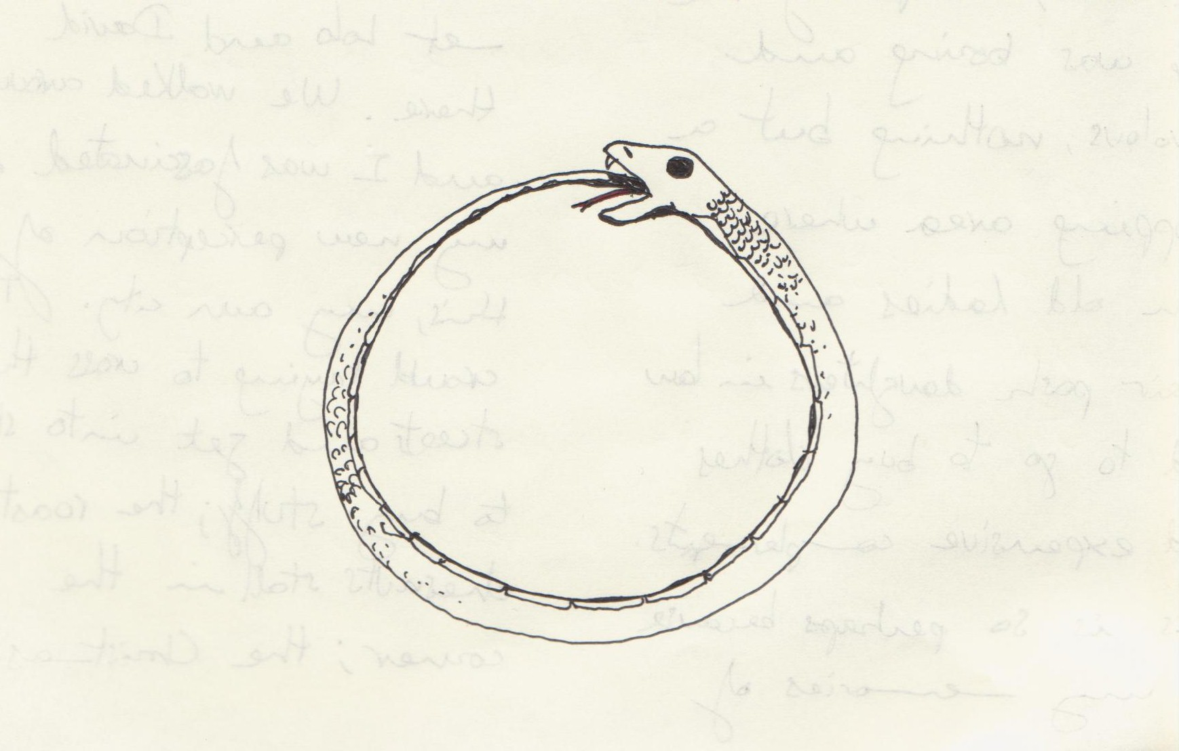
Vicious and virtuoscircles
The monopolization of knowledge inhibits investments in human capital or, to use a Marxian expression dead intellectual capitalis likely to increase with respect to living intellectual capital. The owners of dead intellectual capital have greater incentives to develop their capabilities and, for this reason, tend to become the best owners.
The monopolistic ownership of intellectual property encourages investment in the skills necessary to improve the knowledge that one owns and the skills that are developed make it even more convenient to acquire and produce more private knowledge: a virtuous circle!
Other individuals may be trapped in vicious circles of under-investment in human capital where the lack of intellectual property discourages the acquisition of skills and the lack of skills discourages the acquisition of intellectual property. This adds to the causes of increasing global inequality!

Slide 23

The Knowledge-Economy
Paradox.
Thenon-rival nature of knowledge, which could in principle favor small, and even self-managed, firms, is used to create artificial economies of size which make a cheap acquisition and the defense of property rights possible only for big business.
Absent knowledge privatization, the need to provide incentives to invest in human capital would be an argument favoring the labor-hiring-capital solution.
Because of the monopolization of intellectual capital the knowledge economy can become the most unfriendly environment for small labor-managed firms.

Slide 24
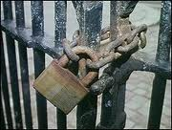
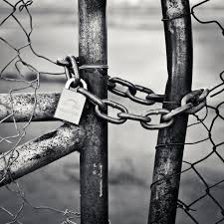
Closed Science and ClosedMarkets
Under intellectual monopoly capital, there is an evident complementarity between closed marketsand closed scienceand the selection of the organizational form is biased in favor of the capital-hiring-labor solution.
Intellectual monopoly capitalism is not a world of open science and open markets but a world suffering an unhealthy alliance between closed scienceand closed markets.
The exit strategy from the crisis and an entry strategy in a more democratic economy require that we move to a world of open science and open markets.

Slide 25

Commodification of knowledge
Financialization of the economy
Commodification
of knowledge
Financialization
of the economy
The commodification of kwowledgeallows the firm to be traded as a thing of financial markets (not equally possible for knowledge embodied in human beings).
In turn, the financialization of the economy induces companies to commodify their intellectual capital because they need to attract cheap finance.

Slide 26
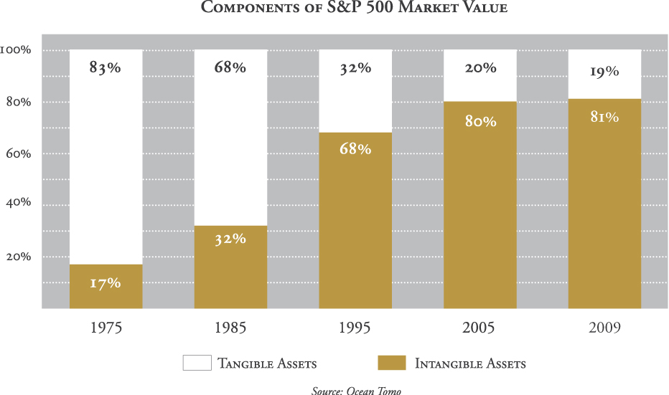
The Intellectual Property Boom
Intangible assets are taken as a proxy of intellectual property.
Even with all the benefits of the doubt for this heroic approximation, one can say that there is a boom of the share of intellectual property.
Ocean Tomo
The Intellectual Capital Merchant Banc™ Firm Established in 2003

Slide 27
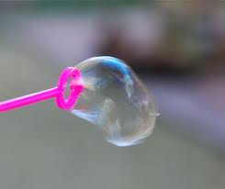
An Intellectual property
(under-ground) bubble?
Since the incentive effect is immediate (the blocking effect comes later), the intellectual property institutions are reinforced by the the investments induced by the initial rush to acquire positions of intellectual monopoly.
Thus, in an initial phase, intellectual property enforcement and investments’ growth reinforce each other as well as the institutions of intellectual property.
The complementary financializationof the economy reinforces and is reinforced by the bubble while the commodification of knowledge contributes to financial instability.

Slide 28
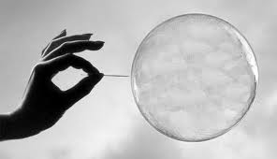
Will the (under-ground)Bubble Burst?
If, in spite of a slump, investments in intellectual property continue to boom, the lobbies, favoring its preservation, become stronger.
Moreover, firms endowed with more intellectual property have still a better time than the ones blocked by monopolies. This reinforces the idea the intellectual property increases efficiency.
Unlike the case of the housing market, the intellectual property bubble can be seen only through the slump of the entire economy and/or as an “under-ground bubble” feeding other bubbles of the economy..........
It is a major constraint of relations of productions on productive forces!

Slide 29

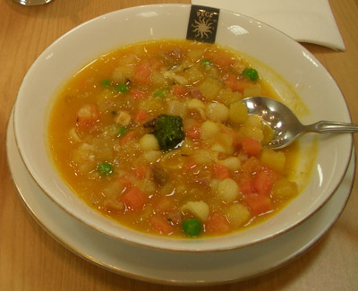
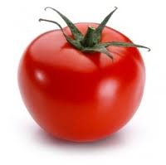
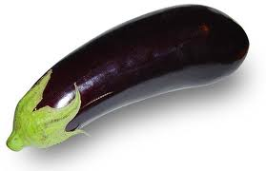

After the crisis: an eclectic approach……
The Marxianingredient:
the relation of production of intellectual monopoly capitalism fetter the productive forces of the knowledge economy.
The Liberalingredient:
open markets should replace intellectual monopolies.
The Keynesianingredient:
open science should greatly expand its domain and a public buy-out of blocking private knowledge. The multiple use characteristics of public knowledge should produce a Keynesian super-multiplier.

Slide 30

……. possible general therapies…….
Besides the “Keynesian Knowledge Super-Multiplier”, we need at least another remedy.
The post-WTO world pushes each country to over-invest in commodified knowledge and to free-ride on public knowledge.
This free-riding can be seen a form of unfair competition damaging international trade.
We need that participation to WTO be conditional on a progressive share of GNP to be invested in public research!

Slide 31
……..and local remedies.
The example of the German FraunhoferIstitute:
http://www.fraunhofer.de/en.html
Open science within national boundaries and exclusion of others (doubtful role of the new European courts).
Changing the role of the Universities?
Intellectual districts and local authorities.

