Slide 1
Sources of import and export NEPAL AND SRI LANKA ISA 2016
B/BORALANDA DHARMAPALA VIDYALAYA, SRI LANKA &
DELHI PUBLIC SCHOOL, BIRATNAGAR, NEPAL

Slide 2
What is International trade??
The exchange of goods or services along international borders.
A country requires a market for its goods. Markets are available locally as well as internationally.
This could involve the activities of the government and individual.

Slide 3
Benefits of International Trade
Monetary gains to the respective country indulging in trade.
More variety of goods available for consumers.
Better quality of goods.
Competition both at the international level as well as local level.
Closer ties between nations.
More exchange of technical know-how.
Local producers will try to improve the quality of their products.
Increase in employment locally.

Slide 4
Disadvantages of International Trade
Local production may suffer
Local industries may be overshadowed by their international competitors
Rich countries may influence political matters in other countries and gain control over weaker nations.
Ideological differences may emerge between nations with regard to the procedures in trade practices.

Slide 5
Import A good or service brought into one country from another.
Export
Send goods or services across national borders for the purpose of selling and realizing foreign exchange.

Slide 6
Major Exports Commodities
Sri Lanka | Nepal
Textiles and apparel Tea and spices Diamonds Emeralds Rubies Coconut products Rubber manufactures Fish Vegetables | Knotted Carpets Iron and steel Flavored Water Synthetic Filament Yarn Woven Fabric Fruit Juice Non-Retail Synthetic Staple Fibers Yarn Vegitables

Slide 7
Major Imports Commodities
Sri Lanka | Nepal
Consumer goods: Rice, Sugar, Wheat, Other Intermediate goods: Petroleum, Fertilizer, Chemicals, Textile, Other Investment Goods: Machinery and equipment, Transport equipment, Building material, Other Unclassified Imports | Refined Petroleum Gold Soybean Oil Petroleum Gas Semi-Finished Iron

Slide 8
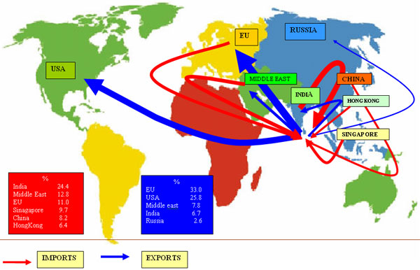
Main Import and Export destinations of Sri Lanka

Slide 9
Main Import and Export destinations of Nepal
Top Export Origins | Top Import Origins
India The United States Germany China The United Kingdom Bangladesh France Canada Japan | India China The United Arab Emirates Indonesia Argentina

Slide 10
Thank you..
Boralanda Dharmapala vidyalaya,
Sri Lanka.

