Slide 1
Quality of Service
Requirements
Techniques for Achieving Good Quality of Service
Integrated Services
Differentiated Services
Label Switching and MPLS

Slide 2
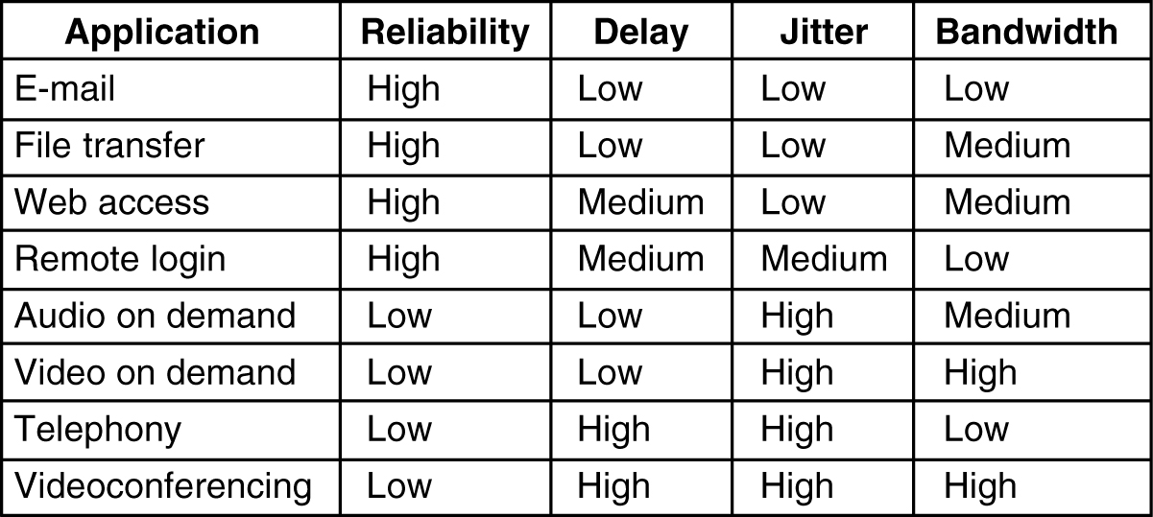
Quality of Service-Continued
Requirements
How stringent the quality-of-service requirements are

Slide 3
Quality of Service-Continued
Techniques for achieving Good quality of Service :
Overprovisioning
Buffering
Traffic shaping
The leaky Bucket Algorithm
The Token Bucket Algorithm
Resource Reservation
Admission Control
Proportional Routing
Packet Scheduling

Slide 4
Overprovisioning

Slide 5
Techniques for achieving Good-quality of Service - Continued Buffering
Smoothing the output stream by buffering packets.

Slide 6
Techniques for achieving Good-quality of Service - Continued
Traffic Shaping
Bursty traffic is one of the main causes of congestion. If hosts could be made to transmit at a uniform rate, congestion would be less common.
Traffic shaping is about regulating the average rate of data transmission.
When a virtual-circuit is set up, the user and the subnet (carrier) agree on a certain traffic shape for that circuit. This agreement is called traffic contract.

Slide 7
Techniques for achieving Good-quality of Service - Continued
Traffic Shaping
As long as the customer sends packets according to the agreed upon contract, the carrier promises to deliver them all in timely fashion.
Traffic shaping is very important for real-time data, such as audio and video.
Traffic policing is to monitor the traffic flow.
Traffic shaping and policing mechanisms are easier with virtual circuit subnets than with datagram subnets.

Slide 8
Techniques for achieving Good-quality of Service - Continued
The leaky Bucket Algorithm
Imagine a bucket with a small hole in the bottom. No matter at what rate water enters the bucket, the outflow is at a constant rate, ρ, when there is any water in the bucket, and zero when the bucket is empty. Also, once the bucket is full, any additional water entering is spills over the sides and is lost

Slide 9
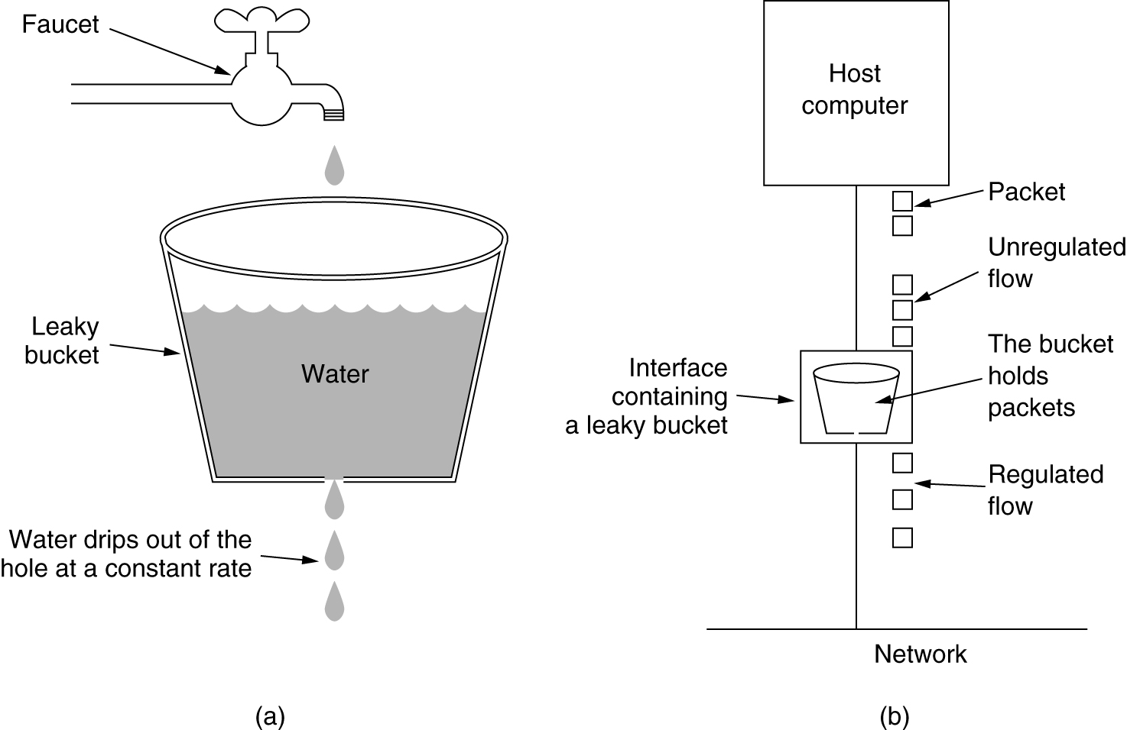
Techniques for achieving Good-quality of Service - Continued
The leaky Bucket Algorithm

Slide 10
Techniques for achieving Good-quality of Service - Continued
The leaky Bucket Algorithm
The same idea can be applied to packets. Each host is connected to the network by an interface containing a leaky bucket, that is, a finite internal queue. When a packet arrives, if there is room on the queue it is appended to the queue; otherwise, it is discarded. At every clock tick, one packet is transmitted (unless the queue is empty).

Slide 11
Techniques for achieving Good-quality of Service - Continued
The leaky Bucket Algorithm
The byte-counting leaky bucket is implemented almost the same way. At each tick, a counter is initialized to n. If the first packet on the queue has fewer bytes than the current value of the counter, it is transmitted, and the counter is decremented, by that number of bytes. Additional packets may be sent as long as the counter is high enough. When the counter drops below the length of the next packet on the queue, transmission stops until the next tick

Slide 12
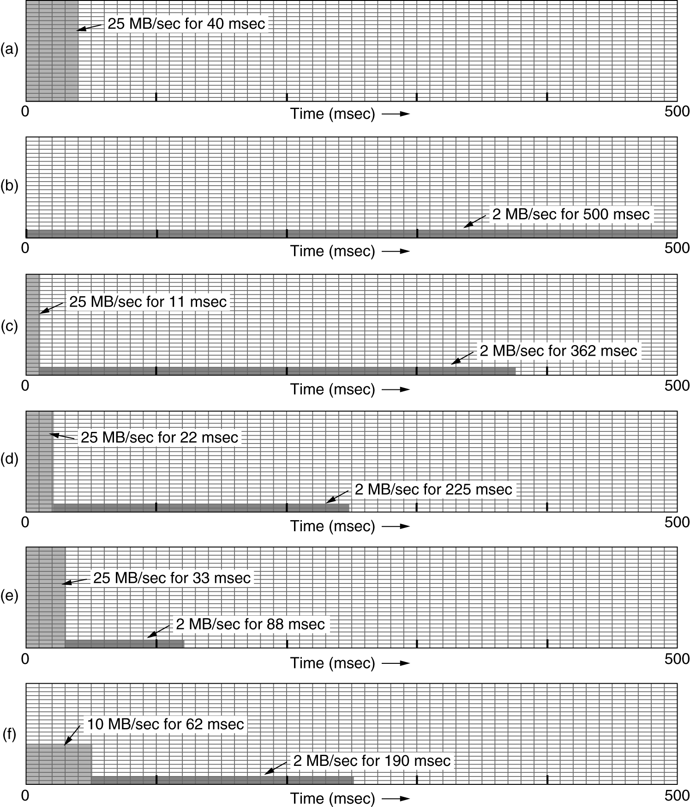
Techniques for achieving Good-quality of Service - Continued
The leaky Bucket Algorithm
Input to a leaky bucket.
(b) Output from a leaky bucket. Output from a token bucket with capacities of (c) 250 KB, (d) 500 KB, (e) 750 KB, (f) Output from a 500KB token bucket feeding a 10-MB/sec leaky bucket.

Slide 13
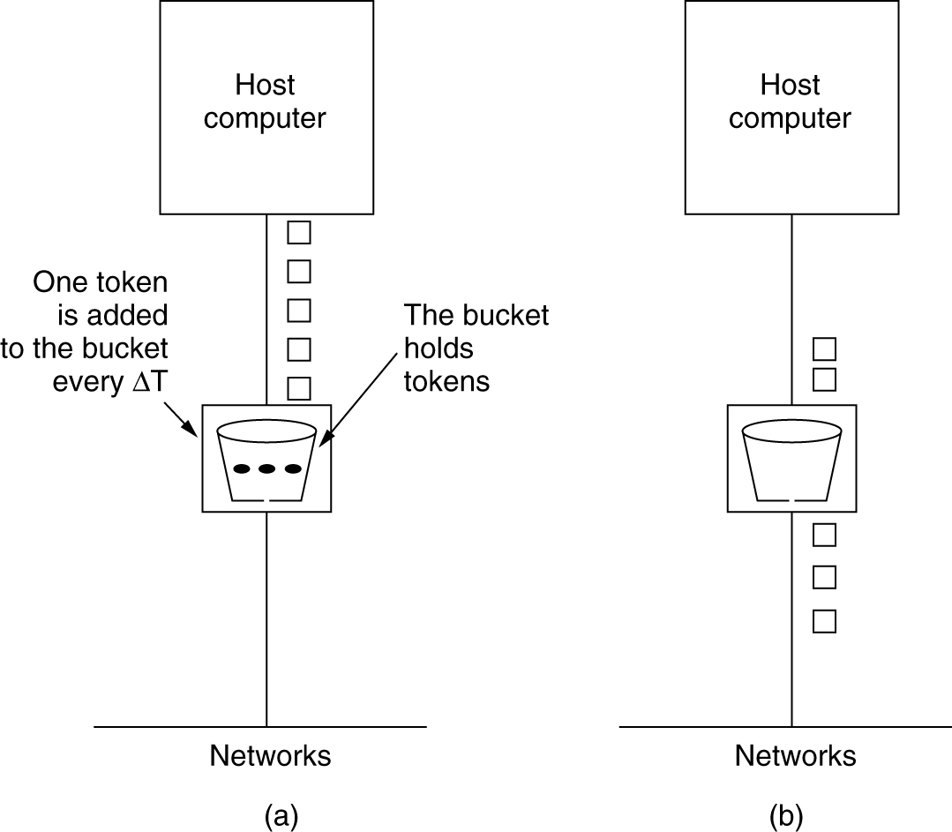
Techniques for achieving Good-quality of Service - Continued
The Token Bucket Algorithm
(a) Before. (b) After.

Slide 14
Techniques for achieving Good-quality of Service - Continued
The Token Bucket Algorithm
If we call the burst length S sec, the token bucket capacity C bytes, the token arrival rate ρ bytes/sec, and the maximum output rate M bytes/sec, then the output burst contains a maximum of C + ρS bytes.
We know that the number of bytes in a maximum-speed burst of length S seconds is MS.

Slide 15
Techniques for achieving Good-quality of Service - Continued
The Token Bucket Algorithm
It is better to allow the output to speed up somewhat when large burst arrives, so a more flexible algorithm is needed. One such algorithm is the token bucket algorithm.
In this algorithm, the leaky bucket holds tokens, generated by a clock at the rate of one token every DT sec.
The implementation of the basic token bucket algorithm is a variable that counts tokens. The counter is incremented by one every DT and decremented by one whenever a packet is sent. When the counter is zero, no packets may be sent.
In the byte-count variant, the counter is incremented by k bytes every DT and decremented by the length of each packet sent.

Slide 16
Techniques for achieving Good-quality of Service - Continued
The Token Bucket Algorithm
The token bucket algorithm allows saving, up to the maximum size of the bucket, n. This property means that bursts up to n packets can be sent at once, allowing some burstiness in the output stream and giving faster response to sudden burst input.
The token bucket algorithm throws away tokens when the bucket fills up but never discard packets. In contrast, the leaky bucket algorithm discards packets when the bucket fills up.

Slide 17
Techniques for achieving Good-quality of Service - Continued
Resource Reservation
Three different kinds of resources can potentially be reserved :
1) Bandwidth
2) Buffer space
CPU cycles

Slide 18
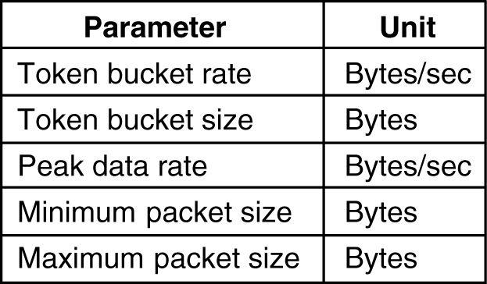
Techniques for achieving Good-quality of Service - Continued
Admission Control
An example of flow specification.

Slide 19
Techniques for achieving Good-quality of Service - Continued
Proportional Routing

Slide 20
Techniques for achieving Good-quality of Service - Continued
Packet Scheduling
(a) A router with five packets queued for line O.
(b) Finishing times for the five packets.

Slide 21
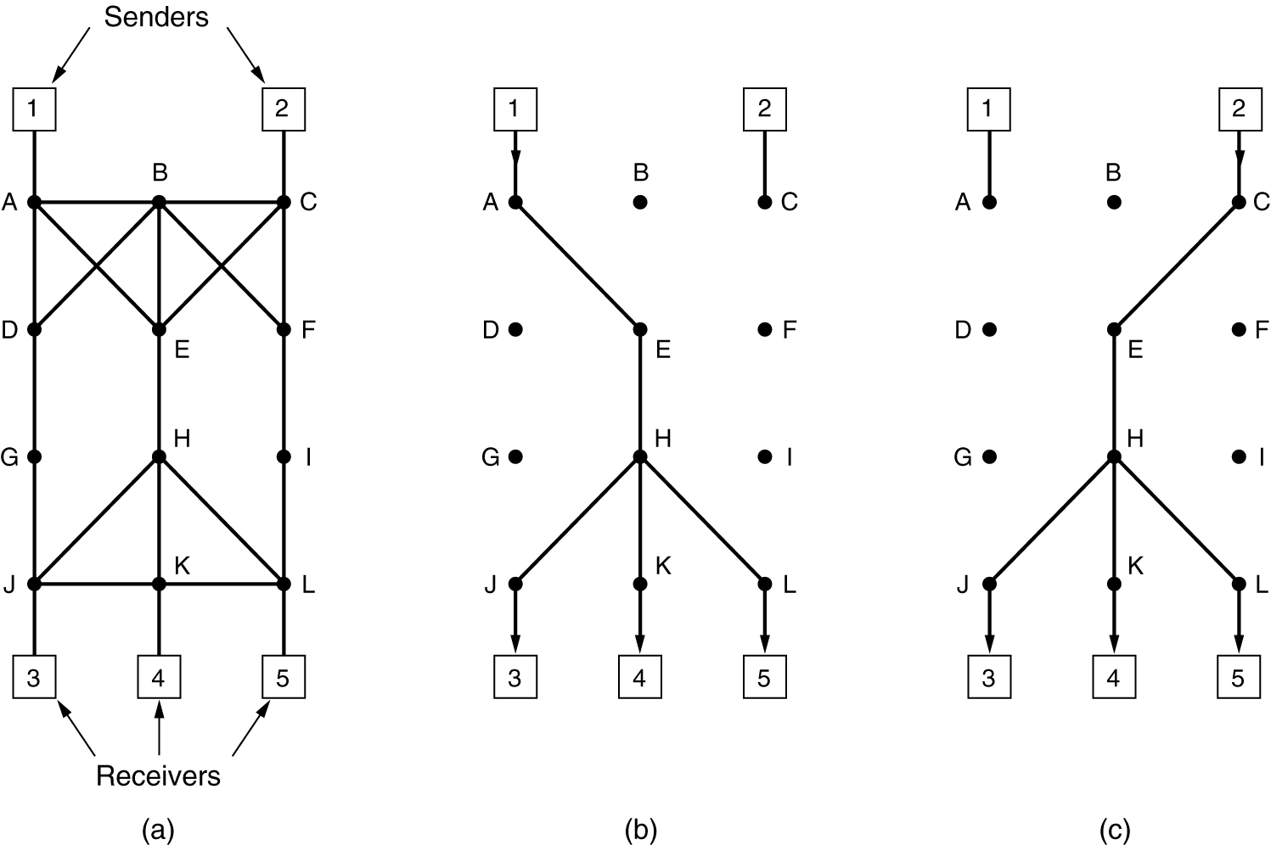
Integrated Services
RSVP – The Resource reServation Protocol
(a) A network, (b) The multicast spanning tree for host 1. (c) The multicast spanning tree for host 2.

Slide 22
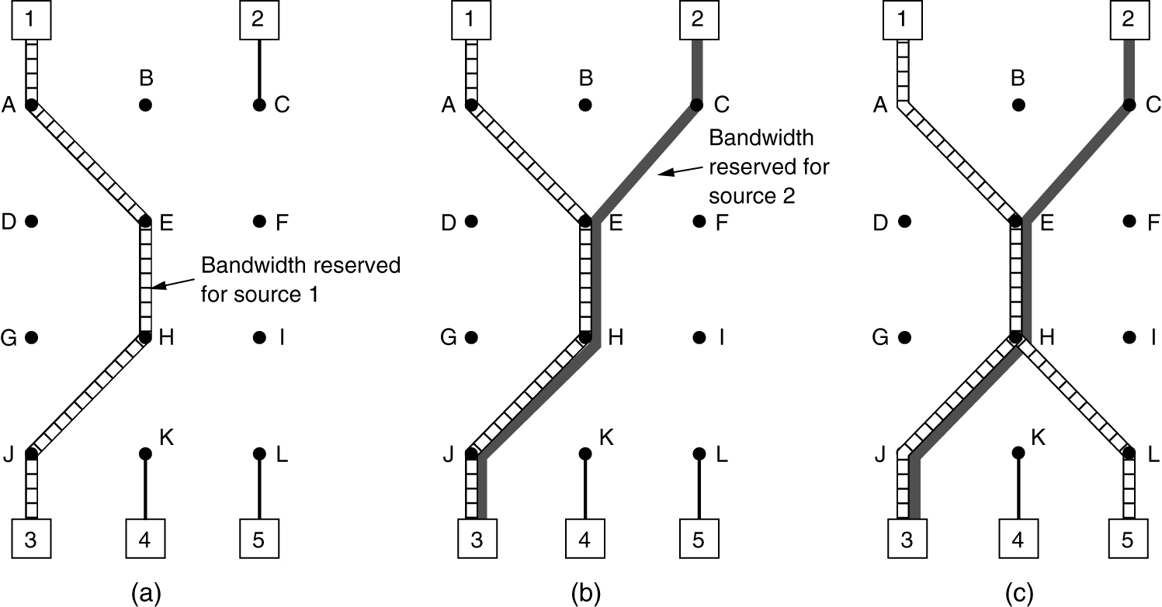
Integrated Services
RSVP – The Resource reServation Protocol
(a) Host 3 requests a channel to host 1. (b) Host 3 then requests a second channel, to host 2. (c) Host 5 requests a channel to host 1.

Slide 23
Differentiated Services
Expedited Forwarding
Assured Forwarding

Slide 24
Expedited Forwarding

Slide 25
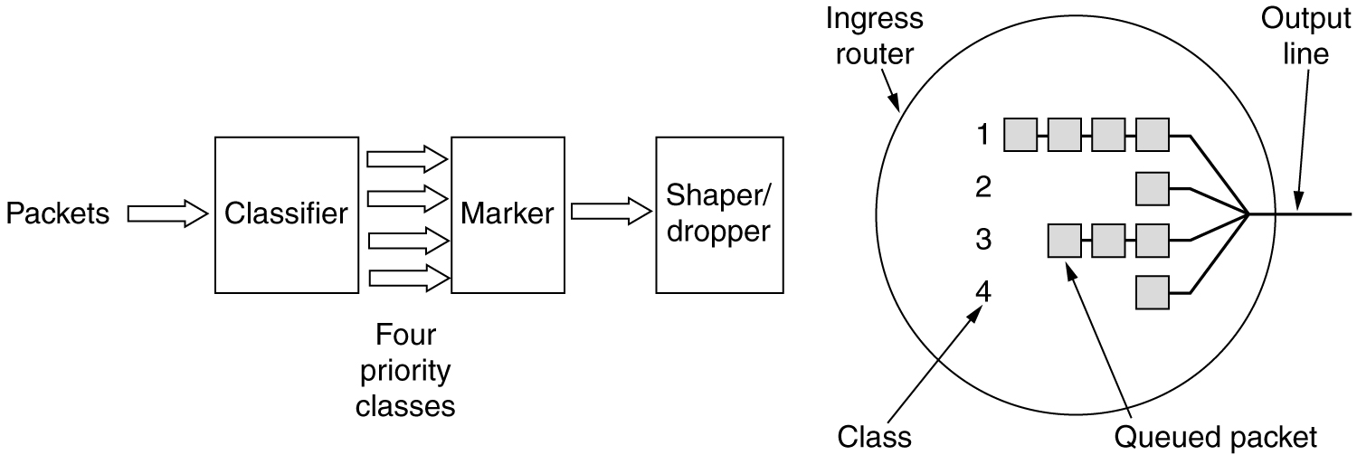
Assured Forwarding
A possible implementation of the data flow for assured forwarding.

Slide 26
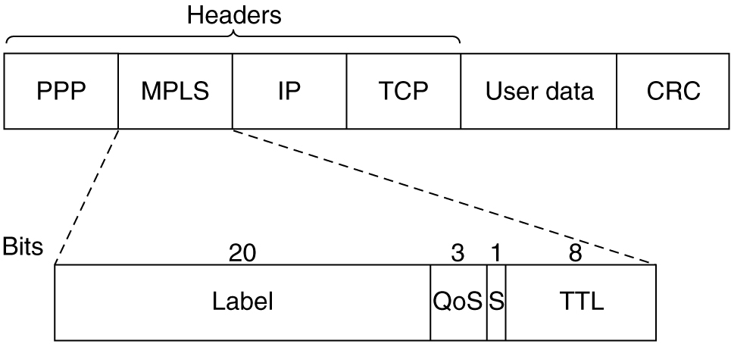
Label Switching and MPLS
Transmitting a TCP segment using IP, MPLS, and PPP.

Slide 27
Internetworking
How Networks Differ
How Networks Can Be Connected
Concatenated Virtual Circuits
Connectionless Internetworking
Tunneling
Internetwork Routing
Fragmentation

Slide 28
Internetworking
Two or more networks are connected to form an internet.
A variety of different networks will always be around, for the following reasons:
The installed base of different networks is large and growing.
As computers and networks get cheaper, the place where decisions get made moves downward.
Different networks (e.g., ATM and wireless) have radically different technology.

Slide 29
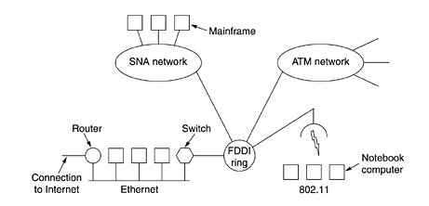
Internetworking
A collection of interconnected networks

Slide 30
Internetworking
An internetworking device is inserted at the junction between two networks to handle the necessary conversions as packets move from one network to the other.
The name used for the interconnecting device depends on the layer that does the work. Some common names are:
Layer 1: Repeaters copy individual bits between cable segments.
Layer 2: Bridges store and forward data link frames between LANs.
Layer 3: Multiprotocol Routers forward packets between dissimilar networks.
Layer 4: Transport gateways connect byte streams in the transport layer.
Above 4: Application gateways allow internetworking above layer 4.

Slide 31
Internetworking
A repeater is a low-level device that just amplifies or regenerates weak signals.
A bridge accepts an entire frame and passes it up to the data link layer where the checksum is verified. Then the frame is sent down to the physical layer for forwarding on different network. Bridges can make minor changes to the frame before forwarding it, such adding or deleting some fields from the frame header.
A multiprotocol router takes the incoming packets from one line and forwards them on another. They lines may belong to different networks and use different protocols. Multiprotocol routers operate at the level of the network layer.
A transport gateway makes a connection between two networks at the transport layer.
An Application gateway connects two parts of an application in the application layer. For example, The mail gateway would unpack the message, convert it to the different format used by the other network

Slide 32
Internetworking

Slide 33
How Networks Can Be Connected
(a) Two Ethernets connected by a switch.
(b) Two Ethernets connected by routers.

Slide 34
Concatenated Virtual Circuits
Procedure:
When a connection to a host in a distant network is established, the subnet sees that the destination is remote, and builds a virtual circuit to the router nearest the destination network. Then it constructs a virtual circuit from that router to an external "gateway". The gateway records the existence of the virtual circuit in its tables and proceeds to build another virtual circuit to a router in the next subnet. This process continues until the destination host has been reached.
Once Data packets begin flowing along the path, each gateway relays incoming packets, converting between packets formats and virtual circuit numbers as needed. Clearly, all data packets must traverse the same sequence of gateways, and thus arrive in order.

Slide 35
Concatenated Virtual Circuits

Slide 36
Connectionless Internetworking
In datagram model, the only service the network layer offers to the transport layer is the ability to inject datagrams into the subnet.
This model does not require all packets belonging to one connection to traverse the same sequence of gateways.
Routing decision is made separately for each packet, possibly depending on the traffic at the moment the packet is sent.
There is no guarantee that the packets arrive at the destination in order.
This model is not quite as simple as it looks. Some issues have to be considered such as:
The multiprotocol routers can translate from packet format to another when the two formats are close. Otherwise, the conversion is always incomplete.
Different addressing system.

Slide 37
Connectionless Internetworking

Slide 38
Tunneling
Tunneling is used when both source and destination hosts are on the same type of networks, but there is a different network in between.
Example:
Assume an international bank with TCP/IP based Ethernet in Paris, a TCP/IP based Ethernet in London, and a WAN in between.

Slide 39
Tunneling

Slide 40
Tunneling
Procedure of Tunneling:
To send an IP packet to host 2, host 1 constructs the packet containing IP address of host 2, inserts it into an Ethernet frame addresses to Paris multiprotocol router, and puts it on the Ethernet.
When the multiprotocol router gets the frame, it removes the IP packet, inserts it in the payload field of the WAN network layer packet, and addressed the later to the WAN address of the London multiprotocol router. When it gets there, the London router removes the IP packet and sends it to host 2 inside an Ethernet frame.

Slide 41
Tunneling

Slide 42
Internetwork Routing
Consider, for example, the internetwork in which five networks are connected by six multiprotocol routers.
The procedure for internetwork routing is:
1. Construct a graph of the internetwork.
2. Any known routing algorithm, such as the distance vector and link state algorithms, can be applied to the set of multiprotocol routers

Slide 43
Internetwork Routing

Slide 44
Fragmentation
The solution to this problem is to allow gateways to break packets up into fragments, sending each fragment as a separate internet packet.
Two opposing strategies exist for recombining the fragments back into the original packet.

Slide 45
Fragmentation

Slide 46
Fragmentation
Each network imposes some maximum size on its packets. These limits have various causes, among them:
Hardware (e.g., the width of a TDM transmission slot).
Operating system (e.g., all buffers are 512 bytes).
Protocols (e.g., the number of bits in the packet length field).
Compliance with some (inter)national standard.
Desire to reduce error induced retransmissions to some levels.
Desire to prevent one packet from occupying the channel to long.
Maximum payloads range from 48 bytes (ATM cells) to 65,515 bytes (IP packets).
An obvious problem appears when a large packet wants to travel through a network whose maximum packet size is too small.

Slide 47
Fragmentation
First: Transparent Fragmentation
When oversized packet arrives at a gateway, the gateway breaks it up into fragments. Each fragment is addressed to the same exit gateway, where the pieces are recombined.
ATM networks have special hardware to provide transparent fragmentation (segmentation) of packets into cells and then reassembly of cells into packets.
Transparent fragmentation is simple but has some problems such as:
The exit gateway must know when it has received all the pieces, so that either a count field or an "end of packet" bit must be included in each packet.
All packets must exit via the same gateway. Therefore, some performance may be lost.
The overhead required to repeatedly reassemble and then refragment a large packet passing through a series of small-packet networks.

Slide 48
Fragmentation
Second: Nontransparent Fragmentation
It refrains from recombining fragments at any intermediate gateways. Once the packet has been fragmented, each fragment is treated as though it were an original packet. Recombination occurs only at the destination host.
Nontransparent fragmentation also have some problems:
It requires every host to be able to do reassembly.
When a large packet is fragmented, the total overhead increases, because every fragment must have a header.
The advantage of this method is that multiple exit gateways can be used and higher performance can be achieved.

Slide 49
Fragmentation
Fragmentation when the elementary data size is 1 byte.
(a) Original packet, containing 10 data bytes.
(b) Fragments after passing through a network with maximum packet size of 8 payload bytes plus header.
(c) Fragments after passing through a size 5 gateway.

