Slide 1
E-Commerce Payment System

Slide 2
Agenda
Electronic Payments
E-Commerce Transaction
EXAMPLES OF ELECTRONIC PAYMENT SYSTEMS FOR E-COMMERCE
Examples of online payment systems

Slide 3
Electronic Payments
E-Commerce or Electronics Commerce sites use electronic payment where electronic payment refers to paperless monetary transactions.
Electronic payment has revolutionized the business processing by reducing paper work, transaction costs, labour cost.
Being user friendly and less time consuming than manual processing, helps business organization to expand its market reach / expansion.
Some of the modes of electronic payments are following.

Slide 4
Electronic payment systems
Electronic payment systems may be more convenient for international online business due to differences in credit card customer protection laws in different countries.

Slide 5
E-Commerce Transaction

Slide 6
EXAMPLES OF ELECTRONIC PAYMENT SYSTEMS FOR E-COMMERCE

Slide 7
Digital wallets
Digital wallets make paying for purchases over the Web more efficient by eliminating the need for shoppers to enter their address and credit card information repeat- edly each time they buy something. The digital wallet securely stores credit card and owner identification information and enters the shopper’s name, credit card number, and shipping information automatically when invoked to complete a purchase. Google Checkout is an example.

Slide 8
Digital Wallets
Concept of digital wallet relevant to many of the new digital payment systems
Seeks to emulate the functionality of traditional wallet
Most important functions:
Authenticate consumer through use of digital certificates or other encryption methods
Store and transfer value
Secure payment process from consumer to
merchant
Two major categories:
Client-based digital wallets – Gator.com, MasterCard Wallet
Server-based digital wallets – MSN Wallet

Slide 9
Type of Digital Wallets

Slide 10
Micropayment
Micropayment systems have been developed for purchases of less than $10, such as downloads of individual articles or music clips, which would be too small for conventional credit card payments.

Slide 11
Accumulated balance digital payment systems
Accumulated balance digital payment systems enable users to make micropayments and purchases on the Web, accumulating a debit balance that they must pay periodically on their credit card or telephone bills. Examples are Valista’s PaymentsPlus used by AOL, Vodafone, and NTT DoCoMo, and Clickshare, which is widely used by the online newspaper and publishing industry.

Slide 12
Accumulated balance
Accounts that accumulate expenditures and to which consumers make period payments
Examples: utility, phone, American Express accounts
Allows users to make micropayments and purchases on the Web, accumulating a debit balance for which they are billed at the end of the month
Examples: Qpass and iPin

Slide 13
Digital Accumulating Balance Payment Systems

Slide 14
Online stored value payment systems
Online stored value payment systems enable consumers to make instant online payments to merchants and other individuals based on value stored in an online digital account. Some online stored value payment systems such as Valista are merchant platforms. Others are focused on peer-to-peer payments, such as PayPal. PayPal is owned by eBay and makes it possible for people to send money to vendors or individuals who are not set up to accept credit card payments.

Slide 15
Online Stored Value Systems

Slide 16
Digital checking systems
Digital checking systems such as PayByCheck extend the functionality of existing checking accounts so they can be used for online shopping payments. Digital checks are processed much faster than traditional paper-based checking.
Extend the functionality of existing checking accounts for use as online shopping payment tools
Examples: eCheck, Achex (MoneyZap)

Slide 17
Digital Checking: eCheck

Slide 18
Digital Checking Payment Systems

Slide 19
Electronic billing presentment and payment systems
Electronic billing presentment and payment systems are used for paying routine monthly bills. They enable users to view their bills electroni- cally and pay them through electronic fund transfers from bank or credit card accounts. These services notify purchasers about bills that are due, present the bills, and process the payments. Some of these services, such as CheckFree, consolidate subscribers’ bills from various sources so that they can all be paid at one time.

Slide 20
Examples of online payment systems
Virtual PIN
DigiCash (or E-cash)
CyberCash/CyberCoin
SET (Secure Electronic Transactions)
PayPal
Smart cards

Slide 21
Examples of Digital Cash

Slide 22
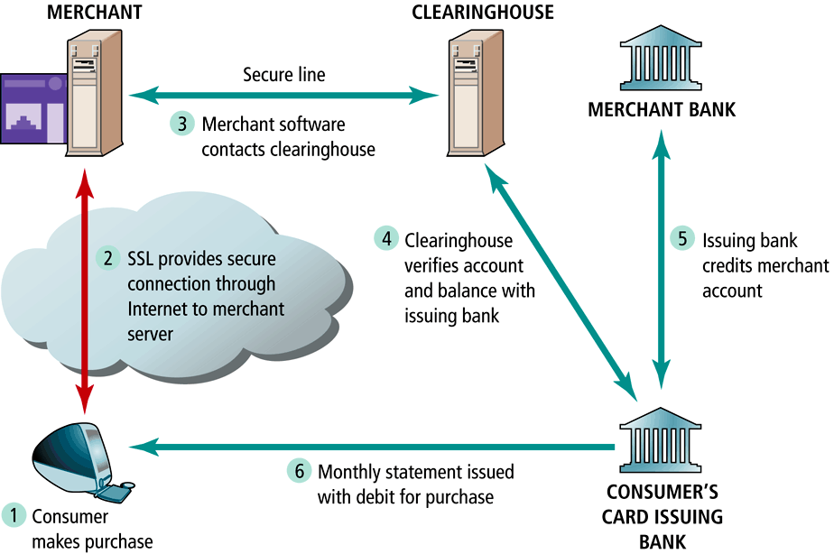
Online Credit Card Use

Slide 23
Digital Credit Card Payment Systems

Slide 24
PayPal
PayPal is an electronic payment system which can transfer money between its accounts. In order to use PayPal, one has to obtain a PayPal account, which is associated either with the customer's credit card or with their regular bank account.
To avoid fraud, PayPal sends an e-mail message to both the initiator and the recipient of the transaction.
PayPal is used to settle online auctions, such as eBay auctions. The ease of use and the fact that no credit card is required to use it makes PayPal increasingly popular.

Slide 25
PayPal

Slide 26
Credit Card
Represents an account that extends credit to consumers, permitting consumers to purchase items while deferring payment, and allows consumers to make payments to multiple vendors at one time
Credit card associations – Nonprofit associations (Visa, MasterCard) that set standards for issuing banks
Issuing banks – Issue cards and process transactions
Processing centers (clearinghouses) – Handle verification of accounts and balances

Slide 27
How an online credit transaction works

Slide 28
Limitations of Online Credit Card Payment Systems
Security – neither merchant nor consumer can be fully authenticated
Cost – for merchants, around 3.5% of purchase price plus transaction fee of 20-30 cents per transaction
Social equity – many people do not have access to credit cards (young adults, plus almost 100 million other adult Americans who cannot afford cards or are considered poor risk)

Slide 29
Stored Value
Accounts created by depositing funds into an account and from which funds are paid out or withdrawn as needed
Examples: Debit cards, gift certificates, prepaid cards, smart cards
Debit cards: Immediately debit a checking or other demand-deposit account
Peer-to-peer payment systems such as PayPal a variation
An example of an online stored value system
Aimed at teenagers
Funds can be deposited in a RocketCash account, which functions like a credit card and allows teens to buy products online

Slide 30
The SET (Secure Electronic Transaction) Protocol
Authenticates cardholder and merchant identity through use of digital certificates
An open standard developed by MasterCard and Visa
Transaction process similar to standard online credit card transaction, with more identity verification
Thus far, has not caught on much, due to costs involved in integrating SET into existing systems, and lack of interest among consumers

Slide 31
How SET Transactions Work

Slide 32
References
E-Commerce. Copyright© 2002PearsonEducation,Inc.
https://www.tutorialspoint.com/e_commerce/e_commerce_payment_systems.htm
http://www.oecd-ilibrary.org/docserver/download/5kz84p6kcv36.pdf?expires=1477755689&id=id&accname=guest&checksum=E7F8161C42DF5FB5591FFD5E043852EE

