Slide 1
Software Development Life Cycle
Waterfall Method

Slide 2
Background
Introduced by Winston Royce in 1970
Illustrated as a flawed model
Oldest and most well tested methodology
Still used by 70% of software development organizations (VersionOne survey, 2007)

Slide 3
What is it?
The classic approach to the Systems Development Life Cycle
Linear and sequential
Several phases of development
Each phase is assigned to a separate team
100% complete and absolutely correct
Seen as flowing steadily downward
Notes:
Each phase is assigned to a separate team for greater control
Make sure each phase is 100% complete and absolutely correct before proceeding to the next phase.
Seen as flowing steadily downward like a waterfall

Slide 4
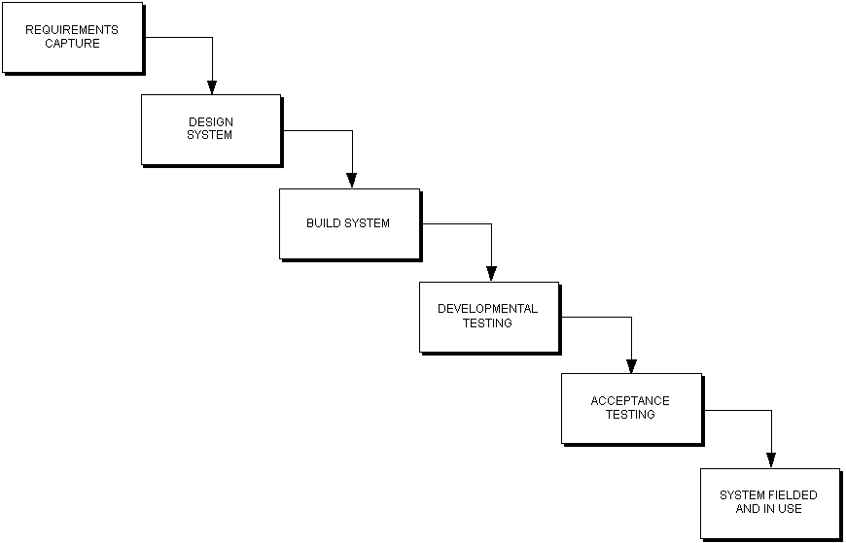
Stages
Goes downwards and not backwards

Slide 5
Pros and Cons
Pros
Cons
Clear initial requirements
Strict order of phases
Faults are detected early
Emphasis on documentation
Well-known and easy to use
Does not allow for revision
Time wasted waiting
Late testing period
Not suitable for smaller projects
Users are not involved until testing stage
Notes:
Pro point: The waterfall method is best when you want everything documented and you want to force all proposed changes through scope-change management.
With good documentation on requirements and design, should a team member leave (or be fired), would help to familiarize new members
Con point: The waterfall process requires heavy user involvement during planning, analysis, and testing versus throughout the entire life cycle

Slide 6
Who Uses and When?
Use only when:
Clear and fixed requirements
Experienced organization or inexperienced leader
The project is simple or large
The project requires better control
Who still uses:
Toyota - embedded software (moving toward Agile)
Notes:
Also, if you have a large project you can split it into smaller pieces so the small subprojects could utilize the waterfall method

Slide 7
Modified Methodology
The V-Model
Aorta Lifecycle Model
Sashimi Model
Royce Model
Combat Waterfall’s assumption that the requirements will not change
Notes:
These provide slight or major variations to the Waterfall development process

Slide 8
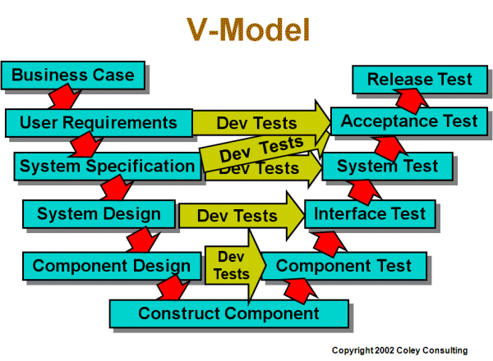
The V-Model
Development and testing stages start simultaneously
Allow for Developing Acceptance Criteria early

Slide 9
Waterfall vs. Agile Method
Waterfall
Agile
Benefits small projects
Strict with Predictability
“Big Design Up Front”
To fix problem, must redesign entire system
One BIG model release at the end
Benefits projects with constant changing requirements
Flexible with Adaptability
Fit puzzles together at the “right” time
A working model
Agile is a lower overhead method that emphasizes values & principles rather than processes.
Notes:
Working model = Launchable at end of each tested phase
a bug found in the early stages (such as requirements specification or design) is cheaper in money, effort, and time, to fix than the same bug found later on in the process.[6] To take an extreme example, if a program design turns out to be impossible to implement, it is easier to fix the design at the design stage than to realize months later, when program components are being integrated, that all the work done so far has to be scrapped because of a broken design.
This is the central idea behind Big Design Up Front and the waterfall model: time spent early on making sure requirements and design are correct saves you much time and effort later.

Slide 10
Conclusion
Be aware of your chosen technologies capabilities
Emphasis on requirements and design
No room for changing of requirements
Enforces discipline
Schedule
Know what your customers needs are!
Notes:
Steve McConnell, Code Complete, (a book that criticizes widespread use of the waterfall model) refers to design as a "wicked problem"—a problem whose requirements and limitations cannot be entirely known before completion. The implication of this is that it is impossible to perfect one phase of software development, thus it is impossible if using the waterfall model to move on to the next phase.

Slide 11
References
“Agile Introduction for Dummies, part 1.” http://agileintro.wordpress.com/2008/01/04/waterfall-vs-agile-methodology/
Melonfire, Contributor. Understanding the pros and cons of the Waterfall Model of software development. http://www.techrepublic.com/article/understanding-the-pros-and-cons-of-the-waterfall-model-of-software-development/6118423
Mochal, Tom. How to pick the right method for your project. http://www.techrepublic.com/article/waterfall-vs-rad-how-to-pick-the-right-method-for-your-project/1044102
“All About the Waterfall Model” http://www.waterfall-model.com/
“Waterfall SDLC Methodology” http://skysigal.xact-solutions.com/Resources/SoftwareDevLifeCycle/WaterfallMethodSDLC/tabid/600/Default.aspx
Elssamadisy, Amr. Toyota Using Waterfall? http://www.infoq.com/news/2010/04/toyota-waterfall

