Slide 1

Dynamic Binary Translation for Embedded Systems with Scratchpad Memory
Ph.D. Dissertation Defense
José A. Baiocchi Paredes
Department of Computer Science
University of Pittsburgh

Slide 2
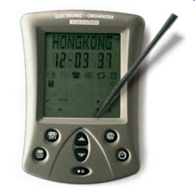
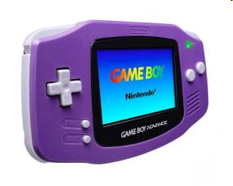
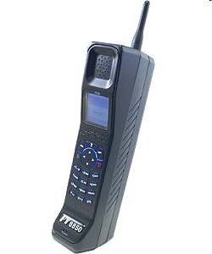
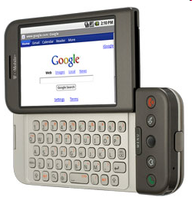
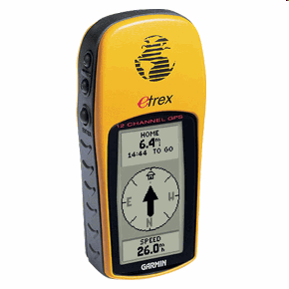
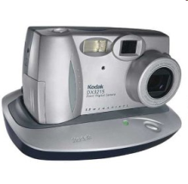
Embedded Systems Evolution
Past
  Characteristics
    single purpose
    simple applications
    co-designed SW/HW
  Traditional concerns
    reliability
    safety
    performance
    memory
    energy
    real-time
Present
  Characteristics
    multiple purpose
    multiple, complex apps.
    dynamic SW changes
  Additional concerns
    security
    IP protection
    adaptability
Addressable
  with DBT
Enable DBT for Embedded Systems
with Scratchpad Memory

Slide 3
Overview
Dynamic Binary Translation for Embedded Systems
Target System-on-Chip
StrataX DBT Framework for Embedded Systems
  Fragment Formation Tuning
  Control Code Footprint Reduction
  Heterogeneous Fragment Cache
  Victim Compression and Fragment Pinning
  Demand Paging w/o MMU
Conclusions & Contributions

Slide 4
Dynamic Binary Translation (DBT)
Modification of the binary instruction stream of a running program before its execution on a host platform
  Translation units (Fragments) created as execution progresses
  Stored and executed in SW-managed buffer (Fragment Cache)
Binary Code
DBT System
Translator
Fragment
Cache
Host Platform

Slide 5
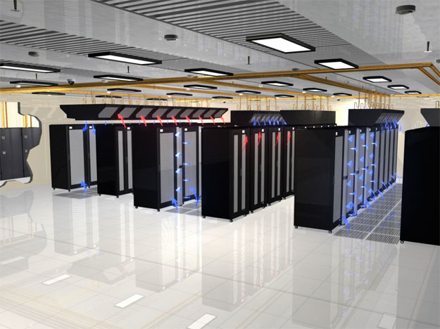

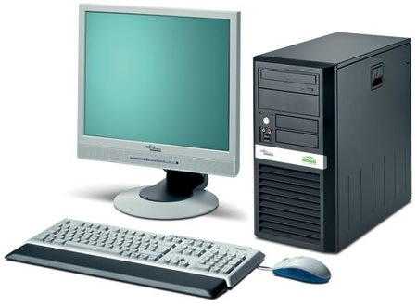


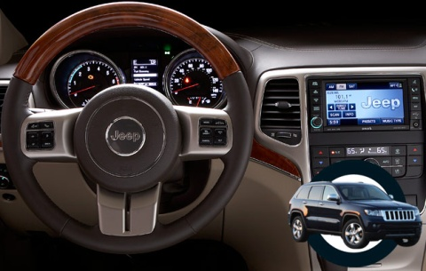

Uses of DBT
Just-In-Time Compilation
Emulation
Simulation
Code Security
Dynamic Instrumentation
(Profiling)
Dynamic Optimization
Full-System Virtualization
Co-designed VMs
Code (De)Compression
ISA Customization
SW Instruction Caching
Demand Paging w/o MMU

Slide 6
Target System-on-Chip
General-purpose Processor
Application-specific Integrated Circuit (ASIC)
Heterogeneous Memory System
  ROM (system code)
  NAND Flash (external storage)
  SDRAM (main memory)
  HW Caches
  Scratchpad Memory
System-on-Chip
Main
Memory
(SDRAM)
CPU
I$
DRAM
Ctrl.
D$
SPM
ROM
Flash
Storage
(SD card)
ASIC
Card
Ctrl.

Slide 7
Native Execution w/Shadowing
NAND Flash storage
  stores program binary image
  internally organized into pages
Memory Shadowing
  code & static data copied to main memory
  all-at-once before starting program execution
System-on-Chip
Main
Memory
(SDRAM)
CPU
I$
DRAM
Ctrl.
D$
SPM
ROM
Flash
Storage
(SD card)
ASIC
Card
Ctrl.

Slide 8
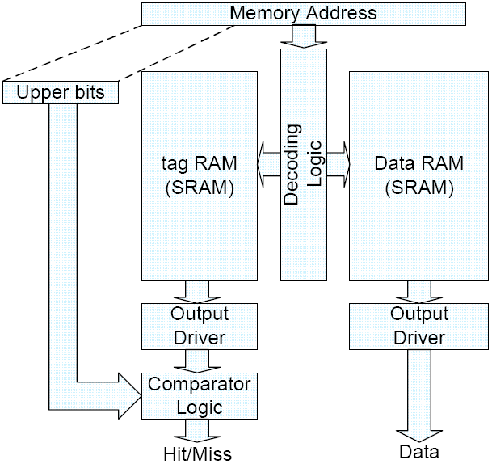
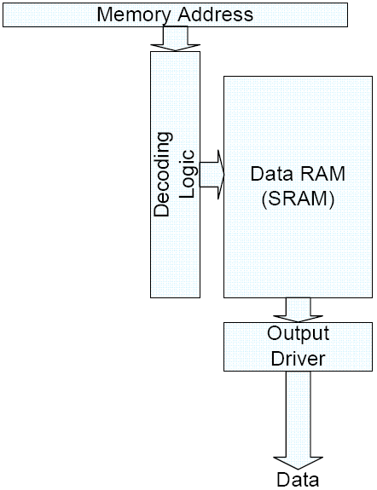
Scratchpad Memory (SPM)
Software-managed on-chip SRAM
  Mapped to physical address space
  StrataX manages SPM as a SW I-cache
Advantages:
  Low latency
  Smaller than HW cache
  Energy-efficient
  Simpler WCET analysis

Slide 9
Basic DBT System (Strata)
App. Binary
Dynamic Binary Translator
Code Cache
START
Save
Context
Cached?
NO
Build
Fragment
New
PC
YES
Link
Fragment
Restore
Context
BUILD
Restore
Context
Dispatch
Save
Context
STOP
N

Slide 10
Allocate F$ on SPM
App. Binary
Dynamic Binary Translator
EXEC
Create
Context
Make room
in F$
YES
FLUSH
Cached?
NO
Build
Fragment
Overflow?
New
PC
YES
NO
Link
Fragment
Fragment Cache
Restore
Context
BUILD
Destroy
Context
Dispatch
Save
Context
EXIT
FLASH
ROM
SPM
N

Slide 11
Experimental Methodology
MiBench Applications
StrataX DBT
  Strata → SS/PISA
  + stand-alone binary
  + support for complex F$ mgmt.
SoC Simulator
  SimpleScalar v4.0d (PISA)
  + support for dynamically generated code
  + SPM + ROM + Flash (+ stats)
  Processor Models:
    XScale
    ARM9
    ARM11
Scripts to configure, run and process results
MiBench Apps.
StrataX
<translator cfg>
<F$ cfg>
SoC Simulator
<processor cfg>
<memory cfg>

Slide 12
Allocate F$ on SPM
Reduces cost of translation (emit), linking, first execution
  1-cycle access latency
  No need for HW cache synch.
Limited capacity
  Working set may not fit in SPM
Needs F$ Mgmt.
  Make room for new code on F$ overflow (e.g., FLUSH)
  Premature evict. = retranslation
Bounding F$ size not enough!
  Bad performance loss
  But gain if working set fits
N

Slide 13
DBT for Embedded Systems
CHALLENGES
Memory Constraints
  Shadowed binary code
  Unbounded fragment cache
  Code expansion
Performance Constraints
  High (re)translation cost
  Frequent / premature translated code evictions
Heterogeneous Memory
  SPM + HW caches
SOLUTIONS
  Demand paging w/DBT
  Bounded fragment cache
  Footprint reduction
  Victim compression
  Fragment pinning
  Heterogeneous Fragment Cache
StrataX DBT Framework

Slide 14
StrataX
A low-overhead DBT framework for
embedded systems with scratchpad memory
App. Binary
Dynamic Binary Translator
Page Buffer
EXEC
Create
Context
Make room
in F$
YES
SDRAM
Cached?
NO
Build
Fragment
Overflow?
Fragment Cache
New
PC
YES
NO
Compressed?
YES
Decompress
& Pin Frag.
Link
Fragment
NO
SDRAM
Restore
Context
BUILD
Destroy
Context
Dispatch
Save
Context
EXIT
FLASH
ROM
SPM
N

Slide 15
Fragment Formation
App. Binary
Dynamic Binary Translator
Fragment Cache
START
Save
Context
Build Fragment
Prologue
New
Fragment
A
A
B
NO
Fetch
trB
Trampoline
Cached?
Decode
NO
trC
C
Build
Fragment
Translate
Finished?
D
Next PC
call
New
PC
YES
YES
E
G
Link
Fragment
H
I
return
J
Restore
Context
BUILD
Restore
Context
Dispatch
Save
Context
STOP

Slide 16
Fragment Linking
App. Binary
Dynamic Binary Translator
Fragment Cache
START
Save
Context
Build Fragment
New
Fragment
A
A
B
NO
Fetch
trB
Link
Cached?
Decode
NO
trC
C
Build
Fragment
Translate
Finished?
D
Next PC
C
call
New
PC
YES
YES
D
E
G
Link
Fragment
trG
H
I
return
J
Restore
Context
BUILD
Restore
Context
Dispatch
Save
Context
STOP

Slide 17
Indirect Branch Target Cache (IBTC)
App. Binary
Dynamic Binary Translator
Fragment Cache
START
Save
Context
Build Fragment
New
Fragment
A
A
B
NO
Fetch
trB
Cached?
Decode
NO
trC
C
Build
Fragment
Translate
Finished?
D
Next PC
C
call
New
PC
YES
YES
D
E
G
Link
Fragment
trG
H
H
I
J
return
J
Restore
Context
ibtc
lkup
E
tr
BUILD
Restore
Context
Dispatch
Save
Context
STOP
computed
target
translated
target
IBTC

Slide 18
Fragment Formation Tuning
At direct CTIs decide whether to stop or continue fragment formation
Continue with target already in F$
  Better locality, reduced dynamic instruction count
  Greater F$ space consumption (duplicated code)
Continue with speculative target
  If taken, less context switches
  If not taken, wasted F$ space (dead code)
 | Original Strata Fragments | Optimized Strata Fragments | Least Redundant Effort (LRE) | Dynamic Basic Blocks (DBB)
Uncond. Jump | Always Elide | Stop if Target in F$ | Stop if Target in F$ | Always Stop
Cond. Branch | Always Stop | Always Continue | Always Continue | Always Stop
Direct Call | Always Inline | Always Stop | Always Continue | Always Stop

Slide 19
Fragment Formation Tuning
Avg. 32K | DBB | Orig.Strata | Opt. Strata | LRE
Dupl. | 24% | 38% | 58% | 69%
Dead | 7% | 7% | 45% | 57%
Use DBB in memory-constrained F$

Slide 20
Control Code Footprint Reduction
App. Binary
Dynamic Binary Translator
Fragment Cache
EXEC
Create
Context
Make room
in CC
YES
Cached?
NO
Build
Fragment
Overflow?
New
PC
YES
NO
Link
Fragment
Restore
Context
BUILD
Destroy
Context
Dispatch
Save
Context
EXIT
FLASH
ROM
SPM
Reduce amount of “control code” inserted by the translator
N

Slide 21
Trampoline Size Minimization
2-Argument Trampoline
Shadow Link Register
# after $ra def.
lui $t9,HI(&app_RA)
ori $t9,$t9,LO(&app_RA)
sw $ra,0($t9)
frag_PC : ...
frag_PC : ...
tramp_PC: sw $a0,a0_ofs($sp)
sw $a1,a1_ofs($sp)
lui $a0,HI(to_PC)
ori $a0,$a0,LO(to_PC)
lui $a1,HI(&frag)
ori $a1,$a1,LO(&frag)
j reenter
tramp_PC: jal reenter
reenter: #context save
builder(to_PC, &frag)
reenter: #context save
builder(tramp_PC)
Trampoline
Map
tramp : tramp_PC
...

Slide 22
IBTC Lookup Factorization
Inline IBTC lookup
Shared Target Register Copies
fPC: ...
fPC: ...
sw $a0,a0_ofs($sp)
sw $a1,a1_ofs($sp)
sw $ra,ra_ofs($sp)
add $a0,$z0,$rt
lkup://$ra = table
//$a1 = hash($a0)
//$ra = $ra[$a1]
lw $a1,PC_ofs($ra)
bne $a1,$a0,miss
hit: lw $ra,FPC_ofs($ra)
lw $a0,a0_ofs($sp)
lw $a1,a1_ofs($sp)
jr $ra
miss:lui $a1,HI(&frag)
ori $a1,$a1(&frag)
j reenter_ibtc
jr $rt
sw $ra,ra_ofs($sp)
jal rtcp
&frag
jr $rt
# shared by $rt uses
rtcp:sw $a0,a0_ofs($sp)
add $a0,$z0,$rt
jal lkup
Indirect Branch
Translation Cache
PC
fPC
IBTC:
# shared by all indirs.
lkup:sw $a1,a1_ofs($sp)
lw $a1,0($ra)
sw $a1,at_ofs($sp)
//$ra = table
//$a1 = hash($a0)
//$ra = $ra[$a1]
lw $a1,PC_ofs($ra)
bne $a1,$a0,miss
hit: lw $ra,FPC_ofs($ra)
lw $a0,a0_ofs($sp)
lw $a1,a1_ofs($sp)
jr $ra
miss:lw $a1,at_ofs($sp)
j reenter_ibtc
$a0
$ra

Slide 23
Fragment Prologue Elimination
Context Restore
Self-Modifying Context Restore
exec: #$a0 == F1
add $ra,$z0,$a0
rest: #context restore
jr $ra
rest: #context restore
jr $ra
self_mod_exec: #SPM
#$a0 == fPC
#$a0 = [j F1]
lui $ra,HI(Jx)
ori $ra,$ra,LO(Jx)
sw $a0,0($ra)
jal rest
lw $ra,ra_ofs($sp)
Jx:
j F1
F1: lw $ra,ra_ofs($sp)
F1:
F2:
j F2t
T1:jal reenter
T1:jal reenter
F2: lw $ra,ra_ofs($sp)
F2t:
Bottom Jump Elision

Slide 24
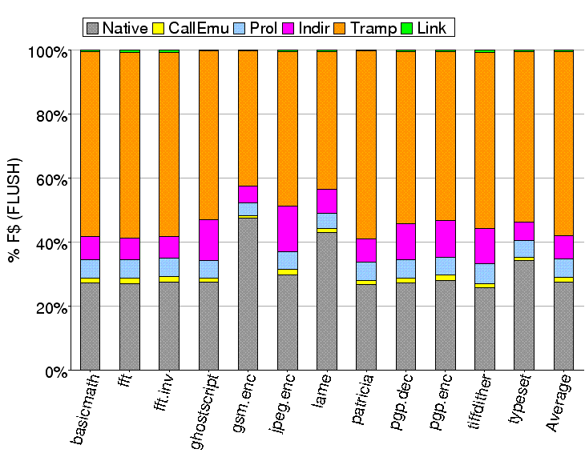
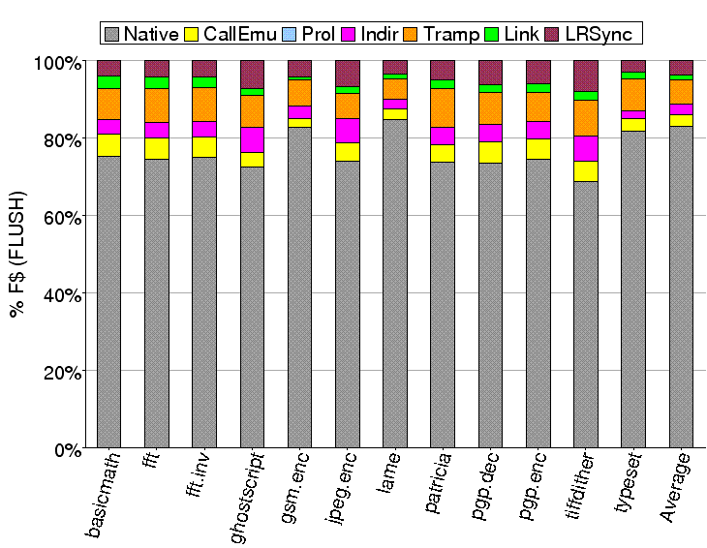
32KB Code Cache Usage
Without Footprint Reduction
  Control code > 70% CC
With Footprint Reduction
  Application code > 80% CC

Slide 25
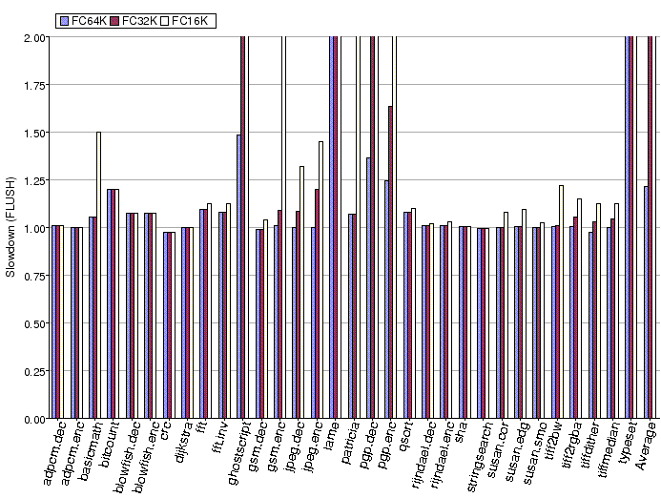
Performance w/Footprint Reduction
MiBench App.
StrataX
F$: SPM (64KB,32KB,16KB)
SimpleScalar
CPU: XScale PXA-270
D-cache: 32KB
Performance similar to
unbounded F$ in SPM
when working set fits
 | 64K-SPM |  | 32K-SPM |  | 16K-SPM
 | Flush | FIFO | Flush | FIFO | Flush | FIFO
Initial | 10x | 9x | 185x | 177x | 643x | 434x
Final | 1.2x | 1.1x | 7x | 6x | 171x | 158x

Slide 26
Fragment Cache Allocation
General-purpose DBT
SW instruction
caching
Heterogeneous Fragment Cache
Main
Memory
MF$
L2-HF$
Instruction
Cache (I$)
address space
Scratchpad
(SPM)
SF$
L1-HF$
Total capacity
DBT overhead
On-chip capacity
Translated code
MM (large)
Low
I$ capacity
~ I$ miss rate
SPM (small)
~ SF$ miss rate
SPM size
Fast
SPM + MM (large)
Low
SPM size + I$ cap.
Fast → ~ I$ miss rate

Slide 27
Heterogeneous Fragment Cache (F$)
App. Binary
Dynamic Binary Translator
L2-HF$
EXEC
Create
Context
Make room
in CC
YES
Cached?
NO
Build
Fragment
Overflow?
New
PC
YES
NO
Link
Fragment
SDRAM
L1-HF$
Restore
Context
BUILD
Destroy
Context
Dispatch
Save
Context
EXIT
FLASH
ROM
SPM
N

Slide 28
Initial HF$ Management
Overflow handling
  Eviction: From any level
    Policies: FLUSH, FIFO, Segmented-FIFO
    Need for fragment unlinking
  Expansion: L2-HF$
    When:
  (# retranslated victims > 0.5 * # victims)
  AND
  (victims did not cause past expansion)
    Linear expansion
HF$
SPM
MM
[miss]
translate
[overflow]
evict
Flash
Initial HCC Design

Slide 29
Initial HF$ Performance
MiBench App.
Similar average slowdowns:
  FLUSH 1.15x
  2KB-Segments 1.14x
  FIFO 1.16x
StrataX
HCC: SPM-4KB +SDRAM-(16+2i)KB
SimpleScalar
CPU: ARM926EJ-S
I-cache: 4KB D-cache: 8KB
I-SPM: 4B

Slide 30
Initial SPM Usage in HF$
Flush 1.35x (5%)
2KB-Segs 1.04x (10%)
FIFO 1.29x (4%)
SPM barely used!
  FLUSH 6.23%, Segmented 7.84%, FIFO 8.36%
Capturing execution on SPM helps (e.g., basicmath)

Slide 31
SPM-aware HF$ Management
SPM
SPM
[overflow]
move
MM
[miss]
translate
MM
[miss]
translate
[overflow]
evict
[overflow]
evict
Flash
Flash
Initial HF$ Mgmt.
SPM-aware HF$ Mgmt.
SPM-Aware Fragment Placement
  New fragments always placed in L1-HCC (SPM)
  At least first fragment execution from SPM
Dynamic Code Partitioning
  Explicit Demotion (SPM→MM): on L1-HCC overflow
  Implicit Promotion (MM→SPM): on retranslation
  Need for fragment relinking

Slide 32
Final HF$ Performance
Improvement with SPM-aware policies:
  FIFO 1.156x, FIFO@L1 1.072x, FIFO/2K-Segs 1.068x
12 of 33 MiBench programs show speedups!

Slide 33
Final SPM Usage in HF$
SPM usage increased:
  FIFO 8.36%, FIFO@L1 42.30%, FIFO/2K-Segs 42.02%
Manage HF$ with SPM-aware policies

Slide 34
F$ in SPM = SW I-cache
App. Binary
Dynamic Binary Translator
Fragment Cache
EXEC
Create
Context
Make room
in F$
YES
Cached?
NO
Build
Fragment
Overflow?
New
PC
YES
NO
Link
Fragment
Restore
Context
BUILD
Destroy
Context
Dispatch
Save
Context
EXIT
FLASH
ROM
SPM
What if “translated code working set” does not fit in SPM?
N

Slide 35
Victim Compression
App. Binary
Dynamic Binary Translator
Fragment Cache
EXEC
Create
Context
Make room
in F$
YES
Cached?
NO
Build
Fragment
Overflow?
New
PC
YES
NO
Compressed?
YES
Decompress
Fragment
Link
Fragment
NO
Restore
Context
BUILD
Destroy
Context
Dispatch
Save
Context
EXIT
FLASH
ROM
SPM
Re-enter translator to build missing fragment
N

Slide 36
Victim Compression
App. Binary
Dynamic Binary Translator
Fragment Cache
EXEC
Create
Context
Make room
in F$
YES
Cached?
NO
Build
Fragment
Overflow?
New
PC
YES
NO
Compressed?
YES
Decompress
Fragment
Link
Fragment
NO
Restore
Context
BUILD
Destroy
Context
Dispatch
Save
Context
EXIT
FLASH
ROM
SPM
Fragment cache is full ➔ compress existing fragments
N

Slide 37
Victim Compression
App. Binary
Dynamic Binary Translator
Fragment Cache
EXEC
Create
Context
Make room
in F$
YES
Cached?
NO
Build
Fragment
Overflow?
New
PC
YES
NO
Compressed?
YES
Decompress
Fragment
Link
Fragment
NO
Compressed
Victim Cache
Restore
Context
BUILD
Destroy
Context
Dispatch
Save
Context
EXIT
FLASH
ROM
SPM
Target fragment found compressed ➔ decompress
N

Slide 38
Victim Compression
App. Binary
Dynamic Binary Translator
Fragment Cache
EXEC
Create
Context
Make room
in F$
YES
Cached?
NO
Build
Fragment
Overflow?
New
PC
YES
NO
Compressed?
YES
Decompress
Fragment
Link
Fragment
NO
Compressed
Victim Cache
Restore
Context
BUILD
Destroy
Context
Dispatch
Save
Context
EXIT
FLASH
ROM
SPM
Translate fragment, return to translated code
N

Slide 39
Victim Compression
App. Binary
Dynamic Binary Translator
Fragment Cache
EXEC
Create
Context
Make room
in F$
YES
Cached?
NO
Build
Fragment
Overflow?
New
PC
YES
NO
Compressed?
YES
Decompress
Fragment
Link
Fragment
NO
Compressed
Victim Cache
Restore
Context
BUILD
Destroy
Context
Dispatch
Save
Context
EXIT
FLASH
ROM
SPM
Link fragments and return to translated code
N

Slide 40
Victim Compression
App. Binary
Dynamic Binary Translator
Fragment Cache
EXEC
Create
Context
Make room
in F$
YES
Cached?
NO
Build
Fragment
Overflow?
New
PC
YES
NO
Compressed?
YES
Decompress
Fragment
Link
Fragment
NO
Compressed
Victim Cache
Restore
Context
BUILD
Destroy
Context
Dispatch
Save
Context
EXIT
FLASH
ROM
SPM
Fragment cache is full ➔ discard compressed fragments
  Otherwise, performance degradation due to smaller F$
N

Slide 41
Victim Compression
App. Binary
Dynamic Binary Translator
Fragment Cache
EXEC
Create
Context
Make room
in F$
YES
Cached?
NO
Build
Fragment
Overflow?
New
PC
YES
NO
Compressed?
YES
Decompress
Fragment
Link
Fragment
NO
Restore
Context
BUILD
Destroy
Context
Dispatch
Save
Context
EXIT
FLASH
ROM
SPM
Fragment cache can now use the entire SPM!
N

Slide 42
Fragment Pinning
Multiple compression/decompression cycles
➔ “lock” needed code in F$
Pinning strategy
  Acquire pin: When fragment found compressed
  Release pin: When total size of pinned fragments >= threshold
Untranslated
On Flash
Executable
In F$
Compressed
In F$
Pinned
In F$

Slide 43
Victim Compression & Pinning
Reduce cost of retranslation
  Compress victim fragments
  Decompress if needed again
Capture frequently executed fragments in F$
  Pin decompressed fragment
  But limit amount of pinned fragments to allow progress
Avg. speedup improvement
  (vs. original Strata with SPM F$):
  SPM-64KB: 1.9x → 2.2x
  SPM-32KB: 1.6x → 2.1x
  SPM-16KB: 0.9x → 1.9x

Slide 44
Demand Paging for NAND Flash
App. Binary
Dynamic Binary Translator
Page Buffer
EXEC
Create
Context
Build Fragment
New
Fragment
NO
Fetch
Cached?
Decode
NO
Build
Fragment
Translate
Finished?
Next PC
New
PC
YES
YES
Link
Fragment
Fragment Cache
Restore
Context
BUILD
Destroy
Context
Dispatch
Save
Context
EXIT
FLASH
ROM
SDRAM
On “fetch”, load page for requested instruction into buffer
  CHALLENGE: how to manage page buffer + fragment cache?
N

Slide 45
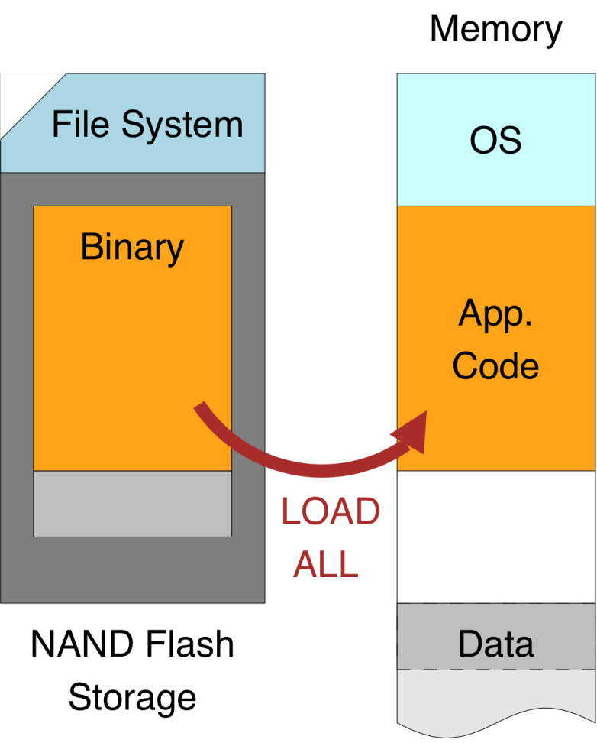
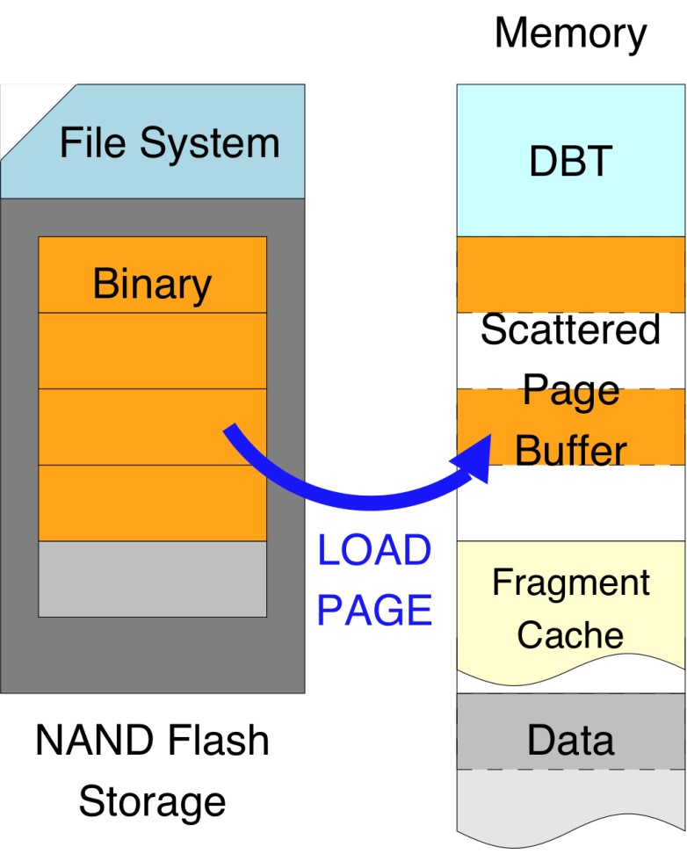
Scattered Page Buffer
Full shadowing without DBT
Demand paging with DBT
using scattered page buffer
Essentially, full shadowing with pages loaded on-demand

Slide 46
Scattered Page Buffer
Fetch steps
Check whether page for requested instruction is already loaded
Load missing page to pre-determined location
Fetch instruction from loaded page
Simple 1-to-1 mapping
  Flash page at fixed location – either there or not
  Low overhead: Quick lookup and no additional data structures
Increases memory overhead
  Footprint: Size of SPB + FC + DBT data structures

Slide 47
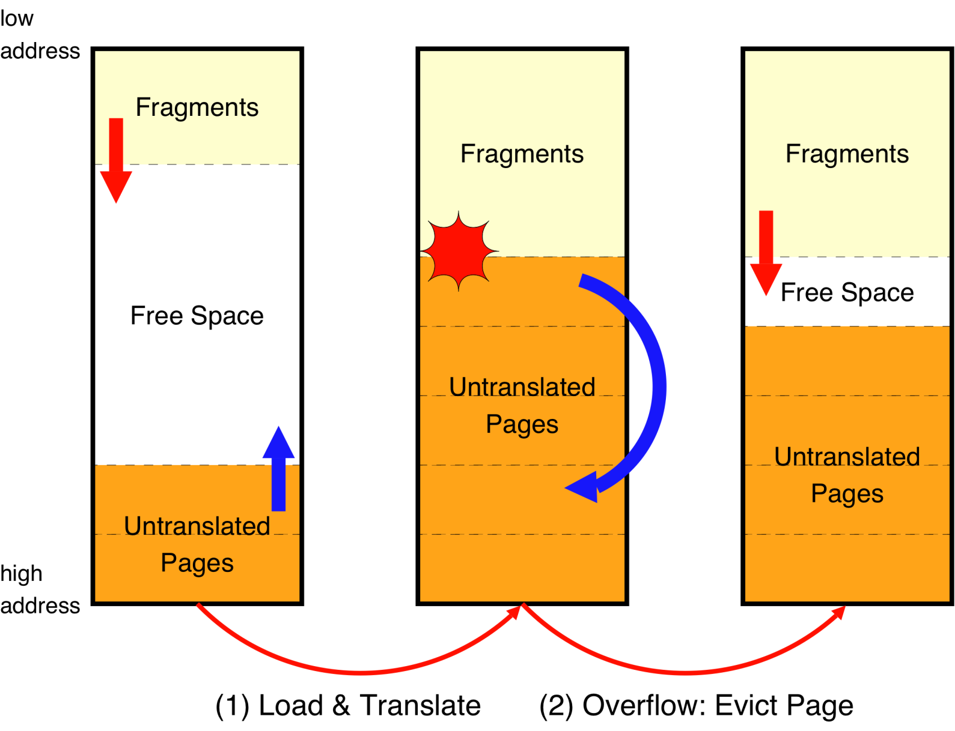
Unified Code Buffer = F$ + PB

Slide 48
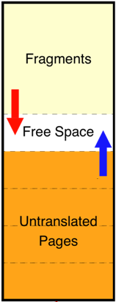
Unified Code Buffer
  Effectiveness depends on:
    Page locality
    Eviction policy (LRU/FIFO)
    UCB capacity
Constrain total DBT footprint
  UCB + DBT data structures ≤ Full shadow size
Performance may be worse
  May need to reload previously seen pages
  Manage data structures, e.g., LRU information

Slide 49
NAND Page Reads
Program | FS | SPB | UCB-75-FIFO | UCB-75-LRU
fft | 92 | 80 | 124 | 120
ghostscript | 2047 | 971 | 971 | 971
lame | 470 | 391 | 534 | 529
jpeg.dec | 277 | 168 | 187 | 183
pgp.enc | 524 | 290 | 292 | 291
susan.cor | 149 | 88 | 91 | 89
Absolute number of page reads with full shadowing (FS), scattered page buffer (SPB) and unified code buffer (UCB) with FIFO and LRU and sized to 75% of binary image.

Slide 50
NAND Page Reads
Program | FS | SPB | UCB-75-FIFO | UCB-75-LRU
fft | 92 | 80 | 124 | 120
ghostscript | 2047 | 971 | 971 | 971
lame | 470 | 391 | 534 | 529
jpeg.dec | 277 | 168 | 187 | 183
pgp.enc | 524 | 290 | 292 | 291
susan.cor | 149 | 88 | 91 | 89
Use FIFO to evict pages from UCB
  Nearly as good as LRU, yet much simpler with less mgmt. cost

Slide 51
Improvement in Boot Time
Boot Time = delay to executing first application instruction
4.41x avg. improvement with UCB-75%

Slide 52
Improvement in Performance
On average, similar performance than shadowing
  Loss in some applications due to memory constraint

Slide 53
StrataX
A low-overhead DBT framework for
embedded systems with scratchpad memory
App. Binary
Dynamic Binary Translator
Page Buffer
EXEC
Create
Context
Make room
in F$
YES
SDRAM
Cached?
NO
Build
Fragment
Overflow?
Fragment Cache
New
PC
YES
NO
Compressed?
YES
Decompress
& Pin Frag.
Link
Fragment
NO
SDRAM
Restore
Context
BUILD
Destroy
Context
Dispatch
Save
Context
EXIT
FLASH
ROM
SPM
N

Slide 54
Conclusions
DBT has many interesting uses for embedded systems
  But performance might be significantly degraded due to memory constraints
StrataX techniques help to achieve reasonable base DBT performance
  Sometimes outperform native execution w/ full shadowing
  Allows imposing hard constraints on memory used for code
StrataX makes it feasible to enable DBT services for embedded systems
  E.g., SPM management as SW I-cache, Demand Paging for NAND Flash

Slide 55
Contributions
Target System-on-Chip Simulator
  Based on SS/PISA + features to support and study DBT
StrataX DBT Framework for Embedded Systems
  Port of Strata to SS/PISA + complex F$ management
  Tuned Fragment Formation Policy: DBB
  Control Code Footprint Reduction: >70% → <20% of F$
  Heterogeneous F$ (SPM + MM), SPM-aware Mngmt. Policies
  F$ in SPM, Victim Compression and Fragment Pinning
  Demand Paging for code in NAND Flash w/o MMU

Slide 56
Questions?
THANK YOU!

Slide 57
Publications
  Fragment Cache Management for Dynamic Binary Translators in Embedded Systems with Scratchpad
  Baiocchi, Childers, Davidson, Hiser and Misurda, CASES 2007
  Reducing Pressure in Bounded DBT Code Caches
  Baiocchi, Childers, Davidson and Hiser, CASES 2008
  Heterogeneous Code Cache: Using Scratchpad and Main Memory in Dynamic Binary Translators
  Baiocchi and Childers, DAC 2009
  Addressing the Challenges of DBT for the ARM architecture
  Moore, Baiocchi, Childers, Davidson and Hiser, LCTES 2009
  Demand Code Paging for NAND Flash in MMU-less Embedded Systems
  Baiocchi and Childers, DATE 2011

Slide 58
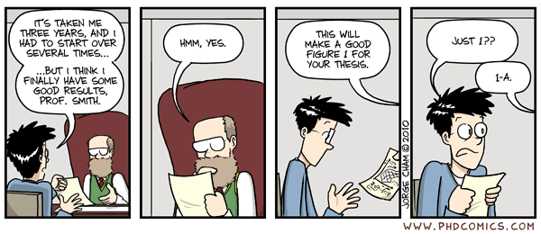
it only took 8 years…

