Slide 1
EMBEDDED SYSTEM IN AUTOMOBILES

Slide 2
CONTENTS
INTRODUCTION
APPLICATION
IN THE DRIVING SEAT
THE DOCTOR WILL SEE
WIRED WEARABLES
DO NOT KEEP YOUR EYES ON ROAD
ADAPTIVE CRUISE CONTROL(A.C.C.)
WORKING PRINCIPLE OF ACC
DOPPLER EFFECT
WORKING OF A.C.C.
ABOUT THE BEAUTY OF A.C.C.
CONCLUSION

Slide 3
INTRODUCTION:-
An embedded system is any device controlled by instructions stored on a chip. These devices are usually controlled by a micro processor that executes the instructions stored on a read only memory (ROM) chip.
The software for the embedded system is called firmware
Embedded systems are also known as real time systems since they respond to an input or event and produce the result within a guaranteed time period

Slide 4
APPLICATONS:-
Vehicle systems for automobiles, subways, aircraft, railways and ships.
Traffic control for highways, airspace, railway tracks and shipping lanes.
Process control for power plants, chemical plants and consumer products such as soft drinks and beer.
Medical systems for radiation therapy, patient monitoring and defibrillation
Military uses such as firing weapons, tracking and command and control.
Manufacturing systems with robots.
Telephone, radio and satellite communications.
Computer games.
Multi media systems that provide text, graphic, audio and video interfaces.
House holds systems for monitoring and controlling appliances.
Building managers that controls such entities as heat, light, Doors and elevators.

Slide 5
EMBEDDED SYSTEM IN A CAR

Slide 6
IN THE DRIVING SEAT:-
Embedded systems can be used to implement features ranging from adjustment of the suspension to suit road conditions and the octane content in the fuel to anti lock braking systems (ABS) and security systems.

Slide 7
THE DOCTOR WILL SEE YOU NOW
Embedded technology advances are pointing towards the use of pace makers that can be transplanted in or near the heart itself. The pacemaker will be able to monitor parameters like blood pressure, blood flow, pulse rate, temperature, etc, using micro sensors planted in various parts of the body.

Slide 8
WIRED WEARABLES:-
Embedded systems have a small foot print and consume very little power which makes them ideal for wearable computing applications.The minimal system requirements of these devices ensure that the hardware is almost microscopic

Slide 9
DON’T KEEP YOUR EYES ON THE ROAD:-
Embedded systems can also make driverless vehicle control a reality. Major automobile manufacturers are already engaged in work on these concepts. One such technology is Adaptive Cruise Control (ACC).

Slide 10
ADAPTIVE CRUISE CONTROL (A.C.C.)
ACC allows cars to keep safe distances from other vehicles on busy highways. The driver can set the speed of his car and the distance between his car and others. When traffic slows down, ACC alters vehicle speed using moderate braking

Slide 11
Each car with ACC has a micro wave radar unit or laser transceiver fixed in front of it to determine the distance and relative speed of any vehicle in the path

Slide 12
THE WORKING PRINCIPLE OF ADAPTIVE CRUISE CONTROL:-
As each car with ACC have a micro wave radar unit fixed in front of it to determine the distance and relative speed of any vehicle in it’s path. The principle behind the working of this type of radar is- THE DOPPLER EFFECT

Slide 13
DOPPLER EFFECT:-
Doppler Effect is the change in frequency of the waves when there is a relative motion between the transmitting and receiving units. The Doppler Effect can be categorize in two ways:-
Higher Pitch Sound
Lower Pitch Sound

Slide 14
1. HIGHER PITCH SOUND
In this case the vehicle is speeding towards the stationary listener. The distance between the listener and the car is decreasing. Then the listener will hear a higher pitch sound from the car, which means the frequency of sound, is increased

Slide 15
LOWER PITCH SOUND:-
In this case the vehicle is moving away from the listener. The distance between and the car is increasing. Then the listener will hear a lower pitch sound from the car, which means the frequency of sound, is decreased. So that is the Doppler Effect in case of sound waves.

Slide 16
WORKING OF A.C.C.:-
In the above case, the gun transmits the waves at a given frequency toward an oncoming car. Reflecting waves return to the gun at a different frequency, depending on how fast the car being tracked is moving. A device in the gun compares the transmission frequency to the received frequency to determine the speed of the car.

Slide 17
We can design the chip or ACC having an algorithm such that it will give output only when the input signals are less than the corresponding safe distance value. So only when the between the car and the object in front of it is less then the same distance value the embedded system will give output to the breaking and the accelerating units. Thus the safe distance will be kept always. That’s how the ACC works.

Slide 18
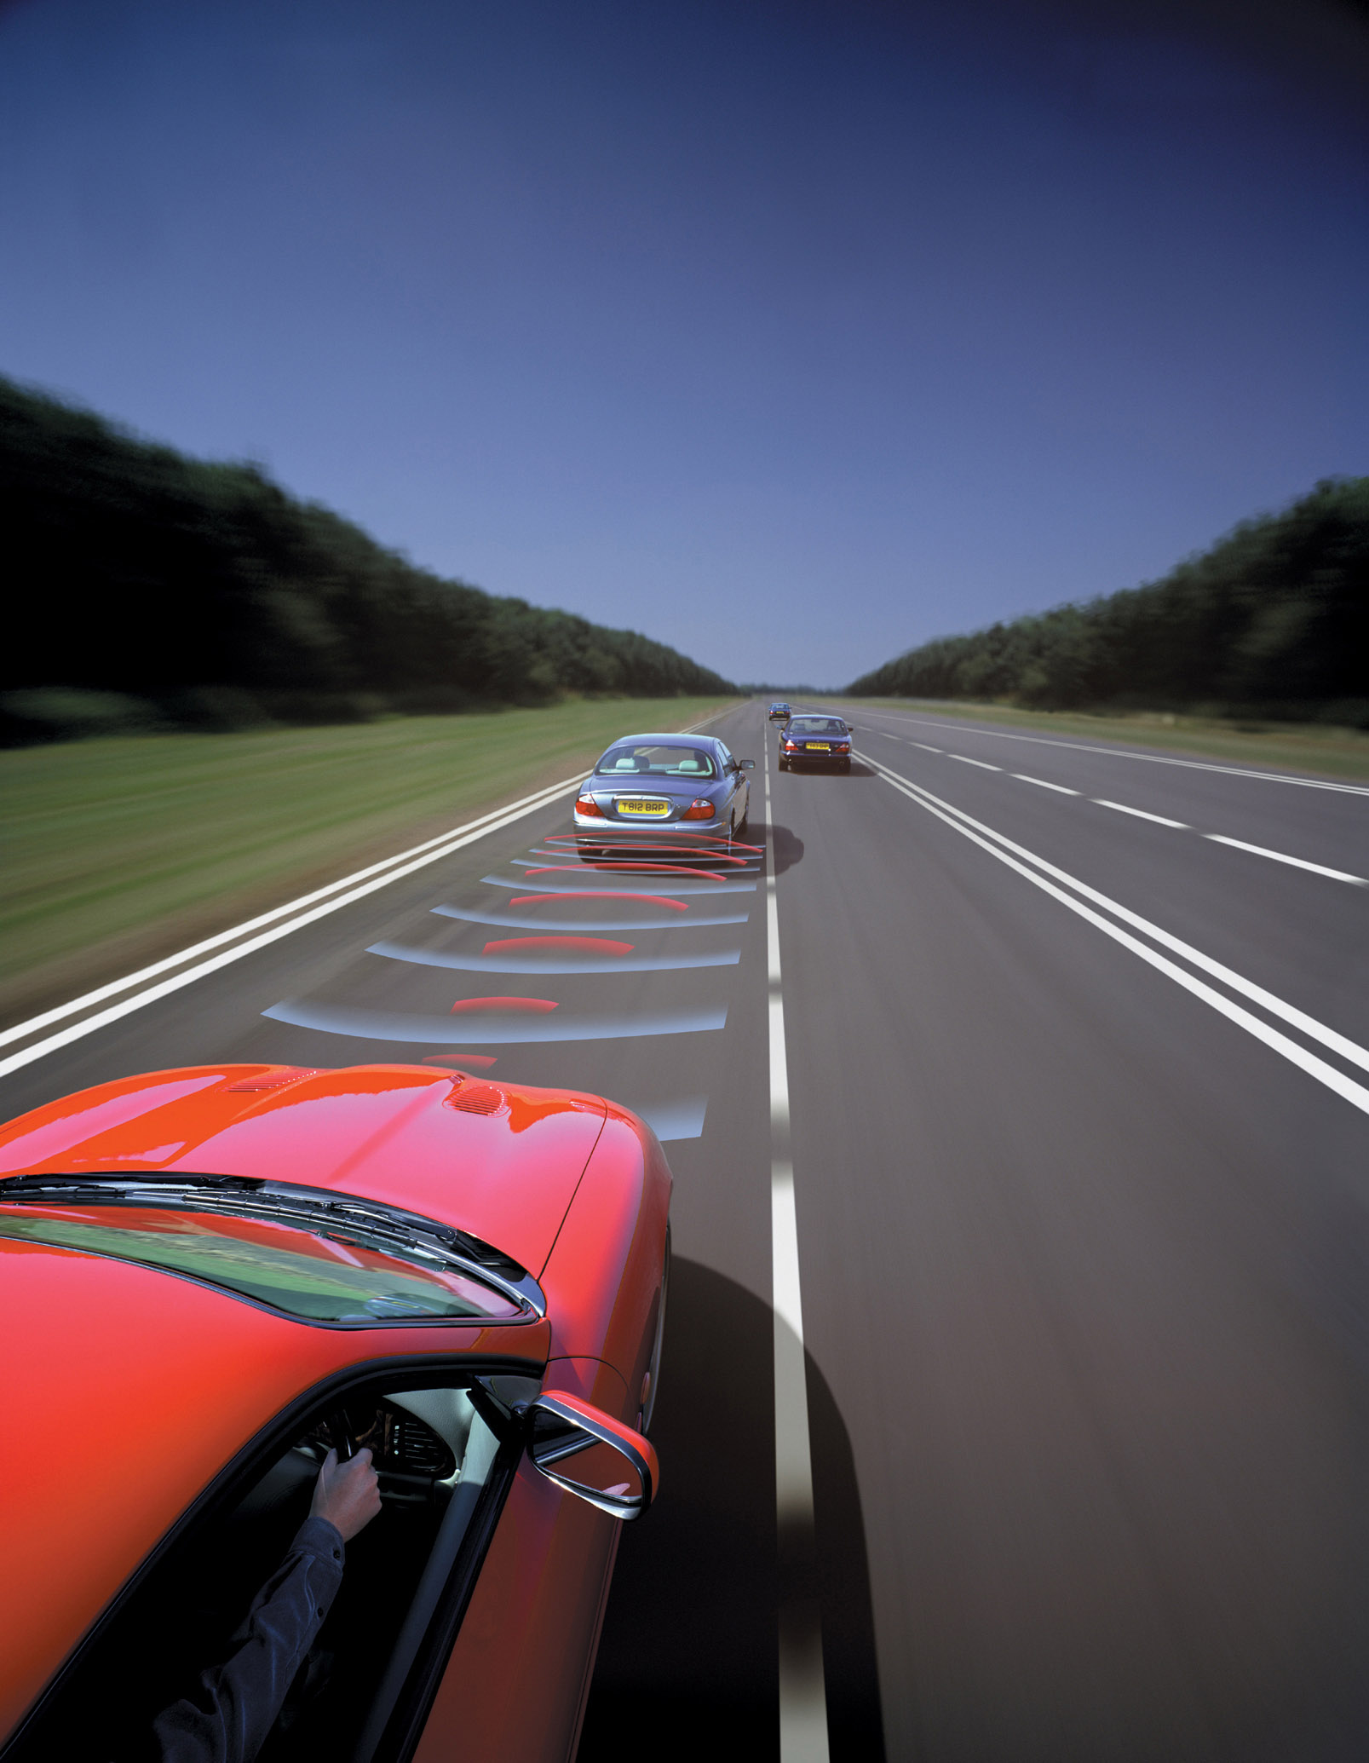

Slide 19
ABOUT THE BEAUTY OF ADAPTIVE CRUISE CONTROL
At a safe distance behind, your car settles to a speed matching that of the driver in front of you. That’s too slow, so after a look in your rear view mirror you pull into the empty outside lane and feel the acceleration as your car speeds up to the preset cruising speed. You still haven’t press the accelerator pedal. That’s the beauty of this racing star of the auto industry, a millimeter- wave radar technology that promises to make driving easier.

Slide 20
CONCLUSION:-
Embedded systems can be used to implement features ranging from the way pacemakers operate and mobile phone that can be worn as jewellery to adaptive cruise control (ACC).

Slide 22
QUERRIES

