Slide 1
Tracing based iris recognition
AVDHESH CHAUHAN
y08uc035

Slide 2
AIM
To create and Implement a fast algorithm for IRIS segmentation which will be free of specular refection and non-circular nature of iris.
Who stands
in front of
the Camera
Image Aquistion
Image Segmentation
IRIS representation as feature set
Database
Database Query

Slide 3
APPROACH
Image Acquisition
Eye Portion Removal
Pupil Extraction
Eyelash Removal
IRIS Boundary Finding
Pupil Boundary Detection

Slide 4
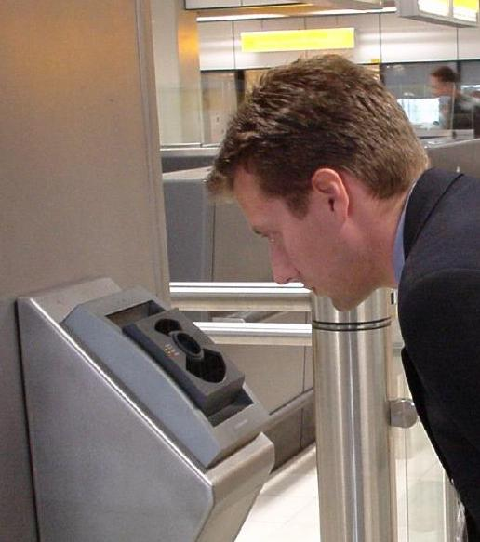
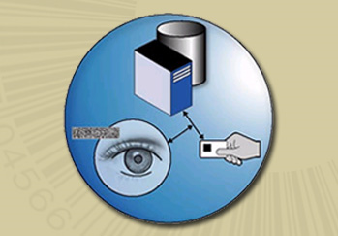
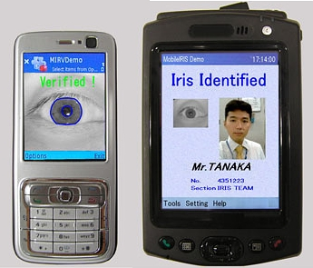
APPLICATIONS

Slide 5
CHALLENGES
Removal of Eyelash which extends beyond the cornea to the Iris portion of the eye.
Removal of uneven Luminosity while taking Eye Image.
Difference in the color of eyes of Asian (have black iris, so hard to differentiate from black pupil) and American (have blue/green iris, so easy to differentiate form the black pupil) people.

Slide 6
Course of Progress
26th Oct
Analysis of Papers published
Implementation of approach
5th Nov
Coding on Database
Testing
16th Nov
Demonstration of Code
FINAL REPORT

