Slide 1
Bandwidth
Chapter 3

Slide 2
This presentation will:
Help you understand the following terms and concepts:
Bandwidth
Bottlenecks
Importance of bandwidth

Slide 3
Introduction
The demand for information has led to a rapid growth of online technology.
Developments are being made all the time and the introduction of Web 2.0 has led to a better online service.
However, this increase in services has come at a cost:
The amount of data we now download has increased which is putting a strain on our infrastructure.
Companies like BT are having to invest £Billions in order to improve our online service.
Virgin Media have invested somewhere in the region of £100,000,000!

Slide 4
Introduction
The amount of data we download isn’t the only issue.
The British Government have announced that they want to dramatically increase the number of people using the internet by 2012.
This increase of users will inevitably mean that the internet slows down for most users as traffic on our infrastructure increases.

Slide 5
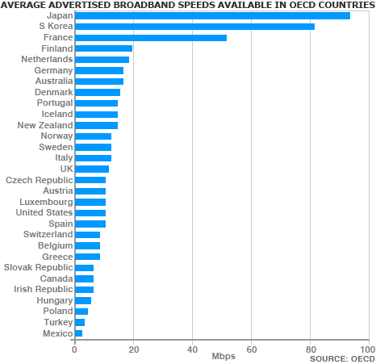
Average Broadband Speeds
This graph shows clearly how far behind the UK is in terms of broadband speeds.
Sources taken from BBC website.

Slide 6
Bandwidth
The term bandwidth is used when talking about how much data can be transferred along a communication channel.
Officially, bandwidth is measured in frequency (Hz) but, more commonly, it is referred to in bit rates.
For example, many companies claim that they can provide users with up to 8Mbps connections. This indicates that the line is capable of transmitting data at rate of 8 megabits per second.
This speed is rarely reached due to bottlenecks in the system.

Slide 7
Bandwidth Explained
Think of bandwidth in terms of a road.
As traffic increases data is not able to move through the communication devices as quick...
You might even get a few collisions along the way meaning data needs to be sent out again!
Bandwidth could be linked to the number of lanes on the road. The more lanes the faster traffic can flow through...less chance of a traffic jam!!

Slide 8
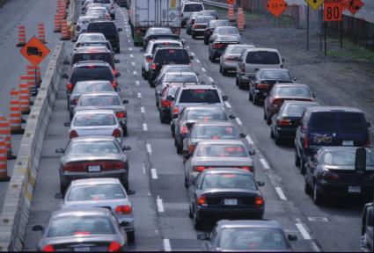
Bottlenecks
Bottlenecks occur when you move from a fast communication device to a slower one.
When this happens you have a lot of data travelling down the line that has to slow down because of the slower device.
Imagine coming across some road works on the motorway.
Traffic slows down because 3 lanes changes to two. The bandwidth has decreased.

Slide 9
Bottlenecks
Your maximum download rate is set at the speed of the slowest bottleneck.
Imagine pouring water out of a bottle and trough three funnels.
The water may start flowing quickly from A...but it will only reach B at the speed at which it can leave the narrowest funnel!
A
As bottle necks occur data transfer is slowed.
B

Slide 10
Importance of bandwidth
The amount of bandwidth you need depends on the type of applications you are trying to use.
Emailing requires small amounts of bandwidth as only a small amount of data is being transmitted.
Video conferencing requires lots of bandwidth because the quantity of data being transmitted is high.
Many people think you need amazingly fast internet connections to play games...which isn’t the case.
Games do send a lot of data but not as much as video conferencing...

Slide 11
Importance of bandwidth
Another aspect to factor in is when the user will access the content they downloaded.
If they user is downloading an MP3 they will have to wait for the content to download regardless of their internet speed.
The end experience is the same...the only difference is the time it takes to download...

Slide 12
Important of bandwidth
Live streaming is a different issue though.
Applications like Spotify allow users to stream audio and YouTube allows users to stream video.
These applications rely more heavily on a faster internet connection.
At the end of the day, the required bandwidth is determined by what types of data the user wants to upload and download.

Slide 13
Activities
Describe the term bandwidth using the following writing frame:
If a user has an 8Mb connection why might it take 30 seconds to download 1MB of data?
Give two examples of why you might need a high bandwidth connections.
Why might it not be important to have a high bandwidth connection if you are downloading MP3 files?
Identify | Amplify | Exemplify
Bandwidth

