Slide 1
Social Media and Family Law
Mining Social Media for Evidence in Family Law Cases
Anne Johnson Mead, Attorney At Law

Slide 2
What is Social Media?
Definition: Forms of electronic communication (as Web sites for social networking and microblogging) through which users create online communities to share information, ideas, personal messages, and other content (as videos).
--Merriam-Webster, n.d. Web. 16 Dec. 2013.

Slide 3
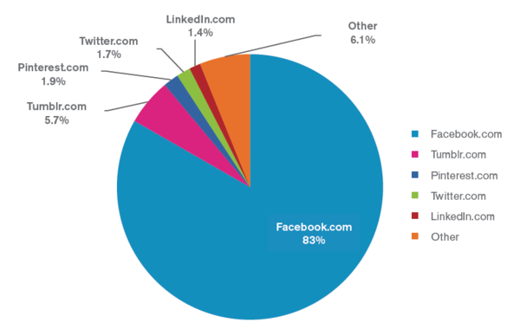
Most Popular Social Media Sites
Aquino, Carmela. "Putting the Digital Future in Focus: Key Trends That Will Shape the U.S. Digital Industry in 2013" ComScore, Inc. N.p., 19 Feb. 2013. Web. 01 Dec. 2013.

Slide 4
What is Facebook?
Definition: Facebook is an online social networking service. Its name comes from a colloquialism for the directory given to American university students.
-- Wikipedia
See photos and updates from friends in the News Feed
Share what’s new in your life on your Timeline
25% of Facebook users don’t look at Privacy Settings

Slide 5
What is Twitter?
Definition: Twitter is an online social networking and microblogging service that enables users to send and read "tweets", which are text messages limited to 140 characters.
-- Wikipedia

Slide 6
What is LinkedIn?
Definition: LinkedIn is a social networking website for people in professional occupations. It is mainly used for professional networking.
-- Wikipedia

Slide 7
Evidence in Family Law Cases

Slide 8
Relevant Evidence in Family Law Matters
Grounds for Divorce
Division of Marital Property
Dissipation of Marital Property
Parental Fitness
Income / Income Potential / Employment

Slide 9
Informal Discovery of Family Law Evidence
Basic information available on Facebook:
Photos - images of a witness or opposing party for service or surveillance
Status updates - check-ins, wall posts, time and date sensitive information
Friends and related information – friends lists, wall posts by others, tagging in photos and at locations, group memberships

Slide 10
Informal Discovery of Family Law Evidence
Basic information available on LinkedIn:
Online resume
photos
Employment history and current employment
Professional connections
Educational background
Degrees, licensures, certifications

Slide 11
Discovery of Family Law Evidence
Other sources of information
Google (name search and photo search)
Google +
Instagram
Tumblr
YouTube
Dating sites

Slide 12
Discovery of Family Law Evidence
Formal Discovery: Interrogatories, Requests for Production of Documents, Depositions
Make sure your terms and definitions adequately define the information you want from each
Narrowly tailor your requests. See Holly Potts v. Dollar Tree Stores, Inc. (M.D. Tenn. March 20, 2013): “The Sixth Circuit has not yet ruled on the scope of discovery of private Facebook pages, but other courts hold that . . .the Defendant does not have a generalized right to rummage at will through information that Plaintiff has limited from public view. Rather, consistent with Rule 26(b) . . . [and decisional law] . . . there must be a threshold showing that the requested information is reasonably calculated to lead to the discovery of admissible evidence. Otherwise, the Defendant would be allowed to engaged in the proverbial fishing expedition, in the hope that there might be something of relevance in Plaintiff's Facebook account.”
Request that the other party identify all social media accounts, and be prepared and willing to identify your client’s accounts

Slide 13
Discovery of Family Law Evidence
Preservation of Data
Inception of the case or prior to filing:
The litigation hold letter
consent order concerning the preservation of electronic data on specified devices and within specified social media accounts
Forensic imaging of specified devices to ensure preservation, when social media has been used on said devices
Consider the expense of same and how it will be shared

Slide 14
Important Issues When Mining for Social Media Evidence
Procedure and Ethics

Slide 15
Procedural Issues
Tennessee Rule of Civil Procedure 37.06: Electronically Stored Information
If a party fails to provide electronically stored information and a motion to compel discovery is filed, a judge should first determine whether the material sought is subject to production under the applicable standard of discovery. If the requested information is subject to production, a judge should then weigh the benefits to the requesting party against the burden and expense of the discovery for the responding party, considering such factors as: the ease of accessing the requested information; the total cost of production compared to the amount in controversy; the materiality of the information to the requesting party; the availability of the information from other sources; the complexity of the case and the importance of the issues addressed; the need to protect privilege, proprietary, or confidential information, including trade secrets; whether the information or software needed to access the requested information is proprietary or constitutes confidential business information; the breadth of the request, including whether a subset (e.g., by date, author, recipient, or through use of a key-term search or other selection criteria) or representative sample of the contested electronically stored information can be provided initially to determine whether production of additional such information is warranted; the relative ability of each party to control costs and its incentive to do so; the resources of each party compared to the total cost of production; whether the requesting party has offered to pay some or all of the costs of identifying, reviewing, and producing the information; whether the electronically stored information is stored in a way that makes it more costly or burdensome to access than is reasonably warranted by legitimate personal, business, or other non-litigation-related reasons; and whether the responding party has deleted, discarded or erased electronic information after litigation was commenced or after the responding party was aware that litigation was probable.

Slide 16
Ethical Issues
Social Media and Your Client
RULE 3.4: Fairness to Opposing Party and Counsel: A lawyer shall not: (a) unlawfully obstruct another party's access to evidence or unlawfully alter, destroy, or conceal a document or other material having potential evidentiary value. A lawyer shall not counsel or assist another person to do any such act;
Do not instruct your client to edit, alter or destroy social media accounts
See Lester v. Allied Concrete: Plaintiff’s attorney instructed a paralegal to have the client clean up his Facebook page because “we don’t want any blow-ups of this stuff at trial.” The trial court sanctioned the attorney in the amount of $542,000, and Plaintiff in the amount of $180,000.
Do instruct your client to
Preserve social media content
review privacy settings, most importantly to control with whom he or she is sharing information in each social media account
Consider, going forward, whether you would want your Judge or Chancellor to see your postings, pictures or tweets

Slide 17
Ethical Issues
Social Media and Opposing Party or Third Party
Rule 4.2 Communication with a Person Represented by Counsel: In representing a client, a lawyer shall not communicate about the subject of the representation with a person the lawyer knows to be represented by another lawyer in the matter, unless the lawyer has the consent of the other lawyer or is authorized to do so by law or a court order.
Rule 4.3 Dealing with an Unrepresented Person: In dealing on behalf of a client with a person who is not represented by counsel, a lawyer shall not state or imply that the lawyer is disinterested. When the lawyer knows or reasonably should know that the unrepresented person misunderstands the lawyer's role in the matter, the lawyer shall make reasonable efforts to correct the misunderstanding. The lawyer shall not give legal advice to an unrepresented person, other than the advice to secure counsel, if the lawyer knows or reasonably should know that the interests of such a person are, or have a reasonable possibility of being, in conflict with the interests of the client.
Making contact with a person through social media can be interpreted as communication, depending on several factors which should be considered before initiating contact.

