Slide 1
Object-Orientation Meets Big Data
Language Techniques towards Highly-Efficient Data-Intensive Computing
Harry Xu UC Irvine

Slide 2
Big Data Applications
Large-scale, data-intensive applications are pervasively used to extract useful information from a sea of data items
Three categories of applications
Dataflow frameworks such as Hadoop, Hyracks, Spark, and Storm
Message passing systems such as Giraph and Pregel
High-level languages such as Pig, Hive, AsterixDB, FlumeJava

Slide 3
Big Data, Big Challenges
All of these applications (except for Spark) are written in Java
Spark is written in Scala but relies on JVM to execute
Huge performance and scalability problems

Slide 4
Example Performance Problems
The implementations of PageRank in Giraph, Spark, and Mahout all failed to process 500MB data on a 10GB heap
Numerous complaints on poor performance and scalability can be found on various mailing lists and programming Q/A sites (e.g., stackoverflow.com)
47% of the execution time for answering a simple SQL query is taken by GC
More details can be found in our ISMM’13 paper

Slide 5
What is Happening?
Excessive object creation is the root of all evils
Each object has a header (space overhead)
Each object is subject to GC traversal (space and time overhead)
A Java program makes heavy use of data structures that use pointers to connect objects (space and time overhead)
Object-oriented developers are encouraged to create objects

Slide 6
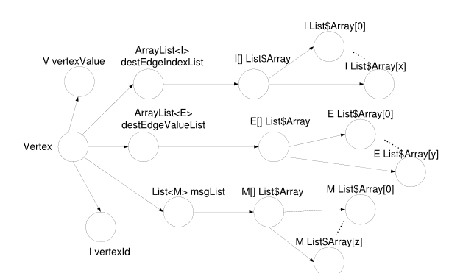
Consequences
Low packing factor
Suppose each vertex has m outgoing edges and n incoming edges
The space overhead of the vertex is 16( m + n ) +148
The actual data only needs 8( m + n ) + 24
Large GC costs
A Java hash table can contain millions of objects in a typical Big Data application

Slide 7
Our Proposal
Stage I: an bloat-free design methodology
A buffer-based memory management technique
A bloat-free programming model
Stage 2: provide compiler support
Automatically transform a regular Java program into a program under the bloat-free design
Various static/dynamic analysis and optimization techniques will be developed
Stage 3: provide maintenance support
Design novel algorithms for analysis, debugging, testing etc. to reduce maintenance costs

Slide 8
Buffer-based Memory Management
Key to designing a scalable Big Data application is to bound the number of objects
It cannot grow proportionally with the size of the input data set
Allocate data items in buffers, which themselves are Java objects (e.g., java.nio.ByteBuffer)
Data items in a buffer have similar lifetimes and can be discarded all together at the end of the iteration in which they are processed

Slide 9
Accessor-based Programming Model
Data are all in buffers now
We create objects only to represent accessors (not data items)
An accessor can bind itself to different data items (i.e., reuse)
For each type of data structure, we form an accessor structure, in which each accessor accesses a data item

Slide 10
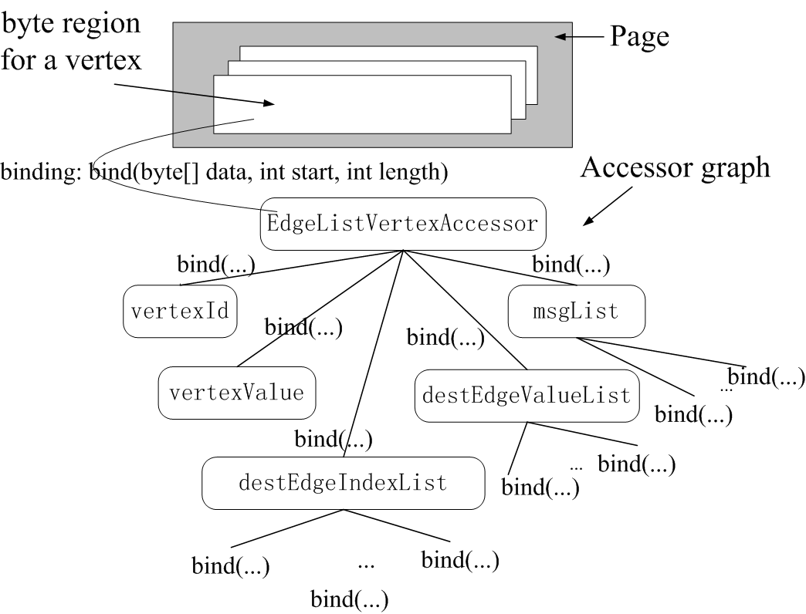
Accessor Structure

Slide 11
An Initial Evaluation of Performance on PageRank
The bloat-free version scales well with the size of the data set
All the object-based implementations run out of memory at the 10 GB scale

Slide 12
The Current Status
This is joint work with the database group at UCI, particularly
Vinayak Borkar, Yingyi Bu, and Michael Carey
We are between stage 1 and stage 2

Slide 13
Why not switch back to An Unmanaged Language
A typical Big Data application exhibits clear separation between control path and data path
A control path takes the majority of the development effort
Our study on 6 Big Data applications shows that on average 64% of the LOC is in the control path
A data path creates the majority of the heap objects
More than 90% of the heap objects is created by a data path
Can we enjoy both the benefit of a managed language for a control path and the high performance for a data path?

