Slide 1
FPGA Global Routing Architecture
Dr. Philip Brisk
Department of Computer Science and Engineering
University of California, Riverside
CS 223

Slide 2
Effect of the Prefabricated Routing Track Distribution on FPGA Area-Efficiency
V. Betz and J. Rose,
IEEE Trans. VLSI 6(3): 445-456, Sep. 1998

Slide 3
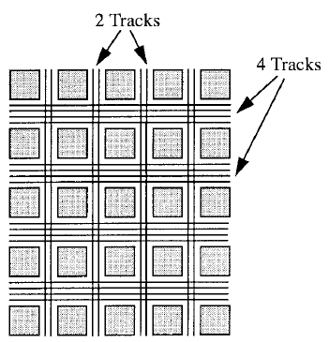
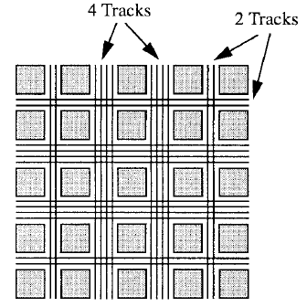
Directional Bias and Non-uniformity ®
Directional Bias
Non-uniformity

Slide 4
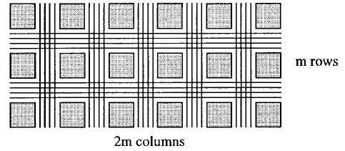
FPGA Aspect Ratio
Rectangular architectures increase the device perimeter
… which in turn increases the I/O to logic ratio

Slide 5
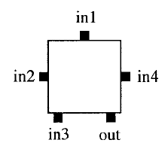
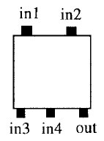
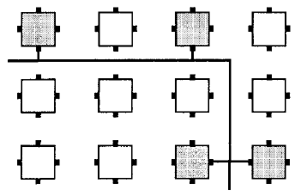
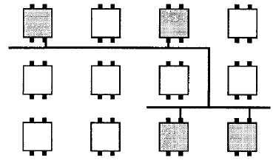
Logic Pin Positions
Full Perimeter
Top-Bottom

Slide 6
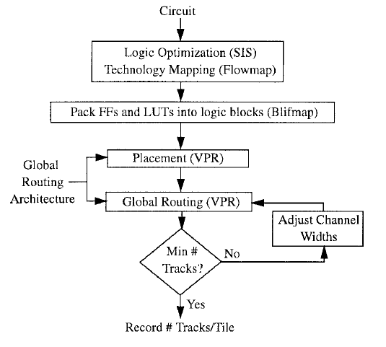
CAD Flow
Vary channel width via binary search
Determine the min. channel width that yields a legal routing solution
For directional bias and non-uniformity, maintain the correct ratios throughout the search
Report averages for multiple benchmark circuits

Slide 7
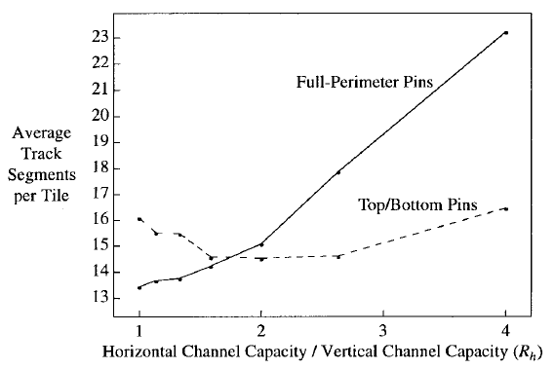
Directional Bias / Square FPGA
Optimal directional bias for full-perimeter pins is square
Full-Perimeter
Top-Bottom
8%
Optimal directional bias for top/bottom pins is 2:1

Slide 8
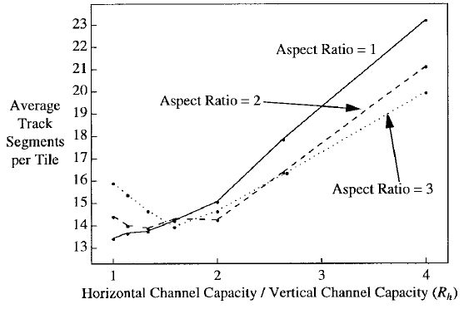
Area Efficiency vs. Aspect Ratio
(w/Full-perimeter pins)
The most area efficient directional bias increases as the aspect ratio of the FPGA increases
Square is most area-efficient

Slide 9
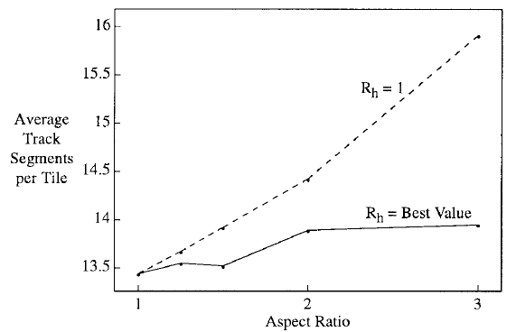
Area Efficiency vs. Aspect Ratio
As long as horizontal and vertical channel widths are appropriately balanced, aspect ratios (I/O counts) can be increased with minimal impact on core area

Slide 10
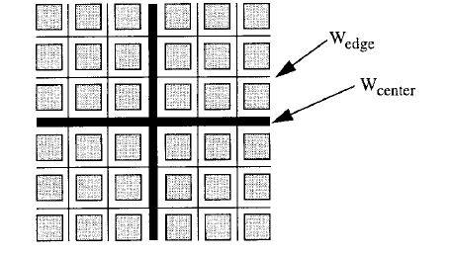
Extra-wide Center Channels
R_{W} = W_{center} / W_{edge}
R_{C}: Ratio of the number
of channels having
width W_{center} to those
having width W_{edge}

Slide 11
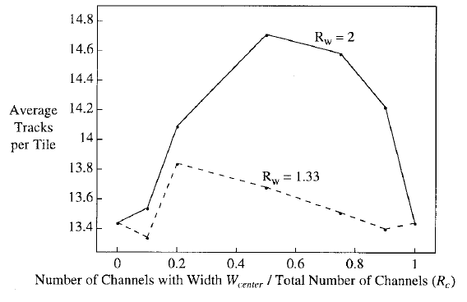
Effect of R_{W} and R_{C} on Area Efficiency
Greatest area efficiency for (near)-uniform architectures

Slide 12
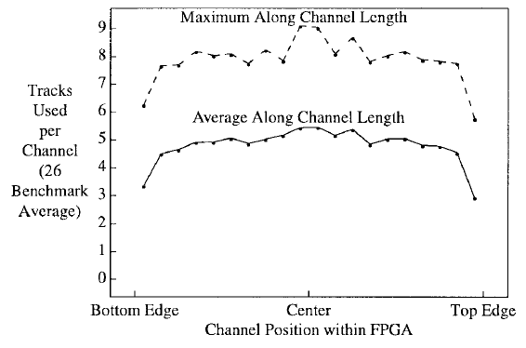
Are FPGAs More Congested Near the Center?
Not significantly!

Slide 13
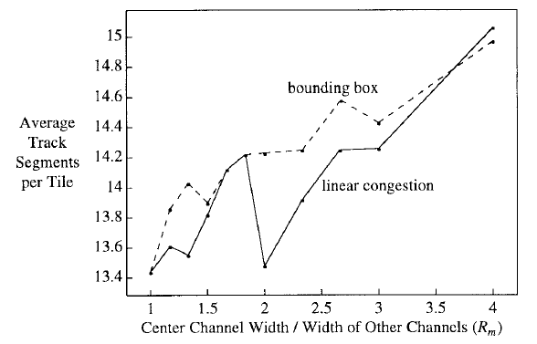
One Extra-Wide Center Channel?
Placement
Objective #1
Placement Objective #2
That looks like a pretty good design point!

Slide 14
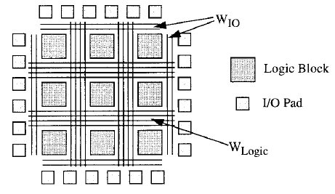
I/O Channels
R_{I/O} = W_{I/O} / W_{Logic}

Slide 15
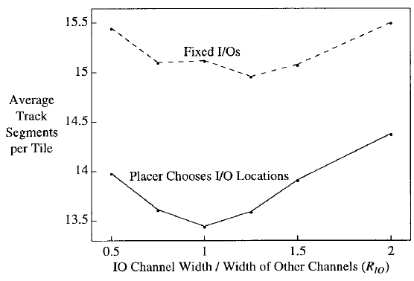
Routability vs. R_{I/O}
(Overly constrained placer)
Avg. 12%
Favors a uniform
allocation of
resources across
the chip

Slide 16
Conclusion
Highest area-efficiency achieved with completely uniform channel capacities across the chip
  Reason: Circuits tend to have routing demands that are spread uniformly across the chip
Pin placement on logic blocks should match channel capacity distribution
Caveat: Results are specific to THIS CAD flow, e.g., placement and routing algorithms, objectives, etc.

Slide 17
FPGA Routing Architecture: Segmentation and Buffering to Optimize Speed and Density
V. Betz and J. Rose,
International Symposium on FPGAs, 1999

Slide 18
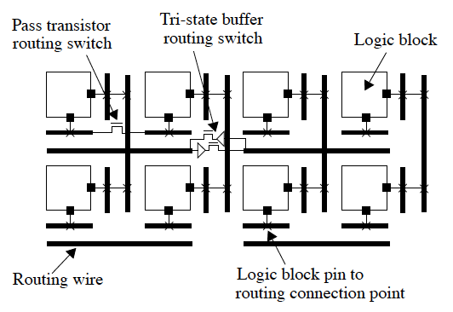
FPGA Routing Architecture

Slide 19
Wire Length Tradeoff
Too many short wires?
  Long connections will use many short wires
  Switches connect wires
    Increase delay; increase power/energy
Too many long wires?
  Short connections will use long wires
    Degrade speed, waste area

Slide 20
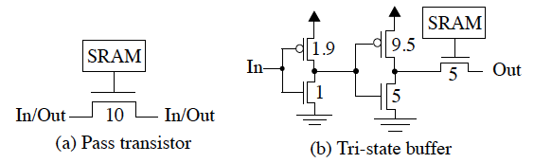
Pass Transistors vs. Tristate Buffers
Less area
Fast for short connections
Better for connections that pass through many switches in series

Slide 21
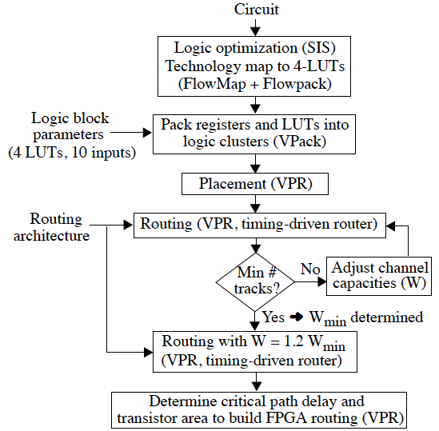
CAD Flow

Slide 22
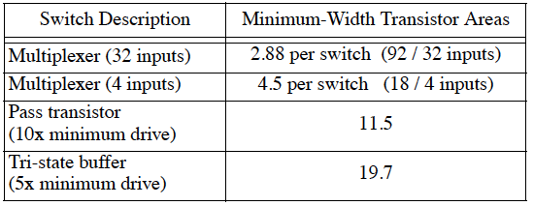
Switch Options

Slide 23
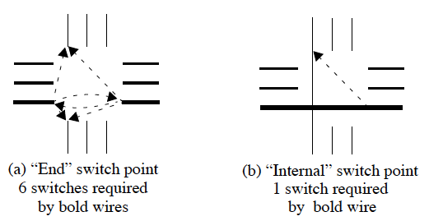
“End” vs. “Internal” Switches

Slide 24
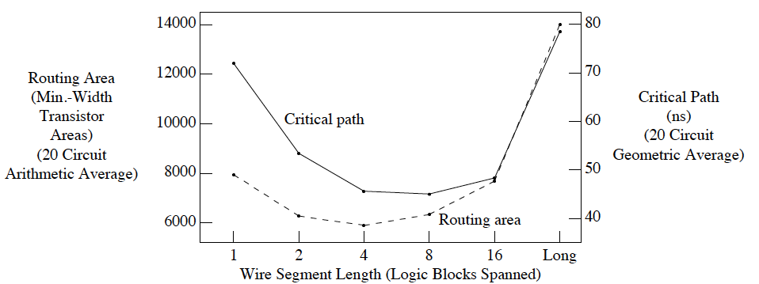
Uniform Wire Segment Length
Long connections
must pass through
too many buffers
Short connections
must use long wires
For long connections metal
resistance degrades speed
Longer wires are less flexible; more tracks per channel needed to route

Slide 25
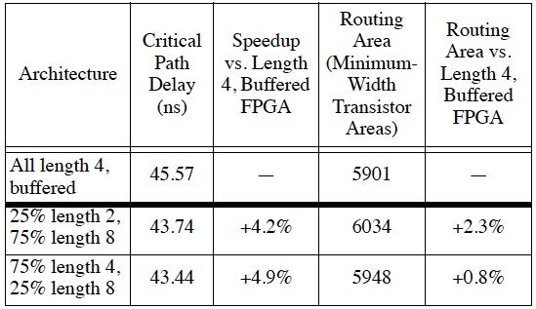
Varying Wire Lengths
“[L]ength 4 wires provide an efficient way to make both long and short connections!”

Slide 26
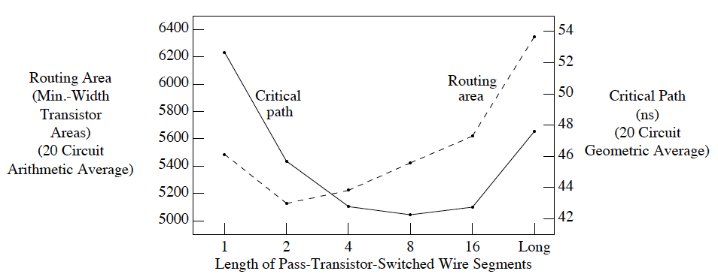
Heterogeneous Routing Architecture
50% of routing tracks are length-4 and are connected by buffered switches
50% have other lengths and are connected by pass transistors
Sweet spot?
Best for speed
Best for area

Slide 27
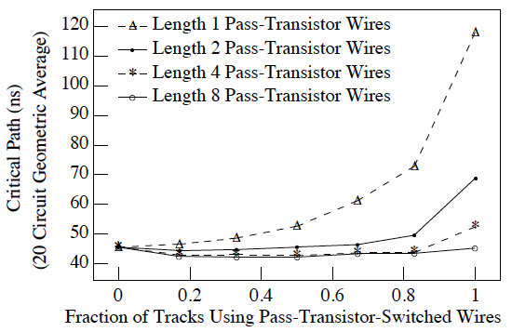
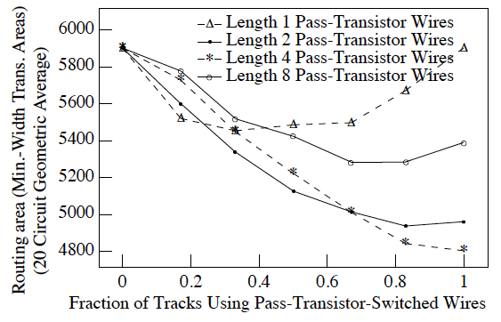
Heterogeneous Routing Architecture
X% of routing tracks are length-4 and are connected by buffered switches
(100 – X)% have other lengths and are connected by pass transistors
To increase speed, make 17-83% of routing tracks pass-transistor-switched wires
Increasing the fraction of routing tracks using length 2, 4, or 8 pass-transistor wires improves FPGA area efficiency up to ~83%

Slide 28
More Observations (no Charts)
The best area/delay result is when the pass-transistor switched wires have length 4 or 8
The best architectures contain 50-80% pass-transistor-switch routing tracks
  The 50% pass-transistor architectures give the best speed
  The 83% pass-transistor architecture yield the best area efficiency

Slide 29
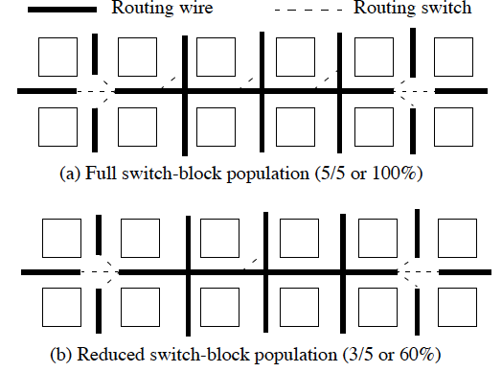
Long Wires / Switch Block Population

Slide 30
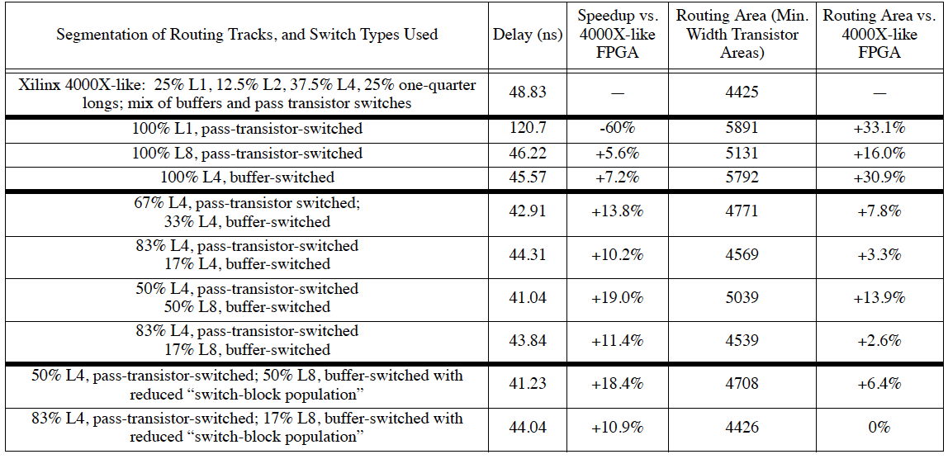
Lots of Data

Slide 31
Conclusion
FPGAs should contain wires of moderate length
  4 to 8 logic block
Mix of tri-state buffers and pass transistors is beneficial
  The router (CAD tool) needs to know the difference
Reducing switch-block internal population reduces area
  2.5% to 7.5%
Significant overall improvements compared to Xilinx XC4000X
  In retrospect: that architecture died a long time ago

Slide 32
Should FPGAs
Abandon the Pass-Gate?
C. Chiasson and V. Betz
International Conference on Field Programmable Logic and Applications (FPL), 2013

Slide 33
Key Issues
It isn’t 1999 anymore
  Pass transistor performance and reliability has degraded as technology has scaled
Transmission gates
  Larger, but more robust, than pass transistors

Slide 34
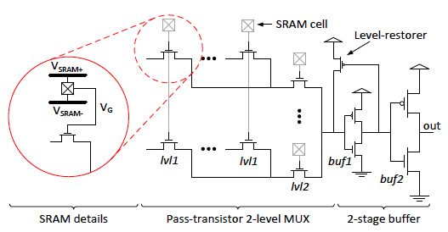
Pass Transistor

Slide 35
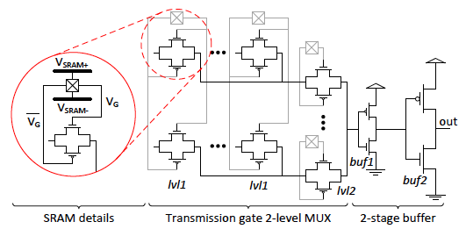
Transmission Gate
Gate Boosting: V_{SRAM+} > V_{DD}

Slide 36
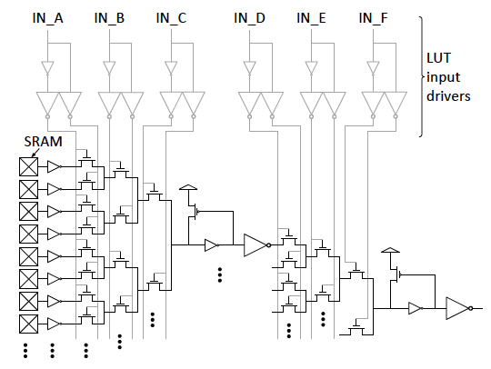
6-LUT w / Internal Rebuffering

Slide 37
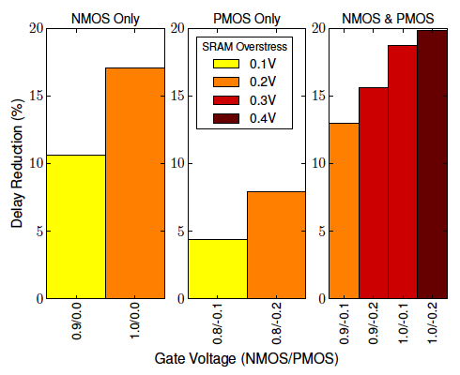
Gate Boosting (Switch Block Mux)

Slide 38
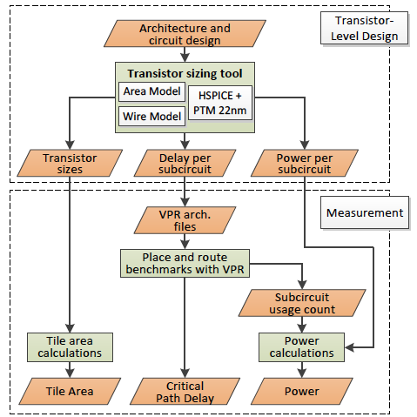
CAD Flow

Slide 39
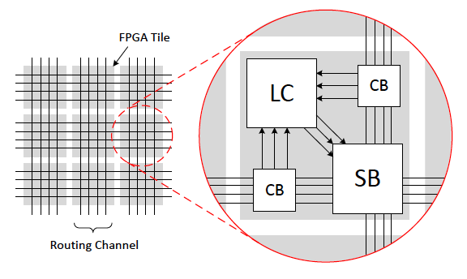
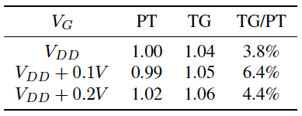
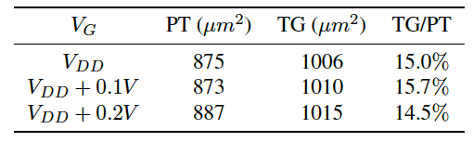
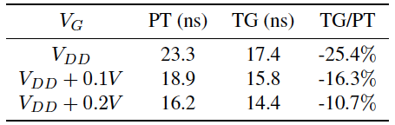
FPGA Tile Area, Avg. Critical Path Delay, and Power (VTR Benchmarks)
Avg. Power
Avg. Critical Path Delay
Tile Area

Slide 40
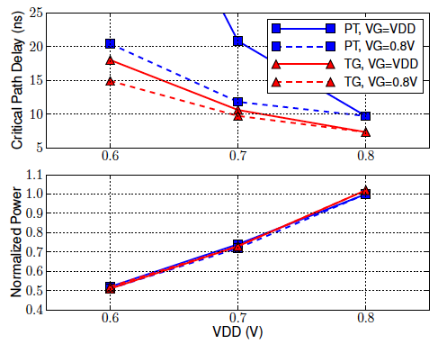
Critical Path Delay and Dynamic Power with Decoupled V_{DD} and V_{G}

Slide 41
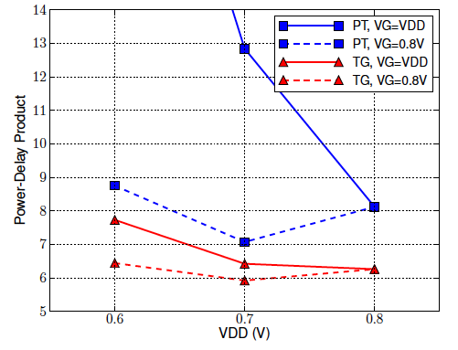
Power-Delay Product with Decoupled V_{DD} and V_{G}

Slide 42
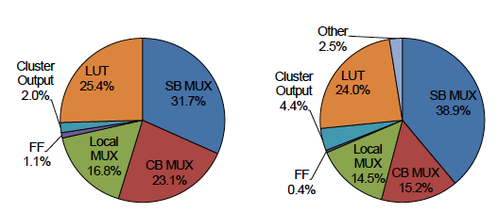
Tile Area and Critical Path Delay
Tile Area
Critical Path

Slide 43
Conclusion
Transmission gate vs. Pass-transistor FPGAs
  15% larger
  10-25% faster, depending on “gate boosting”
Transmission gate with a separate power supply for gate terminal (decoupled results)
  50% power reduction with good delay

Slide 44
Directional and Single-Driver Wires in FPGA Interconnect
G. Lemieux, et al.
International Conference on Field Programmable Technology (ICFPT), 2004

Slide 45
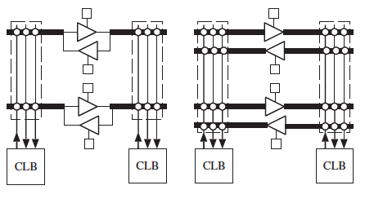
Uni- and Bi-directional Wires

Slide 46
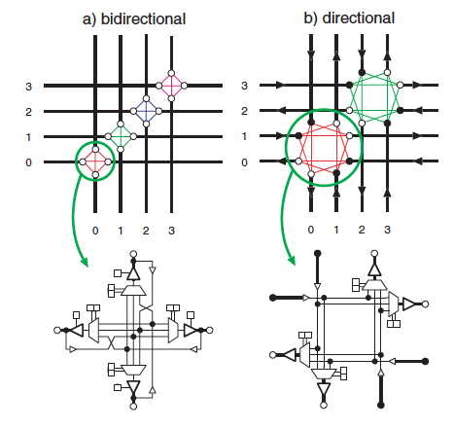
Switch Block (Length-1 Wires)

Slide 47
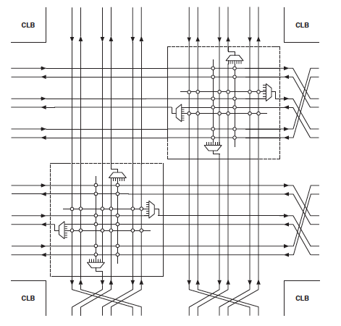
Directional Switch Block
(Length-3 Wires)

Slide 48
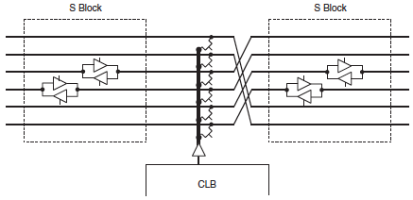
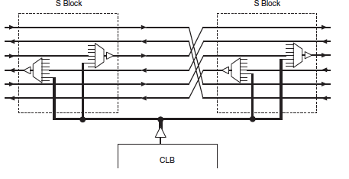
Uni- and Bidirectional CLB Outputs

Slide 49
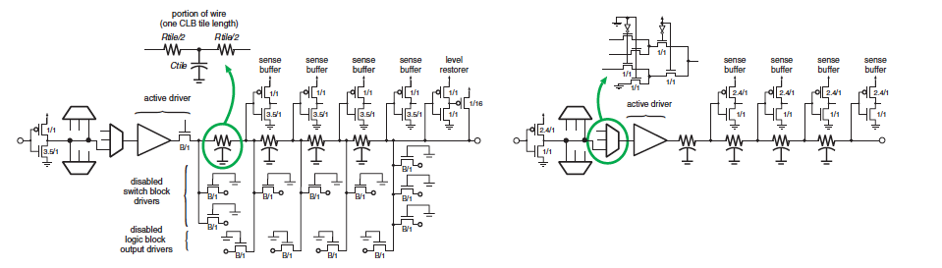
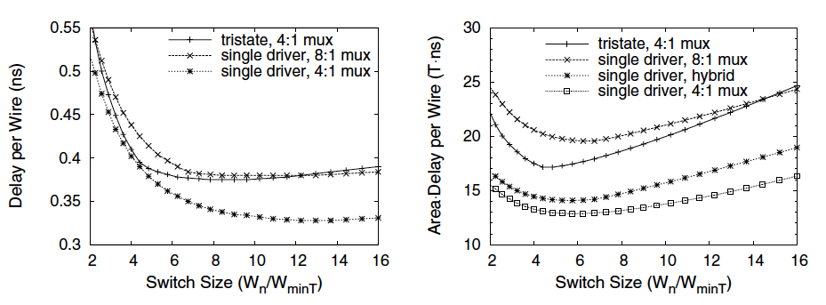
HSPICE Models
Tri-state
Single-driver switching elements

Slide 50
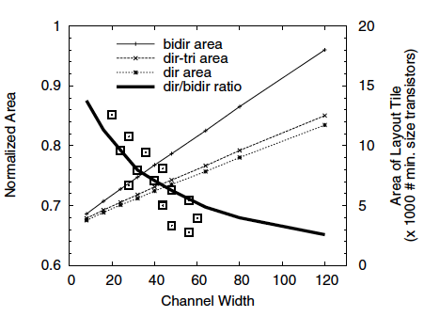
Area Overhead
Area savings (15-34%, per benchmark) increases
as channel width increases
Bidir : Bi-directional wires; tri-state switches
Dir-tri : Directional wires, tri-state switches
Dir : Directional wires, single-driver switches

Slide 51
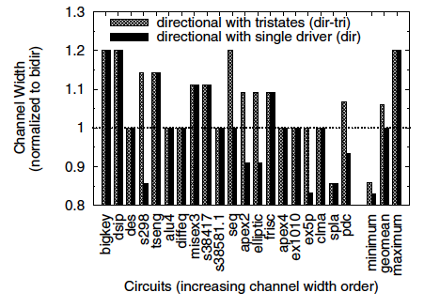
Channel Width (Normalized to bidir)
dir-tri requires up to 20% more tracks per channel than bidir
  17% fewer tracks for spla
dir requires fewer tracks than dir-tri
  Better CLB output connectivity

Slide 52

Transistor Count (Normalized to bidir)
dir-tri yields 20% area savings
  Reducing transistor count reduces CLB area, which tile length
  (Average shrink length is 14%)
dir reduces wire capacitance by 37% by eliminating tri-state drivers

Slide 53

Critical Path Delay (Normalized to bidir)
dir-tri increases delay by 3% on average
  Fanout degradation
dir reduced delay by 9% on average
  dir connects to equal # of tracks per direction (no fanout degradation)
  Lower capacitance due to length shrinkage

Slide 54
Conclusion
Directional, single-driver wiring yields:
  25% area savings (15-34% for individual circuits)
  9% delay reduction (4-16% for individual circuits)
  32% area-delay product (23-45% for individual …)
  37% capacitance reduction
No impact on channel width
Minimal advantage to mixing uni- and bi-directional wires in the same device

Slide 55
Automatic Generation of FPGA Routing Architectures from High-Level Descriptions
V. Betz and J. Rose
International Conference on FPGAs, 2000

Slide 56
Parameters
Number of logic block input and output pins

Slide 57
Parameters
Sides of the logic block from which each I/O pin is accessible

Slide 58
Parameters
Number of I/O pads per row/column

Slide 59
Parameters
Switch Block topology (next lecture)

Slide 60
Parameters
Percentage of tracks to which each CLB input connects (F_{c,in})

Slide 61
Parameters
Percentage of tracks to which each CLB output connects (F_{c,out})

Slide 62
Parameters
F_{c} Values for I/O Pads (F_{c,pad})

Slide 63

Parameters
Wire segment types
  Length
  % of tracks per channel of this type
  Switch type (pass-transistor, tri-state buffer)
  Switch block and connection block internal population density

Slide 64
Parameters for Delay Extraction
I/O capacitance, equivalent resistance, and intrinsic delay for each switch type
Capacitance and resistance of each wire segment type
Delays of all combinational and sequential elements in a logic block
I/O pad delay

Slide 65

Routing Resource Graph (RRG)
(Needed by the Router)

Slide 66
Challenges
Many FPGA architectures may satisfy the parameters
  We want a GOOD architecture that satisfies them
Satisfying all parameters may be difficult or impossible
  E.g., F_{c,in} = 100% AND C-block population = 40%

Slide 67
Approach
Generate C Block for all 4 sides of each CLB
Generate I/O C Block
Generate S Block
Replicate each
pattern and stitch
them together
to form the 2D
array (FPGA)

Slide 68
C Block Generation Challenges
Each of the W tracks in a channel should be connected to approximately the same number of CLB input and output pins
Each pin should connect to a mix of different wire types (e.g., wires of different lengths)
Pins that appear on multiple sides of the CLB should connect to different tracks on each side
Logically equivalent pins connect to different tracks

Slide 69

Pathological Switch Topologies
Nets starting at out1 can only reach in1
Nets starting at out2 can only reach in2

Slide 70

More Routable Topology
Nets starting at either output can reach either input

Slide 71


Unsatisfiable Topology
1. W = 3 tracks per channel
2. All wires have length L=3
3. Each wire has internal switch population of 50%
4. Disjoint switch box topology
5. Routing switches can only connect to the end of a wire segment

Slide 72

Adjust the Segment Start Points

Slide 73


Single Layout Tile

Slide 74

Example Architecture Description

Slide 75


Entire FPGA (Left) / Close-up (Right)

Slide 76

Segment Distribution

Slide 77

Complex Routing Architecture

Slide 78
Conclusion
Parameterized architecture generation yields efficient design space exploration
  Vaughn Betz and colleagues formed RightTrack CAD Corp., which was bought by Altera
  RightTrack’s software was then used to design the Stratix II (killing the Stratix in the process)
  Stratix III, IV, V are clear evolutions of the Stratix II

