Slide 1
FPGA Security and Cryptographic Application Generating Stream Cyphers
Shemal Shroff
Shoaib Bhuria
Yash Naik
Peter Hall

Slide 2
outline
Introduction to Security
Relevance to FPGA
Design and Manufacture flow for an FPGA
Things to secure and why?
Types of Attack
Prevention
PUFs

Slide 3
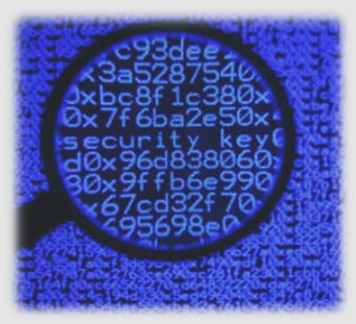
What is Security (from a networking aspect)?
Provisions and policies adopted by a network administrator
To prevent and monitor:
  Unauthorized access,
  Misuse,
  Modification,
  Denial of a computer network and network-accessible resources.
Simmonds, A; Sandilands, P; van Ekert, L (2004). "An Ontology for Network Security Attacks". Lecture Notes in Computer Science. Lecture Notes in Computer Science 3285: 317–323
Notes:
Network security^{[1]} consists of the provisions and policies adopted by a network administrator to prevent and monitor unauthorized access, misuse, modification, or denial of a computer network and network-accessible resources

Slide 4

How is it relevant to an FPGA?
Research on “FPGA Security” has been active since the early 2000s.
Several commercial and military applications employ programmable logic.
This makes design security important for safety and national security.
WP365, Solving Today’s Design Security Concerns, Xilinx White Paper.
Notes:
Moreover, with the ever-expanding usage of FPGAs in products and systems of all
kinds, FPGAs often form the core of any system. This rise in both the usage and
importance of FPGAs in a system make protecting the IP contained in FPGAs as
important as protecting the data processed by the FPGA.

Slide 5

Why would someone attack the FPGA?
To learn the confidential cryptographic key.
One-to-one copy or “cloning” together with its key.
Reverse engineering of encryption algorithm.
Execute certain cryptographic operation with presumably secret key.
  E.g. pay-tv and in-government communications
Thomas Wollinger and Christoff Paar, Security Aspects of FPGAs in Cryptographic Applications in New Algorithms, Architectures and Applications for Reconfigurable Computing, Springer, 2005, Ch. 21, pp 265-278.
Notes:
After this slide add a slide on things that need to be secured in FPGA.
The most common threat against an implementation of a cryptographic algorithm is to learn a confidential cryptographic key.
At times, the sole criteria is to simply execute certain cryptographic operation with presumably secret key.

Slide 6
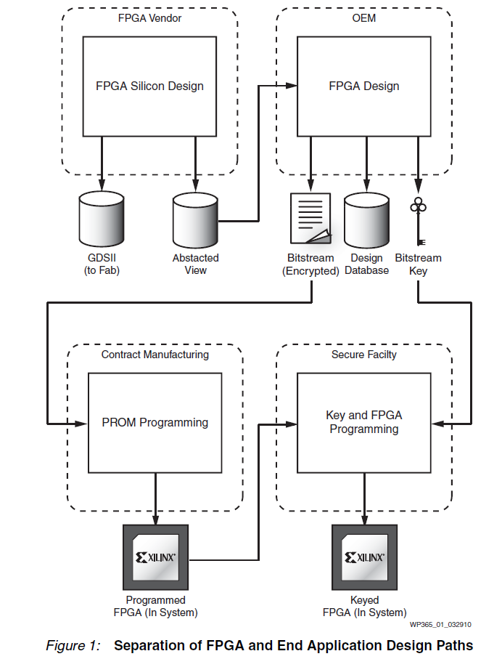
Saar Drimer, Volatile FPGA Design Security – A Survey, v0.96, April 2008.
Notes:
By their very nature, FPGAs are a secure platform for design because device manufacture is separated from end-application design by an original equipment manufacturer (OEM), and end-product manufacture is handled separately.
With an FPGA, therefore, separation of knowledge bases is intrinsic to the nature of
the device and its method of implementation:
• The device supplier handles the design and manufacture of the unprogrammed
silicon but does not have access to the end application.
• Conversely, the end-application designer does not have access to the details of
how the FPGA base device is designed, nor to its internal security structures. The
application design engineer sees only a software-abstracted view of the device.
• Product manufacturing can be given only an encrypted bitstream and a bill of
material (BOM), and therefore has knowledge neither of the end-application
design nor the FPGA design.
• Programming of the bitstream decryption key can be handled in a secure facility
separate from product manufacturing—for example, during final test by the OEM
or other trusted third party.
In contrast, with a custom device, the end-application designer and the manufacturer
(fab) have complete details of the device structure and function. Additionally, a
custom device can be “de-lidded,” the process of chemically or mechanically
removing one layer at a time. Using this method, the entire design database can be
recovered. Performing the same process on an FPGA might recover the structure of
the device, but in the unprogrammed state. No customer data is compromised.

Slide 7
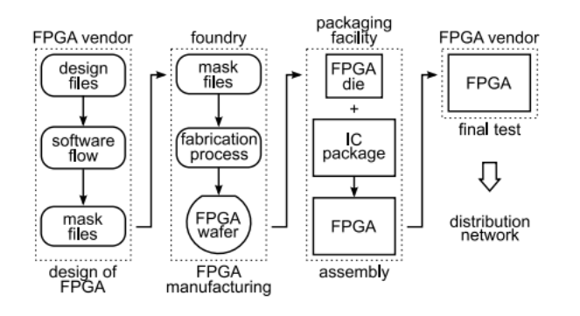
Design and manufacture flow
Figure: Simplified depiction of the FPGA design, manufacturing, packaging, and testing processes.
Saar Drimer, Volatile FPGA Design Security – A Survey, v0.96, April 2008.
Notes:
“A principal is an entity that participates in a security system. This entity can be a subject, a person, a role, or a piece of equipment, such as a PC, smartcard, or cardreader terminal“

Slide 8
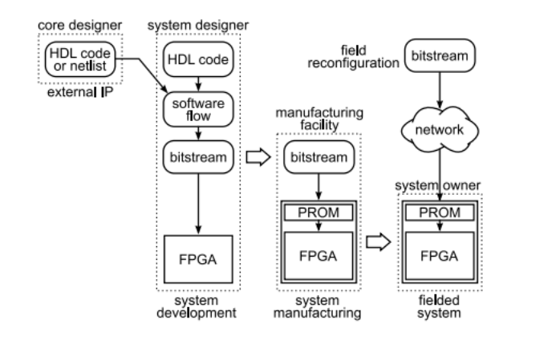
Development, manufacturing and distribution of an fpga-BASED SYSTEM
Figure: Development, manufacturing, and distribution of an FPGA-based system.
Saar Drimer, Volatile FPGA Design Security – A Survey, v0.96, April 2008.
Notes:
The system developer must be assisted by several other principals such as manufacturers, and cores and EDA vendors. At the end of the development cycle the product is in the system owner's hands.
Security-wise, FPGA vendors have two dominant concerns. Firstly, they need to protect
their own proprietary designs and technology from being reverse engineered, copied,
exposed, or modied. Secondly, they need to provide their customers means to protect
their own designs throughout the design ow and in the eld.

Slide 9
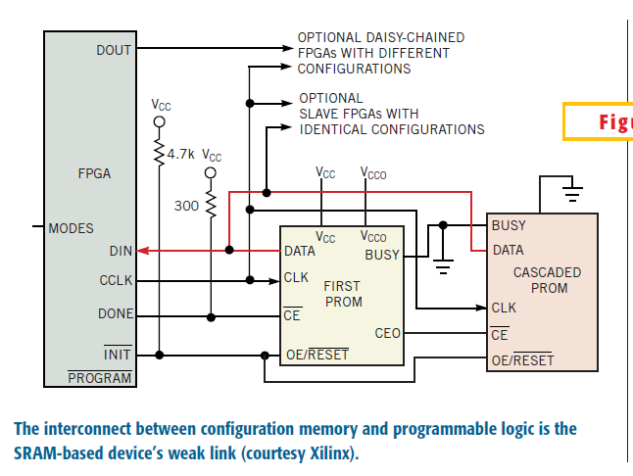
Weakest link in SRAM-based devices
B. Dipert. Cunning circuits confound crooks. http://www.e-insite.net/ednmag/contents/images/21df2.pdf, October 12 2000.

Slide 10
Things to secure in FPGA
Bitstream
Configuration of the device
Notes:
A set of bits containing the functionality of the fpga. The way it is suppose to work for a given functionality.

Slide 11
Why do you need to secure a bitstream?
Bitstream has all the configuration bits required for programming the FPGA.
If the bitstream is compromised then your design can be cloned or reverse engineered.

Slide 12
Why do you need to secure the configuration of the FPGA?
To protect the logic of FPGA
To prevent manipulation of design using JTAG.
Single Event Upset (SEU) or faults
Verify that the application is trusted to be correct.
Authenticate the application.

Slide 13
Types of attack
Attacks
Bitstream
Black box Attack
Reverse engineering
Configuration of the device
Fault injection
Cloning of sRAM FPGAs
Readback Attack
Side Channel Attack
Hardware virus
Manipulating design through JTAG
Voltage modification
Temperature modification

Slide 14
Type of bitstream Attacks
Black Box Attack
Reverse-Engineering of the Bitstreams
Cloning of sRAM FPGAs
Readback Attack
Side Channel Attacks
Notes:
Modify types of attacks.

Slide 15
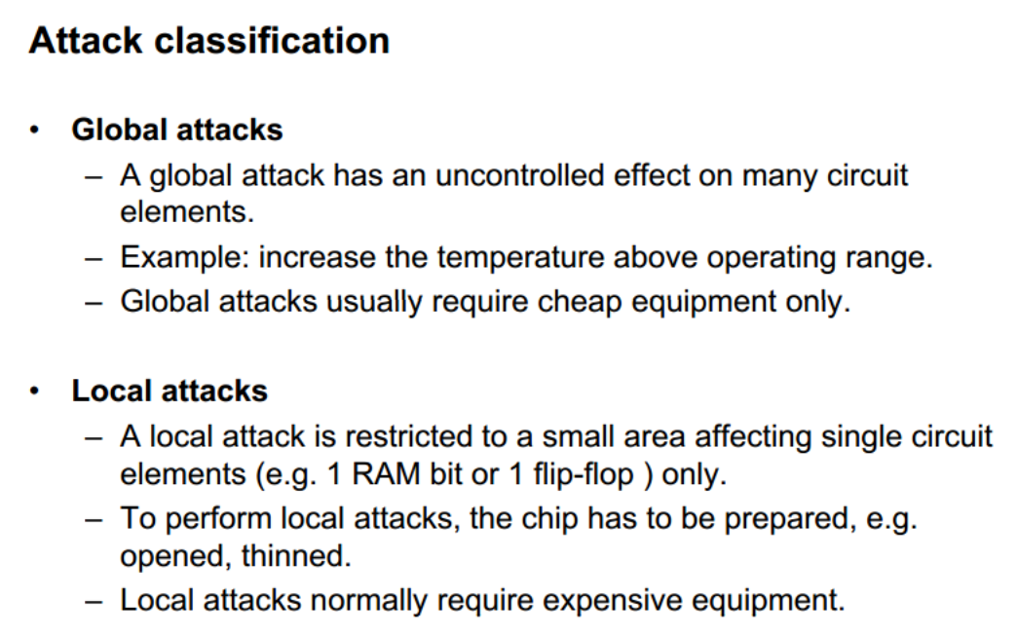
classification

Slide 16

1. Black Box Attack
Step 1: The attacker inputs all possible combinations, while saving the corresponding outputs.
Step 2: Develops a K-map to simplify the resulting tables
Step 3: Extracts the logic of the FPGA.
Thomas Wollinger and Christoff Paar, Security Aspects of FPGAs in Cryptographic Applications in New Algorithms, Architectures and Applications for Reconfigurable Computing, Springer, 2005, Ch. 21, pp 265-278.
Notes:
This attack is only feasible for small FPGAs.
The reverse engineering effort grows and becomes less feasible as the size and complexity of the FPGA increases.

Slide 17
Example
A | B | C | Output (Y)
0 | 0 | 0 | 0
0 | 0 | 1 | 0
0 | 1 | 0 | 1
0 | 1 | 1 | 0
1 | 0 | 0 | 0
1 | 0 | 1 | 0
1 | 1 | 0 | 0
1 | 1 | 1 | 0
C AB | 00 | 01 | 11 | 10
0 | 0 | 1 | 0 | 0
1 | 0 | 0 | 0 | 0

Slide 18
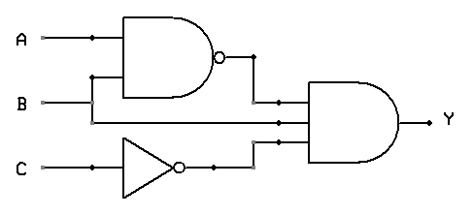
Logic Circuit
Y = (A.B)’.B.C’
= A’BC’

Slide 19
Prevention
Not a real threat nowadays, due to:
  complexity of the designs
  size of state-of-the-art FPGAs.
Common I/O pins which makes it difficult to connect to the right pin.
An attacker has to connect to device’s pin of a known function like,
  Microprocessor interrupt input,
And also,
Figure out whether to:
  Drive a pin with a voltage,
  Sense its output state, or both isn’t a straightforward exercise.
B. Dipert. Cunning circuits confound crooks. http://www.e-insite.net/ednmag/contents/images/21df2.pdf, October 12 2000.
Thomas Wollinger and Christoff Paar, Security Aspects of FPGAs in Cryptographic Applications in New Algorithms, Architectures and Applications for Reconfigurable Computing, Springer, 2005, Ch. 21, pp 265-278.

Slide 20

Complexity of the Black Box Attack
We have, in total, $2^{64}$ input combinations.
Lets assume that latency for the adder is 10 ns.
Therefore, time to apply all the combinations is $2^{64}$x10 ns.
This takes approximately 5849 years which is equivalent to 5.849 x ${10}^{11}$ hours.
A = 32 bits
Adder
B = 32 bits
Output

Slide 21
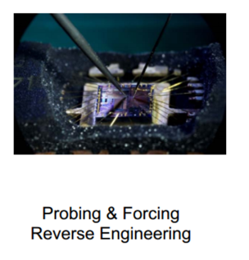
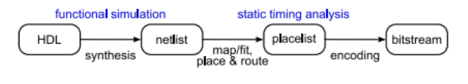
2. Reverse-Engineering of Bitstreams
Reconstructing the original circuit details
Altering the design
Incorporating it in other designs
Reverse Engineering
Saar Drimer, Volatile FPGA Design Security – A Survey, v0.96, April 2008.
Thomas Wollinger and Christoff Paar, Security Aspects of FPGAs in Cryptographic Applications in New Algorithms, Architectures and Applications for Reconfigurable Computing, Springer, 2005, Ch. 21, pp 265-278.
Notes:
transformation of an encoded bitstream into a functionally equivalent description of the original design
In this scenario, someone uses the information stored in the programmable-logic device to reconstruct the original circuit details and then alters and incorporates those details in part or whole into other designs.
Hardware Description Languages (HDLs) are used to describe the behavior and structure of system and circuit designs
The software flow starts with HDL synthesis that optimizes and translates the functional description according to the resources available in the target FPGA architecture
(e.g. Stratix look-up table, Spartan multiplier) into a netlist. Netlists contain a description of the instantiated primitives and the connections between them, usually in the
standardized electronic design interchange format (EDIF). Synthesis tools are available from several EDA vendors, not necessarily from the FPGA vendor of the target device,
unlike the tools used for the rest of the process. The information contained in the netlist is then mapped/fitted to the specific primitives of the architecture and then those are placed and routed to a particular target device to produce a placelist, where the specific route of every interconnect and physical placement of all primitives are described. The
placelist is then encoded to produce a bitstream le that when loaded onto the FPGA establishes the routing to and from all the instantiated elements by setting the state of
memory cells, pass gates, and routing switches.

Slide 22
prevention
These are the toughest to crack. Why?
Increase in gate counts w.r.t number of I/O pins
Antifuse
Encryption
PUFs
B. Dipert. Cunning circuits confound crooks. http://www.e-insite.net/ednmag/contents/images/21df2.pdf, October 12 2000.
Notes:
For example, Actel’s A54SX16A contains 800,000 antifuses with only 2 to 5% programmable.
The only way to look at the state of each antifuse is to cut in to cross sections, which will most likely destroy the die.
A practical attack against AF FPGAs was performed and it was possible to alter one cell in two months at a cost of $1000.

Slide 23
3. Cloning of Sram FPGAs
Security implications of storing data unprotected and external to FPGA
Non-volatile memory
Transmitted during power up
Vulnerability = can be easily eavesdropped
Feasible
Thomas Wollinger and Christoff Paar, Security Aspects of FPGAs in Cryptographic Applications in New Algorithms, Architectures and Applications for Reconfigurable Computing, Springer, 2005, Ch. 21, pp 265-278.
Notes:
The security implications that arise in a system using an SRAM in a FPGA are obvious, if the configuration data is stored unprotected in the system but external to the FPGA.
In a standard scenario, the configuration data is stored externally in nonvolatile memory and is transmitted to the FPGA at power up in order to configure the FPGA.

Slide 24
Prevention
Non-volatile + FPGA on one chip
Battery-Backed RAM
eFUSE
Device DNA
Encryption
PUFs
Thomas Wollinger and Christoff Paar, Security Aspects of FPGAs in Cryptographic Applications in New Algorithms, Architectures and Applications for Reconfigurable Computing, Springer, 2005, Ch. 21, pp 265-278.
Notes:
Learn what each term means. Non volatile + FPGA?
One solution would be to check the serial number before executing the design and delete the circuit if it is not correct.

Slide 25
Description
Battery-Backed RAM
  256-bit key stored in volatile on-chip memory cells.
  Must receive continuous power from the external battery.
eFUSE
  securely store bitstream decryption key.
  No BB-RAM and external battery.
  The OTP eFUSE links are permanently programmed.
  No need battery backup.
Device DNA
  Virtex-6 has embedded, unique device identifier (Device DNA).
  unique 57-bit identifier is nonvolatile and permanently programmed
Notes:
Device DNA:
Because this identifier is programmed into OTP eFUSEs at device final test, it is tamper resistant. First introduced with the Spartan-3A FPGA, the Device DNA number is used with a customer-defined security algorithm in user logic to generate an active value/checksum. Typically, this value is compared to a pre-stored check value to determine whether design functionality can proceed. While Device DNA prevents cloning, it does not protect against spoofing per se. However, the custom-designed security function can be constructed to include a dead-man switch output, which can be used elsewhere in the system either to prevent certain other functions from operating or to detect tampering.
Virtex-6 and Spartan-6 FPGAs contain an embedded, unique device identifier (Device DNA).
This unique 57-bit identifier (analogous to a serial number) is nonvolatile and permanently programmed into the FPGA in the FUSE_ID eFUSE register.
BB RAM:
During normal operation, these memory cells are powered by an auxiliary voltage input to avoid draining this battery. An application can take advantage of this need for external power by cutting the power to both the FPGA and the key storage if tampering or other unauthorized access is attempted. Moreover, an additional powerful key storage security feature exists in Xilinx devices: Any attempted access or write to the battery-backed RAM causes its contents to be cleared and the entire configuration of the FPGA erased prior to access enable.
Efuse:
Allows user to securely store bitstream decryption key.
No need for the BB-RAM and the external battery.
The OTP eFUSE links are permanently programmed via an external voltage supply.
Can be used for applications which require no battery backup.

Slide 26
4. Readback Attack
Present in all FPGAs.
For easy debugging.
Read the configuration of FPGA through JTAG.
Thomas Wollinger and Christoff Paar, Security Aspects of FPGAs in Cryptographic Applications in New Algorithms, Architectures and Applications for Reconfigurable Computing, Springer, 2005, Ch. 21, pp 265-278.
Notes:
Allows reading a configuration out of the FPGA for easy debugging.
The idea of the attack is
Reading the configuration of FPGA through JTAG or programming interface in order to obtain secret information.
Example of software counterfeiting

Slide 27
prevention
A security bit can be used to prevent the readback functionality.
Although, fault injection has proven successful to overcome these countermeasures in FPGA.
PUFs
Notes:
A security bit can be used to prevent the readback functionality.
Although, fault injection has proven successful to overcome these countermeasures in FPGA.

Slide 28
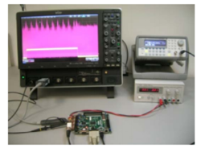
5. Side Channel Attacks
side channel can leak important information.
Side channel can be:
  power consumption
  Light
  Electromagnetic radiation.
Power analysis of bitstream
A. Bogdanov, A. Moradi et. Al, efficient and side-channel resistant authenticated encryption of FPGA Bitstreams, International Conference on Reconfigurable computing and FPGAs, 2012.
Thomas Wollinger and Christoff Paar, Security Aspects of FPGAs in Cryptographic Applications in New Algorithms, Architectures and Applications for Reconfigurable Computing, Springer, 2005, Ch. 21, pp 265-278.
Notes:
Any physical implementation of a cryptographic system provides a side channel that leaks important information.
A side channel can be power consumption, timing behavior, and electromagnetic radiation.
Power analysis of the bitstream can reveal important information about its content.
This content can have public and private keys of the encryption mechanism

Slide 29
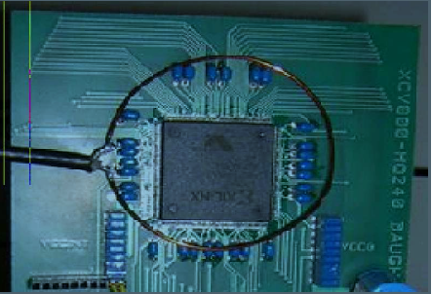
5.1 Simple em attack
Magnetic field surrounding FPGA
Loop antenna to pick variations of field
160 bit EC point Multiplication

Slide 30
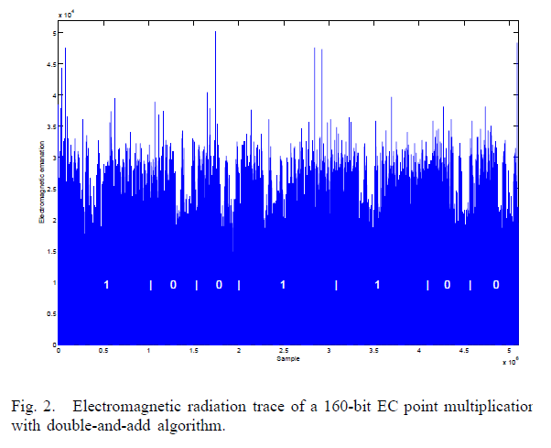
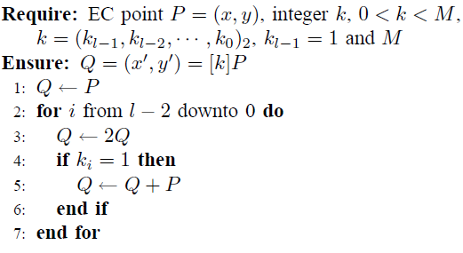
5.1 Simple em attack
Prior info of Encryption is must
Notes:
ECC->Elliptic Curve Cryptography
A SEMA attack is typically used when there is a conditional
branch in the algorithm, which results in a different radiation
pattern whenever the branch is taken.
key used during this measurement is 11001100,
because there is difference between the EM radiation traces
of the EC point addition and doubling

Slide 31
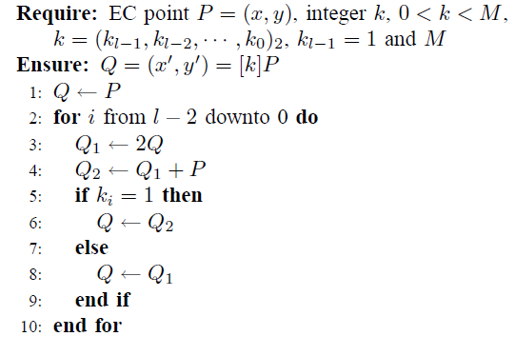
How can WE fix this ?

Slide 32
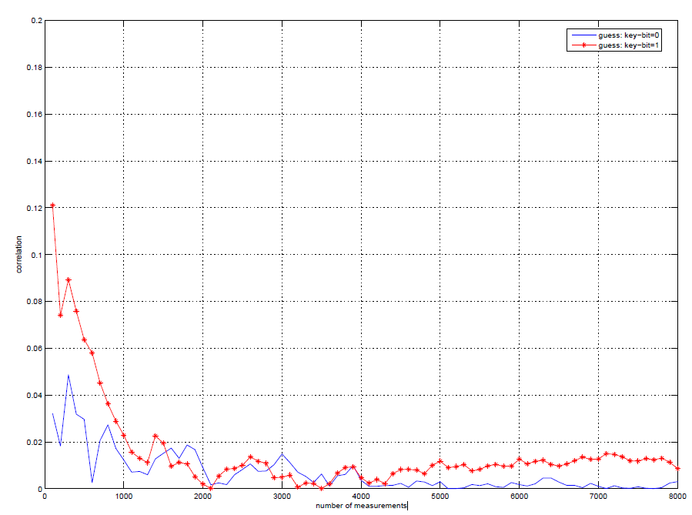
5.2 DIFFERENTIAL EM ATTACK
Notes:
A DEMA attack uses the property that processing different data needs a distinct amount
of power and radiates a different field
In a differential electromagnetic analysis (DEMA)
attack, many measurements are used in order to filter out noise
and the key is derived using a statistical analysis.
Here attackers can use the number of transitions in the register for calculating EM Radiation.
In DEMA, an attacker uses a hypothetical model of the
attacked device. The quality of this model is dependent on
the knowledge of the attacker. The model is used to predict
several values for the electromagnetic radiation of a device.
These predictions are compared to the real, measured electromagnetic
radiation of the device. Comparisons are performed
by applying statistical methods on the data
So the attackers target one bit at a time. They obtain these graphs by filtering techniques
During the execution of the EC point multiplications, C program
computes the number of bits that change from 0 to 1 and
from 1 to 0 in register.
There will be two values for each spike,
one for the guess that the key-bit is 0, one for the guess that
the key-bit is 1
The correlations for spike give us the correct key-bit by using only 1000
measurements.

Slide 33
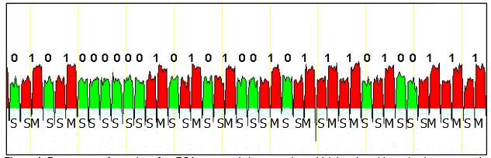
5.3 SIMPLE POWER ANALYSIS
Power trace from an RSA operation
Uses standard square and multiply
Square and multiply operations have visibly different power profiles
‘1’ relates to squaring step followed by a multiplication step
‘0’ in the exponent involves only a squaring step
Notes:
Simple power-analysis attacks exploit the relationship between the instantaneous power consumption of a device and the instructions that are executed. For simple power-analysis attacks it is assumed
that every instruction has its unique power-consumption trace. An attacker simply monitors the device's power consumption while it performs a cryptographic
operation.
Then, the attacker carefully studies the obtained power-consumption trace to determine the sequence of instructions performed by the device. If this
sequence is directly related to the secret key which was involved in the cryptographic operation, the attacker can deduce this secret key from the power-
consumption trace. Such an attack typically targets implementations which use
key dependent branching in the implementation.
SPA attacks recover the secret keys by directly observing features within individual power consumption measurements.
Implementations that have significantly different power consumption depending on secret key bits are most vulnerable to SPA.
For example, implementations of modular exponentiation for RSA (Ron Rivest, Adi Shamir, and Leonard Adleman)
In each case, the pattern of these operations reveals the value of the key.
Figure shows the power trace from an RSA operation using a standard square and multiply sequence. The square and multiply operations have visibly different power profiles that are easy to
distinguish.
In particular, each ‘1’ in the secret exponent consists of a squaring step (lower power) followed by a multiplication step (higher power), while a ‘0’ in the exponent involves only a squaring
step (lower power).
In Figure 1, steps involved with processing a “0” have been highlighted in green, while steps involved in processing a “1” are highlighted in red.

Slide 34
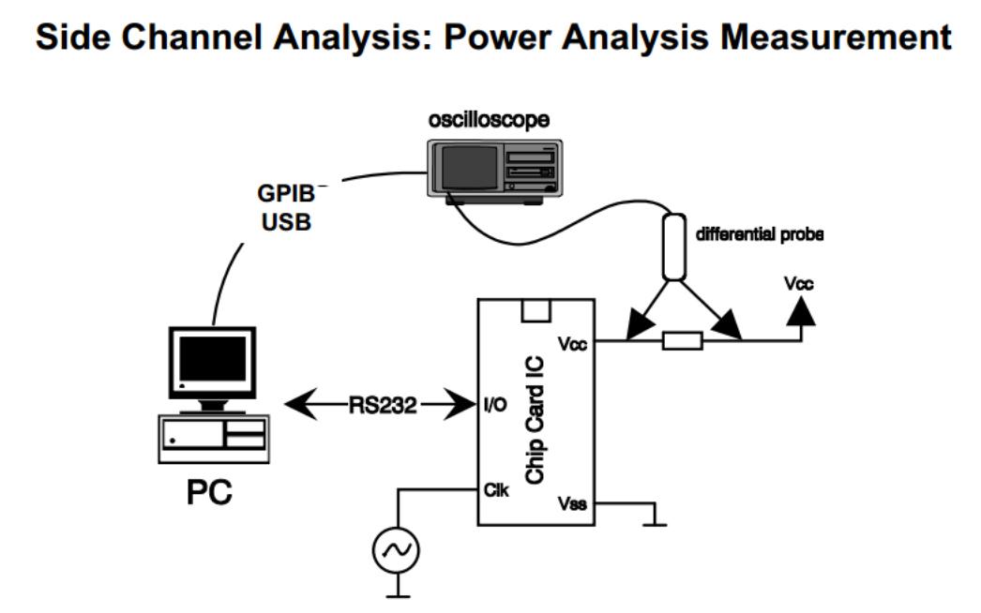
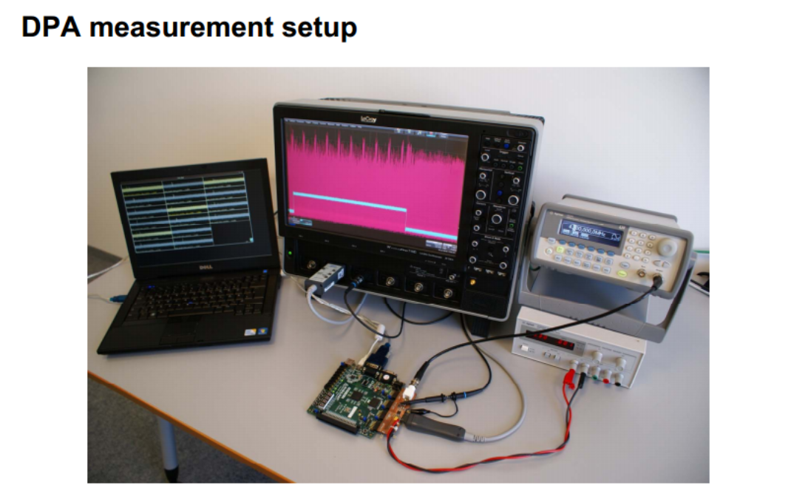
5.4 Differential power analysis

Slide 35
5.5 Light Emission as a side channel
CMOS transistors emit photons.
Electrons gain energy when current flows.
Emission energy is much higher for transition 0->1 than 1->0
To observe the light emitted, the chip needs to be opened either from its backside or front side, depending on its package type.
Photons collected by high sensitivity photon sensor.
InGaAs detectors have best quantum efficiency.
J.Di. Battista, J. Courrege, B. Rouzeyre, L. Torres and P. Perdu, “When Failure Analysis meets Side-Channel Attacks”, CHES 2010, IACR, Santa Barbara, California, USA.
Notes:
CMOS transistors emit photons during their computation.
When current flows between the source and the drain, the electrons gain energy and accelerate due to the electrical field.
Emission energy is much higher for transition 0->1 than 1->0
To observe the light emitted, the chip needs to be opened either from its backside or front side, depending on its package type.
Photons can be collected by high sensitivity photon sensor. InGaAs detectors have the best quantum efficiency.

Slide 36
5.6 Light Emission as a side channel
First the light emission activity is localized by turning the cryptoprocessor is on/off.
It is not necessary to know either the architecture of the algorithm, or its implementation.
This technique is now less used because of the increasing number of metal layers which act as a light screen.
Notes:
In addition, a built-in potentiometer can be used to increase the FPGA core voltage (1.5V to 3V) in order to increase
the light emission activity. It is not necessary to know either the architecture of the algorithm, or its implementation, as the overall light emission
of the cipher block is collected instead of a specific area (SBOX output, XOR
operation...). It is then the data post-treatment on the TRE (Light Emission Traces) curves which will
give us the expected results.

Slide 37
Prevention
There are two kinds of countermeasures: Hardware and software
Software countermeasures refer to algorithmic changes, such as masking of secret keys with random values, which are also applicable to implementations in custom hardware or FPGA.
More Complex Algorithms
Hardware countermeasures often deal either with some form of power trace smoothing or with transistor-level changes of the logic.
This technique is now less used because of the increasing number of metal layers which act as a light screen.
Thomas Wollinger and Christoff Paar, Security Aspects of FPGAs in Cryptographic Applications in New Algorithms, Architectures and Applications for Reconfigurable Computing, Springer, 2005, Ch. 21, pp 265-278.

Slide 38
Changing the configuration of fpga
Temperature Modification
Voltage Modification
Fault Injection/Single Event Upsets
Hardware Virus
Manipulating design through JTAG

Slide 39
Temperature/Voltage Monitoring and Alarms (Detection)
Modify operating voltages or temperatures of FPGA.
Causes unintended behavior.
Can be used to extract data or bypass certain security features.
Notes:
Modifying the normal operating voltages and/or temperature of an FPGA.
This causes the device to behave in an unintended way.
Used to extract data from it or cause it to bypass certain security features.
Cryptographic module shall monitor and correctly respond to fluctuations in the operating temperature and voltage outside of the specified normal operating ranges.
To help meet this type of requirement, on-chip hard IP blocks can be used, namely, the Virtex-6 FPGA System Monitor (SYSMON) or the 7 series FPGAs Xilinx analog-to-digital converter (XADC).

Slide 40
PREVENTION
Monitor and correctly respond to fluctuations in the operating temperature and voltage.
Virtex-6 FPGA System Monitor (SYSMON)
Notes:
Cryptographic module shall monitor and correctly respond to fluctuations in the operating temperature and voltage outside of the specified normal operating ranges.
To help meet this type of requirement, on-chip hard IP blocks can be used, namely, the Virtex-6 FPGA System Monitor (SYSMON) or the 7 series FPGAs Xilinx analog-to-digital converter (XADC).

Slide 41
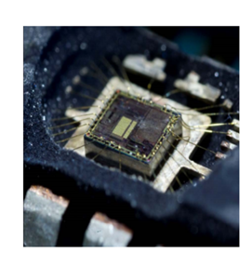
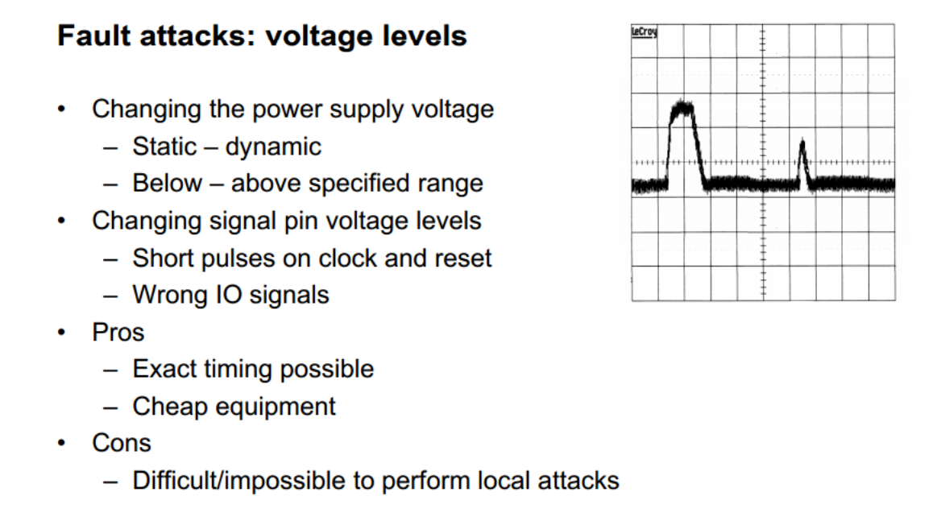
Injection of FAULT’s
Notes:
Cryptographic module shall monitor and correctly respond to fluctuations in the operating temperature and voltage outside of the specified normal operating ranges.
To help meet this type of requirement, on-chip hard IP blocks can be used, namely, the Virtex-6 FPGA System Monitor (SYSMON) or the 7 series FPGAs Xilinx analog-to-digital converter (XADC).

Slide 42
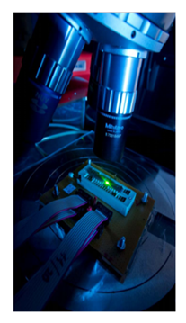
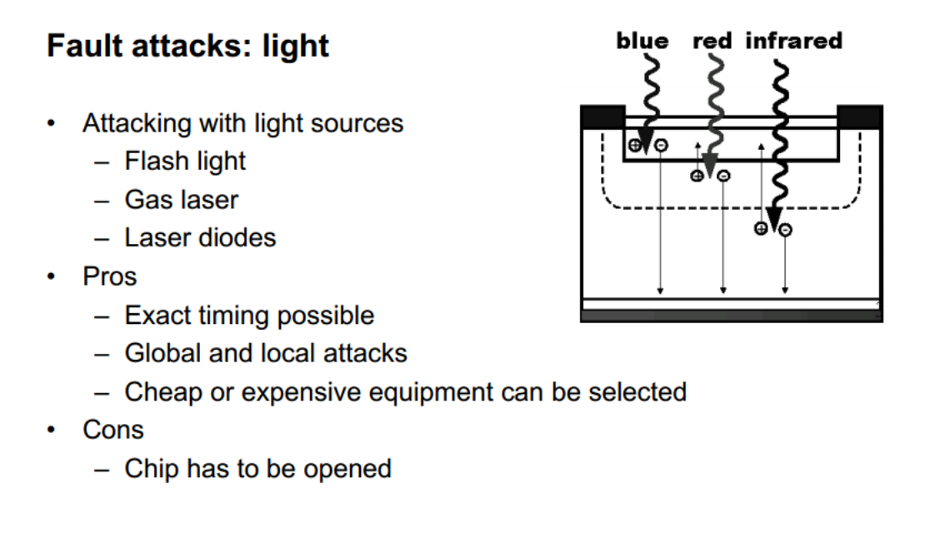
Injection of FAULTs

Slide 43
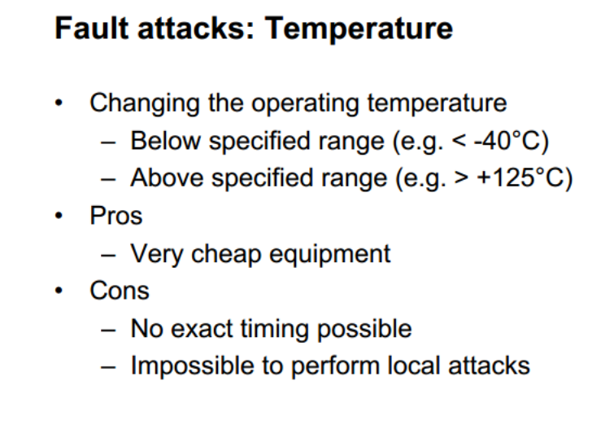
Injection of FAULTs
Notes:
Cryptographic module shall monitor and correctly respond to fluctuations in the operating temperature and voltage outside of the specified normal operating ranges.
To help meet this type of requirement, on-chip hard IP blocks can be used, namely, the Virtex-6 FPGA System Monitor (SYSMON) or the 7 series FPGAs Xilinx analog-to-digital converter (XADC).

Slide 44
Prevention
CRC circuitry
Zeroization of Device
Thomas Wollinger and Christoff Paar, Security Aspects of FPGAs in Cryptographic Applications in New Algorithms, Architectures and Applications for Reconfigurable Computing, Springer, 2005, Ch. 21, pp 265-278.

Slide 45
REST OF THEM
Hardware virus or a hardware Trojan
Kill switch
Manipulating the design through JTAG
Notes:
Since DPR changes the hardware architecture of the circuit, an unauthorized bitstream can cause fatal, unrecoverable damage to the system or may cause secret information to leak through a network connection.
is the malicious manipulation of the hardware itself and/or the software that runs on the chip, that
once activated, renders the chip inoperable.
The kill switch could be performed through thinning certain crucial wires, so that electro migration eventually eliminates
part of a wire, creating an open connection

Slide 46
prevention
Disable write feature in JTAG
Don’t download untrusted designs.

Slide 47
What are PUFs?
Physical entity easy to manufacture but difficult to clone.
PUFs implement a challenge-response authentication.
Unpredictable response.
This is because of the physical factors.
Notes:
PUF or physical uncloneable function is a physical entity which is easy to manufacture but difficult to duplicate or clone.
PUFs implement a challenge-response authentication which means the function generates an output depending on the input
A physical stimulus is applied to the structure and PUF will respond in an unpredictable way.
This is because of the physical factors which are introduced at the time of manufacture which are unpredictable.

Slide 48
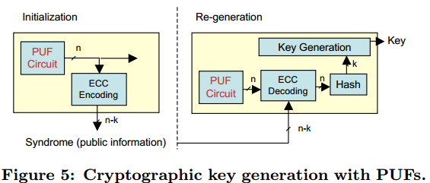
Why are PUFs used in cryptographic applications?
PUFs generate different outputs for same inputs.
Also, they can generate same outputs for different inputs.
This randomness is due to the Challenge-Response Pairs.
Ideal for cryptographic applications
Notes:
Physical Uncloneable Functions for Device Authentication
and Secret Key Generation G. Edward Suh, Srinivas Devadas
PUFs generate different outputs for same inputs.
Also, they can generate same outputs for different inputs.
This randomness is due to the Challenge-Response Pairs.
This randomness is the ideal for cryptographic applications where, if the key is random then the encryption more secure.

Slide 49
Main Types of PUFs
Arbiter PUFs
  Based on MUXes and Arbiter
Ring Oscillator or RO-PUF
  Based on Delay Circuit and Counters
Note: RO PUFs are more suitable for ASICs and FPGAs. Therefore, we will concentrate on it.

Slide 50
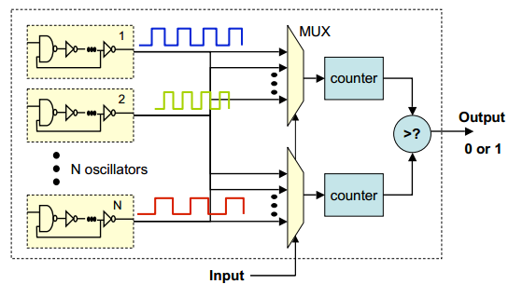
RO-PUF
Consists of N oscillators circuits.
Each Oscillator has a unique frequency.
At any instance two oscillators are picked by the MUXes.
Every counter will counter number of cycles.
Output will be 0 or 1 depending on counter values.

Slide 51
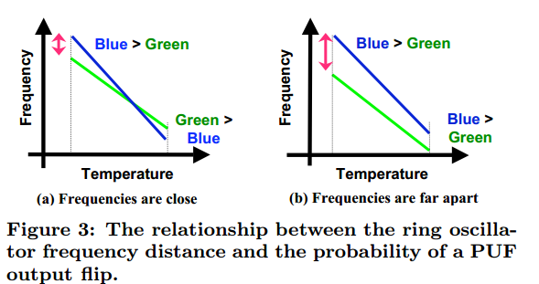
Limitations of RO-PUF
Sensitive to temperature variations
Limited number of Outputs
Limited number of Challenge Response Pairs

Slide 52
Some attacker always pops up
PUFs used to store memory (sRAMs) are the vulnerable to attacks because,
  They are not Manufacturer Resistant
  Nature of Response
  Controlled
In IEEE HOST 2013, an sRAM PUF was cloned to generate an identical response to a same input.
The attackers used a “Focused Ion Beam Circuit Edit” for the same.
Notes:
Helfmeier, Clemens; Nedospasov, Dmitry; Boit, Christian; Seifert, Jean-Pierre (2013). "Cloning Physically Uncloneable Functions". IEEE Hardware Oriented Security and Trust (IEEE HOST 2013). June 2–3, 2013 Austin, TX, USA.
1. Using the CE ,manipulate the transistor to give a more deterministic reponse
2. Use the Focussed Ion Beam to scan the area
3. The binary nature of the physical
response of SRAM means that a simple bitmap generated
during the PUF characterization can be utilized for the FIB CE
with high success probability
4.Such a bitmap makes it possible
to edit tens of cells simultaneously, making it possible to clone
the response of an SRAM array of several kilobits in size.

