Slide 1
FPGA’s for Power Electronics & Drives Past to Present
October 17, 2012
Silicon Valley / S.F. Bay Area
IEEE Power Electronics Meeting
James Bonanno, P.E.

Slide 2
Introduction
History
When did FPGA’s come onto the scene?
How have they done?
Motivations For FPGA based controllers
Synergistic effect of power topology with parallel based controls
Present Trends
Are some Power Topologies better suited for FPGA use than others?
What is the state of the art?
Some of the nitty gritty, some high level
This is a vendor agnostic presentation

Slide 3
History When Did FPGA’s Come Onto the Scene?
Early to mid 1990’s saw the emergence of FPGA in power electronics is a standard configuration of DSP/uP
What is a good benchmark in price? $22 to $25 for example. i.e. how much base elements (LUTs, LE’s, etc. can you get for the price.)
Mid to Late 1990’s saw the trajectory of price of FPGA’s towards DSP prices; but still higher cost
Still, compelling reasons for FPGA’s in 1996-2000 timeframe
Consider the proliferation of power converter topologies over the last twenty years

Slide 4
History
One must remember the analog history of power converter control; still continued on into the 1990’s for some drives and UPS; obviously DC/DC has had primarily analog controller for quite some time

Slide 5
Motivations
Historical Projects
Industry Perspectives

Slide 6
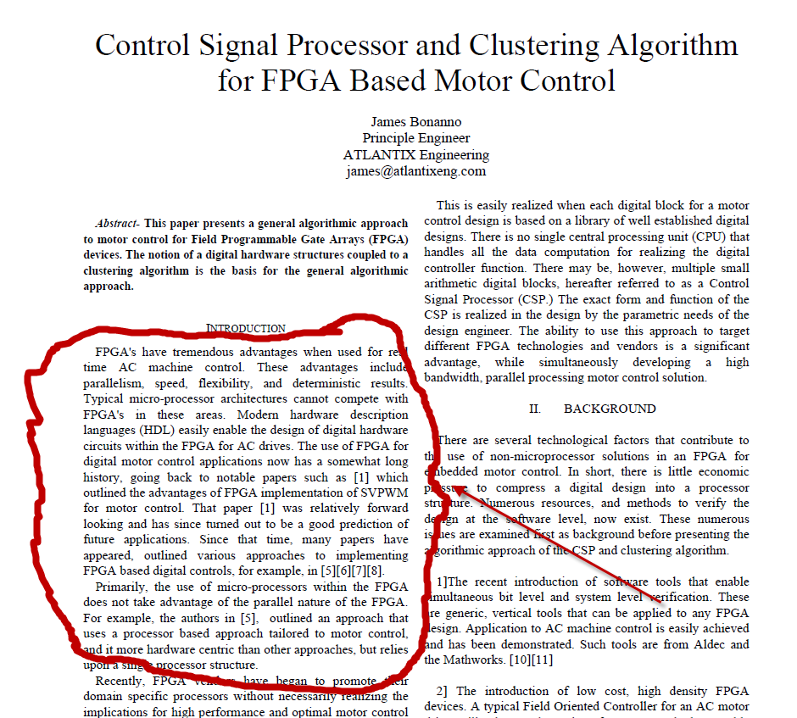
Motivations

Slide 7
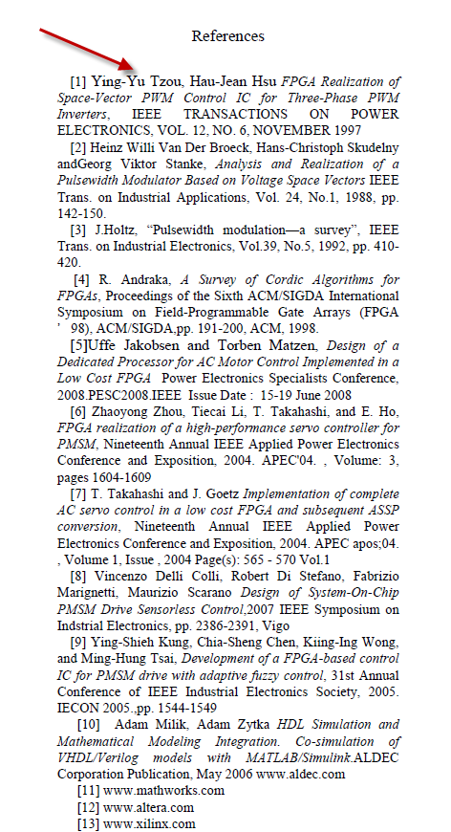
Motivations

Slide 8
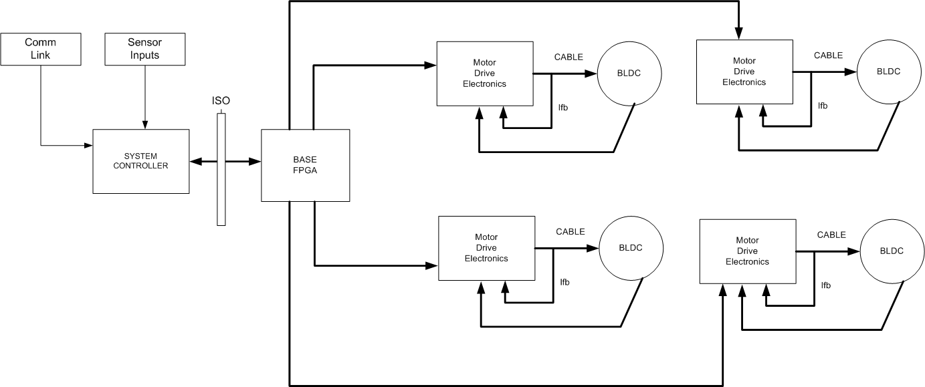
Motivations
N-dimensional drives

Slide 9
Motivations
Aerospace (high-reliability, deterministic testability)
Automotive
Industrial (Flexibility, Ethernet + Drive)
High Frequency operation
ASIC conversion

Slide 10
Motivations
Speed of analog
Advances in analog; high speed SAR ADC’s
Flexibility of digital
Friendlier tools
Higher level tools
Locked portions of a design
Add+ feature without disturbance
Comms will not destroy the design!

Slide 11
Present Trends
DC/DC converters; multi-phase, interleaving
Matrix converters, multi-level converters
Power Factor Correction
Vienna rectifier
+ HF DC/DC converter
EV and Battery Management
Solar inverters and micro-inverters

Slide 12
Present Trends
(In alphabetical order)
Altera
Lattice
Microsemi
Xilinx

Slide 13
Present Trends
Basically, you can get a lot for $30 + delta
Hard processor
Dedicated memory interfaces
Internal memory
Arithmetic “ALU” now . . Not just multipliers
So, what does that mean?

Slide 14
Present Trends
Pushing digital performance to be truly that of analog, with the configurability of the FPGA
Looking to exquisitely tradeoff HDL vs Processor implementations
Exploiting the latest generation of power devices

Slide 15
Present Trends Power Converter Topologies
Multi-phase DC/DC converters
Resonant converters
AC/AC converters; matrix converters; resonant converters
High performance servo drives
Aerospace applications
Now, dare we say “ubiquitous” EV applications

Slide 16
Present Trends
Design Challenge
A 3 MHz, 50 Watt DC/DC converter, all digitally controller with FPGA, hard switched synchronous buck topology
What would this look like?

Slide 17
uC/DSP vs FPGA
Processor distributes an algorithm in time, while FPGA distributes in time and space
What is one EE/math analog?
Fourier Transform vs Wavelet Transform
The digital structure of a processor is fixed, while the FPGA digital structure is configurable
This extends to the peripherals.
What is the % of peripherals to actual computation in your application?

Slide 18
uC/DSP vs FPGA (2)
Design paradigms are different, but intrinsically describe the same thing
If one doesn't understand a difference equation or digital controls, is either a good solution?
Design Tools; Approaches
C/Assembly for DSP, HDL for FPGA, with C for embedded processor if implemented
Longstanding argument that HDL is more complex than C
System level tools such from Mathworks for higher level DSP/Control Design
FPGA Suppliers also have their own versions/interfaces to the Mathworks tools

Slide 19
uC/DSP vs FPGA(3)
Parallelism adds incredible speed to computation, with moderate clocking speeds (100 MHz) for execution of algorithms such as a standard FOC inner current loop (less than 1 usec)
Others are commenting on this as well. See, for example:
http://www.edn.com/design/sensors/4397901/FPGA-high-efficiency--low-noise-pulse-frequency-space-vector-modulation--Part-I

Slide 20
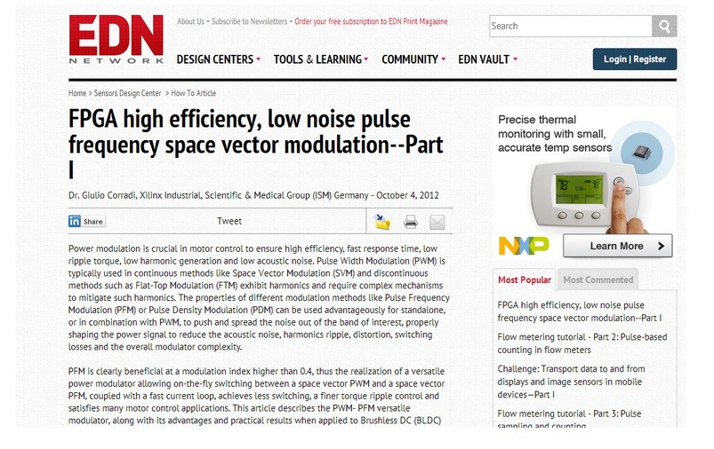
uC/DSP vs FPGA(4)

Slide 21
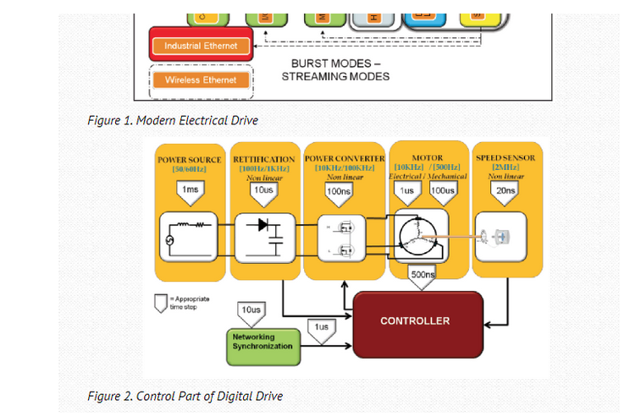
uC/DSP vs FPGA(5)

Slide 22
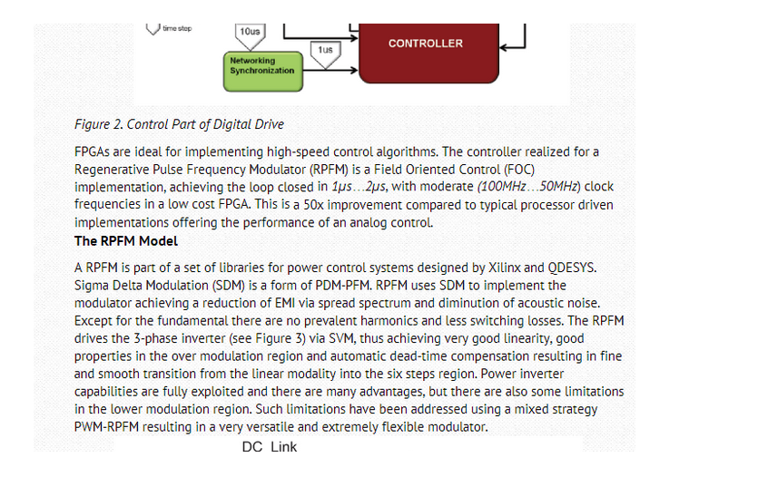
uC/DSP vs FPGA(6)

Slide 23
uC/DSP vs FPGA (7)
For topologies where control algorithm is not known, with initial simulation only, having algorithm flexibility of processor implementation is appealing, at least for section that is being proven
Can be done with DSP or Embedded Processor in FPGA

