Slide 1
LYNX:
CAD for FPGA-based Networks-on-Chip
Mohamed Abdelfattah
Vaughn Betz

Slide 2
System-level Interconnect
FPGA
Example Design
DDRx Controller
module
B
B
From PCIe
To PCIe
A
C
A
C
System-Interconnection Tool e.g. Qsys
Soft Buses
D
PCIe Transcievers
100G Ethernet Controller
Memory
D
Bus
DDRx Controller

Slide 3
Embedded NoCs
FPGA
Embedded NoC on FPGA
DDRx Controller
Implement System Communication
General-purpose system interconnect
Routers
Ease Timing Closure (to IOs)
PCIe Transcievers
100G Ethernet Controller
FabricPorts
More Efficient than Soft Buses
Links
Easy to Use?
Direct IOLinks
DDRx Controller

Slide 4
Embedded NoCs
FPGA
Embedded NoC on FPGA
DDRx Controller
Implement System Communication
General-purpose system interconnect
Routers
Ease Timing Closure (to IOs)
PCIe Transcievers
100G Ethernet Controller
FabricPorts
More Efficient than Soft Buses
Links
Easy to Use?
Direct IOLinks
DDRx Controller

Slide 5
NoC Communication
FPGA
Easy to Use?
DDRx Controller
Example Design
A
Which Router?
FabricPort Mode?
B
Packet
From PCIe
To PCIe
Packetize data
A
C
Data
B
PCIe Transcievers
Manage traffic
D
100G Ethernet Controller
C
Memory
D
Data
DDRx Controller

Slide 6
LYNX CAD Flow
Design
B
A
C
D
NoC-based System
NoC Architecture
Automatically connect design
Satisfy correctness constraints:
ordering
Optimize performance:
Throughput
Latency

Slide 7
Outline
1. LYNX CAD Flow
How can we automate the use of NoCs?
2. Transaction Communication
How to handle request – reply communication on NoC?
3. Comparison
LYNX + NoC compared to Qsys + Bus

Slide 8
Outline
1. LYNX CAD Flow
How can we automate the use of NoCs?
2. Transaction Communication
How to handle request – reply communication on NoC?
3. Comparison
LYNX + NoC compared to Qsys + Bus

Slide 9
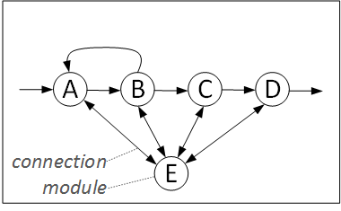
CAD
Automatically connect application using NoC
Application’s communication description

Slide 10
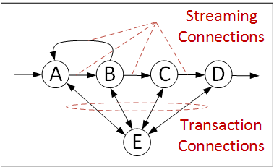
CAD
Classify connection into streaming or transaction

Slide 11
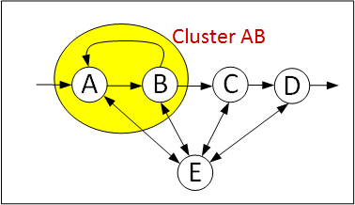
CAD
Tarjan’s clustering algorithm
Cluster feedback loops to avoid stalls
Intra-cluster connected directly

Slide 12
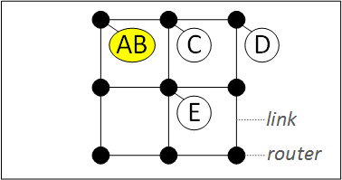
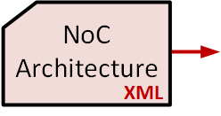
CAD
Map modules and clusters to suitable locations on the NoC
Simulated annealing
Maximize throughput and minimize latency

Slide 13
NoC Mapping
Routers = 16
FPGA
DDRx Controller
Width = 150
VCs = 4
TDM = 4
PCIe Transcievers
100G Ethernet Controller
Router
150 bits
1.2 GHz
FabricPort
600 bits
~ 300 Mhz
DDRx Controller

Slide 14
NoC Mapping
Routers = 16
FPGA
DDRx Controller
Width = 150
VCs = 4
TDM = 4
1
2
3
4
5
6
7
8
PCIe Transcievers
100G Ethernet Controller
Router
150 bits
9
10
11
12
FabricPort
600 bits
13
14
15
16
Module
DDRx Controller
16 locations for a 600-bit module

Slide 15
NoC Mapping
Routers = 16
FPGA
DDRx Controller
Width = 150
VCs = 4
TDM = 4
1
2
5
6
9
10
13
14
3
4
7
8
11
12
15
16
17
18
21
22
25
26
29
30
PCIe Transcievers
100G Ethernet Controller
Router
19
20
23
24
27
28
31
32
150 bits
33
34
37
38
41
42
45
46
FabricPort
35
36
39
40
43
44
47
48
4 x 150 bits
49
50
53
54
57
58
61
62
1
51
52
55
56
59
60
63
64
2
DDRx Controller
3
4
64 locations for a 150-bit module

Slide 16
CAD
Map modules and clusters to suitable locations on the NoC
Simulated annealing
Maximize throughput and minimize latency

Slide 17
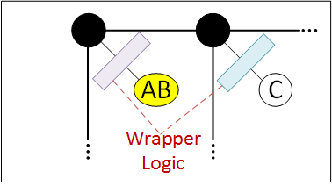
CAD
Soft logic wrappers between module and router
Packetize data (simple)
Manage traffic (complex)

Slide 18
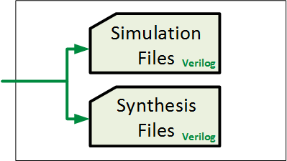
CAD
Analyze throughput and latency in NoC
Estimate frequency

Slide 19
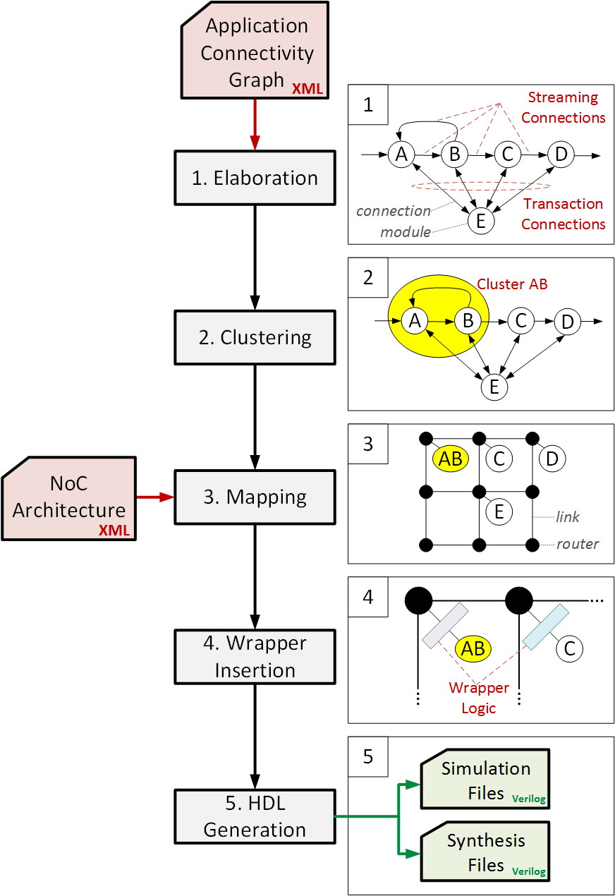
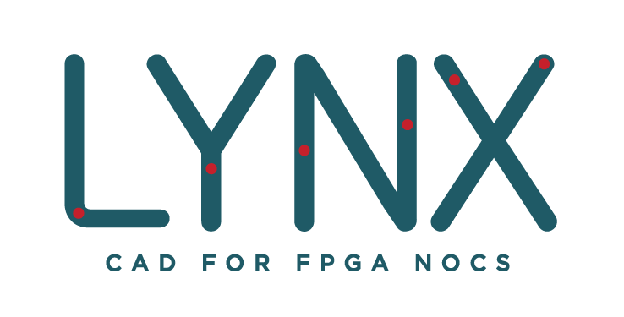
CAD
Java
Open-source
Available at:
eecg.utoronto.ca/~mohamed/lynx
Supports all features of commercial bus-based tools:
Streaming/transaction
E.g.: Uneven arbitration
Challenge: NoC is distributed

Slide 20
Outline
1. LYNX CAD Flow
How can we automate the use of NoCs?
2. Transaction Communication
How to handle request – reply communication on NoC?
3. Comparison
LYNX + NoC compared to Qsys + Bus

Slide 21
Streaming Communication
Streaming communication
Point-to-point
LYNX automatically generates translators
data
valid
packet
5
dest
2
vc
ready
ready

Slide 22
Transaction Communication

Slide 23
Transaction Communication
Request
Return Address
Reply
Response Unit
Simple FIFO
Buffers return address info.
Return router
Return VC

Slide 24
Transaction Communication
Traffic Manager
Decides when requests can be issued
Response Unit
Simple FIFO
Buffers return address info.
Return router
Return VC
1. Traffic Build-Up in Multiple-Master Systems
2. Ordering in Multiple-Slave Systems

Slide 25
Multiple-Master Systems
Master 1
Master 2
Slave
Master 3
E.g.: Memory

Slide 26
Multiple-Master Systems
Master 1
Master 2
Slave
Master 3
Buffering
Switching

Slide 27
Multiple-Master Systems
Master 1
Master 2
Slave
Master 3
Buffering
Switching

Slide 28
Multiple-Master Systems
Traffic Build-Up
Master 1
Master 2
Slave
Master 3
Requests accumulate in the interconnect
Uses much of the buffering
Increases request-reply roundtrip latency
Catastrophic for NoCs – buffering is shared

Slide 29
Multiple-Master Systems
Traffic Build-Up
A
Master 1
Master 2
Slave
Master 3
B
Requests accumulate in the interconnect
Uses much of the buffering
Increases request-reply roundtrip latency
Catastrophic for NoCs – buffering is shared

Slide 30
Multiple-Master Systems
Credits Traffic Manager
Master 1
Credits TM
Master 2
Credits TM
Slave
Master 3
Credits TM
Credits Traffic Manager:
Stalls new requests until reply comes back
Number of requests = number of credits
Prevents traffic build-up in NoC

Slide 31
Credits Traffic Manager
stall
3
1
2
0
Stalls new requests until reply comes back
Number of requests = number of credits
Prevents traffic build-up in NoC

Slide 32
Latency
Without credits traffic manager
With credits traffic manager
Credits TM improves roundtrip latency (drastically)
… and reduces NoC contention

Slide 33
Ordering in Multiple-Slave Systems
Slave 1
Reply 1
Master
Request 2
Request 1
Slave 2
Reply 2
Reply 2 arrives before reply 1
Data ordering hazard!
Interconnect must guarantee correct ordering

Slide 34
1. Stall Traffic Manager
Slave 1
Stop request 2!
Allow request 2
Reply 1
Master
Stall
TM
Request 2
Request 1
Slave 2
Reply 2
Qsys uses “stall traffic manager”
Stall requests to different slave until reply returns
Problem: latency increases / throughput drops

Slide 35
2. VC Traffic Manager
Buffer replies in NoC
Slave 1
Allow reply 1
Allow reply 2
Reply 1 (VC1)
Master
VC
TM
Request 2 (VC2)
Request 1 (VC1)
Slave 2
Reply 2 (VC2)
Leverage VCs & reorder at master
Increase throughput / reduce latency
Use VC buffers in NoC → no added area
Throughput limited by number of VCs

Slide 36
3. ROB Traffic Manager
Slave 1
Buffer replies in RAM
Master
ROB
TM
BRAM
Slave 2
Reorder buffer (ROB) Traffic Manager
Instantiate RAM in FPGA soft logic
Reorder more replies than VC TM
higher throughput
… but more area

Slide 37
Three Traffic Managers for Ordering
Performance
Depending on traffic → VC or ROB TM

Slide 38
Three Traffic Managers for Ordering
Performance
Qsys
Depending on traffic → VC or ROB TM
Performance (much) better than Qsys

Slide 39
Outline
1. LYNX CAD Flow
How can we automate the use of NoCs?
2. Transaction Communication
How to handle request – reply communication on NoC?
3. Comparison
LYNX + NoC compared to Qsys + Bus

Slide 40
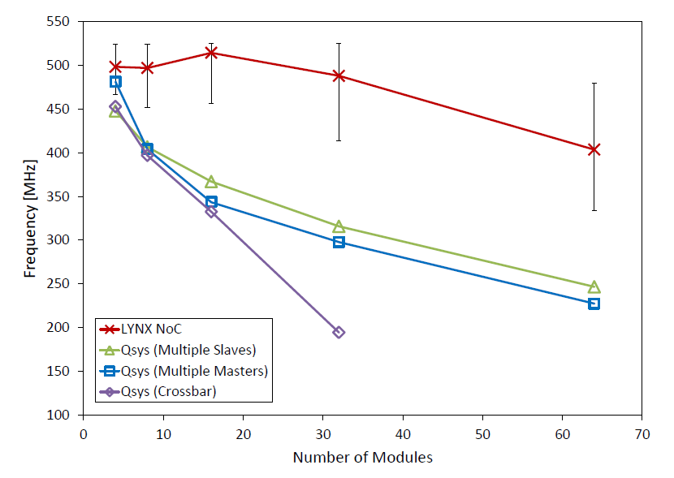
Frequency
LYNX NoC
System Frequency ~1.5X higher with Embedded NoC
Qsys Multi-Master
Qsys Crossbar
Qsys Multi-Slave
(150-bits)

Slide 41
Area
32x32 Qsys crossbar larger than largest FPGA!
Qsys Crossbar
Qsys Multi-Slave
Qsys Multi-Master
LYNX NoC
32x32 crossbar NoC = ~2% of FPGA area
(150-bits)

Slide 42
Summary
1. LYNX CAD Flow
CAD flow steps to automatically connect Design to NoC
2. Transaction Communication
Traffic-build up in Multiple-master
Ordering in Multiple-slave
3. Area/Frequency Comparison
~1.5X higher system frequency
Up to 78X less area

Slide 43
Future Work
“Mimic” Benchmarking
Standard way to compare interconnects
Use graphs not complete apps
B
Traffic generators instead of modules
A
C
D
 | Ordering | Uneven Arbitration | Broadcast
LYNX
Hoplite
Qsys
 | Feed-forward Streaming | External Memory Transactions
LYNX | 100 GB/s | 10 GB/s
Hoplite | 75 GB/s | 12 GB/s
Qsys | 25 GB/s | 7 GB/s
✓
✓
✗
✗
✓
✓
✓
✓
✗

Slide 44
Thank You!

Slide 45
Three Traffic Managers for Ordering
Area
ROB TM twice the area VC/Stall TMs

Slide 46
Future Work
“Mimic” Benchmarking
Application graphs to evaluate and compare different interconnects
NoC in context of tomorrow’s FPGAs
High-level Synthesis
Virtualization
Partial Reconfiguration
 | Transaction Ordering | Uneven Arbitration | Broadcast
LYNX
GENIE
Qsys
✓
✓
✗
✗
A
B
✓
✓
✓
✓
✗
 | Feed-forward Streaming | External Memory Transactions
LYNX | 100 GB/s | 10 GB/s
GENIE | 75 GB/s | 12 GB/s
Qsys | 25 GB/s | 7 GB/s
C
D

Slide 47
Latency
~2.5x
~1.9x
LYNX NoC roundtrip latency lower than Altera Qsys Bus

Slide 48
