Slide 1
P2P File Sharing in VANET
Fenggang Wu
Dept. of Comp. Sci. and Eng., SJTU
Dec.15th 2011

Slide 2
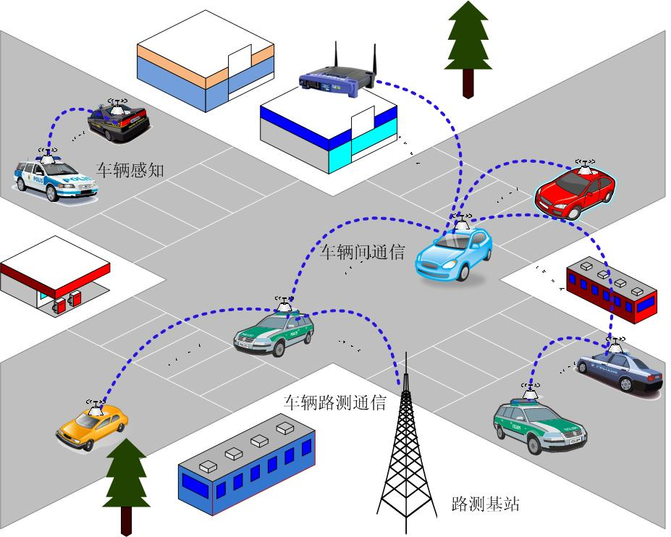
What is VANET?
Wireless Ad Hoc Networking
Decentralized type of wireless network
MANET (Mobile Ad-hoc NETwork)
VANET (Vehicular Ad-hoc NETwork)
http://www.cs.sjtu.edu.cn/~yzhu/nrl/images/VANET_ILL.jpg

Slide 3
What is P2P File Sharing
BitTorrent
Access resources from peer nodes rather than a server node.
Overlay Network

Slide 4
P2P File Sharing in VANETs
Object
Investigate a P2P file sharing scheme in VANETs
Notes:
Weihua zhuang Mobile computing
不是全连通，加入退出更频繁。
上层逻辑和路由分开

Slide 5
Challenge in VANETs
Overlay network, regardless the location of the vehicular
Limited upload and download bandwidth because of intermittent connection
Hard to predict route (or no route at all)
Segmentations: random sequence order performs poorly

Slide 6
Heuristic
ICT (Inter-Contact Time) (rely to the more freq. met cars?)
Sociable Cars (Storing the indices?)
Popular Content (More copies?)

Slide 7
Straightforward Approach
Indexing
Structured: 3G?
Unstructured: DHT
Sociable car maintain the index
Geographical hash
Transferring
Network coding

Slide 8
Related Work
System: VANET MOVE’07 AODV
Network Coding: MobiShare’06, SECON’08
Content Discovery Tech: Computer Communication
IR: ICDCS’09
P2P: Vedio Streaming: Wireless Days’09

Slide 9
Comments?
Thank you!

Slide 10
Straightforward Approach
Storing
Files are separated into segments of equal size(the size can be determined by the test)
Cars with the same interest share the file segments
Files that are more popular have more copies
Querying
Geographical hash
Sociable car maintain the index

