Slide 1
Telehealth
(Telemedicine)
By:
Zahra Aivazpour

Slide 2
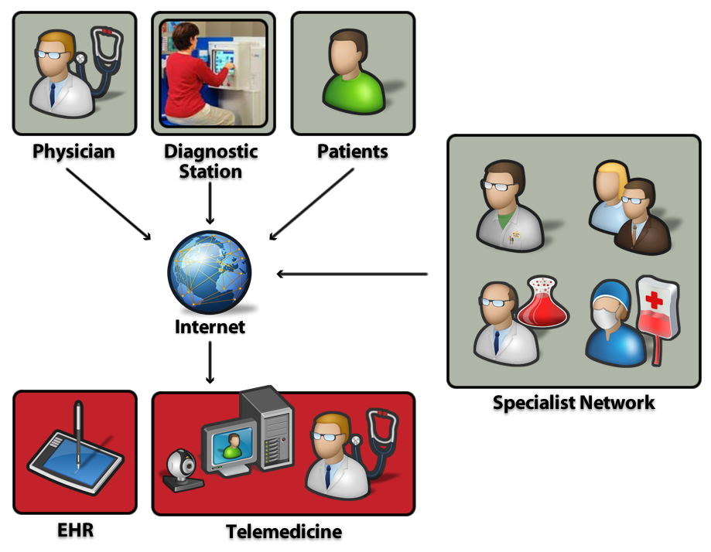

Slide 3
What is Telehealth?
Telehealth is the delivery of health-related services and information via telecommunications technologies.
Telehealth could be as simple as two health professionals discussing a case over the telephone or as sophisticated as doing robotic surgery between facilities at different ends of the globe.

Slide 4
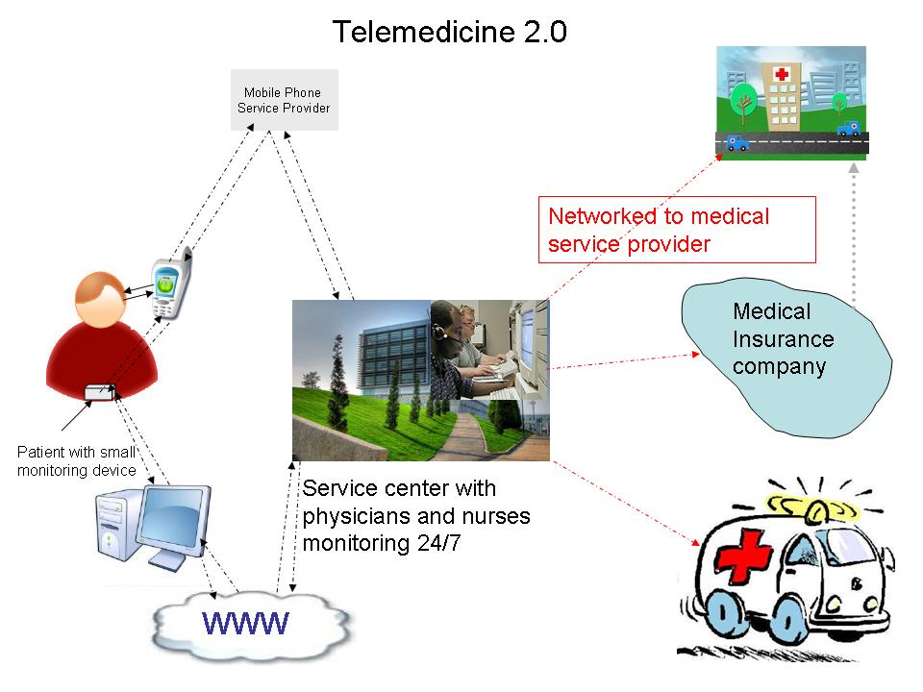

Slide 5
What is telemedicine?
is the use of medical information exchanged from one site to another via electronic communications to improve patients' health status.
"telehealth," is often used to encompass a broader definition of remote healthcare that does not always involve clinical services.
Videoconferencing, transmission of still images, e-health including patient portals, remote monitoring of vital signs, continuing medical education and nursing call centers are all considered part of telemedicine and telehealth.

Slide 6
the pros & cons of
Telehealth
1-eliminates distance barriers and can improves access to medical service in remote areas
2-saves lives in critical care and emergency situations.
3- home monitoring of conditions by patients

Slide 7
4. Convenience
5. Less time in the waiting room
6.Cost-efficiency
7.Expedited transmission of MRIs or X-rays for a second opinion
8.Privacy assurance
19.Electronic glitches

Slide 8
20Telemedicine Tools Transforming Healthcare
Better mobile technologies and more mature electronic health records (EHRs) and clinical decision support (CDS) systems lead the list.

Slide 9
1.american Well Online
provides telemedicine services that enable patients and physicians to consult remotely. patients and doctors can see each other via webcam, as well as communicate by text, email, or phone.
The service can provide patients with medical consultation off hours, with specialists who are in short supply, and to help monitor chronic conditions.

Slide 10
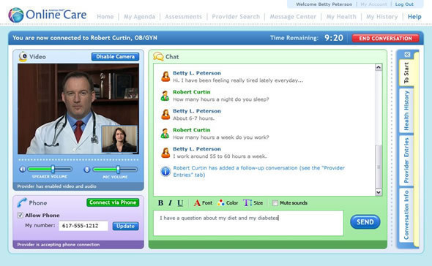

Slide 11
2.philips Electronic ICU
Tele-ICUs and tele-stroke systems represent two of the hottest telemedicine applications.
1- Electronic ICUs, or tele-ICUs, are helping hospitals in regions where there are shortages of intensivist physicians to provide 24 x 7 critical care to patients, using remote monitoring technologies.
2-Tele-stroke applications, on the other hand, are helping hospitals link remote neurologists to ERs so that patients suffering strokes can be diagnosed more quickly and accurately, and receive interventions earlier to help prevent lasting disabilities.

Slide 12
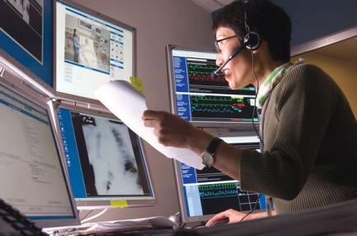

Slide 13
3.GetWellNetwork
the GetWellNetwork iPad offering, interactive patient care and educational resources are accessible to outpatients and families in a variety of care settings.
1-Children's of Alabama is using the iPad offering to let patients and families access medical treatment videos and information in specialty clinics, emergency rooms, outpatient areas, and neonatal intensive care units.
2-the vendor's Getwell@Home product provides hospitals with a digital platform to engage patients from home using mobile devices, the Web, and cable TV after they've been discharged from the hospital and are recovering. That enables patients to remotely review discharge instructions, care plans, and information about their medications.

Slide 14
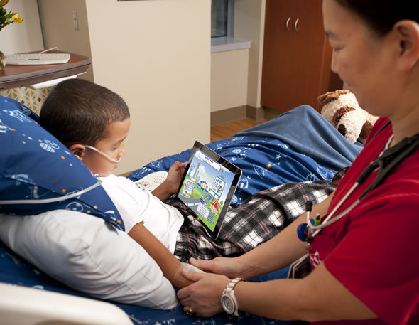

Slide 15
4.VitalPoint In-Home Monitoring
VitalPoint, from CJPS Medical Systems, is a standalone, single unit, 4.5-lb device that can monitor multiple vital signs, including blood pressure, blood oxygen saturation, pulse rate, weight, glucose level, prothrombin time and ratios, temperature, fluid status, and electrocardiogram data, and provide the caregiver with the ability to remotely monitor patients' conditions using their laptop or cellphone.
The physiological data finds its way into the unit, pictured here,
through peripheral medical devices--some wired and some wireless.
Features include a large touch screen and design that's easy for patients, from pediatric to geriatric, to use. The device also provides users with audible reminders of scheduled activities; clinicians' messages; and detailed illustrations and clear voice prompts that guide them through vital signs measurement activities and non-emergency symptom reporting. The product can connect via phone lines if patients don't have Internet access in their homes.

Slide 16
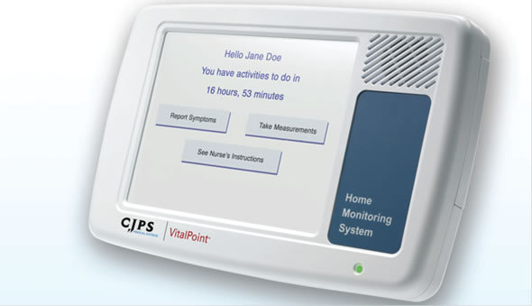

Slide 17
5.Sensei Wellness Plus
Sensei Wellness Plus targets the key risk factors and lifestyle management related to cardiovascular disease. Sensei Wellness Plus' aim is to transform a mobile phone into a virtual coach, providing personalized, timely, and specific guidance as a seamless part of an individual's activities.
winner of the Novartis Health 2.0 Cardio Engagement Innovation Challenge
provides a brief assessment of an individual's cardiovascular risk and then creates a personalized program providing encouragement, education, and guidance on nutrition, weight management, fitness, and condition-specific self-management for those with hypertension, high cholesterol, and diabetes.
For clinicians, the product also supports population health management, connecting healthcare consumers with healthcare providers.

Slide 18
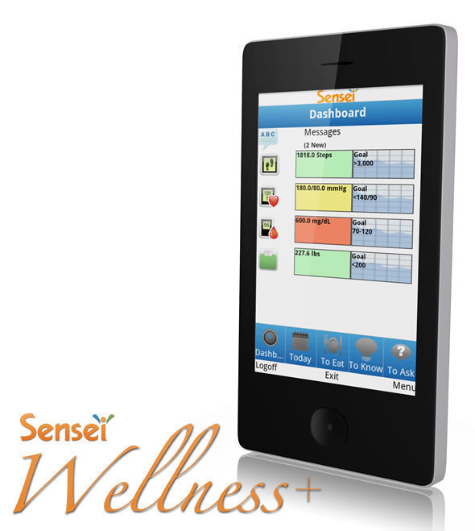

Slide 19
6.Viztek Tele-radiology
Tele-radiology, which allows remote radiologists to view medical images, including X-rays, CT scans, MRIs, and diagnostic tests, is one of the most common types of telemedicine activities.
Viztek's Opal-RAD picture archiving and communication system (PACS),offers multiple tools that cater to the telemedicine radiology practice. include Turnaround-Time (TAT), shown here, which gives radiologists easy visibility to monitor time commitments, ensuring reports are read and signed within any contractually agreed time.

Slide 20
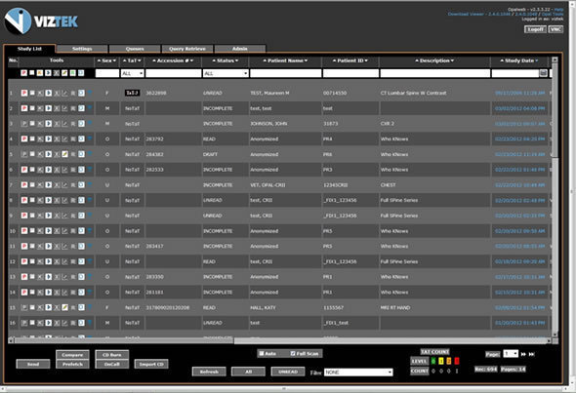

Slide 21
7.ZocDoc
is a free service that enables patients to search for doctors, sort by location, specialty, and insurance accepted; read verified patient reviews; and instantly book an appointment online. By revealing the "hidden supply" of doctors' appointments (including the 10 to 20% cancelled at the last minute), ZocDoc, available as an app on iPhone, Android, and BlackBerry smartphones, helps patients get faster access to healthcare.
40% of ZocDoc patients book an appointment that takes place with 24 hours, and 60% within three days.
its service is used by more than 1 million patients each month, offering more than 5.5 million available appointments at any given time.

Slide 22
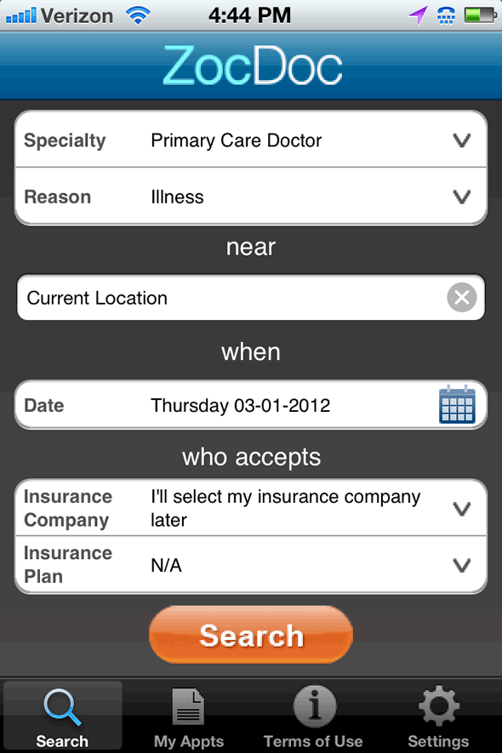

Slide 23
8.Consult A Doctor (MyHealth Plan 24/7 )
Consult A Doctor announced availability of MyHealthPlan 24/7, a new cloud-based telemedicine platform designed to support health plans
gives payer organizations the ability to offer their members on-demand access to their provider networks or, alternatively, Consult A Doctor's national network of on-call physicians. Benefits for employers, health groups, and members include 24/7 physician access, patient portal, and mobile application.
There are also potential benefits for providers because offering telemedicine services can--under the right circumstances--translate to additional revenue, enhanced care management, and flexibility in when services are offered.

Slide 24
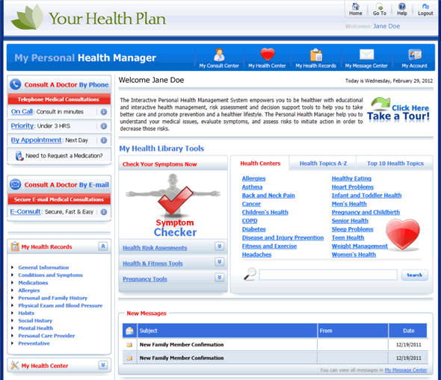

Slide 25
9.TeladocConnect
lets patients and clinicians communicate through telephone or secure online video, giving physicians the flexibility to offer a higher level of personal service. When patients request a consultation with their primary care physicians, the physicians are alerted and can respond.
If the physician is unavailable, the consultation request is routed to Teladoc's national network of U.S. board-certified physicians, which acts as an extension of the physician's practice and gives the patient access to physicians in their state. While the program is available nationally, patients and doctors from the same state communicate via the services to abide by state licensing rules for physicians
Each Teladoc consultation includes a comprehensive review of a patient's electronic health record. If a Teladoc-network physician performs the consultation, the consultation record is provided to the patient's primary care physician, providing continuity of care.

Slide 26
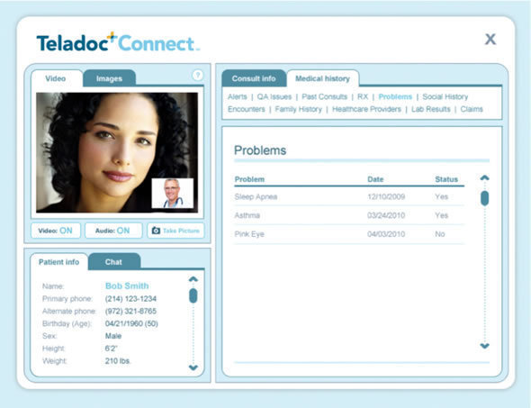

Slide 27
10.Avaya Telehealth
Home-Care Delivery products use video communications to enable homecare nurses, rural hospital workers to gain faster access to specialists and physicians located anywhere.
enables home-based caregivers, as well as individuals to interact with a physician by selecting a link from an e-mail and initiating a videoconference.
The offering is based on Avaya One Touch Video, pictured here, that enables voice and voice/video sessions between agents, experts, or other enterprise resources and end users who have access to an Internet-connected PC, tablet, or mobile device, using a browser with a Flash plug-in or mobile application.

Slide 28
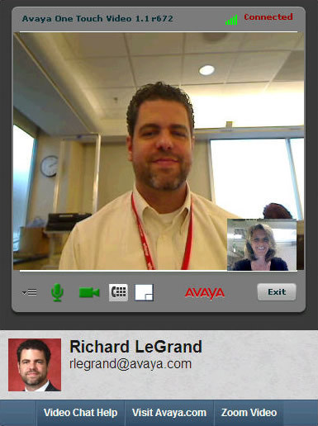

Slide 29
11.Telcare Blood Glucose Meter
Independa, which provides telehealth services via a cloud-based care management platform, recently added support for Telcare's Blood Glucose Meter into its suite of remote monitoring applications and sensors for elderly patients. Telcare's BGM can be particularly handy for elderly diabetic patients who are on the go or travel
Glucose readings taken by the Telcare cellular glucometer, are automatically transmitted to Telcare's central server, with no need for cables or a smartphone. The Independa integration has Telcare securely transmitting the data to Independa's cloud-based caregiver Web app. That app provides a gateway for designated clinicians or caregivers to access the patient's readings via a dashboard on their computers. Clinicians and caregivers also receive alerts when readings hit specific thresholds set for each patient in the Independa system, allowing earlier intervention to prevent diabetic complications from developing.

Slide 30
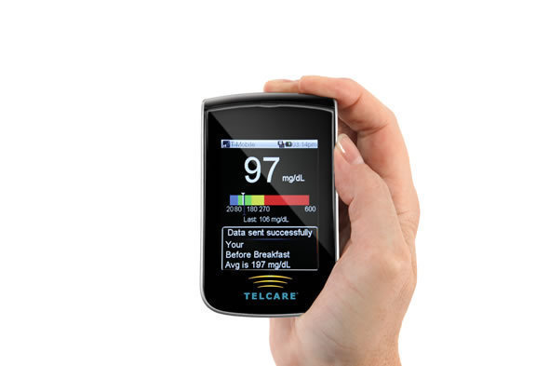

Slide 31
12-Basis Monitoring Wristwatch
The Basis wristwatch measures a variety of health factors, captures the information, and then processes and interprets it
All of this data (measuring heart rate,tracking calory..)gets synced up to Basis (its "cloud service"), where the user can browse the information. Some of the data (motion and skin temperature, for example) gets interpreted as sleep; other data (motion and sweating, for instance) gets interpreted as exercise. The bottom line then is that this data isn't just interpreted individually, but taken and understood collectively.
The watch uses a host of sensors to detect all of this, and it even includes an optical sensor that emits light into the skin at a particular frequency to determine heart rate.
The biggest problem with the Basis product is that the software side is completely browser-based. That works, but having that data in a smartphone app would also be good, especially for viewing the data offline, as so many products let users do

Slide 32
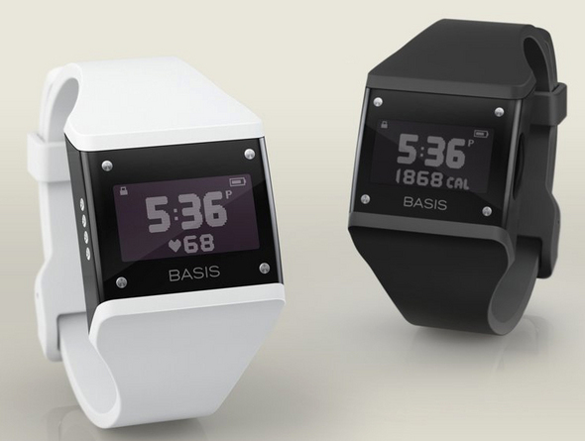

Slide 33
13-Ford Sync System
"The car that cares." The automaker showed a mock-up of a dashboard equipped with the Microsoft-powered Sync "infotainment" system connected to health-related smartphone apps and wireless, portable medical devices.
photo of a prototype car seat with built-in heart rate monitoring, now being tested at a Ford research lab .
Data from the seat could, create a "driver workload estimate" to measure stressors that could affect safety. Sync could automatically route phone calls to voice mail when stress exceeds a predetermined threshold.

Slide 34
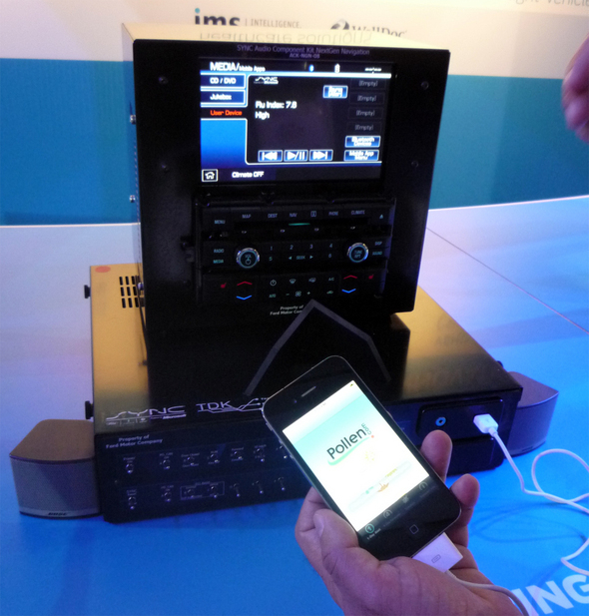

Slide 35
14-AliveCor iPhone ECG
an electrocardiogram module that attaches to the back of an iPhone, plus an accompanying app. There's also a new, credit card-sized module called the iCard ECG that will work with Apple's iPad and other tablets, as well with laptops and Android smartphones.
live cardiac waveform to visitors by pressing the two metal electrodes against his chest, even through a shirt.
The product is useful for post-discharge cardiac patients and those with chronic heart ailments, as well as nurses and emergency medical technicians. The iPhone ECG actually represents wireless electrocardiography.
RhythmStat XL software that wirelessly transmits ECG data from a heart monitor to a palmtop computer. connecting a single-lead ECG to a mobile device on Apple's introduction of the iPhone in 2007

Slide 36
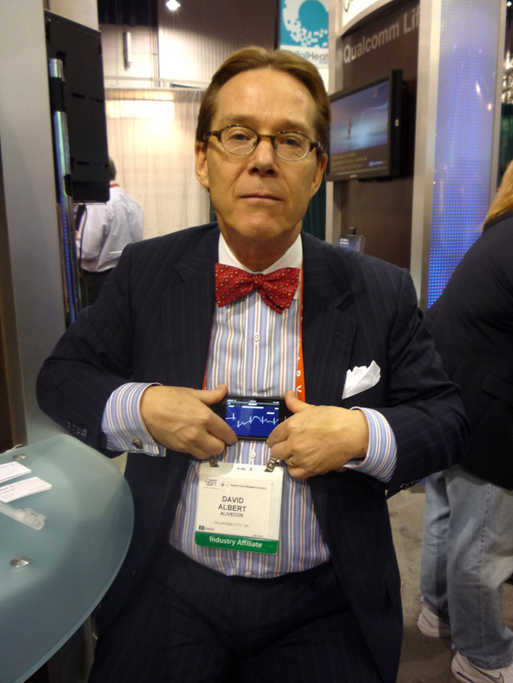

Slide 37
15-Concussion Recognition & Response
athletic organizations have developed protocols for identifying concussions and making sure individuals are symptom-free.
Apple iOS and Android devices called Concussion Recognition and Response. This product walks coaches and parents of young athletes through a checklist of concussion signs and symptoms, following protocols adopted by the Centers for Disease Control and Prevention's (CDC)
Users can e-mail the results to health professionals to document the patient's condition.
The app also features a home symptom monitor for follow-up care and a workout routine to help injured young athletes get ready to return to action.

Slide 38
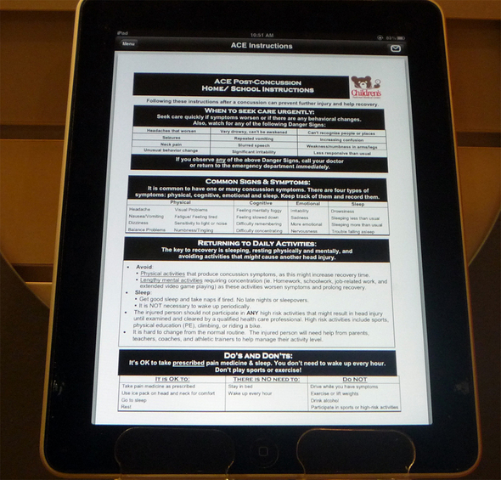

Slide 39
16-Independa
Independa , brought something new :Health Measures, a telephone-based system to complement the existing Artemis platform for wireless home-health sensors. Both work with Angela, Independa's touch-screen dashboard and communications hub.

Slide 40
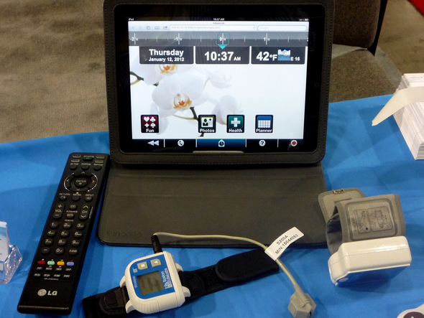

Slide 41
17-Lifecomm MPERS
today's mobile personal emergency response service (MPERS) devices include GPS locators, accelerometers to detect falls automatically, and embedded cellular chips to summon help even if the wearer blacks out and is unable to push a button.
Lifecomm developed a cellular phone-based healthcare service demonstrated its MPERS in three formats: a wristwatch, a pendant, and a belt clip, each of which supports two-way voice and data communication over the Verizon Wireless network. When the user pushes the button or the system detects a fall, a call goes out to Lifecomm's call center, which can then conference in emergency medical services. The Lifecomm representative stays on the line until EMS arrives, then will call the device wearer's designated contacts.
The MPERS can measure wearer activity and inactivity, too, so family members and caregivers can track movement patterns though a Web portal

Slide 42
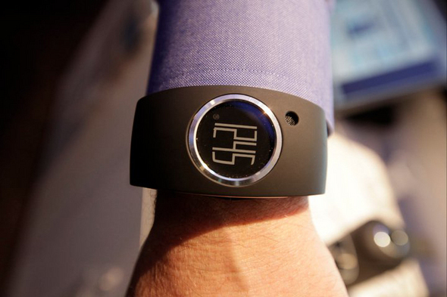

Slide 43
18-Life Technologies Ion Proton Sequencer
it might just represent a landmark step toward fulfilling the promise of personalized medicine. Designed to sequence the entire human genome in one day for this tabletop model decodes DNA with a semiconductor chip, making it much faster and significantly less expensive than optical gene sequencers.
larger, slower optical devices cost half a million dollars or more and take weeks to return results

Slide 44
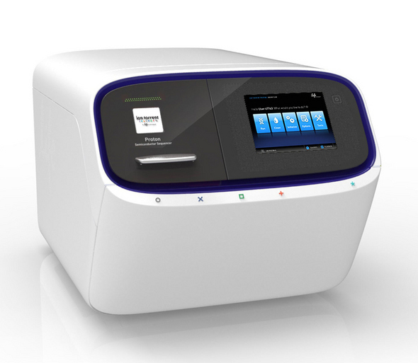

Slide 45
19-Telcare BGM
the Telcare BGM blood-glucose meter helps with diabetes care by sending readings directly from the smartphone-sized monitor over T-Mobile's network to an online, Web-accessible database that patients can share with their physicians. it is the "world's first" cellular-enabled glucometer. An available iPhone app allows for mobile management.
the Telcare database can connect to electronic health records and personal health records. Interoperability is important

Slide 46
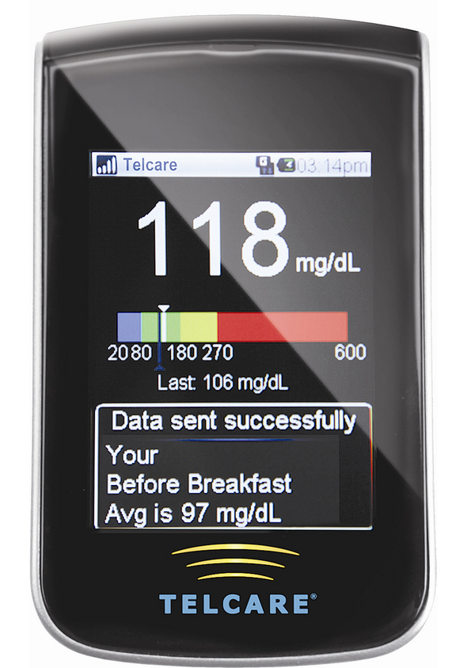

Slide 47
20-UnitedHealth Group
OptumizeMe is a "platform for health achievement," Users can challenge each other to meet whatever health or fitness goals they specify, such as running 5 miles or lowering their cholesterol levels.

Slide 48
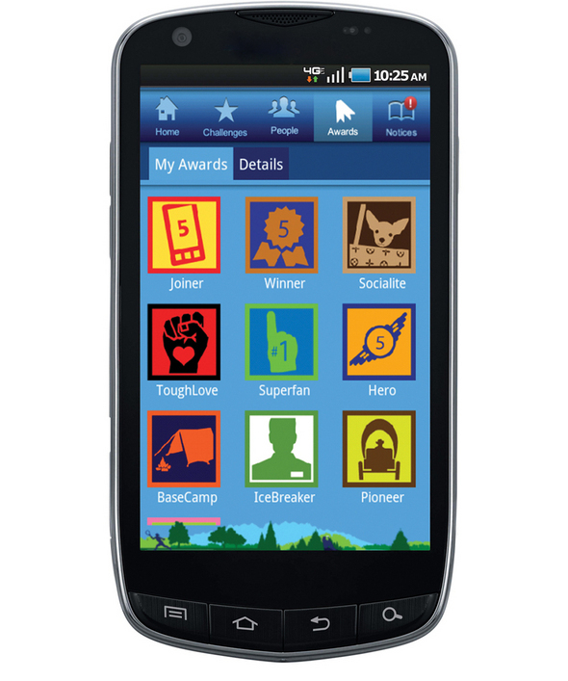

Slide 49
Thank You

