Slide 1
Understanding Credentialing Options for Telemedicine
Kathy Matzka, CPMSM, CPCS
www.kathymatzka.com

Slide 2
What is Telemedicine?
“the provision of clinical services to patients by physicians and practitioners from a distance via electronic communications”
Source: CMS Interpretative Guidelines

Slide 3
Telemedicine
Non-simultaneous: involve after-the-fact interpretation or assessment, such as teleradiology services
Simultaneous: involve “real-time” interpretation or assessment, such as E-ICU services, psychiatry, dermatology

Slide 4
Examples of Telemedicine
Videoconferencing
Transmission of still images
Remote monitoring of vital signs
Tele________ [Fill in the blank]

Slide 5
What we imagine...

Slide 6
Reality?

Slide 7
Where we think they are...

Slide 8
Reality???

Slide 9
Trends driving the growth of telemedicine in the US
A growing population, expected to reach more than 360 million by 2030, which will increase the demand for medical services
A projected physician shortage, which could reach 130,000 by the year 2025
A rapid increase of older Americans, coping with chronic diseases, many of whom are likely to be home-bound and physically challenged late in life
Source: “Balancing Access, Safety and Quality in a New Era of Telemedicine” FSMB, 2011
Notes:
Several trends are driving the growth of telemedicine in the
United States, including:
A growing population, expected to reach more than 360 million by 2030, which will increase the demand for medical services
A projected physician shortage, which could reach 130,000 by the year 2025
A rapid increase of older Americans, coping with chronic diseases, many of whom are likely to be home-bound and physically challenged late in life
A lack of access to medical services in many parts of the country, especially in rural areas
An explosion in computer-based technology and electronic communications capabilities, particularly in mobile devices
A consumer population that is increasingly at ease with computer-based and electronically enabled transactions in day-to-day life

Slide 10
Trends driving the growth of telemedicine in the US
A lack of access to medical services in many parts of the country, especially in rural areas
An explosion in computer-based technology and electronic communications capabilities, particularly in mobile devices
A consumer population that is increasingly at ease with computer-based and electronically enabled transactions in day-to-day life
Source: “Balancing Access, Safety and Quality in a New Era of Telemedicine” FSMB, 2011
Notes:
Several trends are driving the growth of telemedicine in the
United States, including:
A growing population, expected to reach more than 360 million by 2030, which will increase the demand for medical services
A projected physician shortage, which could reach 130,000 by the year 2025
A rapid increase of older Americans, coping with chronic diseases, many of whom are likely to be home-bound and physically challenged late in life
A lack of access to medical services in many parts of the country, especially in rural areas
An explosion in computer-based technology and electronic communications capabilities, particularly in mobile devices
A consumer population that is increasingly at ease with computer-based and electronically enabled transactions in day-to-day life

Slide 11
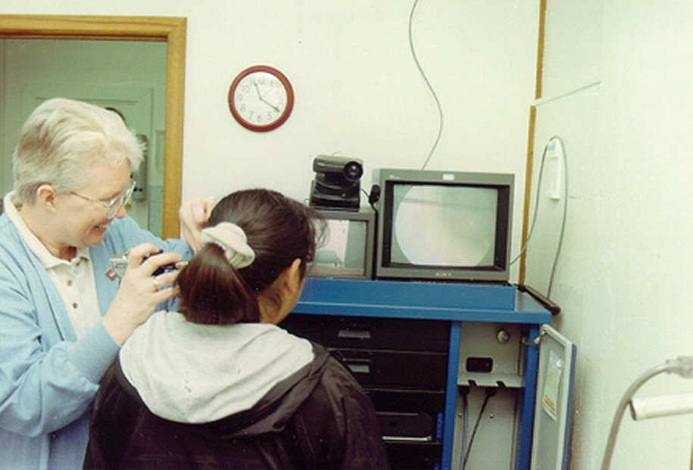
Terminology
Distant Site Hospital
Distant site telemedicine entity
) ) ) ) ) ) ) ) ) ) )
) ) ) ) ) ) ) ) ) ) ) ) )
Originating
Site

Slide 12
CMS – Telemedicine Privileging Choices
Fully credential & privilege per MS bylaws and CMS regs
Privilege via contract with Medicare-approved-Hospital
Privilege via contract with telemedicine entity

Slide 13
Acute Care Hospitals

Slide 14
Distant Site TE Definition
Provides telemedicine services
Is not a Medicare-participating hospital
Provides contracted services in a manner that enables a hospital using its services to meet all applicable CoPs, particularly those requirements related to the credentialing and privileging of practitioners providing telemedicine services to the patients of a hospital.
Includes a distant-site hospital that does not participate in the Medicare program

Slide 15
§482.12(a)(8) - Distant-site Hospital
The GB of the hospital whose patients are receiving the telemedicine services may grant privileges based on its medical staff recommendations that rely on information provided by the distant-site hospital

Slide 16
§482.22(a)(3) – Written Agreement Provisions - Hospital
Distant-site hospital is Medicare-participating
The individual distant-site physician or practitioner is privileged at the distant-site hospital which provides a current privilege list
The individual distant-site physician or practitioner has state license
Originating site hospital performs internal review of the distant-site practitioner’s performance and sends the distant-site hospital information for use in the periodic appraisal. At a minimum - adverse events and complaints.

Slide 17
Surveyor Notes….
Ask to see…Written agreement and the list provided by the distant-site hospital of the telemedicine physicians and practitioners, including their current privileges and pertinent licensure information.

Slide 18
§482.12(a)(9) – Distant-site TE
The GB of originating hospital may grant privileges to physicians and practitioners employed by the distant-site TE based on MS recommendations; such MS recommendations may rely on information provided by the distant-site TE

Slide 19
§482.22(a)(4)Written Agreement Provisions – TE
TE’s utilization of a medical staff credentialing and privileging process that meets the requirements of the hospital CoPs
TE provides a list of all physicians and practitioners covered by the agreement, including their privileges at the distant-site telemedicine entity
The list may not include any physician or practitioner who does not hold privileges at the distant-site telemedicine entity.
The list must be current, so the agreement must address how the distant-site telemedicine entity will keep the list current

Slide 20
§482.22(a)(4)Written Agreement Provisions – TE – cont…
Each physician or practitioner who provides telemedicine services to the hospital’s patients under the agreement holds a license issued or recognized by the State where the hospital is located
The hospital has evidence that it reviews the telemedicine services provided to its patients and provides a written copy of this review to the distant-site telemedicine entity for the latter’s use in its periodic appraisal of the physicians and practitioners providing telemedicine services under the agreement. At a minimum, adverse events and complaints.

Slide 21
Surveyor Notes….
Ask the hospital how it verifies that the telemedicine entity employs a credentialing and privileging process that meets or exceeds what is required for hospitals under the Medicare CoPs
Surveyors do not attempt to independently verify whether or not the distant-site telemedicine entity’s credentialing and privileging process fulfills the regulatory requirements.
Focus only on whether the hospital takes steps to ensure that the distant-site telemedicine entity complies with the terms of the written agreement.

Slide 22
Survey Procedures §482.22(c)(6) – MS Bylaws
In the case of telemedicine physicians and practitioners providing telemedicine services under an agreement with the hospital where the hospital’s GB has opted to have the medical staff rely upon the credentialing and privileging decisions of the distant-site hospital or telemedicine entity, verify that the bylaws include a provision permitting such reliance.

Slide 23
Inter. Guidelines §482.26(c)(1)
When telemedicine is used, and the radiologist who interprets radiological tests and the patient are located in different states, the radiologist interpreting the radiological test must be licensed and/or meet the other applicable standards that are required by State or local laws in both the state where the practitioner is located and the state where the patient is located.

Slide 24
Critical Access Hospitals

Slide 25
§485.616(c) Agreements include
When telemedicine services are furnished to the CAH’s patients through an agreement with a distant-site hospital, the CAH’s governing body or responsible individual may choose to rely upon the credentialing and privileging decisions made by the governing body of the distant-site hospital regarding individual distant-site physicians or practitioners.

Slide 26
§485.616(c) Agreements include
Determine, in accordance with State law, which categories of practitioners are eligible candidates for appointment to the medical staff
Appoint members of the medical staff after considering the recommendations of the existing members of the medical staff
Assure that the medical staff has bylaws
Approve medical staff bylaws and other medical staff rules and regulations
Ensure that the medical staff is accountable to the governing body for the quality of care provided to patients
Ensure the criteria for selection are individual character, competence, training, experience, and judgment
Ensure that under no circumstances is the accordance of staff membership or professional privileges in the hospital dependent solely upon certification, fellowship or membership in a specialty body or society

Slide 27
§485.616(c) Agreements include
Distant-site hospital is Medicare-participating
The individual distant-site physician or practitioner is privileged at the distant-site hospital which provides a current privilege list
The individual distant-site physician or practitioner has state license
Originating site hospital performs internal review of the distant-site practitioner’s performance and sends the distant-site hospital information for use in the periodic appraisal. At a minimum - adverse events and complaints.

Slide 28
§485.641(b)(4) Quality Assurance
The quality and appropriateness of the diagnosis and treatment furnished by doctors of medicine or osteopathy at the CAH are evaluated by--
(i) One hospital that is a member of the network, when applicable;
(ii) One QIO or equivalent entity;
(iii) One other appropriate and qualified entity identified in the State rural health care plan;
Applies to agreements with distant-site telemedicine entity
Agreements with distant- site hospitals give that hospital responsibility

Slide 29
Joint Commission Nuances and Differences

Slide 30
TJC – Telemedicine Privileging Choices
Fully credential & privilege per MS standards
Privilege using credentialing info from TJC-accredited distant site
Use cred/priv decision from the distant site TJC accredited hosp or amb care org. to make a final decision

Slide 31
Using the credentialing and privileging decision of the distant-site - LD.04.03.09 Deemed status only
Distant site GB responsible for process consistent with the cred/priv requirements in the MS chapter
Originating site MS relies on information provided by the distant site and makes recommendation to GB
Originating site GB grants privileges to a distant-site LIP based on originating site recommendation

Slide 32
TJC – Originating site may use the decision from the distant site if:
The distant site is TJC accredited hospital/ACO (verify that they follow TJC credentialing standards)
The practitioner is privileged at the distant site for those services to be provided at the originating site
The distant site provides the originating site with a current privilege list (deeming only and CAH)
The originating site has evidence of an internal review of the practitioner’s performance of these privileges and sends to the distant site including complaints and adverse outcomes related to sentinel events resulting from telemedicine
Distant-site practitioner licensed in originating site’s state

Slide 33
TJC – CAH only
Distant-site Medicare-participating hospital evaluates care provided in CAH
If distant site TE, care is evaluated by hospital that is part of network, QIO or equivalent entity, or entity identified in state rural health plan

Slide 34
TJC – LD.04.03.09
MS clinical leaders and MS provided opportunity to advise about sources of clinical services that will be provided through a contractual arrangement and designated leaders must approve these agreements
Services must be monitored by establishing performance expectations
The leaders who monitor the contracted services are the GB (deemed status)

Slide 35
TJC – Non-Deemed
If the hospital establishes a contract with another accredited organization for services that will be provided off-site, it can do one of two things:
Verify that all LIPs who will be providing patient care, treatment, and services have appropriate privileges (obtain a copy of the provider’s privilege form or list of approved privileges) from the contracted facility) OR
Contract can specify that the contracted organization will guarantee that all contracted services will be within the scope of their approved privileges

Slide 36
TJC – Non-Deemed – Cont.
If the hospital uses direct or interpretive LIP services from a TJC–accredited ambulatory provider through a telemedicine link, the hospital can accept the credentialing and privileging decisions of the provider if the decisions are made using the process described in MS.06.01.03 through MS.06.01.07

Slide 37
QAPI - FPPE and OPPE
Teleradiology
Overeads
Timeliness
Use quality indicators applying to on-site practitioners
All – analyze and report
Re-evaluations
Referrals
Incorrect information or actions
Adverse Events
Complaints

Slide 38
On Staff or Not?
May need Bylaws revisions
Check state regs
Hearing Rights
Peer review

Slide 39
Questions

