Slide 1
Telemedicine in Orthopaedics
John North
Ben Rowney
Alison McGill
November 2011

Slide 2
Declaration
No conflict of interest to declare

Slide 3
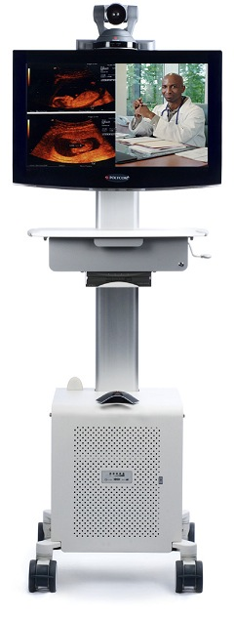
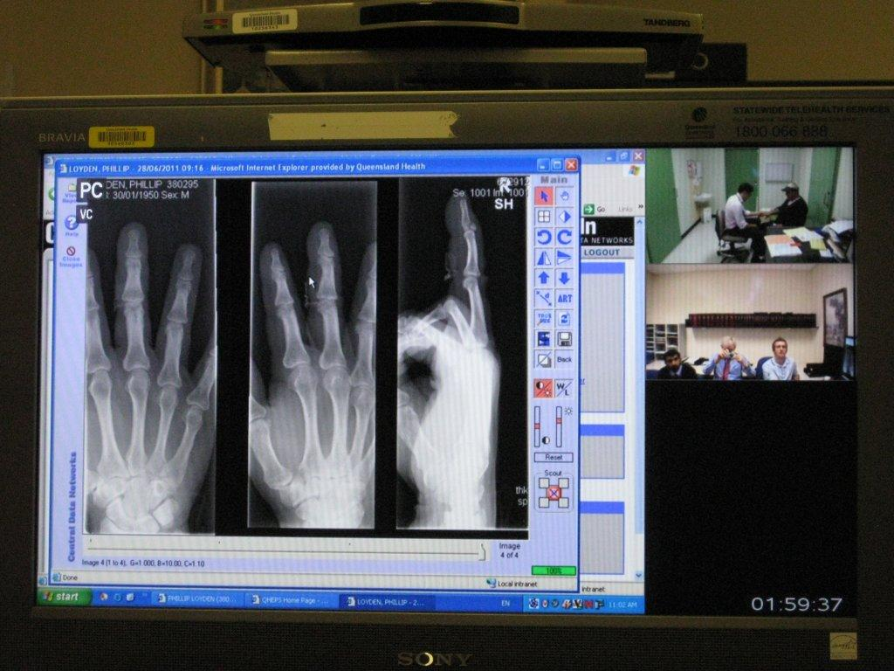
Small Beginnings?
(Telehealth http://www.health.qld.gov.au/qhcss/telehealth/clinicians/default.asp)
Notes:
Tele-health delivery could be as simple as two health professionals discussing a case over the telephone, or as sophisticated as using videoconferencing between providers at facilities in two countries.
Telehealth is enabling specialist staff to convey specific medical knowledge and clinical expertise to staff and patients that do not traditionally have access to it.

Slide 4
‘SWOT’
Strengths

Slide 5
‘SWOT’
Strengths
Weaknesses

Slide 6
‘SWOT’
Strengths
Weaknesses
Opportunities

Slide 7
‘SWOT’
Strengths
Weaknesses
Opportunities
Threats

Slide 8
Opportunities
Cost Benefits

Slide 9
Opportunities
Cost Benefits
Alison McGill ‘Cost Benefit Analysis’
PAH / Mt Isa Fracture Clinic

Slide 10
Opportunities
Patient Benefits

Slide 11
Opportunities
Patient Benefits
Consultant Advice

Slide 12
Opportunities
Patient Benefits
Consultant Advice
Paediatric Advice

Slide 13
Opportunities
Patient Benefits
Consultant Advice
Paediatric Advice
Transfer Avoidance

Slide 14
Opportunities
Patient Benefits
Consultant Advice
Paediatric Advice
Transfer Avoidance
Family sanity preserved

Slide 15
Opportunities
Administration Benefits

Slide 16
Opportunities
Administration Benefits
Fewer complaints

Slide 17
Opportunities
Administration Benefits
Fewer complaints
Better service

Slide 18
Opportunities
Administration Benefits
Fewer complaints
Better service
Faster service

Slide 19
Opportunities
Administration Benefits
Fewer complaints
Better service
Faster service
Earlier Return to Work

Slide 20
Opportunities
Administration Benefits
Fewer complaints
Better service
Faster service
Earlier Return to Work

Slide 21
Opportunities
Treatment Triage
Follow up Support

Slide 22
BUT…………

Slide 23
Threats

Slide 24
Threats
Consultant funding

Slide 25
Threats
Consultant funding
Radiographic funding

Slide 26
Threats
Consultant funding
Radiographic funding
PACS funding

Slide 27
Threats
Consultant funding
Radiographic funding
PACS funding
Admin funding

Slide 28
Threats
PACS access?

Slide 29
PACS
PACS access?
Firewalls

Slide 30
PACS
PACS access?
Firewalls
QH contracts with private suppliers

Slide 31
PACS
PACS access
Firewalls
QH contracts with private suppliers
PACS Access ‘LIMITED’

Slide 32
Fracture Clinic
Patient

Slide 33
Fracture Clinic
Patient
Medical Officer

Slide 34
Fracture Clinic
Patient
Medical Officer
Radiographer

Slide 35
Fracture Clinic
Patient
Medical Officer
Radiographer
Plaster Technician

Slide 36
Tele-health
Tele-health equipment
PACS Access from PAH

Slide 37
Tele-health equipment YES
PACS Access from PAH

Slide 38
Tele-health equipment YES
PACS Access from PAH NO

Slide 39
Only the Start

Slide 40
Small Beginnings?
(Telehealth http://www.health.qld.gov.au/qhcss/telehealth/clinicians/default.asp)
Notes:
Tele-health delivery could be as simple as two health professionals discussing a case over the telephone, or as sophisticated as using videoconferencing between providers at facilities in two countries.
Telehealth is enabling specialist staff to convey specific medical knowledge and clinical expertise to staff and patients that do not traditionally have access to it.

Slide 41
……Great Start
(Telehealth http://www.health.qld.gov.au/qhcss/telehealth/clinicians/default.asp)
Notes:
Tele-health delivery could be as simple as two health professionals discussing a case over the telephone, or as sophisticated as using videoconferencing between providers at facilities in two countries.
Telehealth is enabling specialist staff to convey specific medical knowledge and clinical expertise to staff and patients that do not traditionally have access to it.

Slide 42
……Great Opportunity
(Telehealth http://www.health.qld.gov.au/qhcss/telehealth/clinicians/default.asp)
Notes:
Tele-health delivery could be as simple as two health professionals discussing a case over the telephone, or as sophisticated as using videoconferencing between providers at facilities in two countries.
Telehealth is enabling specialist staff to convey specific medical knowledge and clinical expertise to staff and patients that do not traditionally have access to it.

Slide 43
Don’t Waste the Opportunity
(Telehealth http://www.health.qld.gov.au/qhcss/telehealth/clinicians/default.asp)
Notes:
Tele-health delivery could be as simple as two health professionals discussing a case over the telephone, or as sophisticated as using videoconferencing between providers at facilities in two countries.
Telehealth is enabling specialist staff to convey specific medical knowledge and clinical expertise to staff and patients that do not traditionally have access to it.

Slide 44
Thankyou

Slide 45
TELE-HEALTH
Connecting PAH to Mt Isa
Ben Rowney, John North, Alison McGill

