Slide 1
Recovery Techniques in Distributed Databases
Naveen Jones
December 5, 2011

Slide 2
Overview
Introduction
Recovery Techniques
Summary

Slide 3
Introduction
Distributed Databases: storing data on multiple computers
Replication
Duplication
Recovery protocols bring failed nodes back online.
Effectiveness of recovery protocol affects availability of the database
Notes:
Replication – store some portion of the data on multiple production database.
Replicas helps in load sharing.
Duplication – copy a database to another server.
Primary purpose may not be physical standby but for testing or as archival backup.
Recovery Protocol – bring failed or disconnected nodes back online. Usually recovers from currently active replicas.
Logs from active nodes could be used for recovery or transfer data items that were updated since the recovering node failed.

Slide 4
Recovery Methods
Salvation Program – a post-crash process that tries to restore the DB to a valid state. No recovery data used.
Incremental Dumping – Copies updated files to archival storage. Performed either after TX completion or regular intervals.
Audit Trail – Keeps track of a sequence of actions. Useful for DB restoration to pre-crash state.
Notes:
Incremental Dumping – this creates checkpoints of updated files. Used to restore DB files after a crash.
Audit Trail – tracks actions taken during a TX. Also, useful for rule validation. Supports backing out of a TX, i.e. Kind of undo operation.
Incremental dumping only supports restoration to consistent states.

Slide 5
Differential Files – separate files records updates requested for records in a main file.
Backup/Current Version – current version of DB is stored in currently existing files with present values.
Multiple Copies – multiple identical copies of the DB files are maintained.
Careful Replacement – Update performed on a copy. Original is deleted upon commit. Original copy available after a crash during update.
Notes:
Differential Files - Updates have not yet been applied. Main file is unchanged. Differential file is merged with main file regularly.
Supports recovery to previous checkpoint.
Backup/Current Version – only one copy is active
Multiple Copies – files are inconsistent during update operation. All copies are active. File locks are required during update.
Careful Replacement – supports crash resistance. Two copies exist only during updates.

Slide 6
Dealing with Recovery
Lower time to recover.
Reduce amount of recovery data to be transferred from active nodes.
Log-based and version based recovery support.
Support for amnesia phenomenon.
Notes:
Amnesia: The replication protocol may send the commit message from primary site to the replica. The replica sends an acknowledgement back to primary.
So now the primary assumes that the commit has be completed. But before the actual commit is done, the replica crashes.
So, when recovering the primary assumes a particular state for the recovering node based on the messages it received from the node before the crash while the actual state is different.

Slide 7
HARBOR
Recovery technique for “updatable warehouse” like systems.
Queries active remote nodes.
Timestamps determine which tuples to copy or update.
Allows non-DBA transactions while recovering.
Lower runtime overhead.
Performance comparable to ARIES.
Notes:
Usually data warehouses support read-only analytical queries on historical data. Such systems does not generally support fine-granularity operations over.
HARBOR can be used for systems that want to support fine-grained granularity to support insertion of new missing data in to the warehouse.
Historical queries are read-only queries over some historical data. It behaves as if the query was made some time, T, in the past, and hence does not reflect
Data changes made after the past time T.

Slide 8
Does not require stable log.
Exploits replication to support recovery .
Exploits historical queries.
Supports recovery in warehouse-like systems that requires fine-granularity insertions and updates.
Uses versioning and “time travel.”
Replicas are kept consistent up to some historical point using checkpointing.
Replication need not be physically identical, but must logically represent the same data.
Notes:
High-availability DB systems use data replication to support the feature.
Data is replicated on multiple machines.

Slide 9
Provides K-safety, i.e. tolerates K simultaneous site failures.
Augments the tuples with Insert- and Delete-Time to provide versioning.
3 Stage Algorithm
Restore to last checkpoint
Update With Historical Queries
Update to current time
Notes:
The timestamps are applied at commit time.
Upon first insert the Delete-Time is set to 0.
Delete operation sets the Delete timestamp. The tuple remains in place.
Update operations sets the Delete timestamp of original tuple, and inserts a new tuple with the updates and sets the insert timestamp.
During recovery, writing of checkpoint data is temporarily disabled.
Phase 1: Delete all new insertions or uncommitted tuples made after the last known checkpoint.
Undelete all deletions that were made after last checkpoint.
Phase 2: Run historical queries on active replicas for the data items restored from checkpoints. No read locks required.
Find all tuples and their delete_timestamp that were inserted before the last checkpoint, but deleted after the last checkpoint.
For each tuple returned, set its delete_timestamp to the delete time returned in query.
The historical time is the time T – 1, where T is the time right before the recoverying node started Phase 2.
In historical queries, deletion times of tuples deleted after T – 1 will appear as 0.
Copy over all tuples that where inserted after last checkpoint but at or before T – 1.
Phase 3: Run queries on active replicas to bring the recovered objects up to date with the current state.
A read lock is obtained on all recovering objects at once. This ensures consistency.
Two basic operations:
Copy over effects of all committed TXs from the active replicas.
Join the operations of any TXs operating on over dataset.
1st operation:
We find all tuples deleted at or before T – 1 from Phase 2.
Update the deletion time of local copies to that of the returned tuples’ deletion_time time.
Copy over all data inserted after T – 1.
2nd operation:
Join the current uncommitted TXs dealing with our data set. This brings the recovering site fully back online.
Recovering site sends a msg to coordinator saying it’s coming online.
Coordinator sends all queued update requests of relevant TXs to the recovering site.
This joins the site to the TX and when TX is ready for commit the recovering site is included in the commit protocol.
Once all pending TXs are committed and recovering site has committed, the locks obtained on recovering objects are released
and site is back online. Subsequent TXs can operate on the sites data.

Slide 10
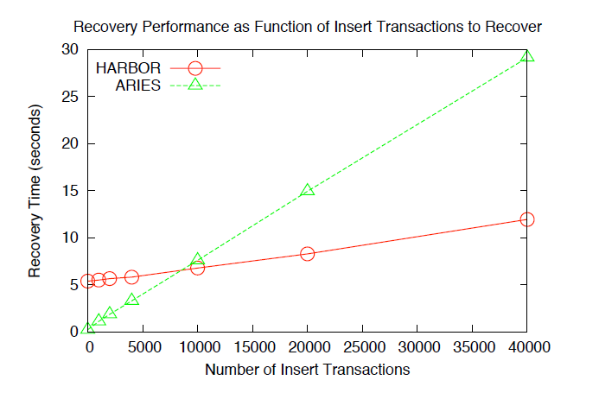
Source: An Integrated Approach to Recovery and High Availability
in an Updatable, Distributed Data Warehouse, Pg. 712
Notes:
After certain point it is more efficient to read in the recovery data from a remote site than to bring in logs and process them.
This experiment omits the optimizations done to ARIES in recent years.

Slide 11
Summary
No stable log required
Non-DBA transactions allowed during recovery.
Exploits historical histories to avoid read locks.
No recovery log → No forced-writes during commit processing.
Performs better than ARIES for insert and update intensive workloads.

Slide 12
Lazy Recovery to reduce recovery overhead.
Recent hacking events should generate some interest in online recovery.
Notes:
Lazy Recovery: the recovery of node is done asynchronously so that the system can function in normal state much earlier than would take for normal recovery.

Slide 13
References
An Integrated Approach to Recovery and High-Availability in an Update, Distributed Data Warehouse; VLDB ’06, September 12-15, 2006.
Improving Recovery in Weak-Voting Data Replication; APPT'07 Proceedings of the 7th international conference on Advanced parallel processing technologies.
Online Recovery in Cluster Databases; EDBT ‘08, March 25 – 30, 2008.
On-Demand Recovery in Middleware Storage Systems; 29th IEEE Symposium on Reliable Distributed Systems, 2010 .

