Slide 1
How E-mail Works
Ameera Al Ghamdi
ID: 201001467

Slide 2
Summary
* What is E-mail?
* How E-mail works?
- How E-mail is delivered over the
internet.
- How E-mail software works.
* References.

Slide 3
What is E-mail?
Electronic mail or email is the exchange of computer-stored messages by telecommunication.
E-mail messages are usually encoded in text. However, you can also send non-text files, such as graphic images and sound files, as attachments sent in binary streams.
E-mail was one of the first uses of the Internet and is still the most popular use.

Slide 4
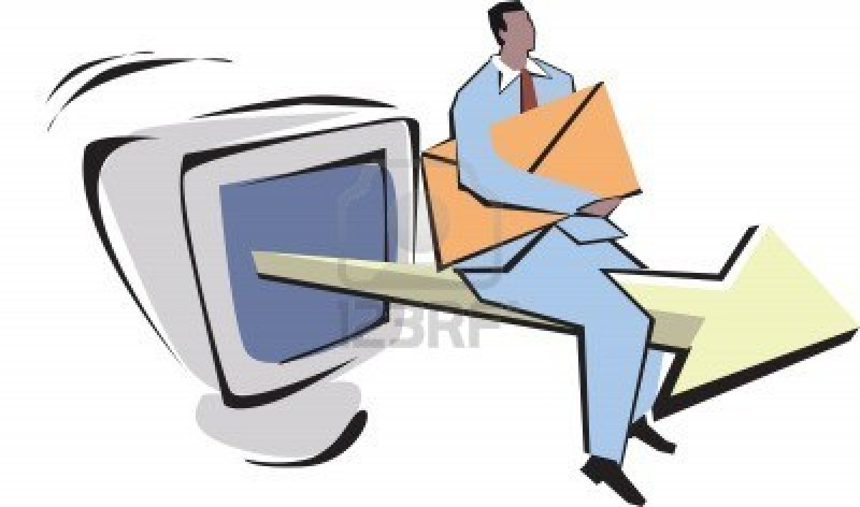
How E-mail works?
How E-mail is
delivered over
the internet.

Slide 5
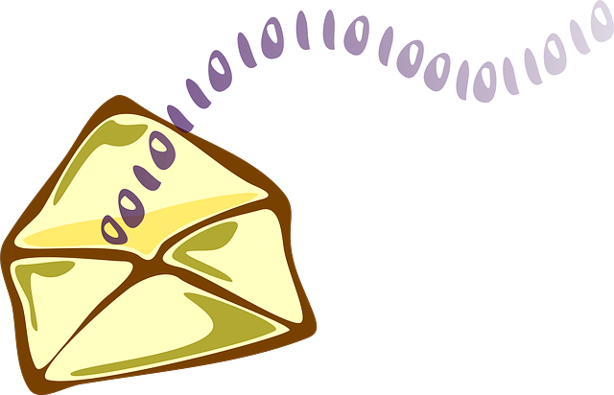
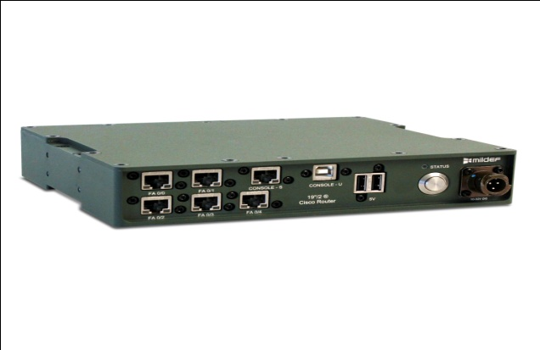
Six steps: 1- After you create & send an e-mail message, it’s sent as a stream of packets using the internet’s TCP\IP protocol. Each packet bears the address of the destination, among many other kinds of information, such as the address of the sender. 2- Routers on the internet look at the addresses in each packets. Each packet might take a different route, so the mail packets can arrive at the destination out of order.

Slide 6
3 - when all the packets have been received at the receiving address, they are recombined into an e-mail message the recipient can read. 4 - Using a mailing lest . You can send a single message to a group of people. A mail reflector is the program that runs on the internet computer and routs mail to members of a mailing list.

Slide 8
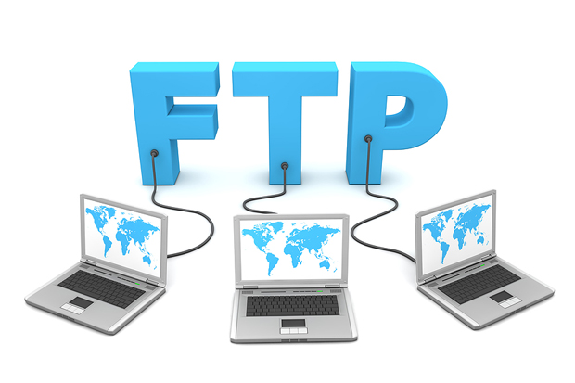
5 - Many internet resources, including FTP servers, can be accessed internevia e-mail access is slower then direct access but it’s helpful when you don’t have a direct connection to the internet.

Slide 10
6 - Using the internet, e-mail can be exchanged among all the major online services, computer bulletin boards and other networks, From the internet, you can send e-mail to any of those networks and from any of those networks mail can be sent to the internet. When mail is sent from one of those networks to another, it often must pass through the internet as a way of routing the mail.

Slide 12
How E-mail software works?

Slide 13
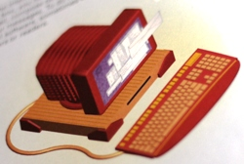
1 – After the internet delivers mail to your email box, you need some way to read the mail,
compose new mail,
and respond to your
messages. To do all
this, you use email
software, sometimes
called mailers or reders.

Slide 14
2 - When someone sends you an internet email message, the message isn’t delivered straight to your computer. Instead, it gets
sent to a mail server.
Your email software logs
in to the mail server and
checks to see whether
you have mail.

Slide 15
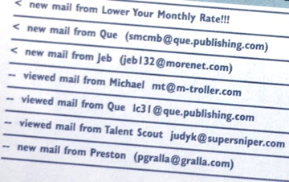
3 - If you have a new mail, you’ll see a list of your new mail messages when you log in to the server. You will often see the name
of the sender,
the subject of the
message and the
date and time
the message was
sent.

Slide 16
4 – When you want to read a mail message, you tell your software to download it to your own computer.
There for, you read the
Message using your
mail reader, and then
you can file it, delete it,
or respond it.

Slide 17
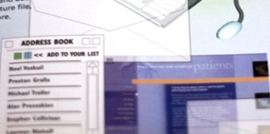
5 – E-mail software enables you to do things such as create folders for storing mail, search through your messenger, keep an address book of people
to whom you send mail,
create group, mailing list,
create
and add a signature
files and more.

Slide 18
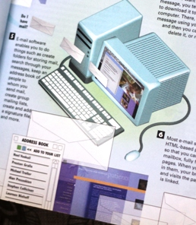
6 – Most e-mail software reads HTML-based pages sent to you so that you can receive, in your mailbox,
fully formatted web
pages. When you click
the links in them,
your browser launches
and visits the
page to which it is linked.

Slide 19
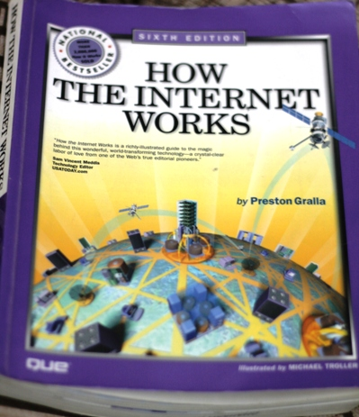
* References.
S I X T H E D I T I O N.
*HOW THE
INTERNET
WORKS*
By Preston Gralla.
Illustrated by:
MICHAEL TROLLER

Slide 20
Thank You
For Listening

