Slide 1
Overview of Electronic Mails
Information Technology Department
Bryar Hassan (BSc & MSc Eng.)
bryar.hassan@kissr.edu.krd

Slide 2
Contents
Email Spelling
Origin of Email
Email Operation
Message Format
Servers and Client Technologies
Types of Emails
Use of Emails
Problems
Case Studies

Slide 3
E-mails Overview
Electronic mail, most commonly called email or e-mail since around 1993
Email is a method of exchanging digital messages from an author to one or more recipients.
Email operates across the Internet or other computer networks.
Spelling
email
e-mail
mail
EMail
E-mail

Slide 4
Origin of E-mail
Host-based mail systems
LAN email systems
Email networks
Attempts at interoperability
From SNDMSG to MSG
ARPANET mail

Slide 5
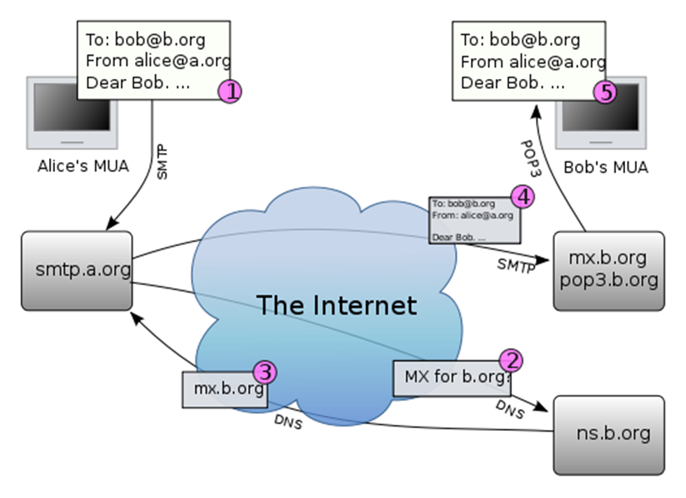
Email Operation
The diagram shows a typical sequence of events
this takes place when sender Alice transmits a message using a mail user agent (MUA) addressed to the email address of the recipient.

Slide 6
Email Operation (Cont.)
The MUA formats the message in email format and uses the submission protocol, a profile of the Simple Mail Transfer Protocol (SMTP), to send the message to the local mail submission agent (MSA), in this case smtp.a.org.
The MSA determines the destination address provided in the SMTP protocol (not from the message header), in this case bob@b.org. The part before the @ sign is the local part of the address, often the username of the recipient, and the part after the @ sign is a domain name. The MSA resolves a domain name to determine the fully qualified domain name of the mail server in the Domain Name System (DNS).
The DNS server for the domain b.org (ns.b.org) responds with any MX records listing the mail exchange servers for that domain, in this case mx.b.org, a message transfer agent (MTA) server run by the recipient's ISP.

Slide 7
Email Operation (Cont.)
smtp.a.org sends the message to mx.b.org using SMTP. This server may need to forward the message to other MTAs before the message reaches the final message delivery agent (MDA).
The MDA delivers it to the mailbox of user bob.
Bob's MUA picks up the message using either the Post Office Protocol (POP3) or the Internet Message Access Protocol (IMAP).

Slide 8
Message Format
Message Header
Header Fields
To
Subject
CC (Carbon Copy)
BCC (Blind Carbon Copy)
From
Date
Message Body
Context Encoding
Plain Text and HTML
Message Header
Message Body
Mail Message

Slide 9
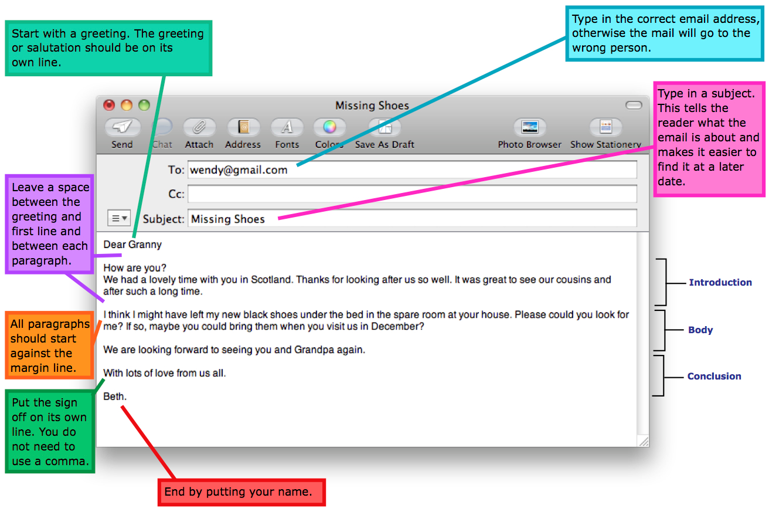
Message Format - Example

Slide 10
Types of Emails
Web-based Email
E.g. AOL Mail, Gmail, Outlook.com and Yahoo! Mail
Allows users to log into the email account by using any compatible web browser
Post Office Protocol 3 (POP3) Email Services
Used by a client application to read messages from the mail server
Internet Message Access Protocol (IMAP) Email Servers
provides features to manage a mailbox from multiple devices
Small portable devices like smartphones are increasingly used to check email while travelling as well as PC is used to check email.
Messaging Application Programming Interface (MAPI) Email Servers
Is an API based on the Component Object Model (COM) for Microsoft Windows.
Notes:
API (application program interface) is a set of routines, protocols, and tools for building software applications. The API specifies how software components should interact and APIs are used when programming graphical user interface (GUI) components.
Which Do I Use to Set Up My Email?
Depending on your personal style of communicating and whom you prefer to get your email service from, you can pretty quickly narrow down how you should use your email.If you use check your email - from a lot of devices, phones, or computers, set up your email clients to use IMAP.
- If you use mostly webmail and want your phone or iPad to sync with your webmail, use IMAP, as well.
- If you’re using one email client on one dedicated machine (say, in your office), you might be fine with POP3, but we’d recommend IMAP.
- If you have a huge history of email and you’re using an old mail provider without a lot of drive space, you may want to use POP3 to keep from running out of space on the remote email server.
- If you use Hotmail or an Exchange Server Email, MAPI or Exchange ActiveSync will give you similar cloud-based syncing, like IMAP.
- If you don’t use Hotmail and you want email sync, use IMAP. If you do use it and want email sync, use MAPI/Exchange ActiveSync.

Slide 11
Uses of Emails
Flaming
Flaming occurs when a person sends a message with angry content
Email Bankruptcy
Also known as "email fatigue", email bankruptcy is when a user ignores a large number of email messages after falling behind in reading and answering them
In Business
Email was widely accepted by the business community as the first broad electronic communication medium and was the first 'e-revolution' in business communication
Pros: logistics and synchronization
Cons: information overload, inconsistency
Mobile
Email has become widely used on smart phones.
Mobile apps for email increase accessibility to the medium.
Notes:
Flaming is a hostile and insulting interaction between Internet users, often involving the use of profanity.
Email bankruptcy is a term used to explain a decision to delete all emails older than a certain date, due to an overwhelming volume of messages.

Slide 12
Problems
Attachment size limitation
Information overload
Spamming and computer viruses
Email spoofing
Email bombing
Privacy concerns
Tracking of sent mail
Notes:
E-mail spoofing is the forgery of an e-mail header so that the message appears to have originated from someone or somewhere other than the actual source.
In Internet usage, an email bomb is a form of net abuse consisting of sending huge volumes of email to an address in an attempt to overflow the mailbox or overwhelm the server where the email address is hosted in a denial-of-service attack.

Slide 13
Case Studies
The U.S. state and federal governments have been involved in electronic messaging and the development of email in several different ways
State countries of the European Union
Universities and Institutes
Companies

Slide 14
Webmail Providers and Products
Main features of webmail providers and products are:
Product
Cost
Mailbox storage
Maximum attachment limit
Supported languages
Support POP3
Support IMAP
Support SMTP support
Account expiration
The attached table compares general and technical information for a number of webmail providers

Slide 15
Recap
typical sequence of Email operation is five steps
Message Format
Message header
Message body
Types of Emails
Web-based Email, POP3, IMAP, and MAPI
Uses of Emails
Flaming, Email Bankruptcy, In Business, and Mobile
Email Problems:
Attachment size limitation
Information overload
Spamming and computer viruses
Email spoofing and bombing
Privacy concerns
Tracking of sent mail

