Slide 1
E-Mail Capturing & E-mail Encryption
60-564 Project
Mohit Sud
Dr. Aggarwal
University of Windsor

Slide 2
Statement of the Problem
Electronic mail (e-mail) messages are one of the most common forms of communication today.
But are our e-mail messages kept private and secure?
How easy is it for someone to eavesdrop and read our e-mails?

Slide 3
Project Overview
Project Scope / Objective
Software, Concepts, & Tools Used
Packet Sniffing
WPA
PGP
Experiment – Packet Sniffing
Experiment – WPA Decryption
Experiment – PGP (E-Mail Encryption)
Observations & Conclusion
Questions
Works Cited

Slide 4
Project Scope / Objective
Demonstrate how vulnerable and insecure an individuals e-mail messages are.
Create an experiment where we simulate how we are able to gain unlawful access to a network
Create an experiment where we simulate how we may then go about reading a network users e-mail messages.
Demonstrate how a user may guard against e-mail privacy invasion.
Create an experiment where we simulate how to protect ourselves against eavesdroppers through the use of cryptography.

Slide 5
Concepts, & Tools Applied
Packet Sniffing
WPA (Wi-Fi Protected Access)
Cryptography
Encrypt & Decryption
PGP (Pretty good Privacy)

Slide 6
Packet Sniffing
What is Packet Sniffing?
When data is transmitted over the internet, it is divided into small chunks known as packets.
The receiver will re-assemble these packets into readable information.
A packet sniffer can gather copies of the incoming and outgoing packets for the network it is eavesdropping on.
A packet sniffer is capable of analyzing these packets and seeing the information that the packet may contain.
A packet sniffer may be considered as a wire-tap device. It is a tool that can eaves drop on network traffic.

Slide 7
Packet Sniffing
How Packet Sniffing Works
The computer running the packet sniffing software is required to be connected to the local area network you wish to eavesdrop on.
Packet sniffing in its simplest environment works best when its associated computer is connected through a hub.
When not connected through a hub but a switch, additionaly steps are needed to be performed to track the switch into behaving as a hub.
Packet sniffing simply acts as a probing device that captures data on the same network.
Although it is required to be on the same LAN, there are ways to work within that limitation.

Slide 8
WPA (Wi-Fi Protected Access)
What is WPA?
Developed by the Wi-Fi Alliance
Addresses weaknesses of WEP
Each packet encrypted with a different code (key)
Keys constantly change
Pre-Shared Key (PSK) generated based on a pass phrase.
Clients use PSK or Passphrase

Slide 9
WPA (Wi-Fi Protected Access)
How WPA works
Resolves weak packet headers and ensures integrity of packets passed through the Message Integrity Check (MIC).
An algorithm TKIP (Temporal Key Integrity Protocol) generates a PSK for each individual packet.
Consumer mode known as WPA-PSK. Keys generated automatically and changed frequently (re-keying).
Periodic authentication is forced.
Re-keying ensures key is very secure.
TKIP handles re-keying and authentication after initial shared secret is entered on the wireless device.

Slide 10
PGP (Pretty Good Privacy)
What is PGP?
An encryption algorithm developed by Phil |Zimmerman in 1991.
Uses the public key / private key cryptography technique.
Key sizes from 512 – 4096 bits.
GP is an application that implements the PGP algorithm and applies it to e-mail messages.
Ensures privacy by encrypting e-mail messages so they appear as a jumble of random characters to everyone except the intended recipient.

Slide 11
PGP (Pretty Good Privacy)
How PGP Works
There are different types of cryptography
Conventional Cryptography
Public Key Cryptography
PGP is a hybrid of both conventional and public key cryptography.
PGP first compresses the plain text.
Benefits include saved disk space, transmission time, stronger encryption.
PGP then creates a random session key based on keystrokes and mouse movements. The key is used with the algorithm to encrypt the plain text, producing ciphertext.
Once encrypted, the session key is then encrypted to the recipient’s public key. The public key’s now encrypted session key is transmitted along with the ciphertext to the recipient.
Decryption works similarly but in reverse. The recipient uses there private key to recover the session key and to decrypt the cipher text.

Slide 12
Experiments
Experiment Creation & Execution
Packet Sniffing
WPA Decryption
PGP Encryption

Slide 13
Experiment – Packet Sniffing
Overview
Packet Sniffing allows an unauthorized individual to read otherwise confidential information from a network user.
Outlined in our experiment is a method for collecting network traffic in the form of packets, and analyzing these packets to read its underlying content.
Specifically, we will demonstrate a method of reading a network users outgoing e-mail message.

Slide 14
Experiment – Packet Sniffing
Test Environment
Hardware
Product Type | Model | Specifications
Laptop Computer | Toshiba Portege R500 | Microsoft Windows XP SP3 Intel Centrino Duo 1.2Ghz. 1gb. DDR2 RAM 160gb hard drive Intel 3945ABG Pro/Wireless 802.11g
Desktop Computer | Custom Build | BackTrack 3 Live CD Intel Core 2 Duo 2.2Ghz. 2gb. DDR2 RAM, 250gb hard drive D-Link 510N 802.11g Wireless Card with Prism
Hub | Linksys 4 Port Hub | 10/100 MB
High Speed Internet | Cogeco | 10mbps Download Speed 3 IP Addresses
Software
Software Title | Description | Availability
Microsoft Windows XP | The Operating system
Wireshark | The packet sniffing & analyzing tool. | http://www.wireshark.org/
Mozilla Thunderbird | The e-mail client sending out an e-mail. | http://mozzila.com/

Slide 15
Experiment – Packet Sniffing
Execution
Installation & Configuration
Install Mozilla Thunderbird on the victim computer that is running the Windows XP Operating System.
Configure Mozilla Thunderbird with the information for our e-mail account.
Install Wireshark on the eavesdropping computer.
Connect all computers directly to the HUB.

Slide 16
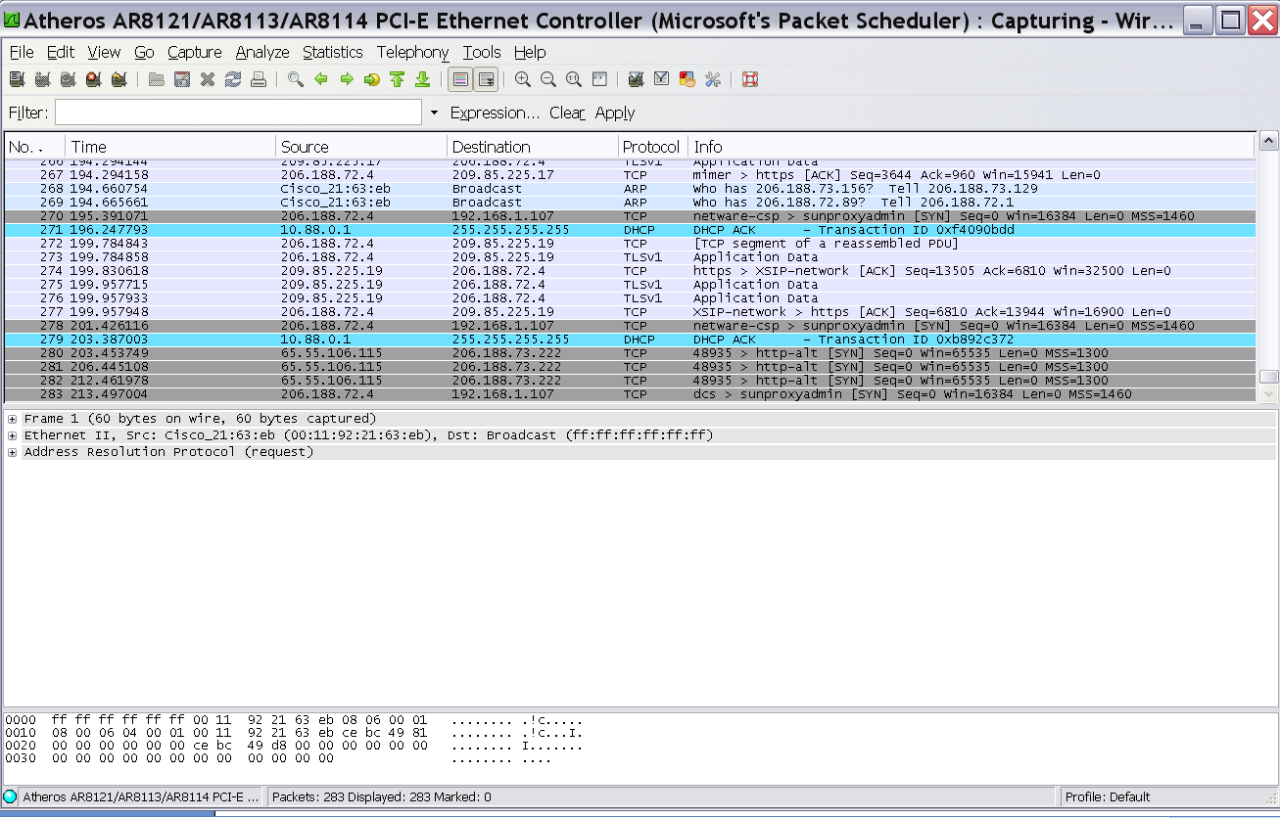
Experiment – Packet Sniffing
Execution
Trial
Begin capturing packets on the network by selecting Capturing -> Start from within Wireshark.

Slide 17
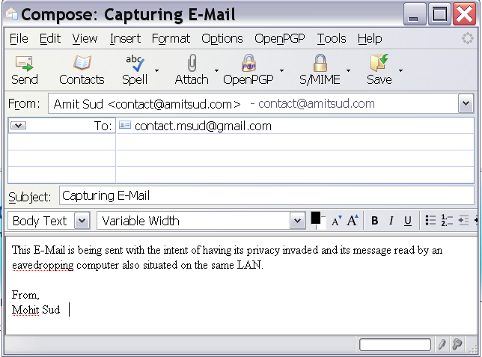
Experiment – Packet Sniffing
Execution
Trial
2. Have the victimized computer send out any plain unencrypted e-mail message through Mozilla Firefox.

Slide 18
Experiment – Packet Sniffing
Execution
Trial
3. Notice how Wireshark immediately captures the SMTP packets being sent.

Slide 19
Experiment – Packet Sniffing
Execution
Trial
Analyze the SMTP packets to obtain the e-mail message contents.
The screenshot is on the following page. If you will notice at the bottom in the packet analysis section, the e-mail message is visible in plaintext.

Slide 20
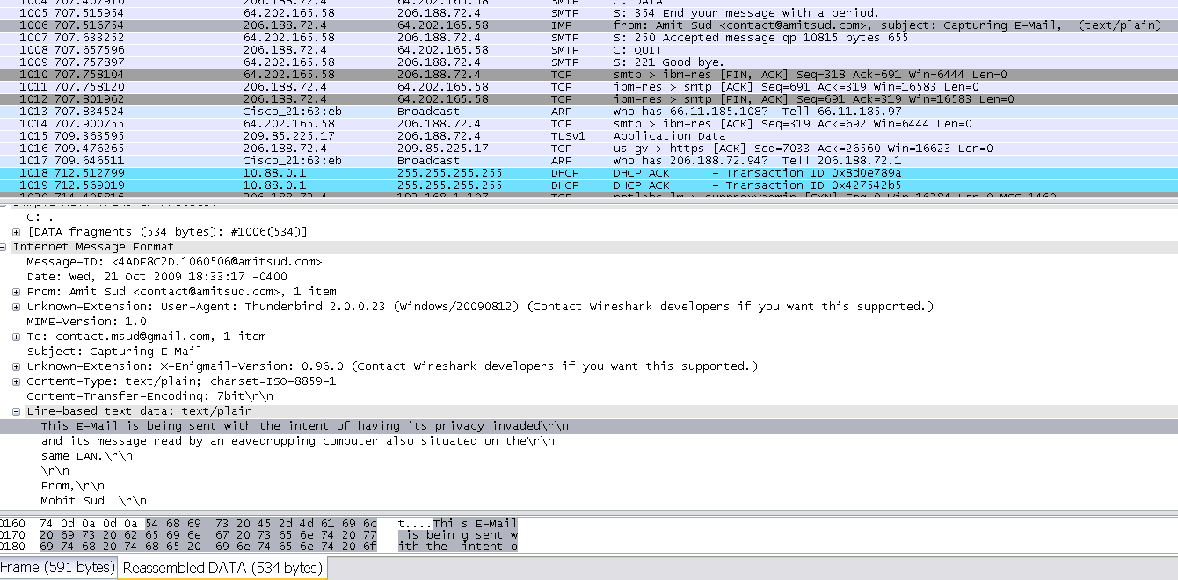
Experiment – Packet Sniffing
4. Analyze the SMTP packets to obtain the e-mail message contents.

Slide 21
Experiment – Packet Sniffing
Results
Wireshark was easily enabled to eavesdrop on network traffic; collecting those packets and analyzing those packets.
Wireshark identified SMTP mail packets, and clearly displayed its underlying contents.
Packet inspection revealed the contents of those packets, and clearly displayed the e-mail message.
Thus, the experiment was successful. We were able to eavesdrop and read a network users private e-mail message.

Slide 22
Experiment – WPA Decryption
Overview
Various vulnerabilities in WPA encryption that can be exploited.
When exploited, it allows an unauthorized user to obtain the passphrase for that network, and ultimately to gain access to that network.
Demonstrated is a method of retrieving the passphrase from a WPA encrypted network by using various techniques including; sniffing, handshake collecting, and brute force.
2 modes of WPA encryption
RADIUS
PSK
The authentication handshake capture is the main requirement/vulnerability.
Once handshake is obtained, brute force to obtain the WPA passphrase.

Slide 23
Experiment – WPA Decryption
Test Environment
Hardware
Product Type | Model | Specifications
Laptop Computer | Toshiba Portege R500 | Microsoft Windows XP SP3 Intel Centrino Duo 1.2Ghz. 1gb. DDR2 RAM, 160gb hard drive Intel 3945ABG Pro/Wireless 802.11g
Desktop Computer | Custom Build | BackTrack 3 Live CD Intel Core 2 Duo 2.2Ghz. 2gb. DDR2 RAM, 250gb hard drive D-Link 510N 802.11g Wireless Card with Prism
Router | Linksys WRT-310N | Supports 802.11ngb 10/100/1000 MB. Supports WEP, WPA, WPA2
High Speed Internet | Cogeco | 10mbps Download Speed 3 IP Addresses
Software
Software Title | Description | Availability
Backtrack 3 Live CD | Includes the Operating system and all of the tools necessary for WPA decryption. | http://www.remote-exploit.org/backtrack.html
Aircrack | The main software suite for WEP/WPA decryption. | http://www.aircrack-ng.org/
MadWifi Drivers | Wireless card drivers to enable injection mode. | http://madwifi.org/

Slide 24
Experiment – WPA Decryption
Execution
Installation & Configuration
Backtrack 3 Live CD http://www.remote-exploit.org/backtrack.html
Includes Airecrack-ng suite
Includes patched mad-wifi drivers
Simply insert the CD and reboot the computer. The Live CD will automatically load the linux operating system.

Slide 25
Experiment – WPA Decryption
Execution
Test Cases
Passphrase | Type | Expected Difficulty
alphabet | Dictionary Term | Easy
SUPER­CALI­FRAGI­LISTIC­EXPI­ALI­DOCIOUS | Dictionary Term | Easy-Medium
abcdefghijklmnopqrstuvwxyz | Random Letters | Hard
Fdlk8932fdssfjq9ruq234sjflkafd20394asldkfj | Random numbers and letters | Unfeasible

Slide 26
Experiment – WPA Decryption
Execution
Trial
Enable Monitor Mode.
Monitor Mode allows us to use the wireless network card to capture and inject packets as required.
airmon-ng stop ath0
airmon-ng start wifi0 9

Slide 27
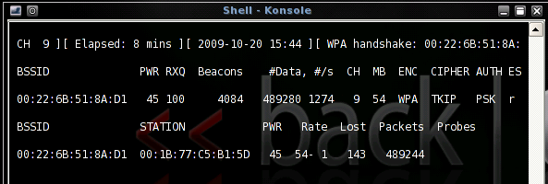
Experiment – WPA Decryption
Execution
Trial
Collect Authentication Handshake – Enable Capture Mode
Captures and record the full authentication process.
To capture a handshake a wireless client must authenticate itself with the access point.
airodump-ng -c 9 --bssid 00:22:6B:51:8A:D1 -w psk ath0

Slide 28
Experiment – WPA Decryption
Execution
Trial
De-Authenticate the Wireless Client
Optional. May speed up the handshake capture process.
Forces client to reauthenticate, and repeat the handshake process.
aireplay-ng -0 1 -a 00:22:6B:51:8A:D1 -c 00:1B:77:C5:B1:5D ath0

Slide 29
Experiment – WPA Decryption
Execution
Trial
Decipher the Pre-Shared Key (PSK)
Intent is to determine the passphrase or PSK.
Uses a brute force approach with a supplied dictionary. Tries each term in a dictionary against the handshake procedure in search for a succesful match. If found, our passphrase is obtained.
aircrack-ng -w dictionary.lst -b 00:22:6B:51:8A:D1 psk*.cap

Slide 30
Experiment – WPA Decryption
Execution
Trial

Slide 31
Experiment – WPA Decryption
Execution
Trial

Slide 32
Experiment – WPA Decryption
Results
Using various techniques we were able to capture the full authentication handshake.
Using brute force in conjunction with a simple dictionary against the collected handshake data, we were successful at obtaining the passphrase when a common dictionary word was used as the passphrase.
Eg. ‘alphabet’ and ‘supercalifragilisticexpialidocious’ were easily derived
Random passphrases such as
When a non-dictionary term was used, the brute force attempt failed and we were not able to derive the pass phrase
Thus, WPA can be very secure providing a strong passphrase is chosen.

Slide 33
Experiment – PGP (E-Mail Encryption)
Overview
It is easy for an eavesdropper to be able to read the contents of our e-mail message. However, if its contents were encrypted, they would not be able to make sense of the data.
PGP is a technique used to encrypt and decrypt e-mail messages
Our test experiment outlines a method of securing an e-mail message:
The sender obtains the recipients public key.
The sender encrypts it’s e-mail message with the retrieved public key and then sends it out.
The recipient receives the e-mail and uses its private key to decipher the ciphertext into plaintext.

Slide 34
Experiment – PGP (E-Mail Encryption)
Test Environment
Hardware
Product Type | Model | Specifications
Laptop Computer | Toshiba Portege R500 | Microsoft Windows XP SP3 Intel Centrino Duo 1.2Ghz. 1gb. DDR2 RAM, 160gb hard drive Intel 3945ABG Pro/Wireless 802.11g
Desktop Computer | Custom Build | Microsoft Windows XP Intel Core 2 Duo 2.2Ghz. 2gb. DDR2 RAM, 250gb hard drive D-Link 510N 802.11g Wireless Card
High Speed Internet | Cogeco | 10mbps Download Speed 3 IP Addresses
Software
Software Title | Description | Availability
Microsoft Windows XP | Operating system
Mozilla Thunderbird | Mail client | http://www.mozilla.com
Enigmail Mail Extension | Mail client add on | http://enigmail.mozdev.org
GNUPG | PGP application | http://gnupg.org/
2 E-mail accounts | Two accounts to act as sender and recipient. | Using http://godaddy.com email accounts.

Slide 35
Experiment – PGP (E-Mail Encryption)
Execution
Installation & Configuration
Install Mozilla Thunderbird on a computer running the Windows XP Operating System.
Configure Mozilla Thunderbird with the information for our e-mail account.
Install the Enigmail extension into Mozilla Thunderbird.
Install GNUPG and configure Enigmail to find the GNUPG installation files.
Use Enigmail to generate your public and private keys. This is accomplished by entering a passphrase, and selecting the ‘Generate Key’ button. (screenshot on next page)

Slide 36
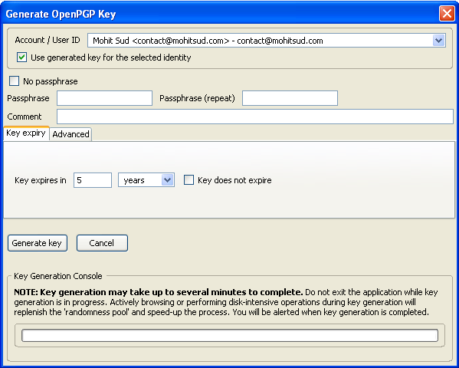
Experiment – PGP (E-Mail Encryption)
Execution
Installation & Configuration

Slide 37
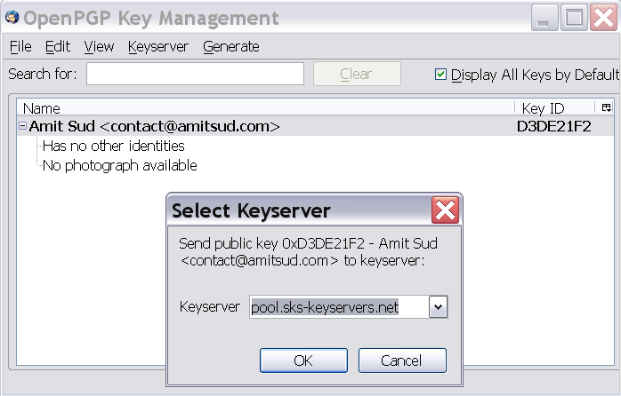
Experiment – PGP (E-Mail Encryption)
Execution
Trial
The recipient must publish their public key. (E-mail, Keyserver, Verbal)
The sender must obtain the recipients public key.

Slide 38
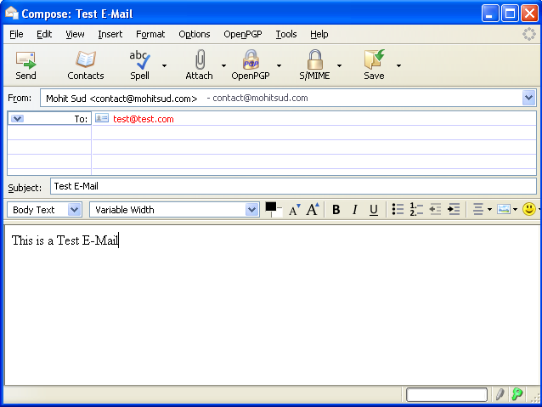
Experiment – PGP (E-Mail Encryption)
Execution
Trial
Sender may then proceed to sending an encrypted e-mail.
The sender composes an e-mail as they would normally
To enable e-mail encryption feature, they would simply select the ‘encryption key’ icon located on the bottom right of the compose e-mail window.

Slide 39
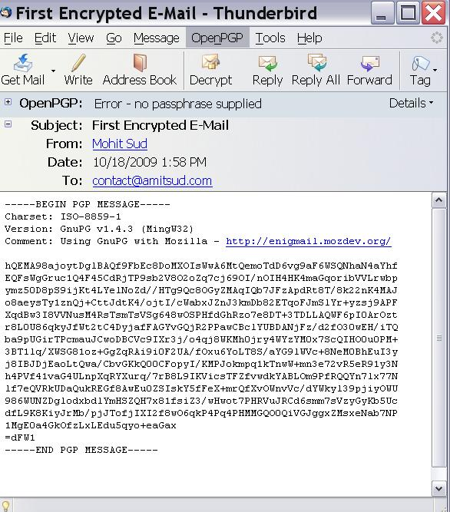
Experiment – PGP (E-Mail Encryption)
Execution
Trial
The recipient receives the e-mail as encrypted text
A random jumble of characters.

Slide 40
Experiment – PGP (E-Mail Encryption)
Results
The results demonstrated that the sender was able to:
retrieve the recipient’s public key,
encrypt the e-mail,
send it out for delivery.
The recipient successfully received the e-mail and decreypted it using there private key and the session key embedded in the encrypted message.
Overall, a highly successful trial that ensured the security and privacy of our e-mails.

Slide 41
Observations & Conclusion
Successful experiment of obtaining WPA passphrase and accessing a restricted network.
Successful experiment of packet sniffing where we captured the packets of an outgoing e-mail and inspected it to read the e-mail message.
Above demonstration shows how insecure e-mail messages can be.
Successfully displayed a method of encrypting and decrypting e-mail messages to ensure privacy.
Overall, e-mails are insecure and cryptography is an easy-to-use measure to ensure privacy.

Slide 42
Any Questions?
Are there any questions, comments or feedback regarding this presentation?

Slide 43
Works Cited
The GNU Privacy Guard - GnuPG.org. Web. <http://www.gnupg.org/>.
"Enigmail: Download Enigmail." Enigmail: A simple interface for OpenPGP email security. Web. <http://enigmail.mozdev.org/download/index.php>.
"How to encrypt your email - Downloads - Lifehacker." Lifehacker, tips and downloads for getting things done. Web. <http://lifehacker.com/180878/how-to-encrypt-your-email>.
"Overview of PGP." The International PGP Home Page. Web. <http://www.pgpi.org/doc/overview/>.
"The comp.security.pgp FAQ." Top Level page for www.pgp.net at cam.ac.uk.pgp.net [08040909]. Web. <http://www.pgp.net/pgpnet/pgp-faq/>.
"Pretty Good Privacy." WWW.GAMERS.ORG. Web. <http://www.gamers.org/~tony/pgp.html>.
"How PGP works." The International PGP Home Page. Web. <http://www.pgpi.org/doc/pgpintro/#p1>.

Slide 44
Works Cited Continued
"What is WPA security?" Belkin : WPA. Web. <http://en-us-support.belkin.com/app/answers/detail/a_id/34>.
"WPA Wireless Security for Home Networks." Microsoft Corporation. Web. <http://www.microsoft.com/windowsxp/using/networking/expert/bowman_03july28.mspx>.
"Cracking_wpa." Aircrack-ng. Web. <http://aircrack-ng.org/doku.php?id=cracking_wpa>.
"Openwall wordlists collection for password recovery, password cracking, and password strength checking." Openwall Project - Information Security software for open environments. Web. <http://www.openwall.com/wordlists/>.
"Packet Sniffing - Part 1 (wiretaps, protocol decoding and surveillance)." SuraSoft - Keeping your computer safe! AntiSpyware & Security Information. Web. <http://www.surasoft.com/articles/packetsniffing.php>.
FrontPage - The Wireshark Wiki. Web. <http://wiki.wireshark.org>.

