Slide 1
Black Hole Attack and its Counter Measures in AODV Routing Protocol
Varsha Patidar, Rakesh Verma
Mengfei Peng

Slide 2
AODV-Ad hoc On-Demand Distance Vector (AODV) Routing
In AODV, the network is silent until a connection is needed.
At that point the network node that needs a connection broadcasts a request for connection.
Other AODV nodes forward this message, and record the node that they heard it from, creating an explosion of temporary routes back to the needy node.
When a node receives such a message and already has a route to the desired node, it sends a message backwards through a temporary route to the requesting node.
The needy node then begins using the route that has the least number of hops through other nodes. Unused entries in the routing tables are recycled after a time.
When a link fails, a routing error is passed back to a transmitting node, and the process repeats.

Slide 3
broadcasts a request
Other AODV nodes forward this message
C
A
F
S
M
H
D
B
G
E

Slide 4
message backwards
3
C
A
2
4
F
S
3
2
1
1
M
H
D
1
4
B
G
E
2
3

Slide 5
Black hole attack- black hole drops message
C
A
F
S
M
H
D
B
G
E

Slide 6
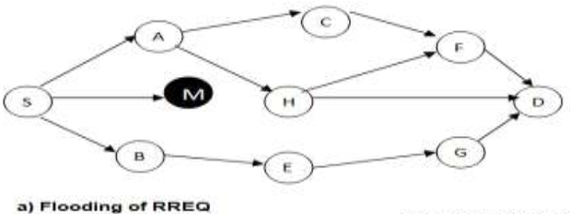
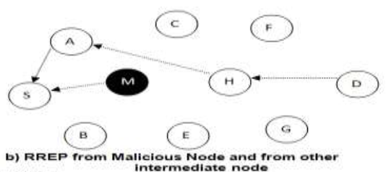
Black hole attack

Slide 7
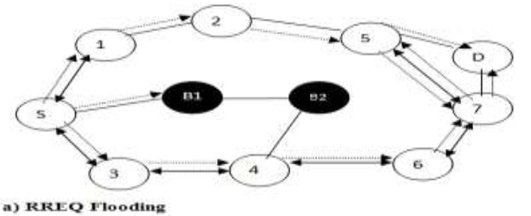
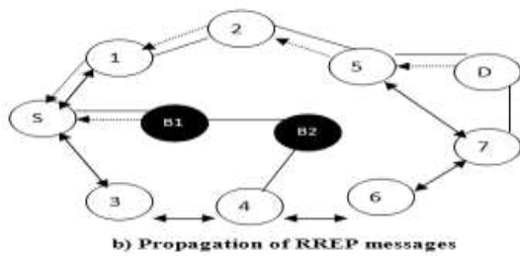
Co-operative Black hole attack

Slide 8
watch dog- Mitigating routing misbehavior in mobile ad hoc networks
Marti S, Giuli TJ,Lai K, Baker M. Mitigating routing misbehavior in mobile ad hoc networks. International conference on mobile
computing and networking, August 2000. Pp 255-265

Slide 9
In watch dog, to detect the misbehavior in the path, it listens the transmission of the next node.
In watch dog mechanism, the state information is maintained on monitored nodes,
but the transmitted packets increase the memory overhead.

Slide 10
Watchdog method
S
A
B
C
D
A
B
C
A
B
C
A overhear B's transmission and can verify that B has attempted to pass the packet to C.

Slide 11
Disadvantages-collision
1.
2.
First time A think B is BH, A will mark B but not tell S. Then A continue watch B.

Slide 12
Disadvantages-cheating
S
A
M
B
D
M is the BH, but M will attempt to cheat A that B is the BH.
A knows M doesn’t forward messages, but A thinks it’s B’s problem.

Slide 13
Pathrater
The pathrater, run by each node in the network
Each node maintains a rating for every other node it knows about in the network.
It calculates a path metric by averaging the node
ratings in the path

Slide 14
Pathrater
0.5
0.5
I
A
0.5
F
1
0.5
0.5
P
C
H
D
0.5
0.5
B
G
the pathrater assigns the nodes a "neutral" rating of 0.5
A node always rates itself with a 1.0

Slide 15
Pathrater
0.5
0.5
I
A
0.5
F
1
0.5
0.5
P
C
H
D
0.5
0.5
B
G
if all other nodes are neutral nodes, the path rater picks the shortest length path

Slide 16
Pathrater
400 ms
0.5
200 ms
0.5
I
A
0.5
F
1
0.5
0.5
P
C
H
D
0.52
0.51
0.5
0.51
0.5
0.52
B
G
Every 200 ms, the path rater will increase the rate of the active nodes –active nodes are the ones which sent messages in the last 200ms.(maximum value: 0.8)

Slide 17
Pathrater
0.5
0.5
I
A
0.5
F
1
0.5
0.5
P
C
H
D
0.45
0.5
B
0.45
0.5
The path rater will decrease a node's rating by 0.05 when we detect a link break during packet forwarding and the node becomes unreachable. (lower bound rating:0.0)
G

Slide 18
Pathrater and watchdog
watchdog finds out the misbehaviour nodes(BH)
Path rater decreases the rate of the BH
Pate rater increases the rate of active nodes
Pate rater chooses the path with the highest average rate
nodes that have negative ratings should have their ratings slowly increased or set back to a non-negative value after a long timeout (in case of some nodes are mismarked as BH)

Slide 19
The end
The paper published in 2000, so it’s an old paper;
To their knowledge, there is no previously published work on detection of routing misbehaviour specific to ad hoc networks
They said they are the first, which is good, but also means:
Their method has a lot of problems, such as: collision, cost, memory, time……
The way they get their simulation result is not connected to my research topic; so I don’t talk about it too much;
Anyway, watchdog and pathrater are interesting mechanism and can be used in the future

