Slide 1
Performance Analysis of Routing Protocols in Mobile Ad-Hoc Network
Bikram Ballav

Slide 2
Roadmap
Introduction
Wireless network
MANET routing protocols
What’s new in this paper
Network Simulator
Quality of Service parameters
Results and Analysis of performance
Conclusion
Future Work
References

Slide 3
Wireless Network
Set of connecting computers that share information forms a network.
Wireless Networking have no Physical connectivity, radio frequencies are used to communicate between computers.
Categorized into two types Centralized and De-centralized .
In centralized network base station is fixed and for de-centralized base station is arbitrary.
Mobile Ad-Hoc Network or MANET is a kind of Wireless Network which is a collection of autonomous nodes where each node acts as router.
No fixed infrastructure and Dynamic network topology .
Multi-hop communication .
Challenging for transferring data towards proper destination.

Slide 4
Routing Protocols in MANET
Routing is main procedure for data transmission in wireless network.
Mobility creates limited bandwidth and energy consumption .
Routing Protocols classified into three kinds e.g. Re-active or On-demand based, Pro-active or Table driven protocols and Hybrid protocols.
Challenges
Network topology is changing over time
Battery Constraints
No centralized authority

Slide 5
Routing Protocols in MANET
Re-active Routing Protocols
Ad-hoc On-demand Distance Vector (AODV)
Use three types of messages i) RREQ ii) RREP iii) RERR
Advantage:
Paths are created when needed which causes a reduction on routing load.
Lower delay for connection setup .
Ad-hoc On-demand Multipath Distance Vector (AOMDV)
Calculate more than one paths in a single path discovery procedure.
Allows intermediate node to reply to RREQ.
Advantage:
Reduce discovery time to search for a route.
Low overhead to search for a route.
Power Aware Ad-hoc On-demand Distance Vector (PAAODV)
Works with more than one power levels during path searching procedure.
Advantage:
Reduction of power consumption for each data packet.
Creation of low overhead for route searching procedure.

Slide 6
Routing Protocols in MANET
Dynamic Source Routing (DSR)
Based on two techniques: Path Discovery and maintaining that path .
Advantage:
Lowest Control overhead in terms of number of control packets.
Useful for low mobility network .
Pro-active Routing Protocols
Destination Sequenced Distance Vector (DSDV)
Use route table for path searching .
Advantage:
Suitable for small networks where topology changes are limited.
Create networks with less number of nodes.
Hybrid Routing Protocols
Nodes are grouped into multiple Zones, inside a zone table driven mechanism used and outside a zone on demand routing is applied.
Example:- Zone Routing Protocol (ZRP) ,
Temporary Ordered Routing Algorithm (TORA)

Slide 7
What’s New this Paper describes
In previous researches, comparison between AODV, DSR, DSDV and AOMDV has been done.
In this paper a new comparison table using PAAODV has been added and all five protocols have been compared.
For comparing the performance of all these five protocols (Network Simulator version 2.35) NS2.35 have been used.
NS2 is a research based discrete-event simulator which helps to simulate mobile ad-hoc networks.

Slide 8
Quality of Service Parameters
End to End Delay
The time which is spent by the packets to reach towards destination
Throughput
Defined by the amount of received data by the destination nodes in a period of time
Packet Delivery Ratio
This is the ratio of the number of data packets successfully delivered to the destinations to those generated by sources.
PDR = ((received packets/sent packets) * 100).
Residual Energy
It is the remaining energy at every node which is the energy left after the packet transmission
Residual Energy (RE) = E(i) – Ec(t)
Where E(i) = The primary energy of a node and
Ec(t) = Energy used up by a node after time t

Slide 9
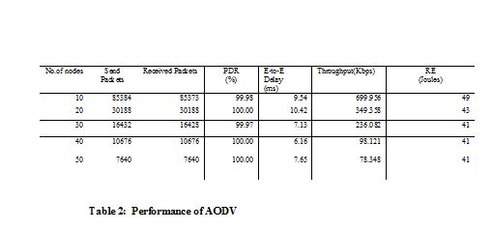
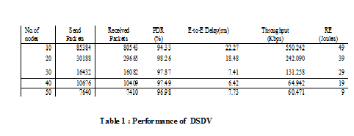
Results

Slide 10
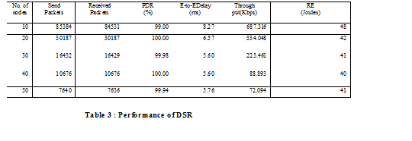
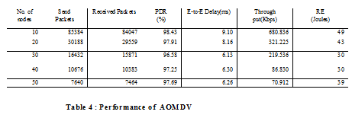
Results

Slide 11
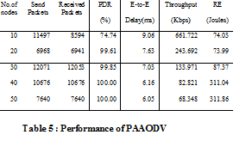
Results

Slide 12
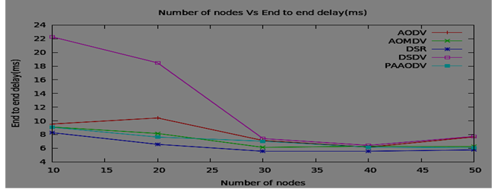
Performance Analysis
DSR has shortest end to end delay value and DSDV has more end to end delay value than the rest protocols.
Hence DSR gives best performance.

Slide 13
Throughput vs Number of Nodes
AODV has better throughput value compared to DSR, PAAODV, AOMDV and DSDV.
With increasing number of nodes the throughput value of AOMDV is same as the throughput value of DSR.
AODV gives better performance as compared to the other protocols in terms of throughput.

Slide 14
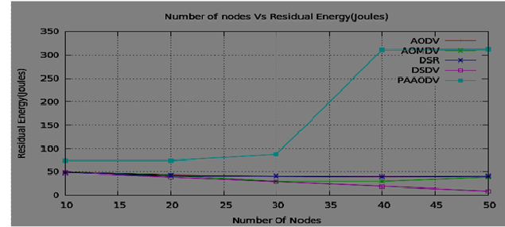
Residual Energy vs Number of Nodes
This figure shows the remaining energy during progress of simulation.
PAAODV gives a better performance based on residual energy and has more remaining energy value as compared to other protocols.

Slide 15
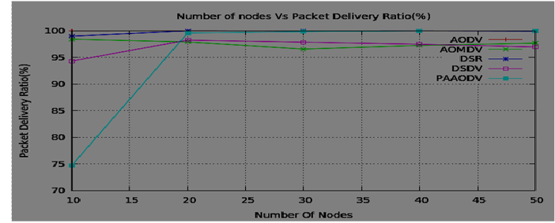
Packet Delivery Ratio vs Number of Nodes
initially PAAODV gives less packet delivery ratio value compared to other protocols.
With the increasing number of nodes PAAODV has better PDR value as compared to AODV, DSDV and AOMDV.
PAAODV gives same PDR value as DSR with increasing number of nodes.
DSR gives more packet delivery ratio value and better performance compared to other protocols.

Slide 16
Conclusion
DSR gives good performance when comparing to PAAODV, AODV, AOMDV and DSDV in terms of packet delivery ratio and end to end delay.
AODV gives better performance than PAAODV, AOMDV, DSR and DSDV in terms of throughput.
PAAODV has better performance in terms of residual energy.
In overall DSR provide better performance than AODV, DSDV, AOMDV and PAAODV.

Slide 17
Future Work
For future work these five protocols can be compared with other Quality of Service parameters like
node mobility with increasing number of nodes and using simulators other than NS2 like glomosim, qualnet, Omnet++ etc .
We can add more MANET protocols like TORA or ZRP for comparing their performances with these existing protocols.

Slide 18
References
[1] Samir R. Das, Charles E. Perkins, Elizabeth M. Royer. and Mahesh K. Marina, “Performance comparison of Two On-demand Routing Protocols for Ad Hoc Networks”, IEEE INFOCOM 2000 conference, 2000.
[2] Sachin Kumar Gupta and R K Saket, “Performance Metric Comparison of AODV and DSDV Routing Protocols in MANETs Using NS-2”,IJRRAS,Vol. 7, Issue No.3, June 2011.
[3] S. Vanthana and Dr. V.Sinthu Janita Prakash, “Comparative Study of Proactive and Reactive Adhoc Routing Protocols Using NS2”, IEEE –World Congress On Computing and Communication Technologies, 2014.
[4] Manveen Singh Chadha and Rambir Joon Sandeep, “Simulation and Comparison of AODV, DSR and AOMDV Routing Protocols in MANETs”, International Journals of Soft Computing and Engineering (IJSCE), Vol.2,July 2012.
[5] Dr. D. Sivakumar and B. Suseela, “A Survey of Routing Algorithms For MANET ”, IEEE-International Conference On Advances in Engineering, Science, Management (ICAESM-2012).
[6] David B. Johnson, “Routing in Ad Hoc Networks of Mobile Hosts”, Proceedings of the Workshop on Mobile Computing Systems and Applications, pp. 158–163, IEEE Computer Society, Santa Cruz, CA. December 1994.
[7] P. Manickam, T. Guru Baskar, M.Girija and Dr.D. Manimegalai, “Performance Comparison Of Routing Protocols In Mobile Ad Hoc Networks”, IJWMN, 2011.
[8] Echchaachoui, Adel, et al. “Comparative Performance Analysis of AODV and AOMDV in Networked Systems”, Springer Berlin Heidelberg, 2013.

Slide 19
References
[9] Binod Kumar Pattanayak, Manoj Kumar Mishra, Alok Kumar Jagadev and Ajit Kumar Nayak, “Power Aware Ad Hoc On-demand Distance Vector (PAAODV) Routing for MANETS”, Journal of Convergence Information Technology, Volume 6, Number 6, June 2011.
[10] Perkins and Bhagwat, “Highly Dynamic Destination Sequenced Distance-vector Routing (DSDV) for Mobile Computers”, ACM SIGCOMM ’94 Conference,1994.
[11] Raj Jain, “Art of Computer Systems Performance Analysis Techniques For Experimental Design Measurements Simulation And Modeling”, Wiley Computer Publishing, John Wiley & Sons, Inc, 1991.
[12] NS2 Tutorial by Marc Greis http://www.isi.edu/nsnam/ns/.
[13] Thakur Anuja, Sharda Patel, and Ashok Verma. “Performance Evaluation of AODV, DSDV and DSR Routing Protocols using NS-2 Simulator”, International Journal Of Engineering Science & Research technology, 2014.
[14] Kavita Pandey and Abhishek Swaroop, “ A Comprehensive Performance Analysis of Proactive, Reactive and Hybrid MANETs Routing Protocols”, IJCSI International Journal of Computer Science Issues, Vol. 8, Issue 6, No 3, November 2011.
[15] Mohammed Bouhorma, H. Bentaouit, and A.Boudhir, “Performance comparison of Adhoc Routing Protocols AODV and DSR”, IEEE,2009.
[16] May Cho Aye and Aye Moe Aung, “Energy Efficient Multipath Routing For Mobile Ad Hoc Networks”, International Journal of Information Technology, Modeling and Computing (IJITMC) Vol. 2, No.3, August 2014.
[17] Rais Khan, Ansari Mohammad NabiAzad and Anilkumar Vishwakarma, “Enhancement of Manet Routing Protocol”, IEEE,2014.

Slide 20
Questions ?

