Slide 1
Effective Leadership Principles for Virtual Teams
Marie Mallory
Regent University
Pinecone ridge research
www.Pineconeridge.com

Slide 2
A Virtual Team:
a group of individuals who work across time, space and organizational boundaries with links strengthened by webs of communication technology.
Also known as:
Geographically Dispersed Team
Distributed Team
Remote Team
http://en.wikipedia.org/wiki/Virtual_team

Slide 3
Benefits of the Virtual Team:
Flexibility & Availability
Comparatively Low Cost
Effective Results

Slide 4
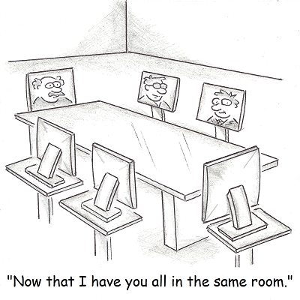
Drawbacks of the Virtual Team
Increased Cognitive Burden (Information Overload)
Funding Challenges
Increased Work Time
Richardson, LaFrance & Beck, 2015

Slide 5
Leading a Virtual Team

Slide 6
Leading the Virtual Team: Primary Challenges
Effective
Communication
Relationship Building
Managing Conflicts
Leadership
Maznevski, Davison & Jonsen, 2006

Slide 7
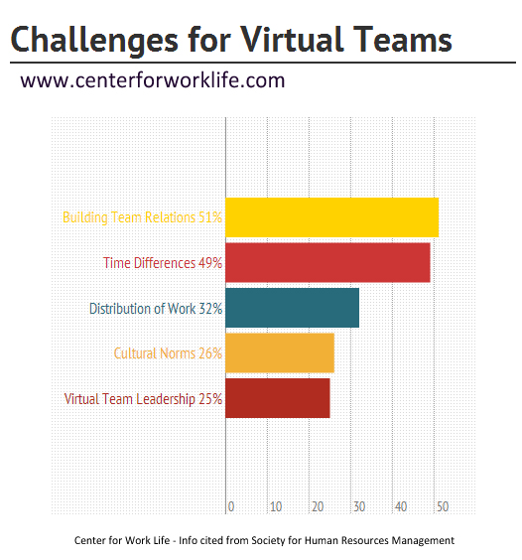

Slide 8
2 Styles of Leadership: Comparison
Transactional
Transformational
Motivates individual effort by engaging in exchange with the follower
Behaviors:
Clarifies task expectations
Provides rewards when expectations are met
Reduces cognitive effort
Motivates followers intrinsically
Behaviors:
Helps followers indentify with the group’s vision and perspectives
Serves as a role model
Negatively associated with short-term tasks
Increases cognitive effort
Bass, 1998 / Judge & Piccolo, 2004 / Jung, 2001 / Kahai, Jestire & Huang, 2013

Slide 9
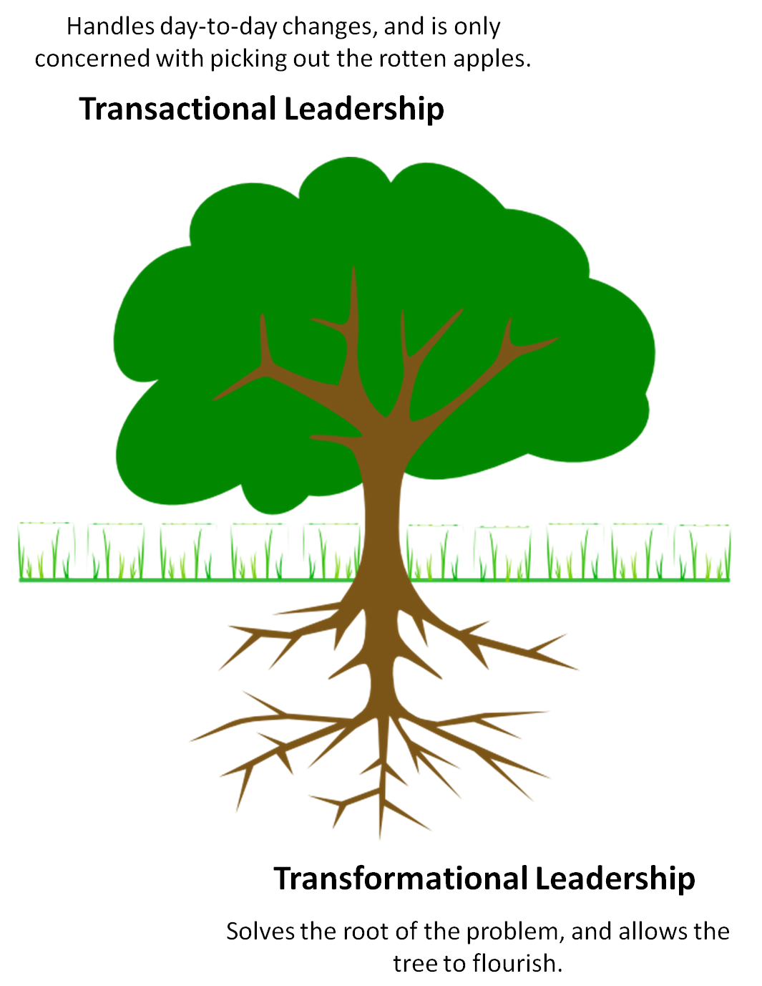
Can You See the Difference?
Transformational Leaders
Coach & Mentor
Lead by Example
Inspire
Provide Meaning
&
Interest

Slide 10
Other Virtual Leadership Styles
Participative: linked to higher member participation when an appointed leader exists.
Directive: higher performance & participation levels than face-to-face teams.
Cruz, Henningsen & Smith, 1999
Kahai, Sosik & Avolio, 2004

Slide 11
The Role of the Virtual Team Leader
Monitoring team member behavior, performance & progress
Devising & implementing effective solutions to issues
Direct interaction with team members
Bell & Kozlowski, 2002

Slide 12
The Effective Virtual Leader: Communicates
Reciprocally
Offers feedback
Provides prompt responses
Goals
Clean
Precise
Responsibility
Clear directions
Clear division of tasks
Communicates regularly
Clear

Slide 13
Effective Leaders
Are:
Cordial, yet assertive
Understanding
Empathetic
Authoritative
Neither arrogant nor timid
Kayworth & Leidner, 2002

Slide 14
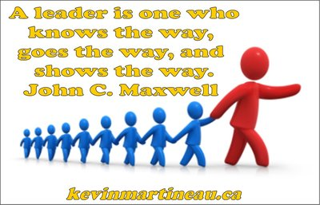
The Effective Virtual Leader: Mentors & Models

Slide 15
The Effective Virtual Leader: Is a Role Model
The most effective leaders exhibit “strong relational skills through their mentoring activities with team members… First and foremost, team members wanted a mentor – someone to guide, to encourage, and to motivate them to excellence.”
Kayworth & Leidner, 2002, p. 27

Slide 17
References
Bass, B. M. (1998). Transformational leadership: industrial, military, and educational impact. Mahwah, NJ: Lawrence Erlbaum Associates.
Bell, B. S. & Kozlowski, S. W. J. (2002). A typology of virtual teams: Implications for effective leadership. Group and Organizational Management, 27(1), 14-49.
Cruz, M. G., Henningsen, D. D. & Smith, B. A. (1999). The impact of directive leadership on group information, sampling, decisions, and perceptions of the leader. Communication Research, 26(3), 349-369.
Judge, T. A. & Piccolo, T. F. (2004). Transformational and transactional leadership: a meta-analytic test of their relative validity. Journal of Applied Psychology, 89(5), 755–768.
Jung, D. I. (2001). Transformation and transactional leadership and their effects on creativity in groups. Creativity Research Journal, 13, 185-195.
Kahai, S. S., Sosik, J. J. & Avolio, B. J. (2004). Effects of participative and directive leadership in electronic groups. Group & Organization Management 29(1), 67–105.
Kahai, S. Jestire, R. & Huang, R. (2013). Effects of transformational and transactional leadership on cognitive effort and outcomes during collaborative learning within a virtual world. British Journal of Educational Technology, 44(6), 969-985.
Kayworth, T. R. & Leidner, D. E. (2002). Leadership effectiveness in global virtual teams. Journal of Management Information Systems, 18(3), 7-40.
Maznevski, M., Davison, S. C. & Jonsen, K. (2006). Creating Effective Virtual Teams. IMD. Retrieved from http://www.imd.org/research/challenges/TC058-06.cfm
Richardson, J. W., LaFrance, J. & Beck, D. (2015) Challenges of Virtual School Leadership. American Journal of Distance Education, 29(1), 18-29, DOI: 10.1080/08923647.2015.992647
Yukl, G. A. (1998). Leadership in Organizations. Prentice Hall, Englewood Cliffs, NJ.

