Slide 1
Introduction to Virtual Machines
Carl Waldspurger (SB SM ’89, PhD ’95), VMware R&D

Slide 2
Overview
Virtualization and VMs
Processor Virtualization
Memory Virtualization
I/O Virtualization

Slide 3
Types of Virtualization
Process Virtualization
Language-level Java, .NET, Smalltalk
OS-level processes, Solaris Zones, BSD Jails, Virtuozzo
Cross-ISA emulation Apple 68K-PPC-x86, Digital FX!32
Device Virtualization
Logical vs. physical VLAN, VPN, NPIV, LUN, RAID
System Virtualization
“Hosted” VMware Workstation, Microsoft VPC, Parallels
“Bare metal” VMware ESX, Xen, Microsoft Hyper-V
Notes:
Virtual systems
Abstract physical components/details using logical objects
Dynamically bind logical objects to physical configurations
This talk will be concentrating system virtualization.

Slide 4
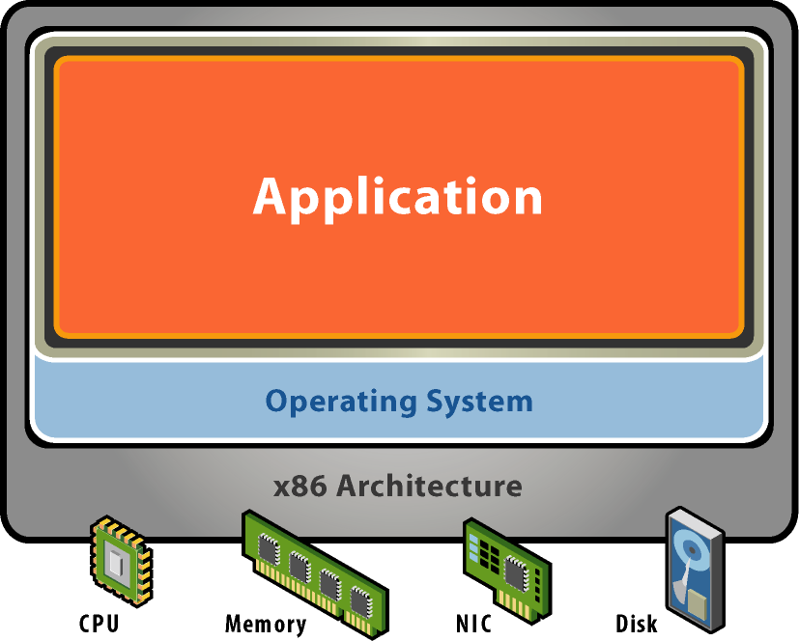
Starting Point: A Physical Machine
Physical Hardware
Processors, memory, chipset, I/O devices, etc.
Resources often grossly underutilized
Software
Tightly coupled to physical hardware
Single active OS instance
OS controls hardware

Slide 5
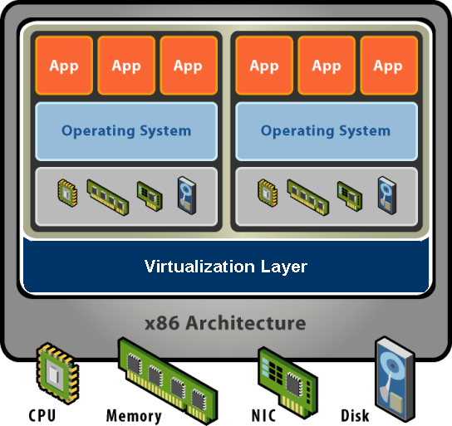
What is a Virtual Machine?
Software Abstraction
Behaves like hardware
Encapsulates all OS and application state
Virtualization Layer
Extra level of indirection
Decouples hardware, OS
Enforces isolation
Multiplexes physical hardware across VMs
Notes:
Virtualization can be defined many ways. I will try to define it formally and also define it by giving a few examples. However loosely, virtualization is the addition of a software layer (the virtual machine monitor) between the hardware and the existing software that exports an interface at the same level as the underlying hardware.
In the strictest case the exported interface is the exact same as the underlying hardware and the virtual machine monitor provides no functionality except multiplexing the hardware among multiple VMs. This was largely the case in the old IBM VM/360 systems.
However the layer really can export a different hardware interface as the case in cross-ISA emulators. Also the layer can provide additional functionality not present in the operating system.
I think of virtualization as the addition of a layer of software that can run the original software with little or no changes.

Slide 6
Virtualization Properties
Isolation
Fault isolation
Performance isolation
Encapsulation
Cleanly capture all VM state
Enables VM snapshots, clones
Portability
Independent of physical hardware
Enables migration of live, running VMs
Interposition
Transformations on instructions, memory, I/O
Enables transparent resource overcommitment, encryption, compression, replication …
Notes:
Virtualization has three main properties that give rise to all its applications.
Isolation
First, virtualization provides isolation. Isolation is key for many applications and comes in several flavors.
Fault Isolation. If one virtual machine contains a buggy operating system, that OS can start scribbling all over physical memory. These wild rights must be contained within the VM boundaries.
Performance Isolation. Ideally VMs performance would be independent of the activity going-on on the hardware. This must be accomplished by smart scheduling and resource allocation policies in the monitor.
Software Isolation. Most of the issues with computers today are complex software configurations. DLL hell on PCs, operating system and library versions, viruses, and other security threats. VMs are naturally isolated for each other by running in separate software environments.
Encapsulation
Encapsulation is the property that all VM state can be described and recorded simply. The VM state is basically the dynamic memory, static memory, and the register state of the CPU and devices. These items typically have a simple layout and are easy to describe. We can checkpoint a VM by writing out these items to a few files. The VM can be moved and copied by moving these files around. You can think about this as similar to doing a backup at the block level vs. doing a backup by recording all the packages, configuration and data files that encompass a file system.
Interposition
At some level all access to the hardware passes through the monitor first. This gives the monitor and chance to operate on these accesses. The best example of this is encrypting all data written to a disk. The advantage of this is that it does it without the knowledge of the OS.
Why not in the OS?
This brings up a good point. Why not do these things in the OS. By splitting up the system this way the OS functions more like a large application library. The VMM functions more like a smart set of device drivers. This is a nice split and can simplify overall system design. It also provides a natural administration boundary. However the monitor is often at a disadvantage because it does not have the same insight into what’s happening as the OS has. For example, the OS knows the distinction between data and metadata when implementing an encrypted file system. So there is a tradeoff there.

Slide 7
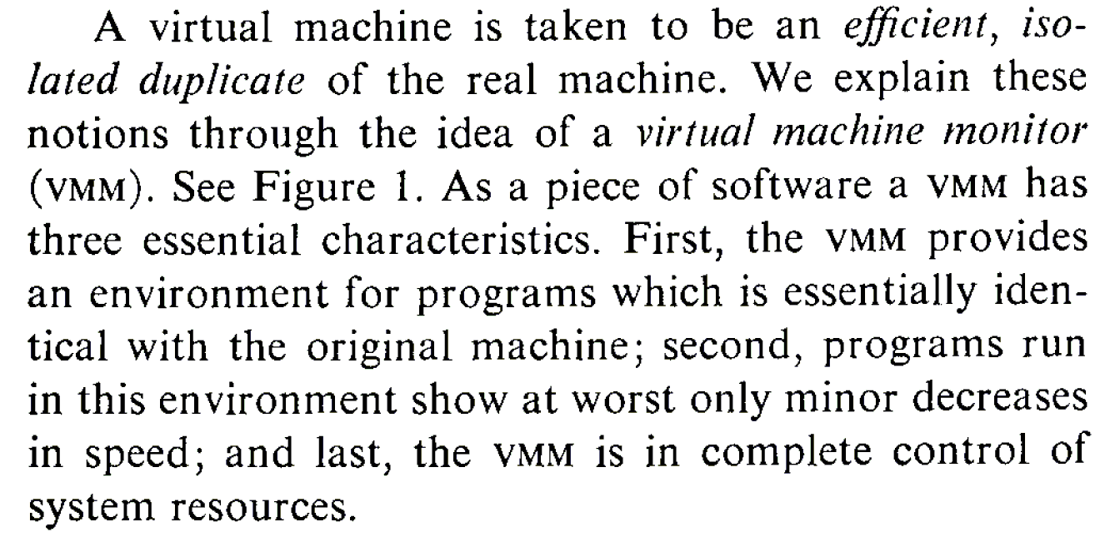
What is a Virtual Machine Monitor?
Classic Definition (Popek and Goldberg ’74)
VMM Properties
Fidelity
Performance
Safety and Isolation

Slide 8
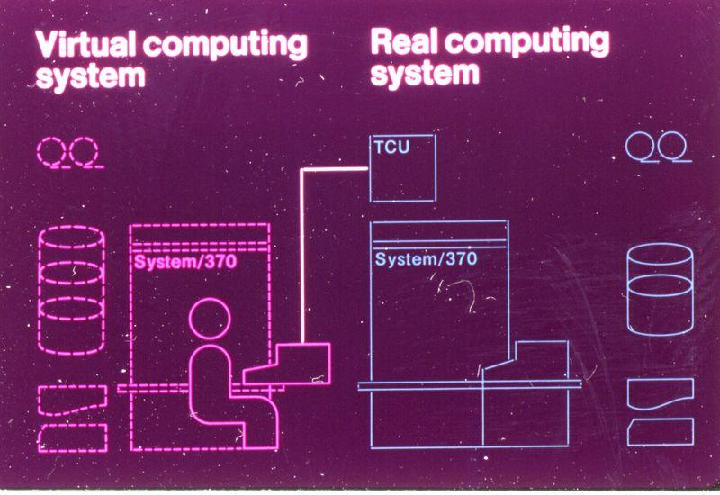
Classic Virtualization and Applications
Classical VMM
IBM mainframes: IBM S/360, IBM VM/370
Co-designed proprietary hardware, OS, VMM
“Trap and emulate” model
Applications
Timeshare several single-user OS instances on expensive hardware
Compatibility
From IBM VM/370 product announcement, ca. 1972

Slide 9
Modern Virtualization Renaissance
Recent Proliferation of VMs
Considered exotic mainframe technology in 90s
Now pervasive in datacenters and clouds
Huge commercial success
Why?
Introduction on commodity x86 hardware
Ability to “do more with less” saves $$$
Innovative new capabilities
Extremely versatile technology

Slide 10
Modern Virtualization Applications
Server Consolidation
Convert underutilized servers to VMs
Significant cost savings (equipment, space, power)
Increasingly used for virtual desktops
Simplified Management
Datacenter provisioning and monitoring
Dynamic load balancing
Improved Availability
Automatic restart
Fault tolerance
Disaster recovery
Test and Development

Slide 11
Processor Virtualization
Trap and Emulate
Binary Translation

Slide 12
Trap and Emulate
Guest OS + Applications
Unprivileged
Page
Fault
Undef
Instr
vIRQ
Virtual Machine Monitor
Privileged
MMU
Emulation
CPU
Emulation
I/O
Emulation
Notes:
Direct execution

Slide 13
“Strictly Virtualizable”
A processor or mode of a processor is strictly virtualizable if, when executed in a lesser privileged mode:
all instructions that access privileged state trap
all instructions either trap or execute identically
Notes:
Again another operational definition. This idea behind strictly virtualizable is the whether trap and emulate will work.
The x86 is not strictly virtualizable. One reason is the popf instruction. popf takes a word off the stack and puts in into the flags register. One flag in that register is the interrupt enable flag. At system level the flag is updated by popf. When the designers of the x86 introduced user mode they realized that modifications of this flag by the user would break the OS. So they solved this by silently dropping updates to the IF at user level. This works for OS’s put breaks VMMs. When a VMM runs the OS by boosting it into user level all modifications the OS make to the IF are silently dropped and the VMM looses track of whether the OS whats interrupts to be enabled or disabled. The way to do this would be to make popf trap, or better yet make popf’s that modify IF to trap.
Note that these conditions are necessary but not sufficient. For example on the x86 there are several other reasons why trap and emulate will not work.

Slide 14
Issues with Trap and Emulate
Not all architectures support it
Trap costs may be high
VMM consumes a privilege level
Need to virtualize the protection levels

Slide 15
Binary Translation
Guest Code
Translation Cache
vEPC
mov ebx, eax
mov ebx, eax
start
cli
mov [VIF], 0
and ebx, ~0xfff
and ebx, ~0xfff
mov ebx, cr3
mov [CO_ARG], ebx
sti
call HANDLE_CR3
ret
mov [VIF], 1
test [INT_PEND], 1
jne
call HANDLE_INTS
jmp HANDLE_RET
Notes:
Dynamic binary translation is used in virtualizing the CPU by translating potentially dangerous (or non-virtualizable) instruction sequences one-by-one into safe instruction sequences.
It works like this:
The monitor inspects the next sequence of instructions. An instruction sequence is typically defined as the next basic block, that is all instructions up to the next control transfer instruction such as a branch. There may be reasons to end a sequence earlier or go past a branch but for now lets assume we go to the next branch.
Each instruction is translated and the translation is copied into a translation cache.
Instructions are translated as follows:
Instructions which pose no problems can be copied into the translation cache with modification. We call these “ident” translations.
Some simple dangerous instructions can be translated into a short sequence emulation code. This code is placed directly into the translation cache. We call this “inline” translation. An example is the modification of the Interrupt Enable flag.
Other dangerous instructions need be performed by emulation code in the monitor. For these instructions calls to the monitor are made. These are called “Call-outs”. An example of these is a change to the page table base.
The branch ending the basic block needs a call out.
The monitor can now jump to the start of the translated basic block with the virtual registers in the hardware registers.
So dangerous instructions can be privileged instructions, non-virtualizable instructions, control flow, memory accesses.

Slide 16
Issues with Binary Translation
Translation cache management
PC synchronization on interrupts
Self-modifying code
Notified on writes to translated guest code
Protecting VMM from guest

Slide 17
Memory Virtualization
Shadow Page Tables
Nested Page Tables

Slide 18
Traditional Address Spaces
0
4GB
Virtual Address Space
0
4GB
Physical Address Space
Notes:
In a traditional system there are typically 2 address spaces – the virtual address space (VAS) and the physical address space (PAS). The OS and user processes run in the VAS. The OS manages the mapping from VAS to PAS through the use of the Memory Management Unit (MMU) provided in the processor. The OS maintains a page table that maps each page in the current VAS to a page in the PAS. Typically the OS will maintain one page table per user level process.

Slide 19
Traditional Address Translation
Virtual Address
TLB
Physical Address
₁
₄
₂
₅
₃
Operating System’s
Page Fault Handler
Process
Page Table
₂
Notes:
Lets follow the path when the required mapping is not in the TLB.
There is a miss in the TLB. The hardware will walk the current process’s page table to find the mapping. The page table structure will probably be more complicated than I’m showing here.
One of two things can happen:
The required mapping is found in the page table and placed in the TLB. The instruction is restarted and all proceeds normally. Note that in this case the hardware does all the work.
The required mapping is not present. An page fault exception is generated by the hardware and trapped into the operating system. The OS will do what it does to figure out the correct mapping.
The new translation is put into the current process’s page table.
The OS resume’s execution at the faulting nstruction. Now the hardware TLB refill mechanism will work.
The hardware put the new mapping in the TLB and life goes on.

Slide 20
Virtualized Address Spaces
0
4GB
Virtual Address Space
Guest Page Table
0
4GB
Physical Address Space
VMM PhysMap
0
4GB
Machine Address Space
Notes:
In a virtualized system the physical address layer becomes the virtual-physical address layer. We continue to call this the physical address layer to remain consistent with the guest’s view. However the real memory of the system is renamed to the machine address layer. The VMM is responsible for maintaining the current VM’s mapping from physical addresses to machine addresses. Most of the machine memory backing the physical address layer can be allocated on demand.

Slide 21
Virtualized Address Spaces w/ Shadow Page Tables
0
4GB
Virtual Address Space
Shadow
Page Table
Guest Page Table
0
4GB
Physical Address Space
VMM PhysMap
0
4GB
Machine Address Space
Notes:
Because of the vast number of instructions that access memory, including the instruction fetch itself, the hardware TLB must be used to translate virtual addresses to machine addresses. So the common case should be that the TLB holds the virtual to machine mapping. To do this we can use a shadow page table. The real hardware MMU points to the shadow page table. The shadow page table holds virtual to machine mappings. The VMM page fault handler is responsible for filling in the appropriate entries in the shadow page table based on the guest page table and PhysMap.

Slide 22
Virtualized Address Translation w/ Shadow Page Tables
Virtual Address
TLB
Machine Address
₄
₁
₅
₂
₆
₃
Shadow
Page Table
Guest
Page Table
₃
PMap
₂
_{A}
Notes:
Lets follow the path when the required mapping is not in the TLB.
There is a miss in the TLB. The hardware will walk the shadow page table to find the mapping. The page table structure will probably be more complicated than I’m showing here.
One of two things can happen:
The required mapping is found in the page table and placed in the TLB. The instruction is restarted and all proceeds normally. Note that in this case the hardware does all the work.
The required mapping is not present. An page fault exception is generated by the hardware and trapped into the VMM. The VMM needs to translate the virtual address to a machine address. It starts by walking the guest’s page table to determine the virtual to physical mapping. Note that the layout of the guest page table will be determined by the hardware being virtualized.
Once the VMM finds the guest mapping one of two things can happen:
The guest mapping is not present. In this case the guest expects a page fault exception. So the VMM must generate an exception on the virtual cpu state and resume executing on the first instruction of the guest exception handler. This is called a true page fault because the hardware page fault results in a guest visible page fault.
If the guest mapping is present then the VMM must translate the physical page to a machine page. This is called a hidden page fault because the hardware fault is a fault that would not have occurred in non-virtualized system. In order to translate the physical page to machine page the VMM must look in a data structure that maps physical pages to machine pages. This data structure is defined by the VMM, for example PMap. (A) The VMM might have perform further processing if there is no machine page backing the physical page or in other special circumstances. More on this later.
The virtual to machine translation is complete. The new translation is put into the shadow page table.
The VMM restarts the guest instruction that faulted. Now the hardware TLB refill mechanism will work.
The hardware put the new mapping in the TLB and life goes on.

Slide 23
Issues with Shadow Page Tables
Guest page table consistency
Rely on guest’s need to invalidate TLB
Performance considerations
Aggressive shadow page table caching necessary
Need to trace writes to cached page tables
Notes:
One thing to worry about is keeping the shadow page table consistent with the guest page table. What happens when the guest changes an entry in its page table? What happens when the guest switches to a new page table on a process context switch?
On real hardware, when the guest updates an entry in its page table, its is required to notify the hardware. This is because the TLB is a cache and the effected entry might be cached. The OS invalidate entries out of the TLB usually through a special instruction. This instruction can be used by the VMM to update or invalidate the corresponding instruction in the shadow page table.
Similarly on a process context switch the OS must do something to notify the hardware that a new process is running. In the most straightforward case, when this happens the VMM can simply flush the shadow page table. It flushes the shadow page table by looping over every entry and marking it invalid. In this way the shadow page table acts as a maximally sized TLB.
However the key to minimizing the overhead of virtualization and specifically the overhead of memory virtualization is to minimize hidden page faults. Aggressive flushing of the shadow page table will cause a flood of hidden page faults every guest context switch as the entries representing the working set are faulted in.
One technique to minimize the flushing on context switches is to keep one shadow page table per guest process. Each time the guest switches processes the VMM can just switch to the corresponding cached shadow page table. What problem does this introduce? While a process is inactive the guest might update the page table. Depending on the hardware no TLB invalidate may be necessary because when the process gets switched back in the whole TLB will be flushed at that time. With the caching scheme the VMM may swap the shadow page table with old entries back in. To prevent this the VMM can trace or watch the cached guest page table and invalidate any entry that is written to by the guest. Tracing will be explained in detail shortly. A negative with this is the added memory overhead.

Slide 24
Virtualized Address Spaces w/ Nested Page Tables
0
4GB
Virtual Address Space
Guest Page Table
0
4GB
Physical Address Space
VMM PhysMap
0
4GB
Machine Address Space
Notes:
Nested Page Tables are an example of hardware asisted virtualization. In this case the hardware will do 2 consective address translations on TLB faults. The guest page table is now used directly by the hardware. The VMM’s PhysMap becomes a hardware defined data structure that is used on the second address translation.

Slide 25
Virtualized Address Translation w/ Nested Page Tables
Virtual Address
TLB
Machine Address
₁
₃
₂
Guest
Page Table
₂
PhysMap
By VMM
₃
Notes:
What is the issue with nested page tables.
There is a miss in the TLB. The hardware will walk the guest page table to find the mapping. The page table structure will probably be more complicated than I’m showing here.
One of two things can happen:
The required mapping is not present. An page fault exception is generated to the VMM. The VMM typically passes this exception onto the guest – a true page fault.
The required mapping is found in the page. The hardware proceeds to walk the second page table.
During the hardware lookup into the PhysMap one of two things can happen:
The required mapping is not present. A page fault is generated to the VMM. The VMM handles the fault in the appropriate way. This would be a hidden page fault.
If the guest mapping is present then the hardware places the composite mapping in the TLB and the instruction is restarted.

Slide 26
Issues with Nested Page Tables
Positives
Simplifies monitor design
No need for page protection calculus
Negatives
Guest page table is in physical address space
Need to walk PhysMap multiple times
Need physical-to-machine mapping to walk guest page table
Need physical-to-machine mapping for original virtual address
Other Memory Virtualization Hardware Assists
Monitor Mode has its own address space
No need to hide the VMM

Slide 27
Interposition with Memory Virtualization Page Sharing
VM1
VM2
Virtual
Virtual
Physical
Physical
Machine
Read-Only
Copy-on-write

Slide 28
I/O Virtualization
Guest
Virtual Device Driver
Virtual Device Driver
Virtual Device Driver
Virtual Device Model
Virtual Device Model
Virtual Device Model
Abstract Device Model
Device Interposition
Compression Bandwidth Control Record / Replay
Overshadow Page Sharing Copy-on-Write Disks
Encryption Intrusion Detection Attestation
Device Back-ends
Remote Access Cross-device Emulation Disconnected Operation
Multiplexing
Device Sharing Scheduling Resource Management
H.W. Device Driver
H.W. Device Driver
Hardware

Slide 29
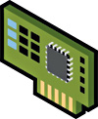
I/O Virtualization Implementations
Emulated I/O
Passthrough I/O
Hosted or Split
Hypervisor Direct
Guest OS
Guest OS
Guest OS
Device Driver
Device Driver
Device Driver
Host OS/Dom0/
Parent Domain
Device Emulation
Device Emulation
Device Emulation
I/O Stack
I/O Stack
Device
Manager
Device Driver
Device Driver
VMware Workstation, VMware Server,
Xen, Microsoft Hyper-V, Virtual Server
VMware ESX
VMware ESX (FPT)

Slide 30
Issues with I/O Virtualization
Need physical memory address translation
need to copy
need translation
need IO MMU
Need way to dispatch incoming requests

Slide 31
Backup Slides

Slide 32
Brief History of VMware x86 Virtualization
x86-64
Intel VT-x
Intel EPT
AMD-V
AMD RVI
1998 1999 2000 2001 2002 2003 2004 2005 2006 2007 2008 2009. . .
ESX 4.0
ESX 3.5
ESX 3.0
Workstation 5.5 (64 bit guests)
ESX 2.0 (vSMP)
ESX Server 1.0
Workstation 2.0
Workstation 1.0
VMware founded

Slide 33
Passthrough I/O Virtualization
Guest OS
Guest OS
Guest OS
High Performance
Guest drives device directly
Minimizes CPU utilization
Enabled by HW Assists
I/O-MMU for DMA isolation e.g. Intel VT-d, AMD IOMMU
Partitionable I/O device e.g. PCI-SIG IOV spec
Challenges
Hardware independence
Migration, suspend/resume
Memory overcommitment
Device Driver
Device Driver
Device Driver
Virtualization
Layer
Device
Manager
I/O MMU
VF
VF
VF
I/O Device
PF
PF = Physical Function, VF = Virtual Function

