Slide 1
Virtual Machine Security
Summer 2013
Presented by: Rostislav Pogrebinsky

Slide 2
OVERVIEW
Introduction
VM Architecture
VM Security Benefits
VM Security Issues
VM Security Concerns

Slide 3
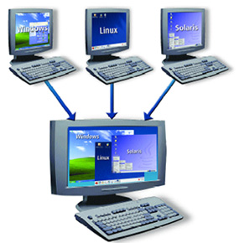
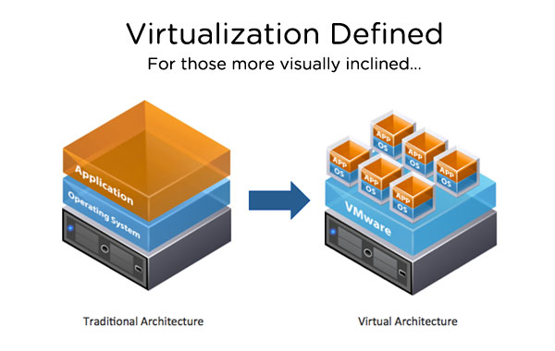
Introduction
A VM is a software implementation of a machine that execute programs like a physical machine
A VM can support individual processes or a complete system depending on the abstraction level where virtualization occurs.
Virtualization – a technology that allows running two or more OS side by side on one PC or embedded controller
Notes:
1. In Old days we used huge amount of computer station with different OS, HW and SW configurations. It is required big efforts for IT, administration and maintenance. The big Question was how make SW portable and compatible? The were a couple attempts, 1st was in HW: HW designers for various computer companies gravitated toward certain common features and big success was IBM 360 series computer, 2nd attempt was in OS: OS starts to standardize their interfaces to the upper application layer, and it was big success as well, that allows to develop large, complex, varied application and provide flexibility and portability to application. “As a reminder, OSs are responsible for managing HW resources, isolation, sharing, hiding idiosyncrasies of the underlying HW.” However it was not perfect, because OS/Application needs certain properties which only certain “real machine” can provide. So, VM, compared to real machine, is invented to provide the same properties OS/Application need which only real machine can provide before. VM may have an different OS from Underlying real HW and/or may have an instruction set.
2. Some VMs support flexible hardware usage and software isolation, while others translate from one instruction set to another.
3. What is virtualization concepts? There are HW and Application Virtualizations. HW Virtualization: Makes an OS think it is running on it own HW, Abstracts the HW from the OS, known forms of HW Virtualization are VMware, MS Virtual PC, XEN. Appl Virtualization: Makes an application thinks it is running in its own OS, Abstracts the services and kernel from an application, known forms of Appl Virtualization are Thinstall and Softgrid. The heart of virtualization is VM, a tightly isolated software container with an operating system and application inside. Because each VM is completely separate and independent, many of them can run simultaneously on a single computer. A thin layer of software called a hypervisor decouples the VMs from the host, and dynamically allocates computing resources to each VM as needed.

Slide 4
OVERVIEW
Introduction
VM Architecture
VM Security Benefits
VM Security Issues
VM Security Concerns

Slide 5
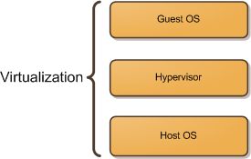
VM Architecture
Virtualization
Host OS
Guest OS
Hypervisor
Notes:
To begin, let me introduce three very simple concepts regarding virtualization: the host operating system, the hypervisor, and the guest operating system.
The host operating system provides a host to one or more virtual machines (or partitions) and shares physical resources with them. It’s where the virtualization product or the partitioning product is installed.
The guest operating system is the operating system installed inside a virtual machine (or a partition). In a virtualization solution the guest OS can be completely different from the host OS. In a partitioning solution the guest OS must be identical to the host OS.
A hypervisor, also called a virtual machine manager (VMM), is a program that allows multiple operating systems to share a single hardware host. Each operating system appears to have the host’s processor, memory, and other resources all to itself. The task of this hypervisor is to handle resource and memory allocation for the virtual machines, ensuring they cannot disrupt each other, in addition to providing interfaces for higher level administration and monitoring tools.

Slide 6
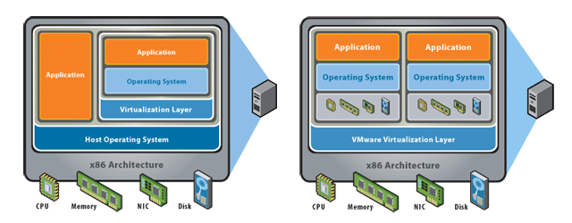
VM Architecture
There are two common approaches to virtualization: "hosted" and "bare-metal“
Hosted
Bare - Metal
Notes:
Hosted virtualization software runs as an application or "guest" on top of a general-purpose operating system.
In this architecture, a base operating system (such as Windows) is first installed. A piece of software called a hypervisor or virtual machine monitor (VMM) is installed on top of the host OS, and allows users to run various guest operating systems within their own application windows
Hosted Hypervisor relies on an underlying OS, more security implications because of the reliance on the underlying OS, used in VMware Workstation/Server/Player and MS Virtual PC.
2. Bare-metal virtualization interfaces directly with computer hardware, without the need for a host operating system. In this architecture, a VMM (also called hypervisor) is installed that communicates directly with system hardware rather than relying on a host operating system.
In Bare Metal Hypervisor virtualization Engine Installs directly on HW, there is no reliance on an underlying OS, used in VMware ESX Server, XEN and MS Hyper V.

Slide 7
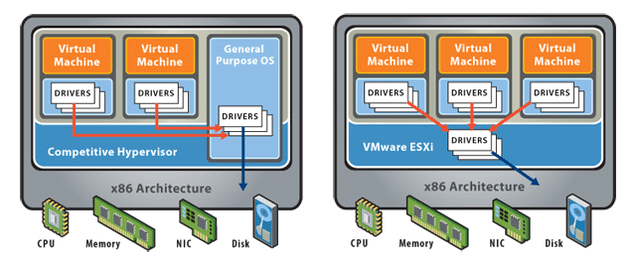
VM Architecture
Thin Virtualization: Get Strong Security in a Small Package
Notes:
"Thin" virtualization, found in software such as VMware ESXi 3.5, is the next step in virtualization, dramatically strengthening security and manageability.
Reduced size makes the attack surface much smaller, and reduces the potential for vulnerabilities
Independence from a parent partition or console based on a general-purpose OS means far fewer interfaces to exploit and less malware threats, especially important given the path of device drivers from the VM to the physical hardware
Unstructured, console-based interaction for administration is replaced by authenticated and audited interfaces such as the VI Client and the Remote CLI

Slide 8
VM Architecture
Security Concepts in Architecture
Extended computing stack
Guest isolation
Host Visibility from the Guest
Virtualized interfaces
Management interfaces
Greater co-location of data and assets on one box
Notes:
What are security concepts in VM Architecture?
New privileged layers (Hypervisor) exist underneath the operating system that need to be considered
One guest VM cannot be allowed to access or even address the “hardware resources” of another guest VM or the host/hypervisor
Can the guest OS detect that it is virtualized and if so can it see anything on the host
Physical connectivity between guests is recreated, e.g. IP network, file shares, may be more or less like true physical counterparts
The protection of management interfaces (Console OS, VirtualCenter, etc...) very important. Root or Administrator Access to these interfaces provides “keys to the kingdom”
Concept of mixing of Trust/Security Zones on a single physical box

Slide 9
OVERVIEW
Introduction
VM Architecture
VM Security Benefits
VM Security Issues
VM Security Concerns

Slide 10
VM Security Benefits
Abstraction and Isolation
Better Forensics and Faster Recovery After an Attack
Patching is Safer and More Effective
More Cost Effective Security Devices
Future: Leveraging Virtualization to Provide Better Security
Notes:
The hardware abstraction and isolation of VM bounds the scope of attack and makes it much more difficult for the attacker to access unauthorized data and resources on the physical machine. The guest is not even aware it is running in a virtualized environment. Since the attacker does not know details of the host environment, manipulating and compromising the machine is much more difficult. Hypervisors are much simpler than traditional OSs, and are therefore much easier to secure. They are nothing more than a microkernel with a hardware compatibility layer and a smaller code base correlates to simplicity, making it easier for software developers to minimize bugs and vulnerabilities. Each VM encapsulates the guest and prevents a malicious guest from accessing resources it does not own. This means that attackers should not be able to compromise the physical machine, only one VM at a time. An attack on the VM should not affect any of the other VMs on the server or the host OS. This is unlike a multi-user OS, where all users can be affected by an attack. In a VM infrastructure, each user can either access a given VM or they cannot. Inside a multi-user OS, a complex and thus vulnerable file system dictates which files each user can read, write, or execute. The isolation and abstraction of VMs provides additional security over a traditional multi-user computer. When a VM is compromised, the hypervisor can remove that VM or restore it to a state prior to attack.
A compromised machine can be cloned in it current compromised state for forensic analysis. Once cloned the
VM can be immediately restored to a known good snapshot which is much faster than a physical server, reducing the impact of a security-related event
You can quickly revert to a previous state if a patch is unsuccessful, making you more likely to install security patches sooner. You can create a clone of a production server easily, making you more likely to test security patches and more likely to install security patches. VMware Update Manager does patch scanning and compliance reporting, along with patch remediation for both online and offline VMs – again, making it more likely that security patches will be installed
You can put in place cost effective intrusion detection, vulnerability scanning, and other security related appliances, because you can put them in a VM instead of a physical server
Better Context – Provide protection from outside the OS, from a trusted context. New Capabilities – view all interactions and contexts: CPU, Memory, Network, Storage.

Slide 11
OVERVIEW
Introduction
VM Architecture
VM Security Benefits
VM Security Issues
VM Security Concerns

Slide 12
VM Security Issues
VM Sprawl
Mobility
Hypervisor Intrusion
Hypervisor Modification
Communication
Denial of Service
Notes:
Like physical machines, VMs are vulnerable to theft and denial of service attacks. The contents of the virtual disk for each virtual machine are usually stored as a file, which can be run by hypervisors on other machines, allowing attackers to copy the virtual disk and gain unrestricted access to the digital contents of the virtual machine. Since VMs share resources from the physical machine, VM infrastructures were particularly vulnerable to denial of service attacks, which could starve resources from all VMs on the physical machine
The single biggest vulnerability of VMs is due to the ease in which users can create many VMs, which become very difficult to secure, monitor, and maintain. VMs can be created and deployed in a matter of seconds, which is significantly smaller than the time to ensure that all VMs are up-to-date and secure. Traditional security methods need to be applied to each VM because the guest OS accesses the network directly. A compromised VM is a potential entry point for attackers to the hypervisor and host. Most current security products are not designed for efficient use in securing many VMs on the same physical server, but this is a problem many software companies are working on. In addition to creating more work for security administrators, VM sprawl wastes resources and creates more entry points for attackers. An obsolete VM becomes an easy entry point for attackers, who could potentially access the hypervisor, other VMs, and the host OS.
Virtual machines are inherently not physical, which means their theft can take place without physical theft of the host machine. The contents of the virtual disk for each VM are stored as a file by most hypervisors, which allows VMs to be copied and run from other physical machines. While this is a convenience feature, it is also a security threat. Attackers can copy the VM over the network or to a portable storage media and access data on their own machine without physically stealing a hard drive. Once attackers have direct access to the virtual disk, they have unlimited time to defeat all security mechanisms, such as passwords, using offline attacks. Since the attacker is accessing a copy of the VM rather than the original, the VM will not show any records of intrusion. The second danger of virtual disks is that the attacker could corrupt or externally modify the file while the VM is offline. This means the integrity of an offline VM may be compromised if the host is not securely protected. This is not usually an issue with physical servers because the machine must be running to be accessible by network. Modern encryption and integrity algorithms can be applied by the host hypervisor so that access and integrity are ensured.
The hypervisor provides the abstraction and resource allocation between the host and guests. Attackers ultimate goal is to compromise the hypervisor to gain with the ability to execute arbitrary code on the host with the privileges of the [hypervisor] process. The hypervisor is a program, running on the host, so if it is compromised, all VMs it controls and the host itself are accessible to the attacker. The hypervisor converts instructions for the guest OS into instructions for the host OS, however, if the guest is compromised, then the instructions sent to the hypervisor may be irrational. Researchers X ran two tools, crashme and iofuzz, which generate random I/O port activity inside the virtual machines, until the hypervisor or VM crashed. The details of these attacks are not included in this paper because they were unique to each VM implementation, and all flaws detected we fixed before the paper was published. They were able to compromise the hypervisor and access the host using any major hypervisor available to the public. However, hypervisors are generally more secure than OSs, since the hypervisor is a relatively small and simple program, which helps to limit low-level vulnerabilities that may be present in many programs.
It does not matter how secure the original hypervisor is if it can be externally modified to use the attackers software. One attack of this form is known as Virtual Machine Based Root Kits (VMBR). In this attack, the hypervisors system calls to the host OS are changed to run malicious code instead. Fortunately, there are several methods for preventing hypervisor modification. The host can use a trusted platform module (TPM) to create a trusted relationship with the hypervisor. Alternatively, the guest can verify the integrity of the hypervisor when it boots. A third solution is to use an embedded hypervisor. An embedded hypervisor runs without a host OS and inherently cannot be modified.
VM Communication refers guest-to-guest attacks, in which attackers use one VM to access or control other VMs on the same hypervisor. These attacks can happen with out without compromising the hypervisor layer. A malicious VM can potentially access other VMs through shared memory, network connections, and other shared resources. For example, if a malicious VM determines where another VM s allocated memory lies, then it could read or write to that location and interfere with the others operation. Sometimes it is desirable for two VMs to be able to communicate. This has many applications, such as for dedicated monitoring of a VM or implementing a network technology that requires multiple peers. Instead of providing full isolation, IBMs sHype is intended to be a secure architecture for addressing inter-VM communication in a VM infrastructure. sHype allows system administrators to define policies for communication between each VM and ensure that only authorized VMs have access to communicate with each other.
DoS attacks are a threat to all servers, however an improperly configured hypervisor can allow a single VM to consume all resources, thus starving any other VM running on the same physical machine. DoS attacks make network hosts unable to function since critical processes do not have the hardware resources to execute in a timely manner. Fortunately, the solution is simple. Hypervisors prevent any VM from gaining 100% usage of any resources, including CPU, RAM, network bandwidth, and graphics memory. Additionally, the hypervisor can be configured so that when it detects extreme resource consumption, it can evaluate whether an attack is being made and automatically restart the VM. VMs can usually be initialized much faster than physical machines because their boot sequence does not need to initialize and verify hardware, so restarting the VM has a smaller effect than restarting a physical machine.

Slide 13
VM Security Issues
Issue | Hosted | Bare-Metal
Vulnerability of the underlying operating system | Hosted virtualization products run on general-purpose operating systems and are susceptible to all the vulnerabilities and attacks that are prevalent on such systems. | VMware bare-metal virtualization is built around the “VMkernel”, a special-purpose microkernel that has a much smaller attack surface than a general-purpose operating system.
Sharing of files and data between the guest and the host | Most hosted virtualization products provide methods to share user information from the guest to the host (shared folders, clipboards, etc). Although convenient, these are vulnerable to data leakage and malicious code intrusion. | Since ESX is designed specifically for virtualization, there is no mechanism or need to share user information between virtual machines and their host.
Notes:
Let’s review the common security issues and the implications of choosing a hosted versus bare-metal virtualization platform.

Slide 14
VM Security Issues
Issue | Hosted | Bare-Metal
Resource allocation | Hosted virtualization products run as applications in the process space of the host OS. They are at the mercy of the host OS and other applications. | VMware bare-metal virtualization allocates resource intelligently while isolating virtual machines from underlying hardware components. No single virtual machine can use all the resources or crash the system.
Target Usage | Hosted virtualization is targeted for environments where the guest virtual machines can be trusted. This includes software development, testing, demonstration, and trouble-shooting. | ESX is meant to be used in production environments in which the guest virtual machines can potentially be exposed to malicious users and network traffic. Strong isolation and strict separation of management greatly reduce any risk of harmful activity going beyond the boundaries of the virtual machine.

Slide 15
OVERVIEW
Introduction
VM Architecture
VM Security Benefits
VM Security Issues
VM Security Concerns

Slide 16
VM Security Concerns
Managing oversight and responsibility
Patching and maintenance
Visibility and compliance
VM sprawl
Managing Virtual Appliances
Notes:
The biggest problem with VMs, Steffen and MacDonald say, is the potential for IT or security managers to lose control of them simply by not being able to see the risks as they crop up. Here's a look at the five top virtual server security concerns of the moment.
The overarching issue with virtual servers is responsibility. Unlike physical servers, which are the direct responsibility of the data-center or IT managers in whose physical domain they sit, responsibility for virtual servers is often left up in the air. Should the business-unit that requested it be able to configure and secure it? Should it be the IT manager closest to the physical host? A centralized master sysadmin tasked with management and security for all the virtualized assets in an enterprise? "People don't appreciate that when you add virtual servers there's another layer there of technology in addition to the application and the operating system and the hardware, and you have to secure it.
The most tangible risk that can come out of a lack of responsibility is the failure to keep up with the constant, labor-intensive process of patching, maintaining and securing each virtual server in a company. Unlike the physical servers on which they sit, which are launched and configured by hands-on IT managers who also install the latest patches, virtual machines tend to be launched from server images that may have been created, configured and patched weeks or months before. Most companies maintain a small number of general-purpose "golden" images from which to launch or relaunch new VMs for many purposes, but also keep dozens or hundreds of server images stored on DVD or disk after being laboriously configured to support specific applications or business requirements. Both Microsoft and VMware supply patch-management schedules with their base infrastructure products. Both require disk images stored in libraries to be launched periodically so they can be patched.
Virtual servers are designed to be, if not invisible, then at least very low profile, at least within the data center. All the storage or bandwidth or floor space or electricity they need comes from the physical server on which they sit. To data-center managers not specifically tasked with monitoring all the minute interactions of the VMs inside each host, a set of virtual servers becomes an invisible network within which there are few controls. "Virtual switch implementations let the VMs talk to each other, and across the network, But unless you put virtualized security controls—virtual sniffers, virtual firewalls, all the same controls you'd use on a physical server, inside that network, you don't see what's going on." "There are a lot of compliance and use issues, Just because you don't have a sniffer to see those packets moving between the virtual servers doesn't mean they're not there,“
Another consequence of the lack of oversight of virtual machines is sprawl—the uncontrolled proliferation of virtual machines launched, and often forgotten, by IT managers, developers or business-unit managers who want extra servers for some specific purpose, and lose track of them later. VM sprawl wastes resources, creates unmonitored servers that could have access to sensitive data, and sets the company as a whole and IT in particular up for a painful cleanup when a problem crops up later.
One of the very best things about virtual infrastructures is the ability to buy or test a product from a third-party vendor and have it up and running in minutes, rather than having to clear space on a test server, install the software, get it to talk to the operating system and the network and then, hours later, see whether it does what it's supposed to. Unfortunately, virtual appliances are also virtual pigs in a poke. "There's an operating system and application in every package, every one with its own configuration and patch status and you have no idea what's in there or who's going to maintain it or what the long-term risk is going to be, It has a full application and OS all configured and ready to run. In five minutes you can try out that new anti-spam server.

Slide 17
Questions ???

Slide 18
References
Secure Your Virtual Infrastructure http://www.vmware.com/technical-resources/security/overview.html
Virtualization Security and Best Practices http://www.cpd.iit.edu/netsecure08/ROBERT_RANDELL.pdf
An overview of virtual machine Architecture
http://www.cse.ohio-state.edu/~agrawal/760/Slides/apr12.pdf
http://itechthoughts.wordpress.com/tag/paravirtualization/
A Survey on the Security of Virtual Machines
http://www.cse.wustl.edu/~jain/cse571-09/ftp/vmsec/index.html#Garfinkel05
Virtualization Technology Under the Hood
http://www.ni.com/white-paper/8709/en
Computer and Network Security Module: Virtualization
http://www.cse.psu.edu/~tjaeger/cse544-s13/slides/cse543-virtualization.pdf
http://www.vmware.com/virtualization/virtualization-basics/virtualization-benefits.html
http://en.wikipedia.org/wiki/Virtual_machine
http://www.microsoft.com/windowsserversystem/virtualserver/

