Slide 1
Idle virtual machine detection in FermiCloud
Giovanni Franzini
September 21, 2012
Scientific Computing Division
Grid and Cloud Computing Department

Slide 2
FermiCloud & FermiGrid
Cloud Computing is the use of computing resources (hardware and software) that are delivered as a service over a network (typically the Internet).
A Cloud creates Virtual Machines (VM) upon request. A VM mimics a physical computer in all functionalities (e.g. it is accessible remotely using ssh connections, etc.).
Here at Fermilab, the Grid and Cloud Computing department manages two distributed systems:
FermiCloud A private Cloud providing Infrastructure-as-a-Service for the Fermilab scientific stakeholders to manage dynamically allocated services, interactive and batch processing.
FermiGrid A distributed campus infrastructure that manages statically allocated compute and storage resources for batch processing.

Slide 3
Problem Statement
FermiCloud and FermiGrid can share resources, so it is important to optimize their individual utilization to maximize available computing cycles.
My work focussed on identifying and minimizing idle virtual machines on FermiCloud. An idle VM is an existing machine that it not currently providing computing services.
If the resources occupied by idle Virtual Machines on FermiCloud were reclaimed, they could be used by FermiGrid to process scientific data.
Problem:
How can we identify idle VMs in FermiCloud?

Slide 4
Project overview
Find a way to identify idle VMs
Investigate the reuse of existing workload management systems for compute intensive jobs, such as Condor.
Develop a software product to address the requirements of the problem.
Develop a mechanism to
Inform the FermiCloud management system (OpenNebula) about the idleness of the machine.
Suspend idle VMs.
Replace the suspended VMs with FermiGrid “worker nodes” to execute jobs in queue.

Slide 5
Identify an Idle VM
In order to identify an idle VM, some components and activities of the machine must be monitored periodically, especially:
CPU idleness
Keyboard / Mouse usage
Network
I/O
Virtual Memory
In Unix, some useful information can be found in special files (like /proc/uptime), or can be obtained using particular commands (such as vmstat) offered by the shell.
Starting from these data, we can create several indexes to detect the VM status.

Slide 6
Identify an Idle VM
For monitoring the VMs, six indexes were defined:
CPU Idle Percentage
Based on /proc/uptime file.
Keyboard / pseudo-terminal idle time (from Condor code)
Based on utmp file.
Bytes tx and rx by the network interface
Iowait ticks
Percentage of time the CPU is idle and there is at least one I/O in progress (local disk or remotely mounted disk, NFS).
Context switches
Memory Paged in/out

Slide 7
Computing the Indexes
CPU idle example.
At step n:
Take times from /proc/uptime → total(n), idle(n)
delta_idle(n) = idle(n) - idle(n-1)
delta_total(n) = total(n) - total(n-1)
idle_perc(n) = delta_idle(n) / delta_idle(n)
avg_idle(n) = (1-α)*idle_perc(n) + α*avg_idle(n-1)
avg_idle(n) is an EMA (Exponential Moving Average). It keeps track of the old values of the index, giving more importance to new values (α < ½).
The sample time for all the indexes is 60 seconds.

Slide 8
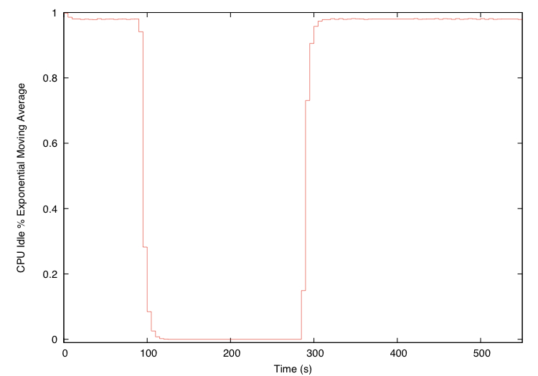
Index in Action: CPU Idle Prime Number Test (T = 5s)

Slide 9
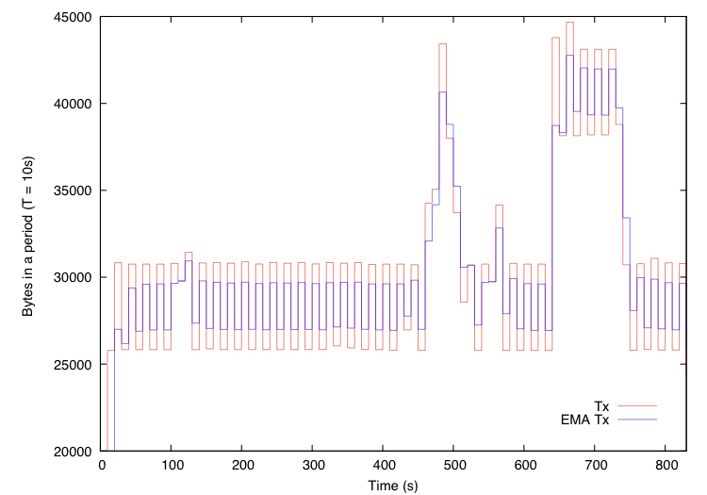
Index in Action: Network Activity Ping Test (T = 10s)

Slide 10
Indexes & Idleness Rules
Rules based on index values can define if a VM is currently idle. These rules are evaluated periodically (e.g. every hour).
An example of rule could be:
vm_status = ( CPU_idle > 0.98 && pty_idle > 2*60 ) ? IDLE : NOT_IDLE
In order to define these rules, “idle” thresholds for the defined indexes must be found.
I considered two ways to define these thresholds:
experimentally (24 hours VM usage tests);
using ANFIS (Adaptive Network Fuzzy Interference System).

Slide 11
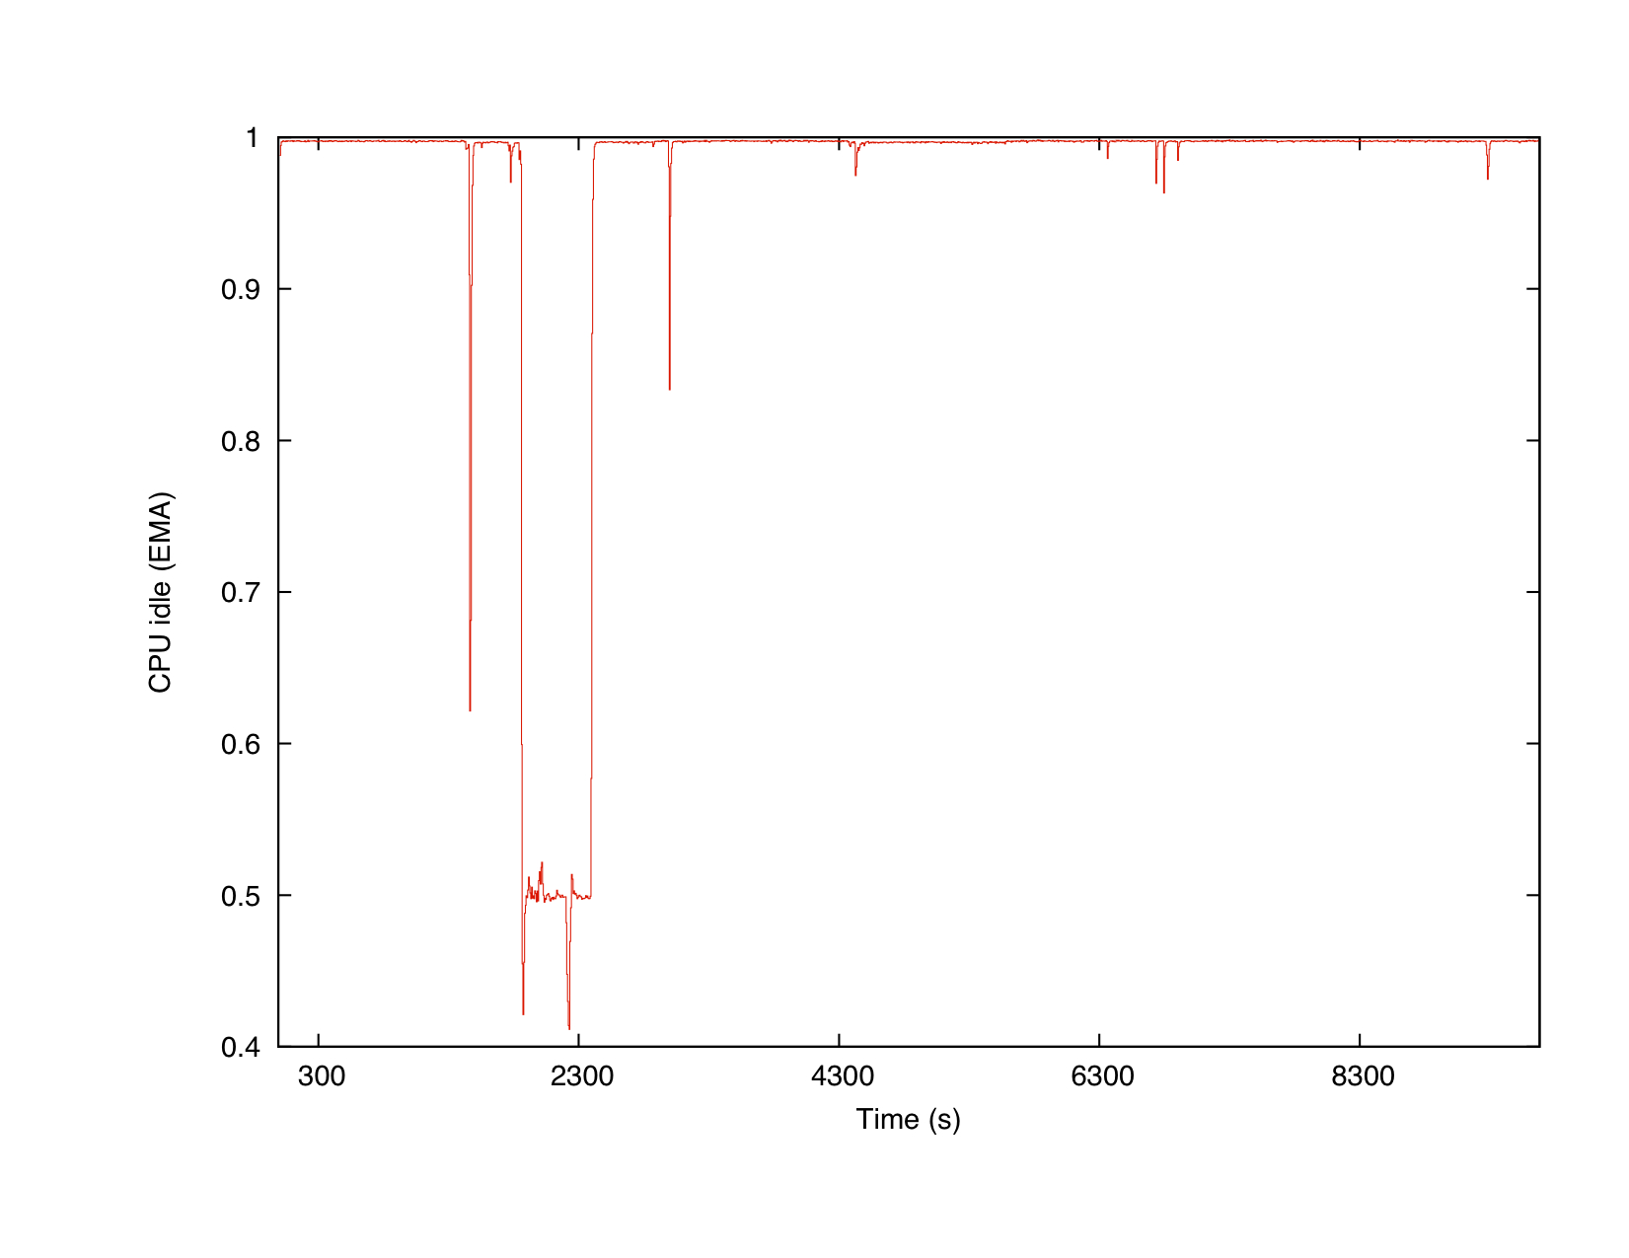
24 Hours VM Test: CPU Idle
Not idle*
* according to the tester report

Slide 12
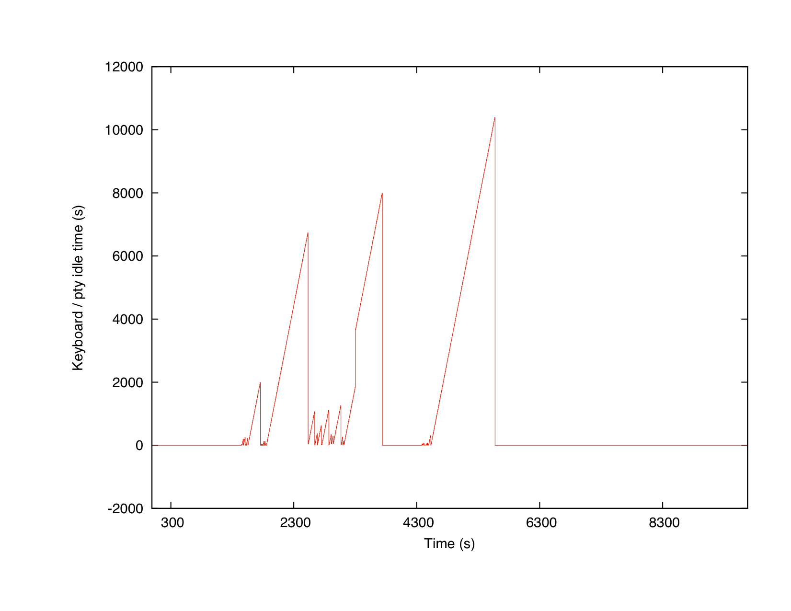
24 Hours VM Test: Keyboard / pty Idle Time
Not idle*
* according to the tester report

Slide 13
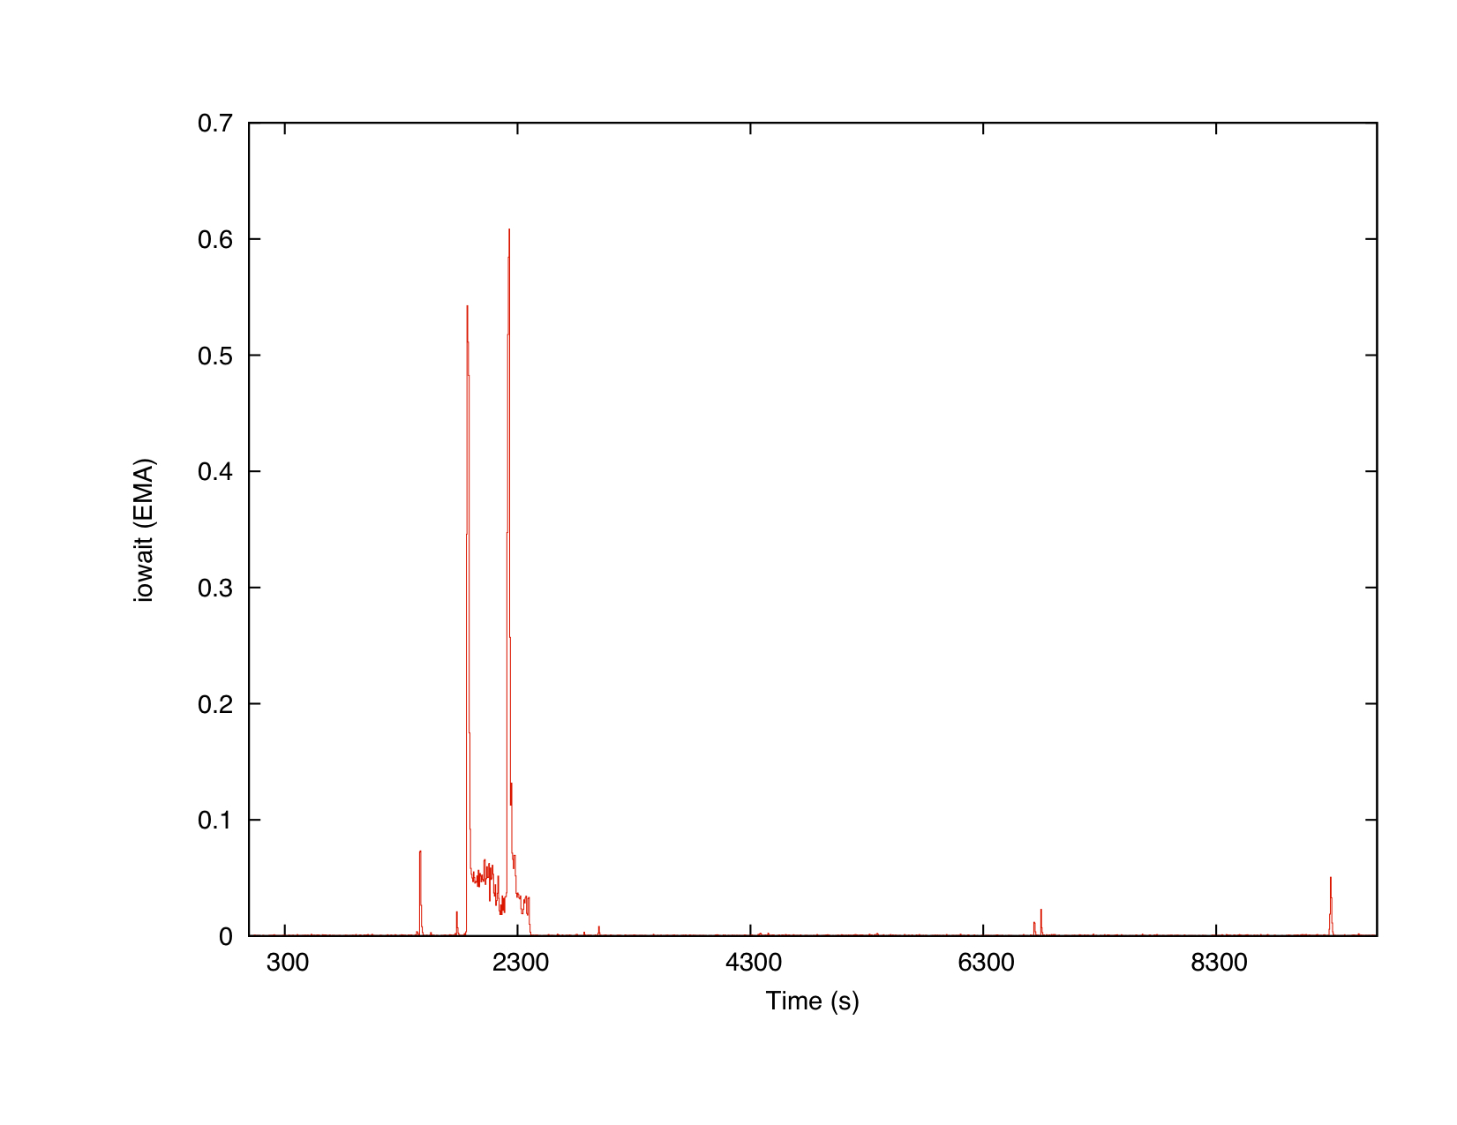
24 Hours VM Test iowait
Not idle*
* according to the tester report

Slide 14
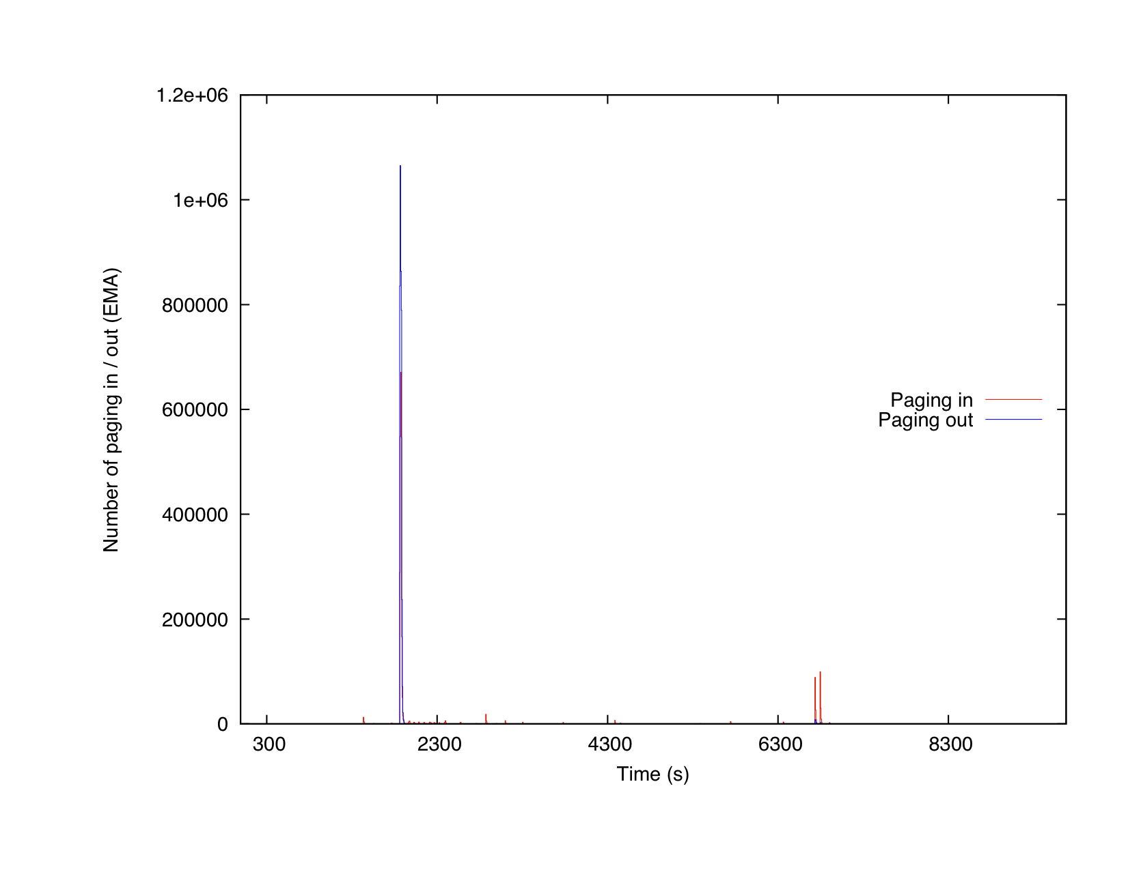
24 Hours VM Test Memory Paging in/out
Not idle*
* according to the tester report

Slide 15
Idleness rule
An average of the indexes values recorded while the VM was idle, was performed. This gave us an idea of typical values for the indexes, when the VM is idle. The “idle” thresholds were defined starting from these averages.
These values show an high standard deviation. Different VMs so may have very different values for the same index.
Idleness rule used for the final tests is shown in the next slide (th_index_A is the idle threshold for index_A).
 | CPU idle | Keyboard/ pty idle time | Bytes tx per period | Bytes rx per period | Iowait | Context switches per period | Paging in per period | Paging out per period
Avg | 0.996 | 3600 | 2089906 | 408922 | 0.0026 | 3012 | 62.43 | 449.19
Std.Dev. | 0.0053 | ~ | 4147777 | 2151731 | 0.0015 | 3378 | 313.01 | 454.68

Slide 16
Idleness rule
SOMEONE_LOGGED = ( keyboard_pty != -1 );
KEYBOARD_USED = ( SOMEONE_LOGGED &&
keyboard_pty < th_keyboard_pty );
CPU_IDLE = ( cpu_idle > th_cpu_idle );
IOWAIT_IDLE = ( iowait < th_iowait );
PI_IDLE = ( paging_in < th_paging_in );
rule_A = ( SOMEONE_LOGGED && !KEYBOARD_USED && CPU_IDLE && IOWAIT_IDLE && PI_IDLE );
rule_B = ( !SOMEONE_LOGGED && CPU_IDLE && IOWAIT_IDLE && PI_IDLE );
vm_status = ( rule_A || rule_B ) ? IDLE : NOT_IDLE;

Slide 17
Final test results
During the final test, the detector identified idle VMs with 90% accuracy.
This is only a first encouraging result. Deeper analysis and improvements of the idle detector are needed.
In particular:
The final test results come from the anaysis of a very little pool of VMs (30). The majority of them were always idle, only a few of them were actually used during the test.
Idle thresholds must be improved, processing data coming from VMs providing different services (servers, worker nodes, etc.).
New ways to use the recorded indexes values may be investigated (use of different averages, recording of the last 60 minute values and processing of these data, etc.).

Slide 18
Conclusions
Goal: optimize the usage of computing resources at Fermilab by detecting idle Virtual Machines (VM).
Idle FermiCloud resources can be reclaimed and used by FermiGrid to run data processing jobs.
I have implemented six indexes to expose the activity of a VM. These indexes are sampled periodically.
An “idleness” rule was defined, to properly identify an idle VM.
Running 24 hour tests: friendly users mark down when their VM is used, while my software record index values and define the VM status.
A first prototype of the detector was created, with an accuracy of 90%.

