Slide 1
Auto Speech Recognition
by
İlkay ATIL
1448372

Slide 2
Outline-1
Introduction
Today and Future of ASR
Automatic Speech Recognition
Types of ASR systems
Fundamentals
Google Search by Voice

Slide 3
Introduction
Automatic Speech Recognition:
«Translation of spoken language into text by a computer»
Also known as:
Speech-to-Text
Computer Speech Recognition
Or just Speech Recognition
An important milestone for human-computer interaction
Keyboard
Mouse
Touch panels
3D sensors (hand and body gestures)
Speech

Slide 4
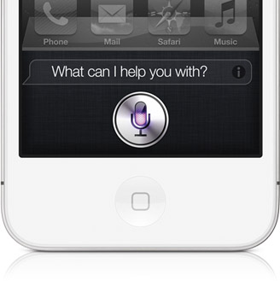
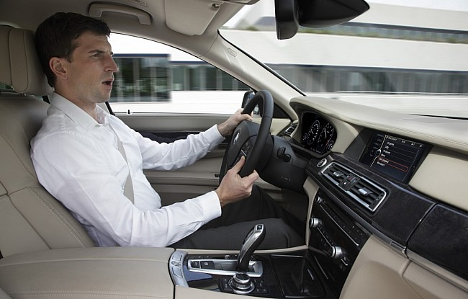
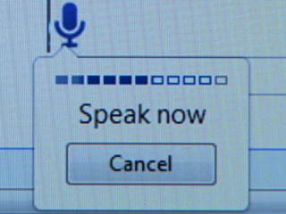
Today and Future of ASR
For today: fast text input and dictation
Fast text input:
Writing 20-30 wpm, Typing 25-40 wpm (words-per-minute)
ASR 100-160 wpm [1]
Dictation: Hands free usage
Smartphones
Automobiles
Personal Computers
[1] Davis, C. (2001). Automatic Speech Recognition and Access: 20 years, 20 months, or tomorrow? Hearing Loss, 22(4), p. 11-14.

Slide 5
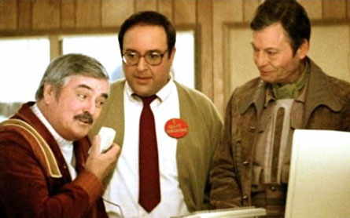
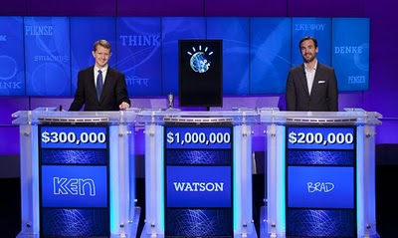
Future of ASR
The first step of a vision of computers able to comprehend spoken language in the future
No keyboards in the future
IBM’s Watson wins Jeopardy

Slide 6
Types of ASR Systems
ASR system can be designed to work in different conditions:
Speaker dependent vs independent
Isolated words, discontinous speech vs continous speech
Reading vs spontaneous speech
Vocabulary: Daily vs Technical
Each type has different requirements in terms of acoustic and language models and required training data.

Slide 7
Fundamentals
A generic ASR system looks like this:
Waveform (Raw Speech)
Acoustic Model
Language Model
Signal Analysis
Time Alignment
Speech Frames
Acoustic Analysis
Frame Scores
Legend:
Text
Data
Process

Slide 8
Fundamentals Cont.
Raw Speech: Human speech is typically captured at 8 kHz for telephone and 16kHz for microphone.
Signal Anaysis: Simplify and divide continuous waveform into parts
Divide into frames of predefined duration (~10 msec)
Dimensionality reduction (FFT, LDA etc.)
...
...
...
...
...
...
...
...
...
...
...
...
...
...
...
...
...
...
...
...
...
...
...
...
...
...
...
Speech frames with reduced dimensionality

Slide 9
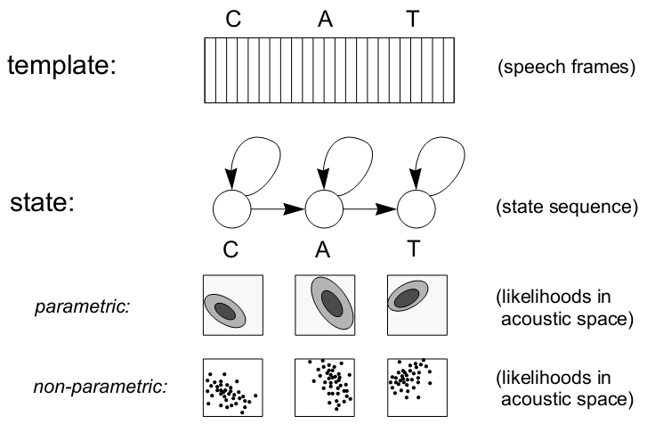
Acoustic Model
There are many kinds of acoustic models. Two popular ones:
*Image taken from [2]

Slide 10
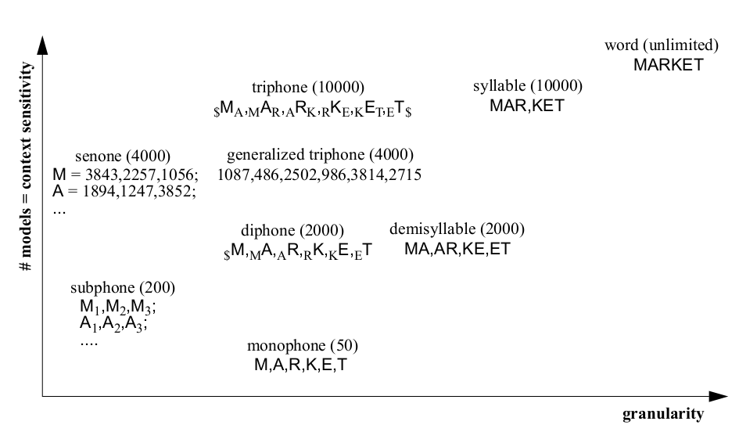
Acoustic Models Cont.
What to model?
Every possible word, each letter?
*Image taken from [2]

Slide 11
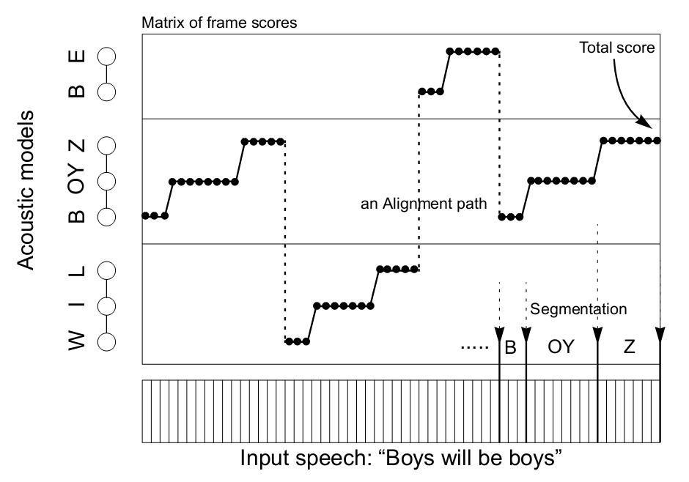
Acoustic Analysis & Alignment
Apply all acoustic model to all speech frames and obtain score for each acoustic model.
*Image taken from [2]

Slide 12
Time Alignment
Given the frame scores, time alignment finds the best alignment of acoustic models given a language model
Language Model defines sequential constraints
Inside a word: Possible sequence of states or frames (defined by phonetic pronounciations in a dictionary)
Between words: Grammar
Can be performed by Dynamic Time Warping or Viterbi algorithm

Slide 13
Output: Text
After the time alignment, we obtain the text represented by the speech.
«Mining a year of speech.»

Slide 14
Evaluation
Based on accuracy and speed of a system
Accuracy
Word Error Rate (WER):
$\frac{\text{(\# }\text{of} \text{substitutions}\text{ + \# }\text{of} \text{deletions}\text{ + \# }\text{of} \text{insertions}\text{)}}{\text{\# }\text{of} \text{words}}$
Single Word Error Rate (SWER)
Speed
Real time factor:
(Time required to process = RTF*speech duration)
Acceptible accuracy and speed scores change depending on application area

Slide 15
Google Search by Voice

Slide 16
Outline-2
History of Search by Voice
Technology
Metric
Acoustic Modelling
Language Modelling
Data Size
Locality
Summary

Slide 17
History of Voice Search
800-GOOG-411: Telephone service
Local business search
Google Maps for Mobile (GMM)
Search by voice for locations
Google Search by Voice
Search for anything on the web
Mainly for smartphones
GOAL: Return the same results with typed queries to google.com

Slide 18
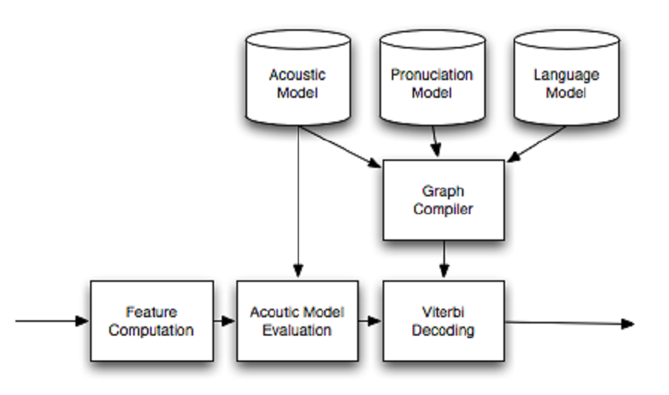
Technology
Very similar to a general ASR system

Slide 19
Metrics
Important because they define the goal of a developed system
Alter your parameters/methods based on metrics
Metrics used to evaluate systems:
Word Error Rate (WER)
Semantic Quality (WebScore)
Perplexity (PPL)
Out-of-vocabulary rate (OOV)
Latency

Slide 20
Modelling
Aim: Scalable Model, Continous Evolution
Started with GOOG-411 acoustic model
Language model is generated from web text
Working system is used to gather more real usage data
Two ways to label collected data:
Supervised: Paid transcribers
Unsupervised: Probabilistic decision on label correctness
Data is represented by using the following:
39-dim Perceptual Linear Predictive coefficients (power cepstrals)
Linear Discriminant Analysis on 9 consecutive frames
Semi-tied full-covariance (STC) matrices for Hidden Markov Models

Slide 21
Acoustic Modelling
Used triphone systems
Like 3-gram for monophones
but not the same
One before and one after
For training:
Maximum Likelihood
Maximum Mutual Information (MMI)
Boosted-MMI
As more data is collected, continously update the models

Slide 22
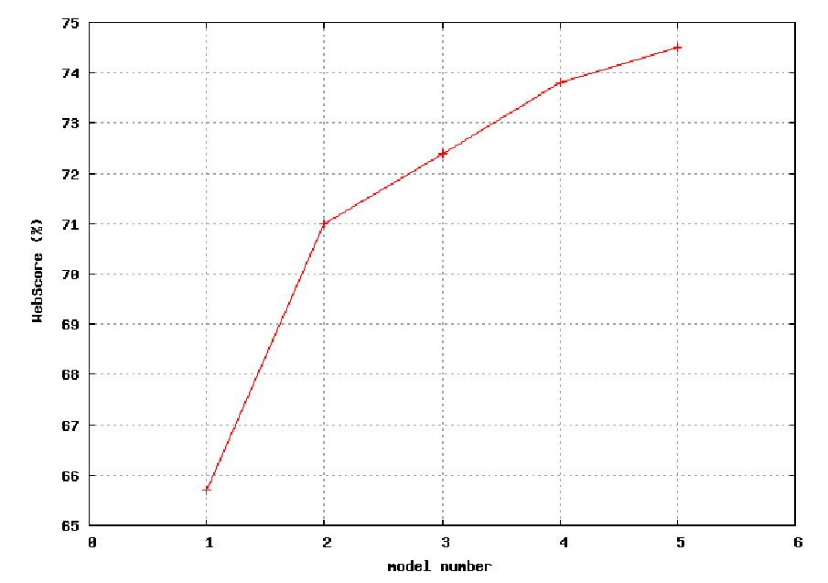
Evaluation of Evolution
Baseline
1K hour labeled
2K labeled + variable GMM
Boosted-MMI + 5K unlabeled data
Even more data

Slide 23
Language Model
Use typed queries to google.com
Requires normalization to obtain speech equivalent
Typed query: «CENG784 presentation week 2»
Spoken query:«ceng seven eight four presentation week two»
Apply Text Normalization to obtain spoken query from typed query
There might be more than one way to read a query
«CENG784»
«CENG seven eight four»
«CENG seven hundred and eighty four»
Use bestpath to select the best candidate
Finally, form n-grams to create language model

Slide 24
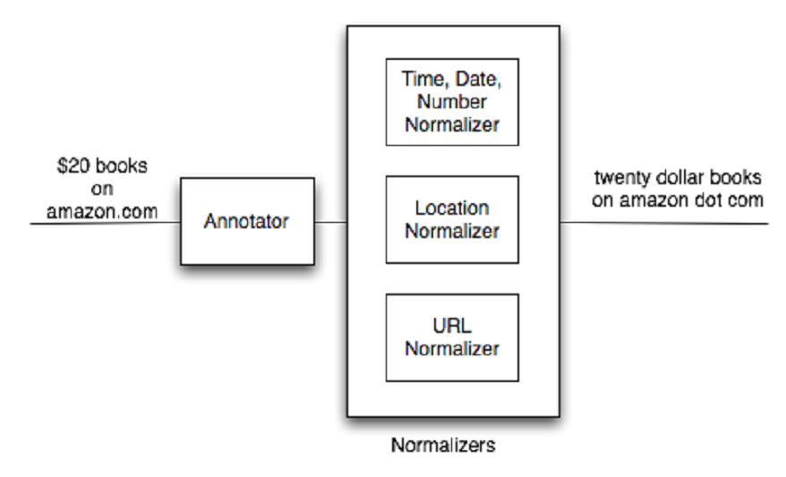
Specialized Text Normalization
For different parts of text, use specialized normalizers

Slide 25
Data Size
A typical model is trained on over 230 Billion words
Vocabulary generated by text normalization: 1 Million words
Huge number of derived n-grams!
Table below shows performance metrics for different sizes:

Slide 26
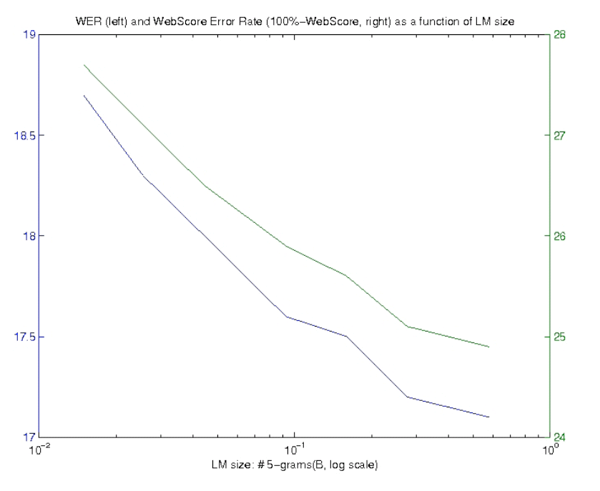
Performance Analysis
What is the effect of Language Model size?

Slide 27
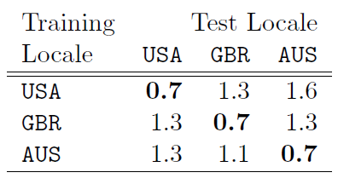
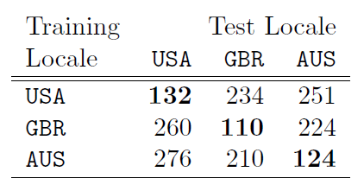
Locality
Locality strongly affects the performance
OOV Rate
Perplexity Relation

Slide 28
Summary
Paper Summary:
Model generation greatly affects the performance
Big data brings high performance
Scalable models are necessary
Locality is an issue
General Summary:
ASR has already changed our lives, will be more common in the future
There are lots to do

Slide 29
References
Davis, C. (2001). «Automatic Speech Recognition and Access: 20 years, 20 months, or tomorrow?», Hearing Loss, 22(4), p. 11-14.
Joe Tebelskis (1995), «Speech Recognition using Neural Networks», Ph.D. Thesis School of Computer Science, Carnegie Mellon University.
Schalkwyk, J. and Beeferman, D. and Beaufays, F. and Byrne, B. and Chelba, C. and Cohen, M. and Kamvar, M. and Strope, B. (2010). «Google Search by Voice: A case study», Visions of Speech: Exploring New Voice Apps in Mobile Environments, Call Centers and Clinics vol. 2.
*All images used in this presentation are taken from internet sources for educational purposes only, all rights reserved to their owners.

Slide 30
Thank You

