Slide 1
DNS – Domain Name system
Converting domain names to IP addresses since 1983

Slide 2
Chapter 2: Application layer
2.1 Principles of network applications
2.2 Web and HTTP
2.3 FTP
2.4 Electronic Mail
SMTP, POP3, IMAP
2.5 DNS && Named Data Networking
2.6 P2P applications
2.7 Socket programming with TCP
2.8 Socket programming with UDP
Application 2-2

Slide 3
DNS: Domain Name System
people: many identifiers:
SSN, name, passport #
Internet hosts, routers:
IP address (32 bit) - used for addressing datagrams
“name”, e.g., www.yahoo.com - used by humans
Q: map between IP address and name, and vice versa ?
Domain Name System:
distributed database implemented in hierarchy of many name servers
application-layer protocol host, routers, name servers to communicate to resolve names (address/name translation)
note: core Internet function, implemented as application-layer protocol
complexity at network’s “edge”
Application 2-3

Slide 4
DNS- a brief history
1983-Designed by Paul Mockapetris at UC Irvine in 1983, and wrote the first implementation at the request of Jon Postel from UCLA
1983-The Internet Engineering Task Force published the original specifications in RFC 882 and RFC 883 in November 1983
1984- A team of graduate students from UC Berkeley , wrote the Unix implementation , BIND(Berkeley Internet Name Domain) (now named) which is the most widely used DNS implementation in the internet today

Slide 5
DNS
DNS services
hostname to IP address translation
host aliasing
Canonical, alias names
mail server aliasing
load distribution
replicated Web servers: set of IP addresses for one canonical name
Why not centralize DNS?
single point of failure
traffic volume
distant centralized database
maintenance
doesn’t scale!
Application 2-5

Slide 6
Distributed, Hierarchical Database
Root DNS Servers
com DNS servers
org DNS servers
edu DNS servers
yahoo.com
DNS servers
pbs.org
DNS servers
poly.edu
DNS servers
umass.edu
DNS servers
amazon.com
DNS servers
client wants IP for www.amazon.com; 1st approx:
client queries a root server to find com DNS server
client queries com DNS server to get amazon.com DNS server
client queries amazon.com DNS server to get IP address for www.amazon.com
Application 2-6

Slide 7
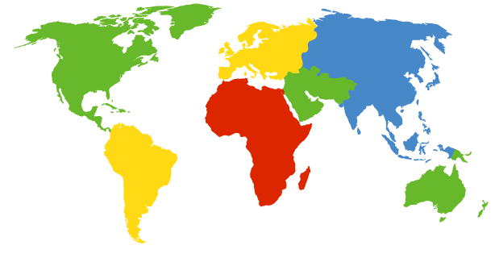
DNS: Root name servers
contacted by local name server that can not resolve name
root name server:
contacts authoritative name server if name mapping not known
gets mapping
returns mapping to local name server
a Verisign, Dulles, VA
c Cogent, Herndon, VA (also LA)
d U Maryland College Park, MD
g US DoD Vienna, VA
h ARL Aberdeen, MD
j Verisign, ( 21 locations)
k RIPE London (also 16 other locations)
i Autonomica, Stockholm (plus 28 other locations)
e NASA Mt View, CA
f Internet Software C. Palo Alto, CA (and 36 other locations)
m WIDE Tokyo (also Seoul, Paris, SF)
13 root name servers worldwide
b USC-ISI Marina del Rey, CA
l ICANN Los Angeles, CA
Application 2-7

Slide 8
Google’s public DNS server
Accessible at the IPv4 addresses - 8.8.8.8 and 8.8.4.4
IPv6 addresses-2001:4860:4860::8888 and 2001:4860:4860::8844
Services a total of 80 Billion name resolution requests per day!!!(stat obtained from Google’s official blog dated 2012) - around 1,000,000 requests per second!!!
Works hand in hand with the IETF
Today, about 70 percent of its traffic comes from outside the U.S. with strong presence in North America, South America and Europe, and Asia.
Other such public DNS providers – OpenDNS .

Slide 9
TLD and Authoritative Servers
Top-level domain (TLD) servers:
Domain Name consists of one or more parts called Labels .
Right most label conveys the Top level domain and each label to the left specifies a sub division or sub domain to the label on the right.
Domain names include com, org, net, edu, aero, jobs, museums, and all top-level country domains, e.g.: uk, fr, ca, jp.
Network Solutions maintains servers for com TLD
Authoritative DNS servers:
An Authoritative only server returns answers only to queries about domain names that have been specifically configured by the administrator.
An organization’s DNS servers, providing authoritative hostname to IP mappings for organization’s servers (e.g., Web, mail).
It can be maintained by organization or service provider
Application 2-9

Slide 10
Local Name Server
Application 2-10
Local Name Servers do not strictly belong to hierarchy
Every ISP (residential ISP, company, university) has a local server also called “default name server”
When a host makes a DNS query, query is sent to its local DNS server which acts as proxy, forwards query into hierarchy.
These local networks implement cache resolvers to improve the efficiency.

Slide 11
DNS name resolution example
root DNS server
2
When a host at cis.poly.edu wants IP address for gaia.cs.umass.edu
3
TLD DNS server
4
5
Iterated query:
Contacted server replies with name of server to contact
“I don’t know this name, but ask this server”
local DNS server
dns.poly.edu
7
6
1
8
authoritative DNS server
dns.cs.umass.edu
requesting host
cis.poly.edu
gaia.cs.umass.edu
Application 2-11

Slide 12
DNS name resolution example
root DNS server
Recursive query:
It resolves any query that it receives even if they are not authoritative for the question being asked , by consulting server or servers that are authoritative for the question
If a name server cannot answer a query because it does not contain an entry for the host in its database, it may recursively query name servers higher up in the hierarchy. This is known as a recursive query or recursive lookup.
2
3
7
6
TLD DNS server
local DNS server
dns.poly.edu
5
4
1
8
authoritative DNS server
dns.cs.umass.edu
requesting host
cis.poly.edu
gaia.cs.umass.edu
Application 2-12

Slide 13
DNS: Updating records and Caching
An Authoritative name server can be either primary or secondary.
Primary servers store the definitive versions of the record in that zone and the secondary server maintains an identical copy of the primary server's database
The update/notify mechanisms proposed IETF standard
RFC 2136 known as Dynamic DNS .
Caching :
Once (any) name server learns mapping, it caches mapping
cache entries timeout (disappear) after some time
TLD servers typically cached in local name servers
Thus root name servers not often visited and improves efficiency.
Application 2-13

Slide 14
DNS records
DNS: distributed db storing resource records (RR)
RR format: (name, value, type, ttl)
Type=A
name is hostname
value is IP address
Type=CNAME
name is alias name for some “canonical” (the real) name
www.ibm.com is really
servereast.backup2.ibm.com
value is canonical name
Type=NS
name is domain (e.g., foo.com)
value is hostname of authoritative name server for this domain
Type=MX
value is name of mail server associated with name
Application 2-14

Slide 15
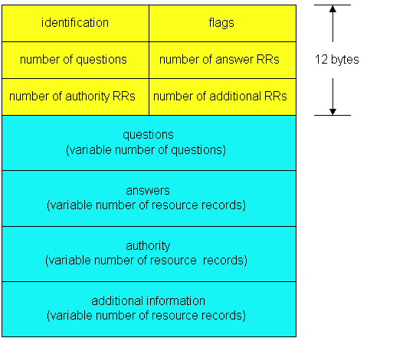
DNS protocol, messages
DNS protocol : query and reply messages, both with same message format
msg header
identification: 16 bit # for query, reply to query uses same #
flags:
query or reply
recursion desired
recursion available
reply is authoritative
Application 2-15

Slide 16
DNS protocol, messages
Name, type fields
for a query
RRs in response
to query
records for
authoritative servers
additional “helpful”
info that may be used
Application 2-16

Slide 17
Inserting records into DNS
example: new startup “Network Utopia”
register name networkuptopia.com at DNS registrar (e.g., Network Solutions)
provide names, IP addresses of authoritative name server (primary and secondary)
registrar inserts two RRs into com TLD server:
(networkutopia.com, dns1.networkutopia.com, NS)
(dns1.networkutopia.com, 212.212.212.1, A)
create authoritative server Type A record for www.networkuptopia.com; Type MX record for networkutopia.com
How do people get IP address of your Web site?
Application 2-17

Slide 18
Named Data networking - NDN
an alternative approach to the architecture of computer networks.
Important Ideal-a communication network should allow a user to focus on the data he or she needs, rather than having to reference a specific, physical location where that data is to be retrieved from.
Based on fact that the vast majority of current Internet usage (a "high 90% level of traffic") consists of data being disseminated from a source to a number of users.
A research effort undertaken by UCLA , UCSD , UCI , UoA , UIUC hand in hand with Xerox Parc.

Slide 19
NDN - goals
aims to develop a new Internet architecture that can capitalize on strengths -- and address weaknesses -- of the Internet's current host-based, point-to-point communication architecture
in order to naturally accommodate emerging patterns of communication.
By naming data instead of their locations, NDN transforms data into the most important entity.
The current Internet emphasizes on the data container- location of data
NDN secures the data itself, a design choice that decouples trust in data from trust in hosts, enabling several radically scalable communication mechanisms such as automatic caching to optimize bandwidth.
The project uses end-to-end test bed deployments, simulation, and theoretical analysis to evaluate the proposed architecture, and is developing specifications and prototype implementations of NDN protocols and applications.

Slide 20
Architectural principles
Retention of the hourglass shape of the internet- the narrow waist of IP
Built in security
End-to-end principle enables development of robust applications in the face of network failures.
Network traffic must regulate itself – self regulating
Routing and forwarding plane isolation

Slide 21
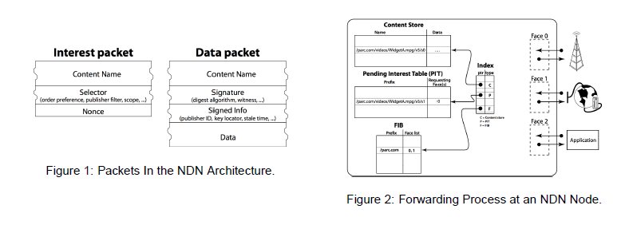
Basic idea of working
Courtesy – NDN Xerox PARC Tech Report 2010-003

Slide 22
NDN – A high level illustration
User
“Interest” Message
A
The actual data ‘D’
Router – which has the routing logic
A
Resource server with the data.
The actual data
‘D’

Slide 23
NDN – research hotspots
Routing
Forwarding
Security and Privacy
Driver Applications
Implementation and deployment

