Slide 1
DNS and Inbound Load Balancing

Slide 2
Understanding DNS
The Domain Name System (DNS) is a hierarchical distributed naming system
Mainly for querying a human readable domain name into IP addresses

Slide 3
DNS Tree
.
.com
peplink
org
wikipedia
Root
Top-level Domain
Second-level Domain
google
www
forum
www
mail
www
Third-level Domain
.edu

Slide 4
Type of DNS server
Authoritative DNS
Authoritative DNS will only answer the DNS queries of domain name which configured in this DNS.
Bind (a UNIX based DNS Server), Microsoft DNS Server, Peplink DNS Server
DNS Forwarder
Find any DNS caching locally (optional)
Forward the DNS queries to another DNS servers
PC/MAC/Linux, Peplink LAN DNS, ISP’s DNS server

Slide 5
When will DNS query happen?
Open the URL via a web browser, it needs to resolve the domain name to IP address before connecting to web server
Email agent connects to mail server
Type “nslookup” a domain name in command line of Windows/Mac/Linux

Slide 6
DNS Query Flow
PC: Query www.foobar.com
Peplink LAN DNS
ISP DNS
Authoritative DNS
Any DNS caching locally?
Query DNS via Peplink
Any Local DNS Records?
Query via ISP DNS
Any DNS caching locally?
Query via Authoritative DNS
Give the result

Slide 7
Type of DNS Records
Type | Description | Fuction
A | Address record | Link the domain or subdomain to IPv4 address
NS | Name server record | Delegates a DNS zone to use the given authoritative name servers
MX | mail exchange record | Directs email to servers for a domain with the order of priority
CNAME | Canonical name records | Aliases for A records
TXT | Text record | Uses for SPF, Domain Key etc
SOA | Start of [a zone of] authority record | Specifies authoritative information about a DNS zone

Slide 8
Domain Registrar
The companies who sell the second-level / third-level domain name (eg: yourdomain.com / yourdomain.co.uk)
It requires to setup at least two name servers (NS) which is used to pointing the zone to the authoritative DNS servers
Update the NS records in Domain Registrar will take up to 72 hours due to most other DNS in internet choose to periodically check for updates and not realtime

Slide 9
Requirement of Authoritative DNS
At least Two Authoritative DNS servers with fixed IP
At least two NS records and two A records in the settings of DNS servers

Slide 10
Requirement of Authoritative DNS
For example: “foobar.com”
The DNS servers IP are 210.10.10.3 and 22.2.2.2
foobar.com. NS ns1.foobar.com.
foobar.com. NS ns2.foobar.com.
ns1 A 210.10.10.3
ns2 A 22.2.2.2
Without trailing dot will add the DNS zone “foobar.com” as suffix
ns1 = ns1.foobar.com.
ns1.foobar.com = ns1.foobar.com.foobar.com
This applies to all DNS server software including Peplink

Slide 11
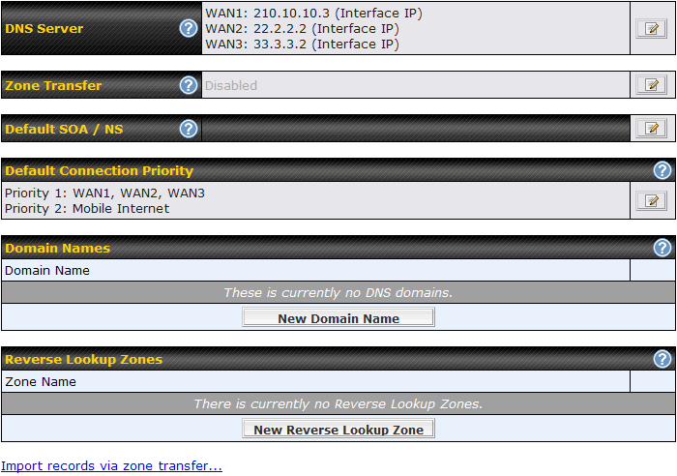
Using Peplink as Authoritative DNS
Enable the DNS Server
Define “Default SOA/NS”
Create the domain name “foobar.com”

Slide 12
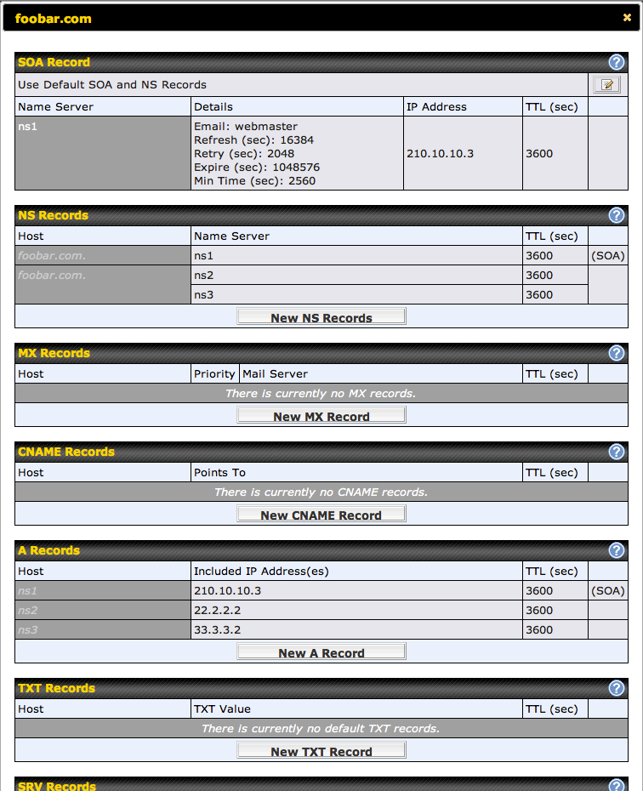
Using Peplink as Authoritative DNS
Using “Default SOA and NS Records”, Peplink will automatically fill in the NS and A records

Slide 13
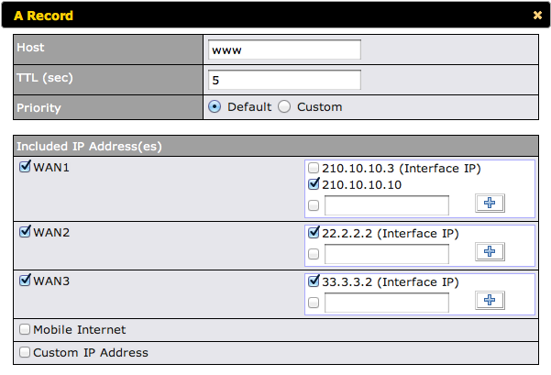
Using Peplink as Authoritative DNS
Create A record “www” for “foobar.com”
Includes the IP address on different WAN links

Slide 14
Troubleshooting
Verify the NS records are setup correctly in Domain Registrar
Perform “nslookup –q=ns foobar.com”
$ nslookup –q=ns foobar.com
Non-authoritative answer:
foobar.com nameserver = ns1.foobar.com.
foobar.com nameserver = ns2.foobar.com.

Slide 15
Troubleshooting
Verify the NS and A are setup correctly in Peplink
“nslookup –q=ns foobar.com 210.10.10.3”
“nslookup –q=a ns1.foobar.com 210.10.10.3”
“nslookup –q=a ns2.foobar.com 210.10.10.3”
IP of Authoritative DNS (Peplink DNS’s IP)
$ nslookup –q=ns foobar.com 210.10.10.3
foobar.com nameserver = ns1.foobar.com.
foobar.com nameserver = ns2.foobar.com.
$ nslookup –q=a ns1.foobar.com 210.10.10.3
Name: ns1.foobar.com
Address: 210.10.10.3
$ nslookup –q=a ns2.foobar.com 210.10.10.3
Name: ns2.foobar.com
Address: 22.2.2.2

Slide 16
Troubleshooting
Verify the Peplink Authoritative DNS returns correct result for www.foobar.com
“nslookup –q=a www.foobar.com 210.10.10.3
$ nslookup –q=a www.foobar.com 210.10.10.3
Name: www.foobar.com
Address: 210.10.10.10
Name: www.foobar.com
Address: 22.2.2.2
Name: www.foobar.com
Address: 33.3.3.2

Slide 17
Delegate the subdomain to Peplink
Customers have their own authoritative DNS and they want to keep it.
In existing authoritative DNS of “foobar.com”
; zone for ‘foobar.com’
balance NS wan1
balance NS wan2
wan1 A 210.10.10.3
wan2 A 22.22.2.2

Slide 18
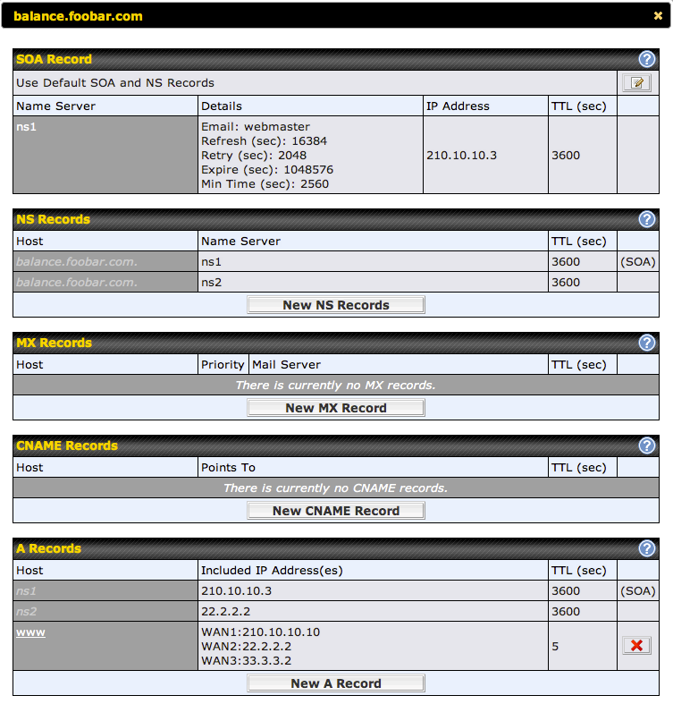
Delegate the subdomain to Peplink
In Peplink
Add the domain “balance.foobar.com”
Add the A record “www”

Slide 19
Delegate the subdomain to Peplink
In the Authoritative DNS
Create a CNAME as below
“www.foobar.com” aliases to “www.balance.foobar.com”
; zone for ‘foobar.com’
www CNAME www.balance

Slide 20
Delegate the subdomain to Peplink
Nslookup result below
$ nslookup www.foobar.com
Non-authoritative answer:
www.foobar.com canonical name = www.balance.foobar.com.
Name: www.balance.foobar.com
Address: 210.10.10.10
Name: www.balance.foobar.com
Address: 22.2.2.2
Name: www.balance.foobar.com
Address: 33.3.3.2

Slide 21
Reverse DNS Lookup
Resolve the IP address to a domain name
Using PTR DNS record to perform reverse lookup
Reverse DNS lookup will be performed within a special domain “in-addr.arpa”
210.10.10.3 > 3.10.10.210.in-addr.arpa
“arpa” is another top-level domain
In most cases, your ISP will manage PTR record for you

Slide 22
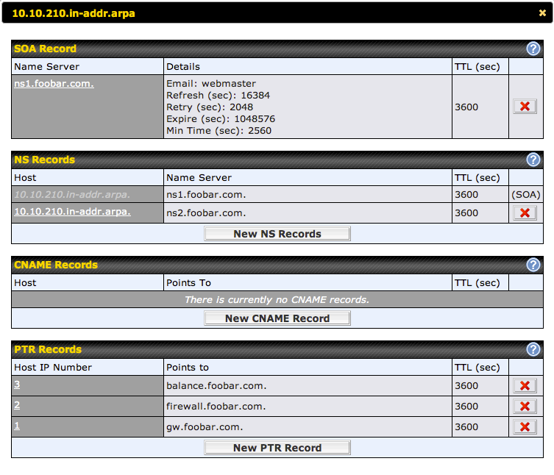
Reverse DNS Lookup
If your ISP delegate the right to you to manage the PTR
You can create the Reverse lookup zone in Peplink
For example, you have authorized to manage the PTR of 210.10.10.0/24

Slide 23
Reverse DNS Lookup
Nslookup a IP address is same as using the syntax “-q=ptr”
“Nslookup 210.10.10.2” will be equal to resolve the PTR record of “2.10.10.210.in-addr.arpa”
$ nslookup 210.10.10.2
2.10.10.210.in-addr.arpa name = firewall.foobar.com.
$ nslookup -q=ptr 2.10.10.210.in-addr.arpa
2.10.10.210.in-addr.arpa name = firewall.foobar.com.

Slide 24
Appendix
Useful syntax of nslookup
Syntax | Description
Nslookup –q=ns | Query NS records
Nslookup –q=a | Query A records
Nslookup –q=mx | Query MX records
Nslookup –q=cname | Query CNAME
Nslookup –q=txt | Query TXT records

