Slide 1
DNS AttackS
Sergei Komarov

Slide 2
DNS
Mechanism for IP <> hostname resolution
Globally distributed database
Hierarchical structure
Comprised of three components
A “name space”
Servers making that name space available
Resolvers (clients) which query the servers about the name space

Slide 3
DNS
Name servers answer ‘DNS’ questions, give authoritative answers for one or more zones.
Several types of name servers
Authoritative servers
master (primary)
The master server normally loads the data from a zone file
slave (secondary)
A slave server normally replicates the data from the master via a zone transfer
(Caching) recursive servers
also caching forwarders

Slide 4
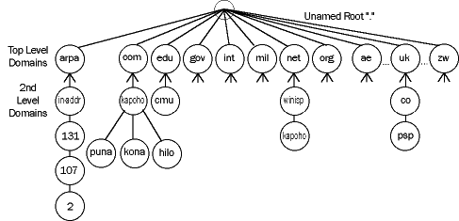
DNS zones & domains
Zone - sub-tree of a larger tree identified by a domain name,
contains resource records and sub-domains

Slide 5
DNS Records
‘A’ record
Defines a host, contains IPv4 address
‘AAAA’ record
Defines a host, contains IPv6 address
‘MX’ record
Defines mail servers for particular domain
‘NS’ record
authoritative nameservers for domain
‘CNAME’ Record
Alias

Slide 6
DNS Security Vulnerabilities
Packet Sniffing
DNS queries/responses come unsigned and unencrypted as one packet
Transaction ID guessing
A 16-bit field identifying a specific DNS transaction. The transaction ID is created by the message originator. Using the transaction ID, the DNS client can match responses to its requests.
Caching problems
No fast & secure way of propagating updates and invalidations

Slide 7
DNS Security Vulnerabilities
Information Leakage
Zone transfer not configured correctly
Result: anyone can query the nameserver
DNS Dynamic Update Vulnerabilities
e.g. DHCP uses DNS Dynamic Updates to add/delete RRs on demand
Authenication takes place on the primary server of the zone, based on the IP address, which could be spoofed
BIND Security
Old versions still in use extensively

Slide 8
DNS Security Attacks
MITM(Man in the Middle Attacks)
The attacker makes connections with the victims and relays messages between them, making them believe that they are talking directly to each other over a private connection
In DNS only IP address, ports and Query ID of source can be verified, but this is easy to spoof.

Slide 9
DNS Security Attacks
Cache Poisoning using Name Chaining
Victim issues a query
Atacker injects DNS names into the response of RR’s and can reroute subsequent DNS queries to another server
This is achieved by means of DNS RRs(resource records) whose RDATA portion includes a DNS name which can be used as a hook to let an attacker feed bad data into a victim’s cache.
The most affected types of RRs are CNAME, NS, and DNAME(alias for the whole DNS domain) RRs.

Slide 10
DNS Security Attacks
Cache Poisoning using Transaction ID Prediction
Transaction ID field is only a 16-bit field
There are only 232 possible combinations of ID and client UDP ports
Some transaction ID generators are flawed, can be predicted

Slide 11
Solution?
DNSSEC
Adds new records:
Origin authentication
Transaction authentication
Request authentication
Each secured zone has a key pair
Public key, stored as a resource record (type KEY) in the secured zone. The public key is used by DNS servers and Resolvers to verify the zone’s digital signature.
A private key is used to sign a RRset. If data is modified during transport the signature is no longer valid.
Nothing is encrypted, only signatures are used.
Easy to implement if hardware support present
Has been around for years

Slide 12
DNS Attacks
Questions?

