Slide 1
OIS Model TCP/IP Model

Slide 2
OSI Model
The Open Systems Interconnection (OSI) model
a conceptual model
characterizes and standardizes the internal functions of a communication system
by partitioning it into abstraction layers
The primary Architectural model for inter-computer communications
“open” denotes the ability to connect any two systems which conform to the reference model and associated standards

Slide 3
History of OSI Model
International standard organization (ISO) established a committee in 1977 to develop an architecture for computer communication
Open Systems Interconnection (OSI) reference model is the result of this effort
In 1984, the OSI reference model was approved as an international standard for communications architecture

Slide 4
History of OSI Model
The OSI model is now considered the primary Architectural model for inter-computer communications
The OSI reference model divides the problem of moving information between computers over a network medium into SEVEN smaller and more manageable problems
This separation into smaller more manageable functions is known as layering

Slide 5
Advantages
Layer architecture simplifies the network design and adds flexibility
It is easy to debug network applications in a layered architecture network
we do not need to modify the entire host software to include more communication devices
The network management is easier due to the layered architecture
Network layers follow a set of rules, called protocol
Defines the format of the data being exchanged
The control and timing for the handshake between layers

Slide 6
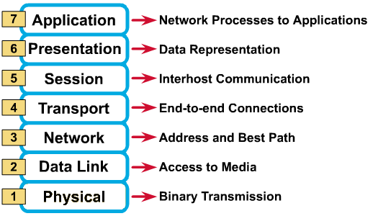
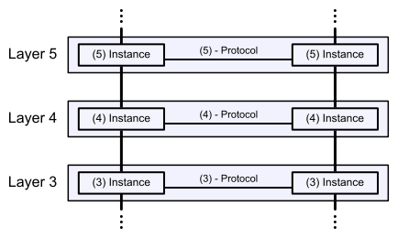
OSI framework architecture
OSI had two major components:
an abstract model of networking, called the Basic Reference Model or seven-layer model
a set of specific protocols
At each level, two entities (N-entity peers) interact by means of the N protocol by transmitting protocol data units

Slide 7
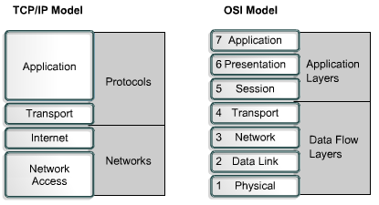
OSI: A Layered Network Model
Each layer
provides a service to the layer above it in the protocol specification
communicates with the same layer’s software or hardware on other computers
The lower 4 layers are concerned with the flow of data from end to end through the network
The upper four are orientated more toward services to the applications

Slide 8
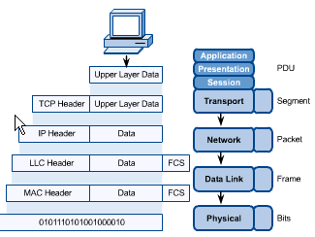
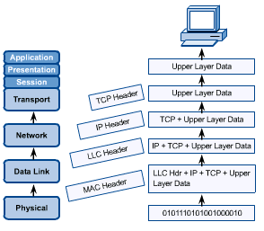
OSI in Action
A message begins at the top application layer and moves down the OSI layers to the bottom physical layer
As the message descends, each successive OSI model layer adds a header to it
A header is layer-specific information that basically explains what functions the layer carried out
Conversely, at the receiving end, headers are striped from the message as it travels up the corresponding layers

Slide 9
Physical Layer
Provides physical interface for transmission of information
Defines rules by which bits are passed from one system to another on a physical communication medium
Covers all aspects for physical communication
mechanical, electrical, functional and procedural
characteristics defined by physical layer
voltage levels, timing of voltage changes, physical data rates, maximum transmission distances, physical connectors, and other similar attributes

Slide 10
Data Link Layer
attempts to provide reliable communication over the physical layer interface
Handle errors by implementing an acknowledgement and retransmission scheme
Breaks the outgoing data into frames and reassemble the received frames
Implement flow control
Supports points-to-point as well as broadcast communication

Slide 11
Network Layer
Implements routing of frames (packets) through the network
Defines the most optimum path the packet should take from the source to the destination
Defines logical addressing so that any endpoint can be identified
Defines how to fragment a packet into smaller packets to accommodate different media
Handles congestion in the network

Slide 12
Transport Layer
Provide a reliable mechanism for the exchange of data between two processes in different computers
Ensures that the data units are delivered error free and in sequence
Ensures that there is no loss or duplication of data units
Provides connectionless or connection oriented service
Provides for the connection management
compare it with a Post Office
deals with the dispatch and classification of mail and parcels sent

Slide 13
Session Layer
Provides
mechanism for controlling the dialogue between the two end systems
defines how to start, control and end conversations between applications
responsible for terminating the connection
full-duplex, half-duplex, or simplex operation
check-pointing mechanism such that if a failure of some sort occurs between checkpoints, all data can be retransmitted from the last checkpoint
Any necessary log-on or password validation is also handled by this layer

Slide 14
Presentation Layer
defines the format in which the data is to be exchanged between the two communicating entities
transforms data into the form that the application accepts
handles data compression and data encryption (cryptography)

Slide 15
Application Layer
the highest level of OSI model, closest to the end user,
both the OSI application layer and the user interact directly with the software application
contains management functions to support distributed applications
Examples are applications such as file transfer, electronic mail, remote login etc.

Slide 16
TCP/IP

Slide 17
TCP/IP Model
The Internet protocol suite
the networking model and a set of communications protocols used for the Internet and similar networks.
commonly known as TCP/IP
its most important protocols, the Transmission Control Protocol (TCP) and the Internet Protocol (IP)
the first networking protocols defined in this standard
provides end-to-end connectivity specifying how data should be formatted, addressed, transmitted, routed and received at the destination

Slide 18
TCP/IP Model
organized into four abstraction layers
Application Layer
Application programs using the network
Transport Layer (TCP/UDP)
Management of end-to-end message transmission,
error detection and error correction
Network Layer (IP)
Handling of datagrams : routing and congestion
Data Link Layer
Management of cost effective and reliable data delivery,
access to physical networks

Slide 19
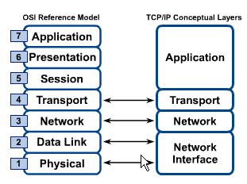
Comparison with OSI model
In the TCP/IP model of the Internet
protocols are not designed into strict layers as in the OSI model
compared with the OSI layering scheme in the following way:
application layer includes the OSI application layer, presentation layer, and most of the session layer
Its end-to-end transport layer includes the graceful close function of the OSI session layer as well as the OSI transport layer
The Internet layer is a subset of the OSI network layer
The link layer includes the OSI data link and physical layers, as well as parts of OSI's network layer.
Internet
Link

Slide 20
Comparison with OSI model
examples of application-layer implementations also include:
On OSI stack:
FTAM File Transfer and Access Management Protocol
X.400 Mail
Common Management Information Protocol (CMIP)
On TCP/IP stack:
Hypertext Transfer Protocol (HTTP)
File Transfer Protocol (FTP)
Simple Mail Transfer Protocol (SMTP)
Simple Network Management Protocol (SNMP)

Slide 21
Thank You!

