Slide 1
DDoS Attacks
A Real and Rising Concern
Sean Dunn
ICS H197
November 19, 2014

Slide 2
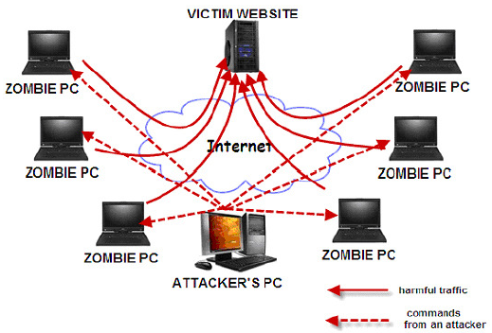
Distributed Denial of Service - DDoS
A DoS (Denial of Service) attack is a method by which malicious hackers prevent legitimate users from accessing a computer resource by overwhelming that resource with network requests
DDoS (Distributed Denial of Service) attacks use arrays of remote or “zombie” computer systems for the same purpose

Slide 3
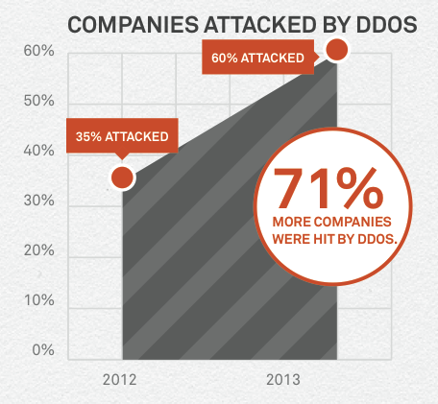
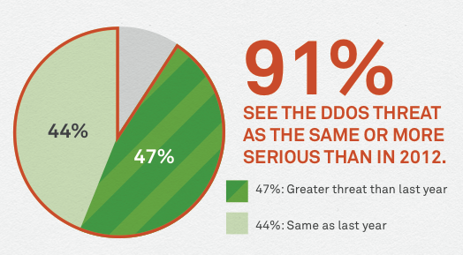
The Weapon of Choice
DDoS attacks are growing in popularity
Any company that uses the Internet is at risk
Every DDoS success inspires more attacks
2014 DDoS Attacks & Impact Report - Neustar
2014 DDoS Attacks & Impact Report - Neustar

Slide 4
Why Choose DDoS?
Distribution makes the attack difficult to isolate
Harder to stop the attack without cutting all users out
More points of attack allows each to be less conspicuous
Fairly easy to implement
Attackers can use cookie cutter versions of proven attacks (LOIC)
Easier than creating a tailored virus/worm
Can provide a “smokescreen”
Distracts the victim, leaving the system vulnerable to other virus injections
Prevention of all DDoS attacks is expensive and infeasible

Slide 5
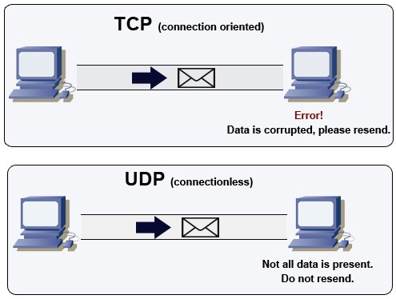
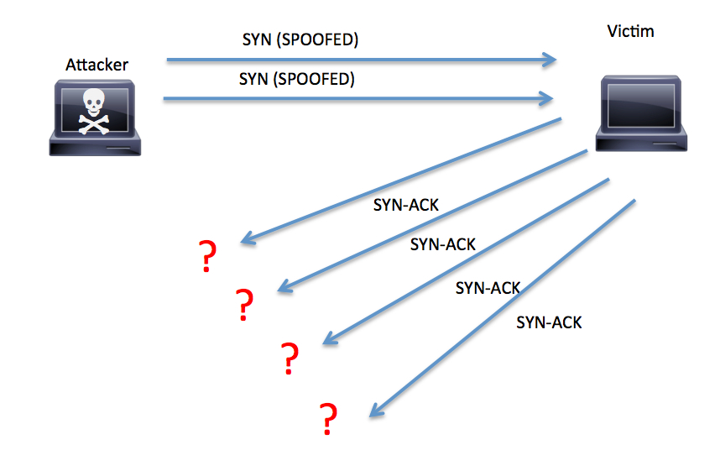
Traditional DoS Attacks
Internet Control Message Protocol
(ICMP) Flood - ICMP echo request (ping) packets, large ICMP packets, and other ICMP types
UDP Flood - resource starvation caused by UDP packets overwhelming the TCP packets in a network
SYN Flood - The attacker does not reply to the server with the expected ACK. To do this, the attacker can spoof the source IP address or simply not reply to the SYN-ACK

Slide 6
Modern DDoS Attacks
DNS Reflection
Zero-Day
Encrypted SSL

Slide 7
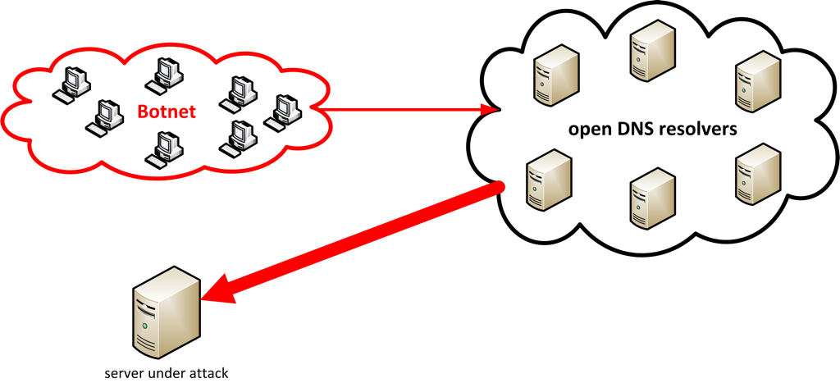
DNS Reflection
Made possible by open DNS resolvers
The attacker uses a distributed system to request large DNS zone files
Source IP address spoofed as the intended victim
DNS zone files are ~100x the size of their requests
Attackers can send attacks many times the size of their bandwidth

Slide 8
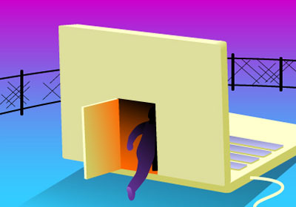
Zero-Day
“One-packet-killers”
These attacks make use of a known vulnerability in a network
With lower-level workarounds such as firmware bugs, DDoS attacks become extremely stealthy

Slide 9
Encrypted SSL
This attack consumes more CPU resources during the encryption and decryption process
The impact on the victim’s system is amplified
Many DDoS mitigation techniques do not account for this type of attack
A large number of these attacks cannot be scrubbed

Slide 10
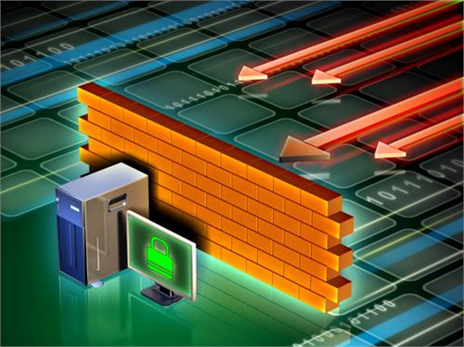
Fighting Back
Preparation
Acquire tools and train a response team
Identification
Classify the type of attack
Identify the appropriate tool to halt the attack
Reaction
Trace back the attack to better grasp how the network is affected
Deploy your tools
Assess the entire attack to better tailor your preparations for next time

Slide 11
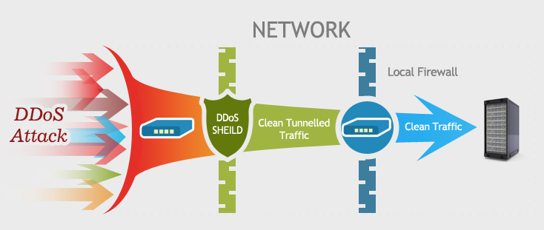
DDoS Mitigation
The most popular mitigation technique is DDoS scrubbing
Scrubbing is done by passing network traffic through high-bandwidth networks with traffic filters
The filters examine attributes such as:
IP addresses
Cookie variation
HTTP headers
Javascript footprints

Slide 12
Enough theory, what happens in the real world?

Slide 13
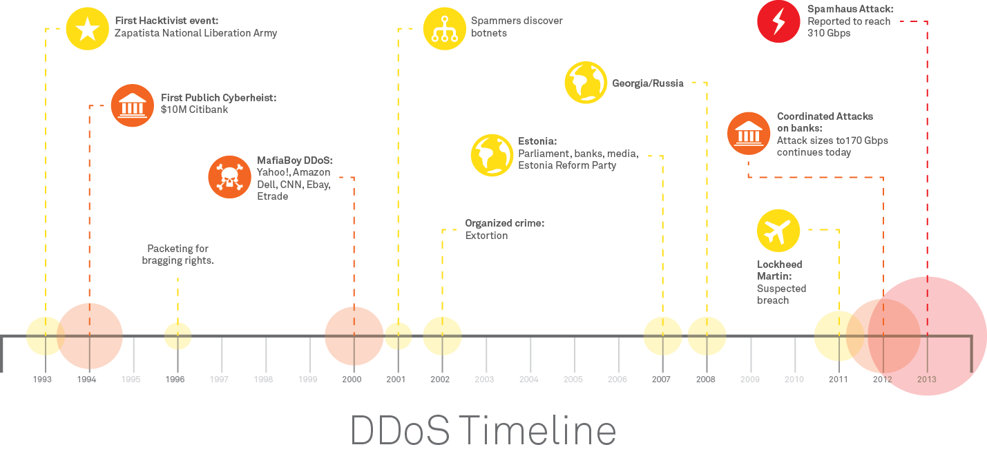
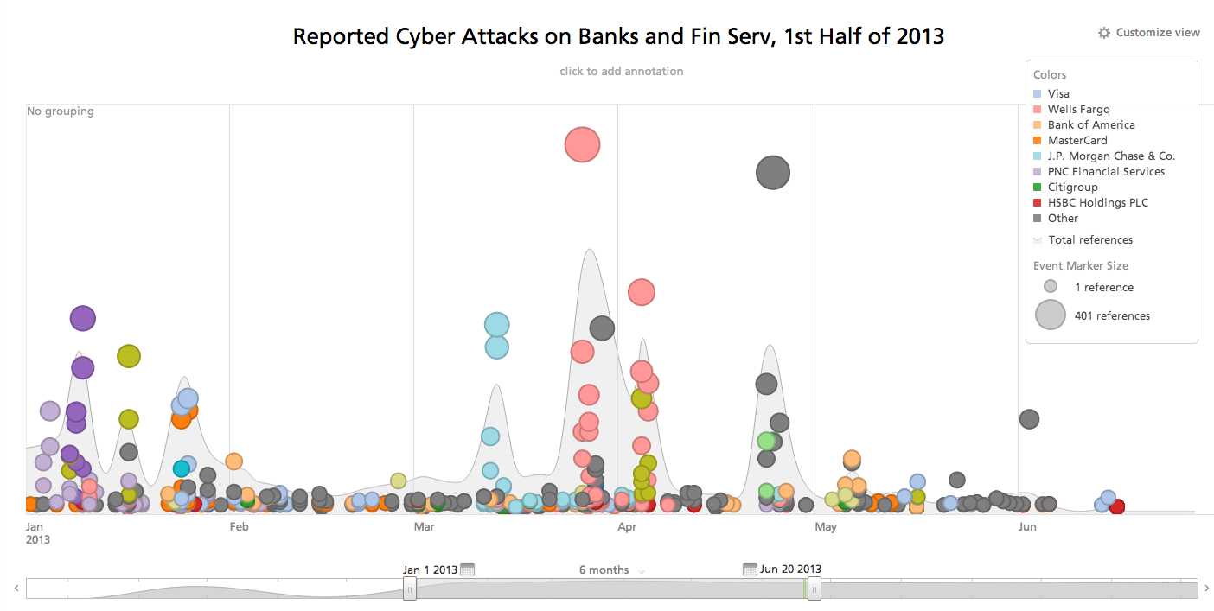

Slide 14
Infamous DDoS Attacks
MafiaBoy, 2000 – 15 year old student launches DDoS against Yahoo, Ebay, CNN, Amazon, and Dell
Estonia, 2007 – A slew of Estonian websites (many governmental) is DDoSed
SpamHaus, 2013 – Non-profit anti-spam organization

Slide 15
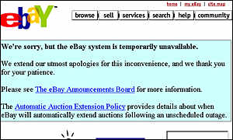
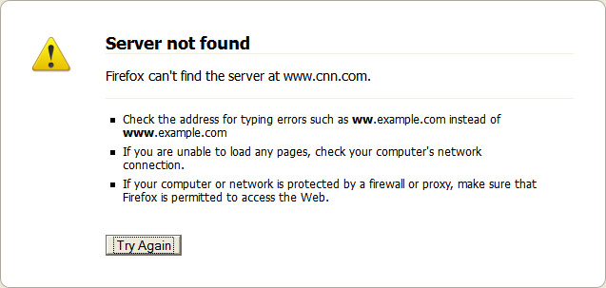
MafiaBoy
February, 2000 – Michael Demon Calce (aka MafiaBoy) runs a homemade script meant to take down high-profile networks
The websites of Yahoo, Ebay, CNN, Amazon, and Dell were all hit within a week
Calce launched his DDoS software from over 50 networks worldwide – many owned by universities
Done in the spirit of “hacking” and to build reputation

Slide 16
Estonia Cyberattacks
April, 2007 - Many websites of Estonian organizations (banks, ministries, newspapers, etc.) brought offline
The attacks ranged from ping floods to sophisticated botnets
A leader in the pro-Kremlin youth movement took credit for organizing the attacks – which had political motives
Experts believe the attacks had the blessing and help of Russian authorities

Slide 17
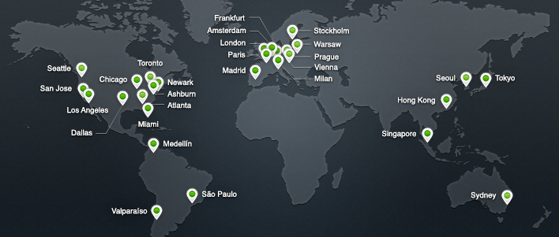
SpamHaus
Directly or indirectly responsible for filtering up to 80% of daily spam messages
March 19, 2013 – SpamHaus servers hit with a DNS Reflection Attack
Incoming traffic between
20-100 Gbits/sec
The Solution - Scrubbing
Routed the attack traffic to a network of 23 different data centers
Many to one -> Many to many

Slide 18
The Research
Popularity-based front-end cache
“IP Fast Hopping” Network-layer architecture for dynamic server IP address change
Stochastic model based puzzle controller
Compares entropy of a covariance matrix to a behavior threshold

Slide 19
Conclusions
Denial of Service is evolving as the major cybersecurity threat to companies and governments
DDoS attacks are difficult to detect and isolate
Modern DDoS attacks are more precise and dangerous (Zero-Day, Encrypted SSL)
Almost every high-profile company that uses the internet must purchase DDoS mitigation services
Attacks are only going to increase in sophistication and size

Slide 20
Thank You! Questions?

