Slide 1
Preventing DDoS Attacks
Matt Jennings

Slide 2
Overview
What is DDoS?
Recent DDoS attacks
History of DDoS
Prevention Techniques

Slide 3
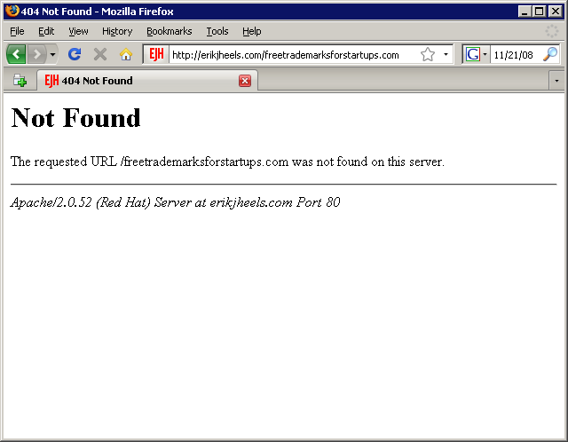
DDoS
Notes:
-Distributed Denial of Service, or DDoS, is simple yet powerful attack used to attack internet resources
-Usually involves flooding a resource with TCP or UDP packets
-Two main classes of DDoS attacks
-Bandwidth depletion, is an attack that is used to flood a victim’s network so that legitimate traffic is not able to access the service, system or site, these attacks are usually layer 4 on the transport layer such as TCP UDP packets
-Another is resource depletion is an attack that ties up the resources of the victim system in order to crash it, these attacks are usually layer 7, HTTP, DNS, FTP

Slide 4
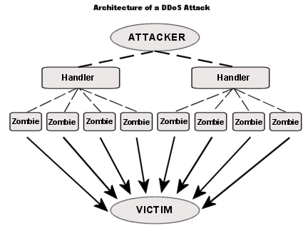
The DDoS Process
Notes:
An attacker will install DDoS software, usually trojans, onto thousands of vulnerable computers
This software allows the hacker remote control of the computers and the ability to issue commands on the computers
-A handler is another type of compromised host that can issue commands, each handler controls multiple zombies
-These commands can also be issued through an IRC client to the zombies
-The zombies will be the computers actually performing the attack

Slide 5
Early DDoS Attacks
February 7-11 2000
CNN, Yahoo, eBay, Buy.com, ZDNet, E*Trade, and Datek were affected
Attacks lasted from 30 minutes to 3 hours
Loss of $1.1 million
Notes:
-these attacks were highly publicized and brought the term DDoS into the main stream
The attacks on these sites caused decreased performance
Losses combined from Amazon and Yahoo totaled 1.1 million dollars

Slide 6
Companies attacked by Anonymous
Amazon
Paypal
Mastercard
Visa
Department of Justice
MPAA/RIAA
Many more
Notes:
Many big name companies refused to support wikileaks
As a result of this, Anonymous attempted to take down these sites.
After the Megaupload website was shut down by the FBI and DOJ
Anonymous attacked the DOJ and took it completely down within 70
After the introduction of the SOPA bill, anonymous also attacked the Motion Picture Association of america and The Recording Industry Associaton of America

Slide 7
History
DDoS attacks relatively new
First DDoS tools were discovered on networks in May and June of 1998
First Attack on University of Minnesota network
Conferences were held in Pittsburgh Pennsylvania by DIST to discuss the DDoS problem
Notes:
In may and june of 1998 the first notable DDoS tools were discovered to being used on networks
The first documented case of a DDoS attack was on the University of Minnesota Network.
Six months after this attack a conference was held in Pittsburgh PA by DIST to discuss how to deal with the problem
-later that year CERT(The computer Emergency Readiness Team) published a white paper on DDoS attacks

Slide 8
DNS Rootserver Attack
October 21st 2002
Hackers targeted DNS root name servers
Attack lasted one hour
900Mbits/sec
No noticeable effect
Government took notice February 6, 2007
Notes:
-the DNS rootservers are essentially the backbone of the website side of the internet
-they map domain names to IP addresses
-the attack lasted 1 hour and sent almost 1 gigabit per second of continuous data that targeted all of the 13 DNS root name servers
-the system was too complex and distributed to receive any noticeable effect, however a few rootservers were unreachable
On Februray 6th of 2007 another similar yet more powerful attack took place in which 4 root servers expereinced very heavy traffic
Two days after the attack, "If the United States found itself under a major cyberattack aimed at undermining the nation's critical information infrastructure, the Department of Defense is prepared, based on the authority of the President, to launch [...] an actual bombing of an attack source or a cyber counterattack."

Slide 9
Low Orbit Ion Cannon
Open source C# program developed by Praetox Technologies
Primitive DDoS attack using Layer 4 of OSI
Easy to use
However, it takes thousands of hosts to bring down a website
Anonymous failed to bring down Amazon.com
Notes:
-Open source C sharp program that was developed by Praetox Technologies
-it was designed to be a network stress tester, but it has obviously been used
-later released to the public for free.
-Floods a service with TCP or UDP packets, usually the SYN(synchronize packets)

Slide 10
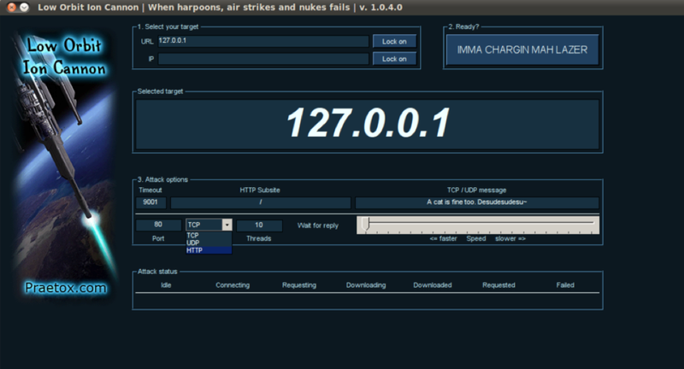
LOIC

Slide 11
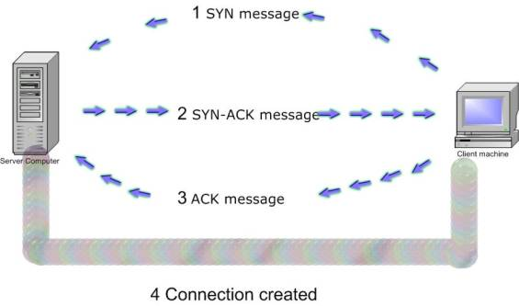
SYN Attacks
Also known as TCP Floods
Three way handshake
Notes:
The SYN packet, a part of the TCP/IP protocol, stands for synchronize and sends when a client is first communicating with a server
The client first sends a SYN request to the server, the server then acknowledges it by sending SYN-ACK (synchronize acknowledge) back to the client
after this, the client will send back an ACK to the server, and then the connection can begin
-this method can be abused when the attacker can force his client to refuse to send the the final ACK message, this creates a Half-open connection which ties up resources
-all of these actions happen on the 4th layer of the OSI model, TCP UDP etc..

Slide 12
7th Layer Attacks
Requires less active connections
Real TCP and UDP connections
Can deny proper function hardware regardless of how good the hardware is
Goal of attacks if for network devices or computers to crash
Hard to defend against
Notes:
-these attacks operate at level 7 of the OSI model, example protocols used in attacks are FTP, DNS, and HTTP
-harder to defend against because these attacks execute through legitimate TCP or UDP connections
- Goal of these attacks is for network devices or computers to reach their resource limit and to crash

Slide 13
False Positives
DDoS attacks are hard to detect
Michael Jackson DDoS
After his death, popular news sites such as Google, CNN, and TMZ were taken offline briefly due to the massive burst of traffic.
This shows how hard it can be to detect legitimate traffic from illegitimate traffic
Notes:
-Google, CNN, TMZ and many others went down briefly when they experienced a massive burst of traffic.

Slide 14
Secure the Network
Update
Operating System
Applications
Install Firewall or IDS/IPS
Use a Patch Management Server to update applications speedily
Remove unnecessary programs and services(especially on Linux distros)
Notes:
-the speed in which people receive information on hackingtools is increasing
-should use a patch management server to update applications
-remove or disable services or programs that are not necessary

Slide 15
Audit the Network
Audit Frequently
Increase frequency of audits for more critical devices such as routers or switches
Scan network
Log
Configure NAT devices to log all events and traffic
Notes:
-the more critical a network device is to your network, an example being a router or switch, the more often it should be audited
-if you have the source code to programs, you should check to see if they have any buffer overflow vulnerabilites
-you can scan the network using programs such as nmap to see if there are any unnecessary ports open
-configure NAT devices to log all events and traffic

Slide 16
Segmentation of Traffic
Segmentation of traffic
Email
Web traffic
Decentralize
If one service is attacked by DDoS, the others won’t go down
Notes:
-segment certain types of traffic logically or physically from other traffic
-an example of this would be segmenting your e-mail server from your website server
-if one service is attacked by DDoS the other won't go down

Slide 17
DNS TTL
Pick a reasonable time
Higher the time, less time to redirect traffic
Less time, more time to redirect traffic
If a DNS TTL is set at 24 hours, servers would keep that IP address in their cache for 24 hours
Pick a DNS TTL between 4 and 8 hours
Notes:
-time that a website record will stay on an primary nameserver
-an example would be if a DNS ttl was set at 24 hours, servers would still have the same value in their cache until they
updated 24 hours later
-during an attack you can change traffic over to other webservers
-useful when dealing with ISP
-point the dns at the ISP so that they observe the traffic
-a lower TTL on a dns will give you more time to redirect the traffic

Slide 18
IDS DDoS Rule Based
Monitors the network for malicious activity
Very Specific
Tailor the rule base depending on the type of service you are running
Lots of false positives will be generated by the nature of IDS/IPS
Notes:
-counts number of SYNS from a particular ip and will flag it
-very specific, tailored to specific sites
-looks for certain exploits
-lots of false positives

Slide 19
Firewalls
Block certain types of packets
UDP
TCP
Block source address
Not very helpful when DDoS attacks originate from spoofed IP addresses
Notes:
-If there is no legitimate need for UDP packets to pass, then a firewall or router can block them
-IP touters can improve traceability by discarding packets whose source address is impossible given the wire on which the packet arrived.
-not very helpful considering most DDoS attacks are from spoofed IP address

Slide 20
Caching Websites
MySQL and Oracle queries
Cache Webpages
Cache in site applications
Caching Web Pages is smart so that if customers need to access an webpage even though the original server is down, they can
Notes:
-Cache popular database queries in MySQL or Oracle
-Cache webpages
- things like product page
-cache applications

Slide 21
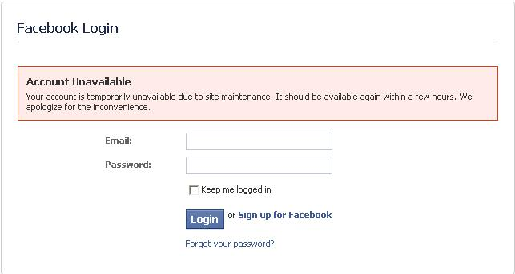
Create a Static Website
Notes:
-develop a static site that will require a low amount of bandwidth, so even if your servers are under attack they can still operate
-if you know that your site is under attack, you can switch over to the static website
-an example of this is on facebook, when you get the service is temporarily unavailable
-if you can respond here is the maintenance page, its not perfect but it gives people feedback and you can get out information that way.

Slide 22
Site Metrics
Develop statistics about who visits your site
Browser Version
Operating System
Country
Referral
Average ping
Notes:
-you can build a databse of statistics on the users that typically visit your site
- these metrics can include information such as the Browser Type, OS, Country, where the webpage was referred from and
average ping times
-anomalies within these metrics on a large scale can indicate that a DDoS attack is tacking place
-can build rules on these anomalies to make the DdoS attacks stop

Slide 23
IP Traceback
Origin of a packet
Communication with ISP
Requires communication with ISP
To properly identify an IP with a 95% accuracy, the IP must have sent atleast 300,000 packets
More streamlined than previous years
Notes:
-IP traceback is basically the methodology used in tracing the orgin of an IP address
-this is a very tedious process, especially if the attack is using a spoofed address(which they always are)
-The network admin will have to communicate with the ISP who will then communicate with their upstream provider, going from hop to hop until the origin is reached
-to properly identify an IP address with a 95% rating, at least 300,000 packets must be sent from that IP address
-the process has become streamlined and automated over the years

Slide 24
BGP redirection and scrubbing
“Border Gateway Protocol”
Reroute ALL traffic
Scrub the bad traffic(DDoS) off
ISP’s and services such as the ones offered by VeriSign help redirect traffic to be filtered
Notes:
-BGP is border gateway protocl
-responsible for routing decisions on a network, mainly that of ISPs and large providers
-you can buy this service from an ISP
-essentially when you know you are under attack by a DDoS attack, you can activate a program that will redirect all the
information back to the ISP and filter out IP address that are executing an attack
-filter based on signatures
-more of mitigation than prevention, but needs to be set up before a network goes live
The verisign service will redirect traffic away from your network if it finds it to be malicous

Slide 25
http://www.youtube.com/watch?v=bVeEUEbOuo0

Slide 26
Questions
Questions?

