Slide 1
Sub-Saturating DDoS Attacks
The Silent Bandwidth Thief
Sean Newman
Director Product Management

Slide 2




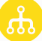


20+ Years of DoS Attacks
500 Gbps Hong Kong attack
France swarmed after terror attack
PlayStation & Xbox hit at Christmas
First Hacktivist event:
Zapatista National Liberation Army
Anon hits Church
of Scientology
Spammers discover
botnets
Spamhaus attack:
Reported to reach 310 Gbps
Panix.net hit with
first major DDoS
ProtonMail
attack
MafiaBoy DDoS:
Yahoo!, Amazon,
Dell, CNN, Ebay,
Etrade
Estonia: Parliament, banks, media, Estonia Reform Party
Coordinated US bank attacks:
Grew to 200 Gbps,
and continue today
Rio
Olympics 540 Gbps
DoS for
Notoriety
Organized crime:
Extortion
1993
1995
1997
1999
2001
2003
2005
2007
2009
2011
2013
2015
2017

Slide 3
Latest DDoS Attack Vectors
Use of NTP for reflection attacks is on the decline
  Significant vulnerabilities patches released early in 2016
New DDoS Reflection vector leveraging TFTP (port 69)
  Small request packet, with spoofed source IP, requesting file
  TFTP Server sends 60x larger response to spoofed target
Many TFTP Servers accessible from the public Internet
  TFTP is Unauthenticated
TFTP Attacks already seen in the wild…

Slide 4
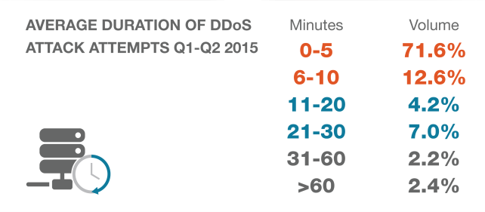
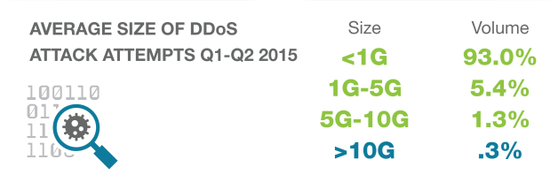
New Breed of Smarter ‘Surgical’ DDoS Attacks
84%
OF ATTACKS ARE LESS THAN 10 MINUTES
93%
OF ATTACKS ARE 1 Gbps OR LESS IN SIZE

Slide 5
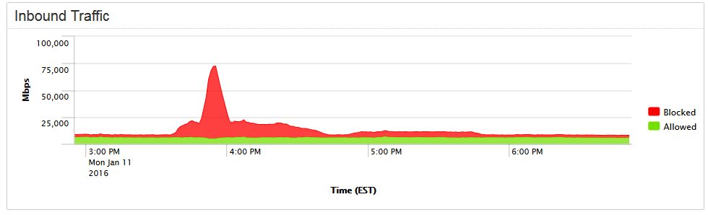
Sophisticated Multi-Layered Attacks
Just enough volume to cripple target destination
Advanced DoS attacks crafted to avoid detection
Short duration to avoid legacy DDoS scrubbing-center mitigation
Initial Attack ramps
Volume ramped to 68Gb for a few minutes duration when attack not succeeding
Ongoing low-level, background attacks

Slide 6
The Challenge - DoS is part of the new-normal
Thousands of attacks every day:
Many Motives
  Political / Beliefs
  Ransom / Extortion
  Targeted Attack Smokescreens
Anyone can launch an attack:
  Free tools and how to videos
  DDoS for hire sites
Increasingly Sophisticated
  Harder to Detect and Mitigate

Slide 7
Why Should You Care?
Cost - Increasing volume of bandwidth being wasted
  Traditional Scrubbing is either blind, or too slow to react
  Even if your customers protect themselves, you still suffer
Reputation – Many businesses believe their provider protects them
Opportunity – Protect your infrastructure and sell on as a service
Businesses believe DDoS protection is not their problem; expectation is service providers already dealing with it!
…are you?

Slide 8
Thank You!
Notes:
Thank You!

