Slide 1
Cyber Crime
MSIT 458: Information Security & Assurance By Curtis Pethley
Selection

Slide 2
Selecting a Firewall
There are 6 General Steps
Identify your topology, applications, and protocol needs.
Analyze trust relationships within your organization.
Develop security policies based on these trust relationships.
Identify the right firewall for your specific configuration.
Employ the firewall correctly.
Test your firewall policies religiously.

Slide 3
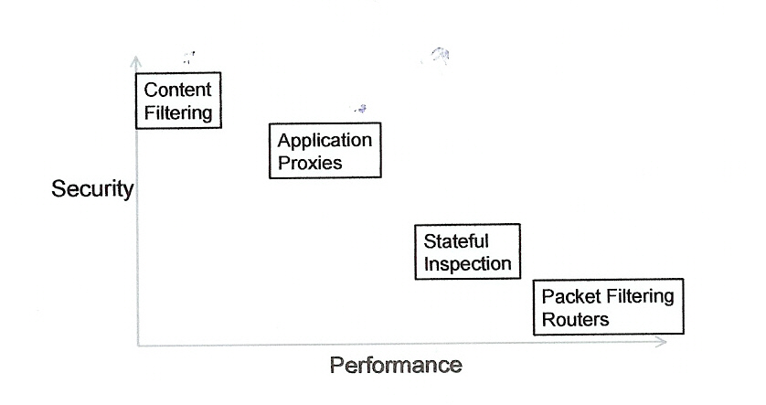
Security vs. Performance

Slide 4
Best for Small/Medium Businesses
Budget - Low level or high level security
Security vs Performance
Packet filter router – Low cost and simple
Configuration
Bastion Host
Selecting the Firewall
Notes:
A budget sets what you get and what you don’t get, it is very ambiguous!! Content filtering provides the most security but the least in performance and Packet filter router provides the most in performance but the least in security, application proxies and stateful inspection are somewhat in the middle

Slide 5
Small/Medium Business Firewalls
1 to 75 Users
Fortinet
Watchguard
Juniper
SonicWALL
Netgear
Cisco
Checkpoint
Notes:
While basic firewall models often have a three-interface limit, higher-end firewalls allow a large number of physical and virtual interfaces

Slide 6
FortiGate-110C/111C
HTTP Throughput of 450 Mbps
400,000 maximum concurrent connections
Network Interfaces 2 x 10/100/1000 WAN port and 8 x 10/100 switch port
MSRP $2,895.00

Slide 7
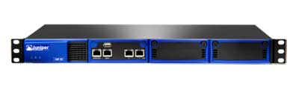
Juniper IDP75
HTTP Throughput of 150 Mbps
100,000 maximum concurrent connections
Two RJ-45 Ethernet 10/100/1000 with bypass
Eight detection mechanisms including stateful signatures and backdoor detection
MSRP $8,000.00
Notes:
Intrusion detection and prevention system

Slide 8
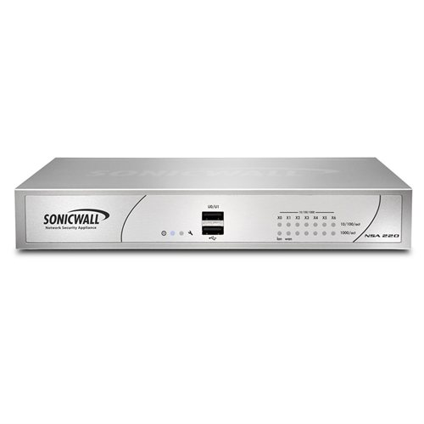
SonicWALL NSA 220
HTTP Throughput of 600 Mbps
85,000 maximum concurrent connections
25 VLAN interfaces
MSRP $1,700.00

Slide 9
Pros & Cons of Small/Medium Firewalls
PROS
Affordable and easy to install
All 3 of these are Stateful firewalls, adaptive and better at identifying unauthorized and forged communications then Stateless
Packet filtering firewalls is their low cost and low impact on network performance
CONS
They do not protect against back door attacks – Juniper IDP75 does offer this protection
Slow under heavy traffic load (low throughput), since all connections must go through the firewall system
Firewalls do not provide data integrity, nor data confidentiality
No IDS, so vulnerable to inside attackers – Juniper IDP75 does offer this protection
Notes:
Examples of backdoor entrance points to the corporate network are:
modems, and importing/exporting floppy discs. The security policy needs to cover these aspects as well
Firewalls do not provide data integrity, because it is not possible, especially in large networks, to have the firewall examine each and every incoming and outgoing data packet for anything.
Firewalls cannot ensure data confidentiality because, even though newer firewalls include encryption tools, it is not easy to use these tools. It can only work if the receiver of the packet also has the same firewall.
Over 70% of all data breaches occur from inside the firewall

Slide 10
Small Business Decision
Purchase the SonicWALL NSA 220 - $1,700
Need to prevent Insider Attacks
Users can access only resources they need
Minimal Direct Access to Database(s)
Training
File/Network Integrity Checking
Purchase Anti-Malware/Virus software
Notes:
Introduced last month NSA 220 Series delivers an unmatched combination of security, performance and price in this class of next-generation firewalls High performance due to the SonicWALL Reassembly-Free Deep Packet Inspection highly efficient, single-pass engine high security with content filtering.
Also SSL encrypted traffic Problem is it does not have an Intrusion detection nor Prevention system. We no that 70% of all breaches come from inside, so this needs to be addressed in one way or another.
Setting account rights is somewhat of an art. It is much like walking a tight rope. Give a person too much access, and they may gain access to data and other resources that are not required for their job. Make access rights too restrictive and he or she may be unable to do their job
database systems are often easy targets for insider attackers
Employee training is another major key to preventing insider attacks. It should go without saying that employees should be taught about basic security practices, such as password and physical security procedures They should also be trained how to correctly respond to these attempts Also Organizations should train employees to lock or logout of their workstation any time they leave it, for any amount of time
A second tool that can be used to detect insider attacks is a file and network integrity-checking piece of software. This software is designed to constantly check multiple servers or computers for any changes in the base file installation. This includes any the installation of backdoor programs in standard programs By monitoring these files for changes, the security administrator can determine if someone has successfully breached the system. The most well-known and recommended piece of software to accomplish this is called Tripwire for Servers.

Slide 11
Medium Business Decision
Purchase the Juniper IDP75 - $8,000
Purchase Anti-Malware/Virus software
Notes:
If the Budget allows for an $8,000 for a security device then the Juniper IDP75 is what I would suggest. You can find them on the internet as non-refurbished units for a little over $5,000. This is the least expensive IDP system that Juniper offers, the IDP8200 is the most expensive at about $40,000.
You have Intrusion detection and prevention and backdoor attack detection, this unit does offer Trojan horse protection but its
Advised to get a full anti-malware/virus protection software.

Slide 12
Best for Large Businesses
Budget- if unlimited
Security vs Performance
Both Content filtering and Packet filtering
Configuration
Dual Firewalls
Selecting the Firewall
Notes:
Content filtering for high security and Packet filtering for high performance

Slide 13
Large Enterprise (UTM) Firewalls
100 to 20,000 users or more!
CISCO
Juniper
Checkpoint
Notes:
Unified Threat Management UTM Firewall comes with additional security features. Some protection features or modules include gateway anti-virus, anti-spam protection, web filtering, IDS/IPS, DLP (Data Loss Prevention) and application control

Slide 14
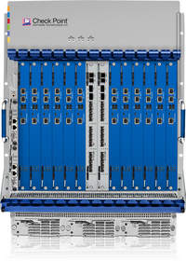
Checkpoint 61000
Tested over 85 Gbps of Real-World HTTP throughput
Scalability - Up to 600,000 connections per second with a total capacity of 70 million concurrent connections
4096 Virtual interfaces (VLANs)
MSRP $100,000.00
Notes:
The Check Point 61000 Security System was just released last August is the industry’s fastest security appliance. Firewall, IPSec VPN, Identity Awareness, Advanced Networking, Acceleration and Clustering, IPS, URL (Content) Filtering, Antivirus & Anti-Malware, Application Control

Slide 15
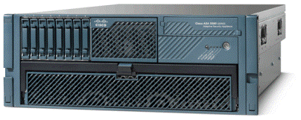
Cisco ASA 5580-40 Firewall
Tested over 10 Gbps of Real-World HTTP throughput
Scalability - Up to 182,000 connections per second with a total capacity of 4 million concurrent connections
1024 Virtual interfaces (VLANs)
MSRP $129,995.00

Slide 16
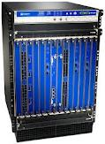
Juniper SRX5800
Tested over 30 Gbps of Real-World HTTP throughput
Scalability - total capacity of 10 million concurrent connections
4096 Virtual interfaces (VLANs)
MSRP $100,000.00
Notes:
Juniper Network's Integrated Security Gateway

Slide 17
Pros & Cons of UTM Firewalls
PROS
As a UTM Firewall all three of these devices have
network firewalling
network intrusion prevention
gateway anti-virus & gateway anti-spam
VPN & content filtering ( high security)
Load balancing & data leak prevention
On-appliance reporting
Integrity and confidentiality of data
Extremely high throughput
Thousands of Virtual Interfaces
Easy Management (Web based GUI), one device taking the place of multiple layers of hardware and software
Notes:
Unified Threat Management (UTM) is a comprehensive solution that has recently emerged in the network security industry and since 2004 primary network gateway defense solution for large organizations The ultimate goal of a UTM is to provide a comprehensive set of security features in a single product managed through a single console UTM solutions emerged because of the increasing number of attacks on corporate information systems via hacking/cracking, viruses, worms- mostly an outcome of blended threats and insider threats. Also, newer attack techniques target the user as the weakest link in an enterprise, the repercussions of which are far more serious than imagined. Data security and unauthorized employee access have become major business concerns for enterprises today. This is because malicious intent and the resultant loss of confidential data can lead to huge financial losses as well as corresponding legal liabilities

Slide 18
Pros & Cons of UTM Firewalls – cont’d
PROS
Reduced complexity: Single security solution. Single Vendor. Single AMC
Reduced technical training requirements, one product to learn.
Regulatory compliance
CONS
Single point of failure for network traffic
Single point of compromise if the UTM has vulnerabilities
Potential impact on latency and bandwidth when the UTM cannot keep up with the traffic

Slide 19
Large Business Decision
Purchase the Checkpoint 61000 - $100,000
Notes:
This security appliance brings the fastest and most fully secured to an enterprise with many ten’s or hundreds of thousands of users. Keep in mind that what I said for the Small businesses, restricting users to only needed resources. Minimal direct access to databases
And training applies to Medium and Large businesses as well.

Slide 20
Summary
Know your Budget guidelines
Security Policy
Best protection from a security appliance within your Budget!

Slide 21
Thank you for Listening!!
Any Questions???

