Slide 1
Firewall
Regan Little

Slide 2
Overview
Definition
Methods of Screening
Types of Firewall
Network-Level Firewalls
Circuit-Level Firewalls
Application-Level Firewalls
Stateful Multi-Level Firewalls
Common Brands of Firewall
Cisco
Netgear
HP
Hotbrick
Conclusion

Slide 3
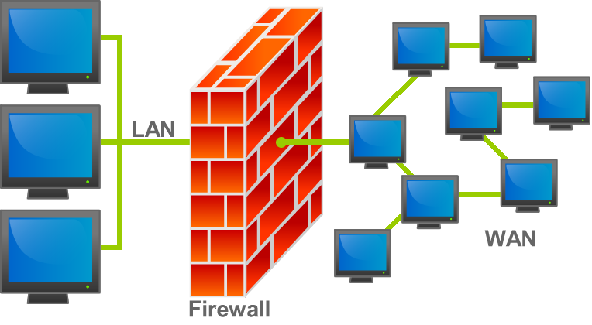
Definition
A firewall is a set of related programs, located at a network gateway server, that protects the resources of a private network from users from other networks.

Slide 4
Methods of Screening
A simple screening method is to examine requests to make sure they come from acceptable or previously identified domain name and Internet Protocol addresses.
For mobile users, firewalls allow remote access into the private network by the use of secure log-on procedures and authentication certificates.

Slide 5
Types of Firewall
Network-Level Firewalls
First generation of firewalls
Fast, but they do not understand languages like HTML and XML
They can’t validate user inputs or detect maliciously modified URL requests
Works at the network level by inspecting packet headers and filtering based on the IP address of the source and the destination, the port and the service
Some applications could also filter based on protocols or the domain name of the source

Slide 6
Types of Firewall
Circuit-Level Firewalls
Second generation of firewall technology
Monitor TCP handshaking between packets to make sure a session is legitimate
Traffic is filtered based on specified session rules and may be restricted to recognize computers only
These firewalls hide the network from the outside which is useful for denying access to intruders
They do not filter individual packets

Slide 7
Types of Firewall
Application-Level Firewalls
They can log user activity
Recently these firewalls have been looking more deeply into the application data going through their filters
They attempt to enforce correct application behavior, block malicious activity, and help organizations ensure the safety of sensitive information and systems
Filtering may also include protection against spam and viruses and be able to block undesirable web sites based on content (rather than just their IP address)
However, since the firewall is looking more closely to the packet, it works slower

Slide 8
Types of Firewall
Stateful Multi-Level Firewalls
SML vendors claim that their products have the best features compared to the other three types of firewall
They filter packets at the network-level and then recognize it and process it at the application-level
Since they do not utilize proxies, they deliver reasonably good performance despite the deep packet analysis
On the downside, they are not cheap, and they can be difficult to configure and administer

Slide 9
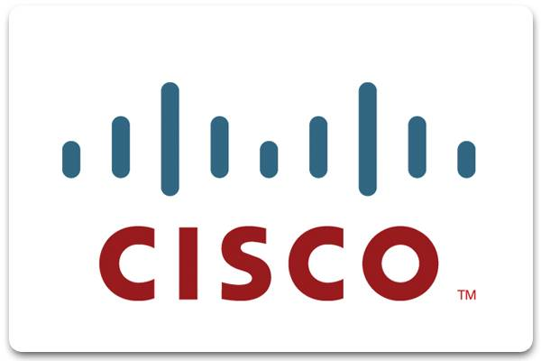
Brands of Firewall
Cisco
They make high end systems that function very well
They are known for working with large enterprise systems

Slide 10
Brands of Firewall
Netgear
At the low end of hardware security
Most computer professionals do not recommend it
The main selling point is its low price

Slide 11
Brands of Firewall
HP
A reliable high performance hardware
Includes application and network layer enhancements that improve the overall network security
Easy to install

Slide 12
Brands of Firewall
Hotbrick (Soho)
A good choice for a home office
Known for being a decent firewall
Priced relatively low for the market

Slide 13
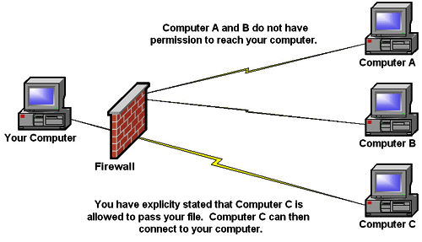
Conclusion
Firewalls are systems designed to prevent unauthorized access to a private network.
Firewalls can be implemented in both hardware and software

Slide 14
Bibliography
http://www.bing.com/images/search?q=firewall&view=detail&id=1C289B2CE22663B554B8E8C4CFC3A65847B77863&first=91&FORM=IDFRIR
http://en.wikipedia.org/wiki/Firewall_(networking)
http://searchsecurity.techtarget.com/definition/firewall
http://www.focus.com/fyi/types-of-firewalls/
http://www.computersecurity.cc/firewallbrands.htmlhttp://isaserver.org/tutorials/HP-ProLiant-DL320-ISA-Hardware-Firewall.html
http://www.webopedia.com/TERM/F/firewall.html

