Slide 1
Firewall Modules and Modular Firewalls
- H.B. Acharya, Aditya Joshi, M.G. Gouda
Classroom Presentation
- Shaayendra Raju

Slide 2
Topics to be covered
What is a Firewall
Metrics of Firewall
Types of Firewalls
Need for Modular Firewalls
Remarks

Slide 3
What is a Firewall
A packet filter placed at the entry point of a network in the Internet
Most important Line of defense for Enterprise networks.
Can be implemented in both hardware & software versions.

Slide 4
How does a firewall works
<Function> -> <Decision>

Slide 5
Dependency explained
Function employs "First - Match" criterion to determine sequence of rules to be applied on any incoming/outgoing packet.
Much of a short-circuit evaluation.
If packet matches multiple rules, action of first matching rule will be taken.

Slide 6
Order of Rules matters
Order of rules creates dependency.
Level of dependency is proportional to Complexity of firewall.
Consumes lot of time to understand and design a firewall.

Slide 7
New Metric …?
Inversion - Number of pairs of adjacent rules that have different decisions in a give firewall F.
For modular firewalls Inversion metric would be 1 or 2.
Inversion and dependency are correlated.

Slide 8
Fields, Packets, Rules and Firewalls
Fields - variables - Source/destination IP address, Transport protocol, Source port number and destination port number.
Consider d fields, f1,f2,….fd and domain values denoted by D(f1)..,D(fd).
Rule would be of form
<r.decision> - accept/discard.
All accept rule -
All discard rule -
Last rule in firewall - accept-all / discard-all.

Slide 9
Dependency metric
Accept band
Discard band
Dependency set - For a given rule 'r' in firewall 'F', it is set containing every rule 's' where s precedes r in F and r, s occurs in different bands in F
Dependency varies with cardinality between 'r' &'s'.
Theorem-1 If the rules in a band in a firewall 'F' are reordered in any way, then the resulting firewall is equivalent to 'F'

Slide 10
Theorem-2
Let 'F' be any firewall with 'n' rules
The smallest possible value of dependency metric is (n-1)/n.
The largest possible value of dependency metric is (n-1)/2.
Proof :
Consider 'F' has only 2 bands , first one has n-1 rules and other has 1 rule. Average cardinality of dependency set (n-1)/n.
Consider 'F' has 'n' bands and each band consists of only 1 rule,
dep. set of first rule - 0 rules, 2nd rule - 1 rule , nth rule - n-1 rules. Average cardinality (n-1)/2.

Slide 11
Inversion Metric - Theorem - 3
The smallest possible value of the inversion metric in 'F' is '1'.
The largest possible value of the inversion metric in 'F' is 'n-1'.
Proof - Consider firewall with two or more bands.
Smallest possible value of inversion metric - 1.
Largest possible value of inversion metric - (n-1).
**Inversion metric

Slide 12
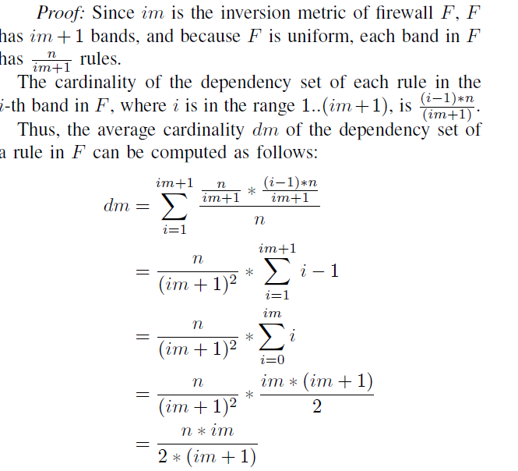
Theorem 4
Let 'F' be a uniform firewall with n rules. 'dm' value of dependency metric of 'F'.'im' be the value of inversion metric of F.
Then dm = n* im / 2*(im+1)

Slide 13
Simple Firewalls
Should have 3 bands B0, B1, B2 and satisfy 3 conditions
B0 consists of zero or more discard rules.
B1 consists of zero or more accept rules.
B2 consists of only one discard-all rule.
If
B0 exists, inversion metric is 2.
else Inversion metric is 1.

Slide 14
Identifying irrelevant rules
Identify irrelevant rules and removing them from firewall 'f' yields firewall 'g' which is simple and equivalent to 'F'.
Conditions
Rule 's' is in band B0 and there is another rule 'r' in B0 where "r covers s".
Rule 's' is in band B0 and there is no rule r in B1 where "r overlaps s"
Rule 's' is in band B1 and there is another rule r in B1 where "r covers s"

Slide 15
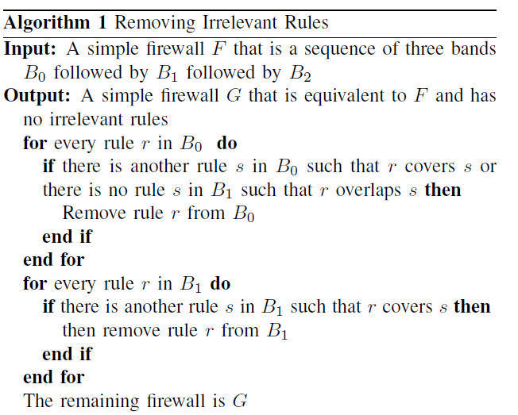
Algorithm for removing Irrelevant rules

Slide 16
Partitioned Firewalls
A non-empty set {PF1,PF2,…,PFn} of firewalls, such that oneness condition holds true.
If
a packet is accepted by one firewall in a partitioned firewall PF, then packet is said to be accepted by PF.
else if
packet is discarded by every firewall in PF, the packet is said to be
discarded by PF.

Slide 17
A simple/ Monolithic firewall (F) <=> partitioned firewall (PF)
iff
F & PF accept / discard same set of packets.
Advantages of partitioned firewalls
Parallel processing of packets.
Ease of design and update.
Small inversion metric.

Slide 18
Theorem 5
Let F & G be two firewalls.
If for every accept rule 'r' in 'F' and every accept rule 's' in 'G', r does not overlap s, then 'F' and 'G' can be components in same firewall

Slide 19
Modular firewall
It is a partitioned firewall {MF1,….,MFr} where each component MFk, called a firewall module, is a simple firewall.
Inversion metric of module MFk is 1 or 2.
Inversion metric of Modular Firewall MF is 1 or 2.
Design
Set of all packets is partitioned into r non-overlapping classes PC1.....PCN
Each module is designed to accept some or all the packets that belong to packet class PCk.

Slide 20
Theorem 6
Assume that Algorithm2 is applied to Monolithic firewall and produced the simple firewalls {MF1,…..,MFr}. Then no two distinct firewalls MF1 and MFk accept the same packet.

Slide 21
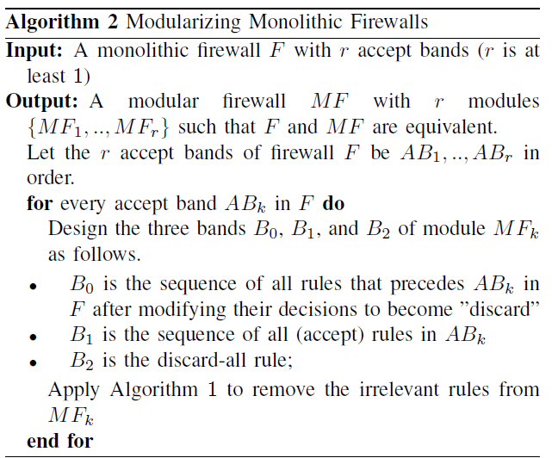
Algorithm2

Slide 22
Theorem 7
Assume that algorithm2 is applied to monolithic firewall 'F' and produced a modular firewall MF that consists of modules {MF1,MF2,...MFk}
Each packet accepted by 'F' is also accepted by 'MF'.
Each packet, that is accepted by 'MF' , is also accepted by 'F'

Slide 23
Design goal
Given a Firewall 'F', whose inversion metric is very large , it's output should be a modular firewall 'MF' whose design metric is 1 or 2.
Complexity - O(n^2).
Algorithm1 is called from algorithm2 to remove irrelevant rules and compute modular firewall.

Slide 24
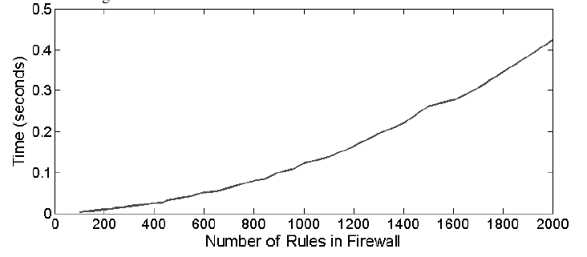
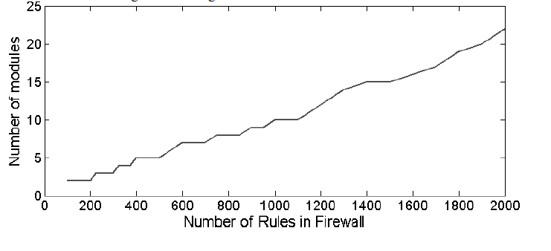
Simulation Results

Slide 25
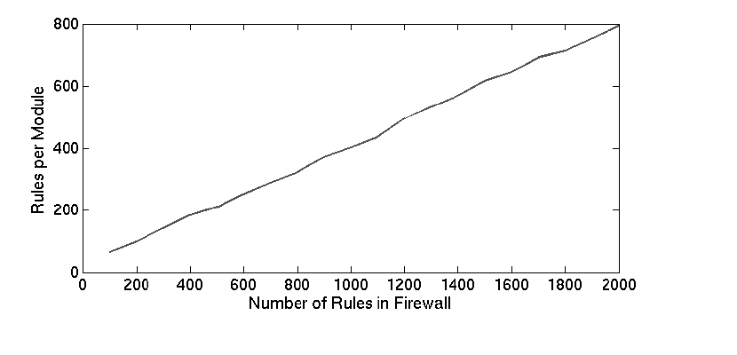
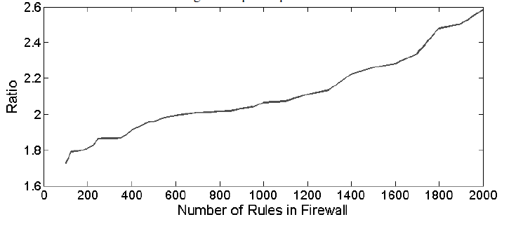
Simulation Results

Slide 26
Conclusion
The author has presented a new metric called 'Inversion' which is related to dependency and designed an algortihm that can compute modular firewall 'MF', given firewall 'F' in O(n^2) time.
Advantage of modular firewalls
Cleanness of design
Low inversion metric that makes firewalls easy to understand.
Permits modification with no unexpected side effects.

Slide 27
Thank you

