Slide 1
Multi Agent System Programming languages
Mahmoud El Razzaz
Mostafa M. Ameen
Mai M. M. Farag

Slide 2
Introduction
Research in Multi-Agent Systems (MAS) has recently led to the development of practical programming languages and tools that are appropriate for the implementation of such systems.
Agent-oriented languages, ranging from purely declarative, to purely imperative, and various hybrid approaches.
Using these languages, instead of more conventional ones, proves useful when the problem is modeled as a multi-agent system, and understood in terms of cognitive and social concepts such as beliefs, goals, plans, roles, and norms.

Slide 3
Classification of MAS Programming Languages
MAS programming languages
Declarative
Imperative
Hybrid approaches

Slide 4
1- Declarative Programming Languages

Slide 5
Definition[1]
Is a programming paradigm that expresses the logic of a computation without describing its control flow.
The programmer can concentrate on stating what is to be computed, not how it is to be computed.
Algorithm = Logic + Control
The programmer gives the logic but not necessarily the control.

Slide 6
Example
//C# Imperative implementation
static int factorial(int n)
{
if (n <= 1)
return 1;
int result = 1;
for (int i = 2; i <= n; i++)
{
result = result * i;
}
return result;
}
//Prolog Declarative implementation
factorial(0,1):-
!.
factorial(N1,T2):-
N2 is N1-1, factorial(N2,T1),
T2 is N1*T1.

Slide 7
Sub paradigms
Declarative languages make extensive use of relationships. There are two principal styles of defining relationships available to such languages:
Functional
Logic
These form the two sub-branches of the declarative family of programming languages.

Slide 8
Functional Definition
Functional declarative languages tend to be inspired by the Lambda Calculus ( Calculus), a computational model proposed by Alonzo Church in the 1930's. As the name suggests, using the functional style, relationships are expressed using functions.
Example:
(square (n)
(* n n))
This is a function, square, that express the relationship between the input n and the output value n*n.

Slide 9
Logic Definition
Logic declarative languages in turn, tend to be inspired by Predicate Calculus and, more particularly, the Horn Clause subset of Predicate calculus. In this style of declarative programming relationships are declared using expressions known as clauses.
Example:
square(N, M):-
M is N*N.
Clauses can be used to express both facts and rules. A logic programme can therefore be treated as a relational database to which we can pose queries of various forms.

Slide 10
Some Tools and Languages
CLAIM
(Computational Language for Autonomous, Intelligent and Mobile agents)[2]
is a high-level agent-oriented programming language that combines cognitive aspects such as
knowledge
goals
capabilities
computational elements
such as communication, mobility and concurrence in order to reduce the gap between the design and the implementation phase.

Slide 11
CLAIM[2]
A CLAIM agent:
Is a node in a hierarchy.
Is an autonomous, intelligent and mobile entity that can be seen as a bounded place where the computation happens.
Has a parent, a list of local processes and a list of sub-agents.
Has intelligent components (knowledge, capabilities, goals) that allow a reactive or proactive behavior.

Slide 12
CLAIM
In CLAIM, agents can be defined using
defineAgent agentName {
authority=null; | agentName ;
parent=null; | agentName ;
knowledge=null; | { (knowledge;)+}
goals=null; | { (goal;)+}
messages=null; | { (queueMessage;)+}
capabilities=null; | { (capability;)+}
processes=null; | { (process | )* process }
agents=null; | { (agentName;)+}
}

Slide 13
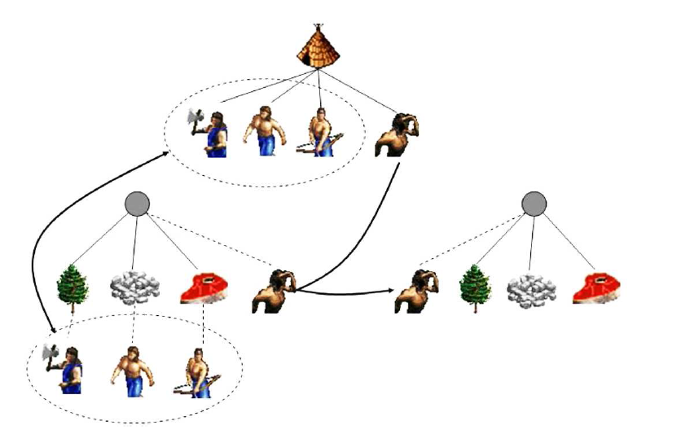
CLAIM[2]
A Case Study: Age of Empires
Figure 1: Age of Empires – Seak order

Slide 14
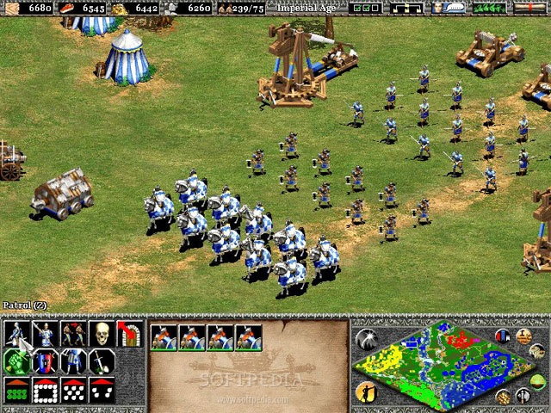

Slide 15
CLAIM[2]
A Case Study: Age of Empires
The Creator agent:
Creates (using newAgent) a Seeker agent.
Finds out the list of the existing sites.
Tells to the Seeker to migrate to each of them (using move).
When the Seeker arrives on a site:
He “counts” the available resources.
He asks (using send) specialized agents from the Creator, who will create (using newAgent) one specialized agent for each type of resource, agents that migrate to the specific resource agents on the site.

Slide 16
CLAIM[2]
A Case Study: Age of Empires
After gathering the resources, they return to the village, give the resources to the Creator and wait for other calls.
Meanwhile, the Seeker moves to other sites, searches for resources and asks for specialized agents.
If there is no specialized agent available at the Creator when a new ask for help arrives, a new specialized agent is created.

Slide 17
Some Tools and Languages
FLUX [3]
MINERVA [4]
DALI [5]
ReSpecT [6]

Slide 18
2- Imperative MAS programming languages [6]
In this paradigm, a program is a series of instructions for the computer.
This is one of the earliest paradigms to emerge, as it is close to what actually occurs inside the computer.
The fundamental tool that makes imperative programming possible is the conditional jump.
In practice, we pretty up our conditional jumps with loops and if syntax.
Fast execution

Slide 19
Imperative is inappropriate![7]
Imperative languages are in essence inappropriate for expressing the high-level abstractions associated with agent systems design; however, agent-oriented programming languages should (and indeed tend to) allow for easy integration with (legacy) code written in imperative languages.

Slide 20
Examples of imperative languages
JACK Intelligent Agents® (JACK)[1] is an Agent Oriented development environment built on top of and integrated with the Java programming language. It includes all components of the Java development environment as well as offering specific extensions to implement agent behaviour.

Slide 21
Examples of imperative languages
JADE (Java Agent Development Framework)[8] is a software development framework aimed at developing multi-agent systems and applications conforming to FIPA standards for intelligent agents.

Slide 22
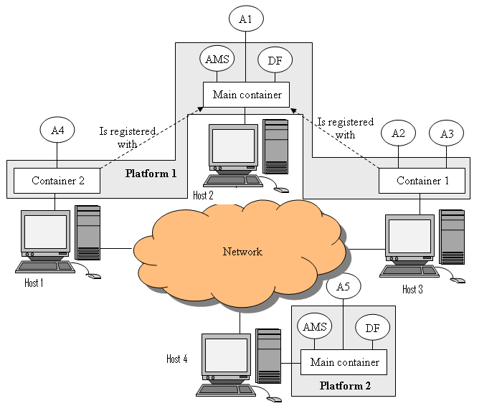
Jade architecture [8]
Figure 2: Jade architecture

Slide 23
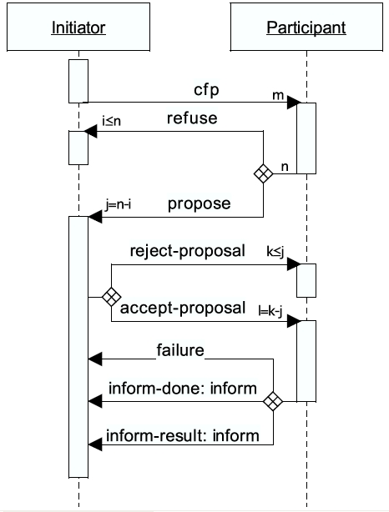
Live example
I'll show you an example of multi-agent system which is developed in JADE framework.
The example shows how to implement a simple ContractNet multi-agent system.
Figure 3: ContractNet protocol

Slide 24
3- Hybrid approaches in MAS programming languages ¹
Introduction:
Various well-known agent languages combine declarative and imperative features. In this section we describe agent programming languages which are declarative while at the same time providing some specific constructs allowing for the use of code implemented in some external imperative language

Slide 25
Examples of Hybrid languages
Jason
Jason is available Open Source, and is distributed under GNU LGPL at: http://jason.courceforge.net
3APL
(An abstract Agent Programming Language)
User guide for 3APL available at: http://www.cs.uu.nl/3apl

Slide 26
Examples of Hybrid languages
IMPACT
IMPACT is a system developed by subrahmanian et al. with the main purpose of providing a framework to build agents on top of heterogeneous sources of knowledge.
Information on the Impact platform is available at: http://www.cs.umd.edu/projects
Notes:
heterogeneous متغاير الخواص

Slide 27
Examples of Hybrid languages
GO!
GO! Is a multi agent programming language with a declarative subset of function and relation definitions, an imperative subset comprising action procedure definition and rich program structuring mechanisme.
Notes:
heterogeneous متغاير الخواص

Slide 28
Examples of Hybrid languages (JASON)
Jason is an interpreter for an extended version of AgentSpeak. It implements the operational semantics of that language, and provides a platform for the development of multi-agent systems, with many user-customizable features.

Slide 29
Examples of Hybrid languages (JASON)
Features of JASON ⁹ :
Some of the features available in Jason are:
speech-act based inter-agent communication (and annotation of beliefs with information sources);
annotations on plan labels, which can be used by elaborate (e.g., decision theoretic) selection functions;
the possibility to run a multi-agent system distributed over a network (using SACI, but other middleware can be used);

Slide 30
Features of JASON:
fully customizable (in Java) selection functions, trust functions, and overall agent architecture (perception, belief-revision, inter-agent communication, and acting);
straightforward extensibility (and use of ) by means of user-defined “internal actions”;
clear notion of multi-agent environments, which can be implemented in Java (this can be a simulation of a real environment, e.g., for testing purposes before the system is actually deployed).

Slide 31
Examples of applications developed by Jason
Gold Miners (Jomi Hübner and Rafael Bordini) ¹⁰
A team of gold-mining agents has to retrieve pieces of gold scatters in a grid-like territory, finding suitable paths to then take the retrieved gold to a depot. In the actual competition, two team of agents compete against each other.

Slide 32
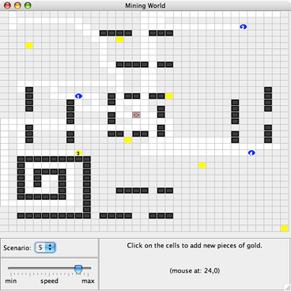
Examples of applications developed by Jason
Gold Miners (Jomi Hübner and Rafael Bordini)

Slide 33
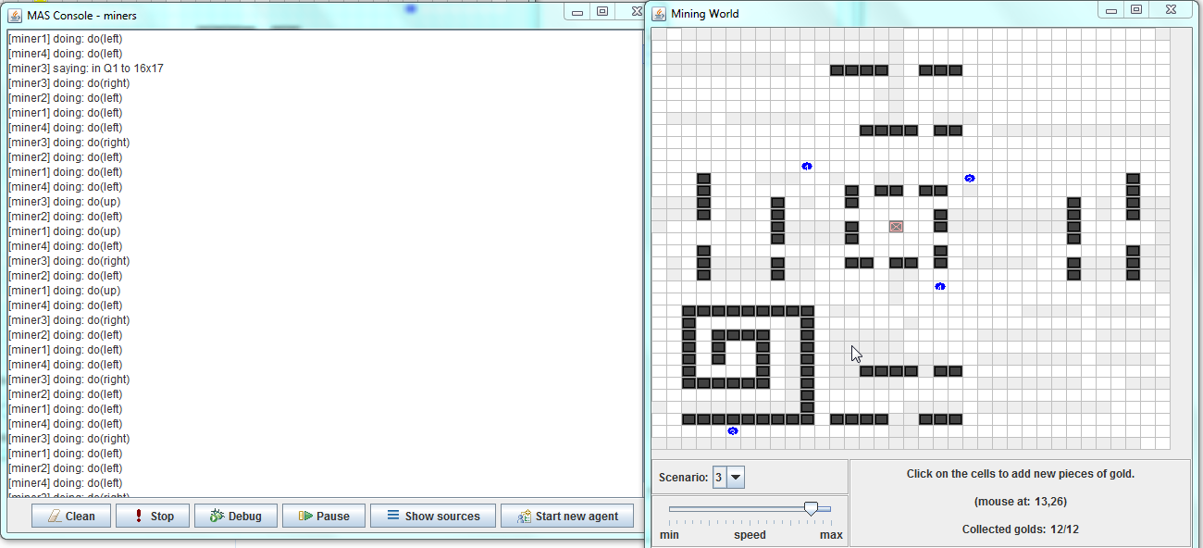
Examples of applications developed by Jason
Gold Miners (Jomi Hübner and Rafael Bordini)

Slide 34
Sample code for the MAS leader /* negotiation for found gold */
+!allocate_miner(Gold)
<- .findall(op(Dist,A),bid(Gold,Dist,A),LD);
.min(LD,op(DistCloser,Closer));
DistCloser < 10000;
.print("Gold ",Gold," was allocated to ",Closer, " options were ",LD);
.broadcast(tell,allocated(Gold,Closer)).
//-Gold[source(_)].

Slide 35
Sample code for the MAS miner /* negotiation for found gold */
// if I see gold and I'm not free but also not carrying gold yet
// (I'm probably going towards one), abort handle(gold) and pick up
// this one which is nearer
@pcell2[atomic]
+cell(X,Y,gold)
: not carrying_gold & not free &
.desire(handle(gold(OldX,OldY))) & // I desire to handle another gold which
pos(AgX,AgY) &
jia.dist(X, Y, AgX,AgY,DNewG) &
jia.dist(OldX,OldY,AgX,AgY,DOldG) &
DNewG < DOldG // is farther than the one just perceived
<- +gold(X,Y);
.drop_desire(handle(gold(OldX,OldY)));
.print("Giving up current gold ",gold(OldX,OldY),
" to handle ",gold(X,Y)," which I am seeing!");
.print("Announcing ",gold(OldX,OldY)," to others");
.broadcast(tell,gold(OldX,OldY));
.broadcast(untell, committed_to(gold(OldX,OldY)));
!init_handle(gold(X,Y)).

Slide 36
Sample code for the MAS miner /* negotiation for found gold */
// I am not free, just add gold belief and announce to others
+cell(X,Y,gold)
: not gold(X,Y) & not committed(gold(X,Y))
<- +gold(X,Y);
.print("Announcing ",gold(X,Y)," to others");
.broadcast(tell,gold(X,Y)).

Slide 37
Sample code for the MAS miner /* negotiation for found gold */
// someone else sent me a gold location
+gold(X1,Y1)[source(A)]
: A \== self &
not allocated(gold(X1,Y1),_) & // The gold was not allocated yet
not carrying_gold & // I am not carrying gold
free & // and I am free
pos(X2,Y2) &
.my_name(Me)
<- jia.dist(X1,Y1,X2,Y2,D); // bid
.send(leader,tell,bid(gold(X1,Y1),D,Me)).

Slide 38
References
Rafael H. Bordini, Lars Braubach, Mehdi Dastani, Amal El Fallah Seghrouchni, Jorge J. Gomez-Sanz, Joao leite, Gregory O’Hare, Alexander Pokahr, Alessandro Ricci “A Survey of programming Languages and platforms for Multi-Agent Systems” Informatica 30 (2006)

Slide 39
References
A. El Fallah Seghrouchni and A. Suna. Claim: A computational language for autonomous, intelligent and mobile agents. Proceedings of ProMAS’03 Workshop of AAMAS, LNAI, 3067:90–110, 2003.
M. Thielscher. FLUX: A logic programming method for reasoning agents. Theory and Practice of Logic Programming, 2005. To appear. K. V. Hindriks, F. S. D. Boer, W. V. der Hoek, and J.-J. C. Meyer. Agent programming in 3APL. AAMAS Journal, 2(4):357–401, 1999.
J. A. Leite. Evolving Knowledge Bases, volume 81 of Frontiers in Artificial Intelligence and Applications. IOS Press, 2003.
S. Costantini and A. Tocchio. A logic programming language for multi-agent systems. In S. Flesca, S. Greco, N. Leone, and G. Ianni, editors, Proceedings of the 8th European Conference on Logics in Artificial Intelligence (JELIA’02), volume 2424 of LNAI, pages 1–13. Springer, 2002.

Slide 40
References
Michael Stevens (2011). "Programming paradigms and an overview of C - COMP3610 - Principles of Programming Languages: Object-Oriented programming". Australian National University. p. 5. Archived from the original on 2011. Retrieved 2012-05-22. "Object oriented programming extends the concept of modularity by introducing objects"
R. H. Bordini, M. Dastani, J. Dix, A. El Fallah Seghrouchni (Eds.), Multi-Agent Programming: Languages, Platforms and Applications, Springer, 2005.
Bellifemine, Fabio, Agostino Poggi, and Giovanni Rimassa. "JADE–A FIPA-compliant agent framework." In Proceedings of PAAM, vol. 99, no. 97-108, p. 33. 1999.“
Rafael H. Bordini,1 Jomi F. Hübner,2 and Renata Vieira3 “JASON AND THE GOLDEN FLEECE OF AGENT-ORIENTED PROGRAMMING”
Jmoi F. Hubner and Rafael H. Bordini “Developing Team of Gold Miners Using Jason”

