Slide 1
Introduction to Multi-Agent Systems
Michal Jakob
Agent Technology Center, Dept. of Cybernetics, FEE Czech Technical University
A4M33MAS Autumn 2011 - Lect. 1
Selected illustrations taken Russel and Norvig – Artificial Intelligence: Modern Approach

Slide 2
General Information
Lecturers: prof. Michal Pěchouček, Michal Jakob and Peter Novák
Tutorials: Peter Novák, Branislav Bošanský and Jan Hrnčíř
13 lectures and 13 tutorials
Course web page: https://cw.felk.cvut.cz/doku.php/courses/a4m33mas/start
Recommended reading:
Russel and Norvig: Artificial Intelligence: Modern Approach
M. Wooldridge: An Introduction to MultiAgent Systems
J. M. Vidal: Multiagent Systems: with NetLogo Examples (available on-line)
Y. Shoham and K. Leyton-Brown: Multiagent Systems: Algorithmic, Game-Theoretic, and Logical Foundations (available on-line)
V. Marik, O. Stepankova, J. Lazansky a kol.: Umela inteligence (3)

Slide 3
Course Requirements and Grading
Total 100 pts – 40 pts projects + 60 pts final exam
Semestral projects:
Project #1 (9 pts) – due end of October
Project #2 (14 pts) – due end of November
Project #3 (17 b.) – due at least a weak before you want course credit (end of semester)
Final exam – 60 pts
At least 50% points required from each part

Slide 4
Introduction
Introduction to Multiagent systems

Slide 5
Trends in Computing
Ubiquity: Cost of processing power decreases dramatically (e.g. Moore’s Law), computers used everywhere
Interconnection: Formerly only user-computer interaction, nowadays distributed/networked machine-to-machine interactions (e.g. Web APIs)
Complexity: Elaboration of tasks carried out by computers has grown
Delegation: Giving control to computers even in safety-critical tasks (e.g. aircraft or nuclear plant control)
Human-orientation: Increasing use of metaphors that better reflect human intuition from everyday life (e.g. GUIs, speech recognition, object orientation)

Slide 6
New Challenges for Computer Systems
Traditional design problem: How can I build a system that produces the correct output given some input?
Each system is more or less isolated, built from scratch
Modern-day design problem: How can I build a system that can operate independently on my behalf in a networked, distributed, large-scale environment in which it will need to interact with different other components pertaining to other users?
Each system is built into an existing, persistent but constantly evolving computing ecosystem – it should be robust with respect to changes
No single owner and/or central authority
Notes:
In particular, distributed systems in which different components have different goals and need to cooperate have not been studied until recently

Slide 7
Multiagent Systems
A field that has emerged as a consequence of the aforementioned problems
Multiagent system is a collection of multiple autonomous (intelligent) agents, each acting towards its objectives while all interacting in a shared environment, being able to communicate and possibly coordinating their actions.
MAS ~ “socially-inspired computing”
Top-down rather than bottom-up construction
Notes:
Bottom-up rather than top-down construction

Slide 8
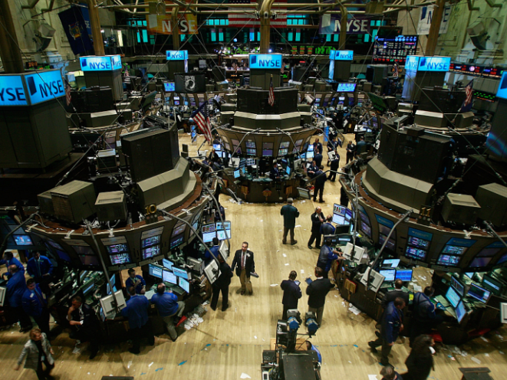
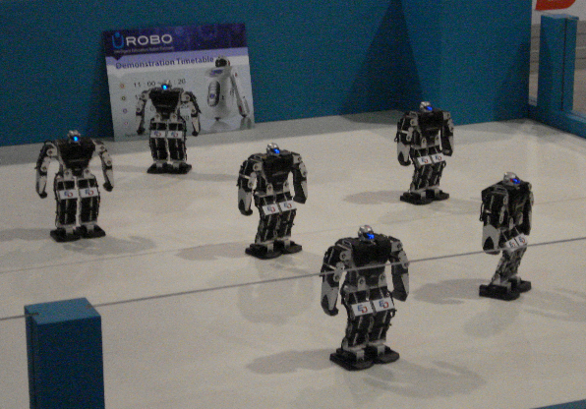
Examples of Multiagent Systems
Human teams and companies
Markets and economies
Transportation networks
Distributed software systems
Communication networks
Robotic teams
Notes:
Cities,...
Types of agents:
Biological agents: a dog, a human.
Man-made/machine agents: the Mars Exploration Rover, a software agent, an industrial robot.
Institutional agents: the Czech Tech University, a company.

Slide 9
Agent Relationships
isolated – equivalent to single-agent systems
cooperative – acting jointly towards a shared goal (team objective)
self-interested – each maximizing its own good while considering the other agents
combination of the above – cooperating with some, competing with others

Slide 10
Micro vs. Macro Perspective
Foundational problems of multiagent systems (MAS):
The agent design problem: how should agents act to carry out their tasks?
The society design problem: how should agents interact to carry out their tasks?
These are known as the micro and macro perspective of MAS

Slide 11
MAS Applications – Problem Characteristics
Non-cooperative/Competetive setting with no trusted central authority and unwillingness of agents to share information
Distributed setting with inability (or ineffectiveness) to create and maintain shared global knowledge
Highly dynamic environments where fast reaction and frequent replanning is necessary

Slide 12
Applications of MAS
manufacturing and logistics – production planning, inventory management, supply chain/network management, procurement
markets – automated trading/auctioning, auction mechanism analysis and design, strategy modeling, market modeling
ubiquitous computing – context-enabled personal assistance, user modeling, privacy management, power-consumption optimization
robotic teams – team planning and coordination, optimum team composition, coalition formation, information fusion
utility networks – smart grid management, virtual powerplants, smart appliances, consumption modeling

Slide 13
Applications of MAS
computer and communication networks – load balancing, intrusion detection, bandwidth management, monitoring
transport – intelligent transport system, cooperative driving, ridesharing
security and defense – mission planning and execution, optimum patrolling and surveillance, opponent modeling, vulnerability assessment
computer games and computer animation - game AI, behavioral animation, NPC implementation
policy-making support – modeling of various socio-economical phenomena (crime, migration, urban growth)

Slide 14
Topics in Multiagent Systems
How should agent’s objectives be specified?
How should agent’s control logic be implemented so that the agents acts towards its objectives?
What languages should agents use to communicate their beliefs and aspiration?
Which protocols should agents use to negotiate and agree/choose if there are multiple options (as there always are)?
How should agents in a team decompose and allocate tasks so as to effectively achieve team’s common goal?
How should the agent maximize its utility in the presence of other competing and possible hostile agents?
Which voting mechanisms are robust against manipulation?
. . .
Notes:
TODO: add/link to course scheduel?

Slide 15
Defining Agency
Introduction to Multi-Agent Systems

Slide 16
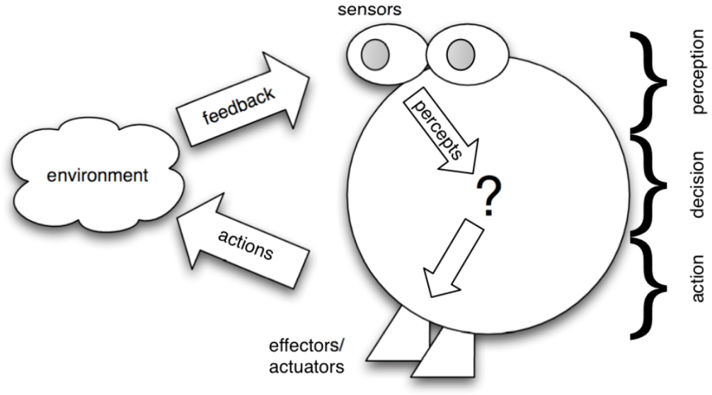
What is Agent?
Definition (Russell & Norvig)
An agent is anything that can perceive its environment (through its sensors) and act upon that environment (through its effectors)
Focus on situatedness in the environment (embodiment)
The agent can only influence the environment but not fully control it (sensor/effector failure, non-determinism)

Slide 17
What is Agent? (2)
Definition (Wooldridge & Jennings)
An agent is a computer system that is situated in some environment, and thatis capable of autonomous action in this environment in order to meet its design objectives/delegated goals
Adds a second dimension to agent definition: the relationship between agent and designer/user
Agent is capable of independent action
Agent action is purposeful
Autonomy is a central, distinguishing property of agents

Slide 18
Autonomous Agent Properties
autonomous – the agent is self goal-directed and acts without requiring user initiation and guidance; it can choose its own goal and the way to achieve it; its behavior is determined by its experience; we have no direct control over it
reactive – the agent maintains an ongoing interaction with its environment, and responds to changes that occur in it
proactive – the agent generates and attempts to achieve goals; it is not driven solely by events but takes the initiative

Slide 19
Autonomous Agent Properties
sociable – the agent interacts with other agents (and possibly humans) via cooperation, coordination, and negotiation; it is aware and able to reason about other agents and how they can help it achieve its own goals
coordination is managing the interdependencies between actions of multiple agents (not necessarily cooperative)
cooperation is working together as a team to achieve a shared goal
negotiation is the ability to reach agreements on matters of common interest
Systems of the future will need to be good at teamwork

Slide 20
Agents vs. Objects
An agent has unpredictable behaviour as observed from the outside
unless its simple reflexive agent
An agent is situated in the environment
Agent communication model is asynchronous
Objects do it for free; agents do it because they want to

Slide 21
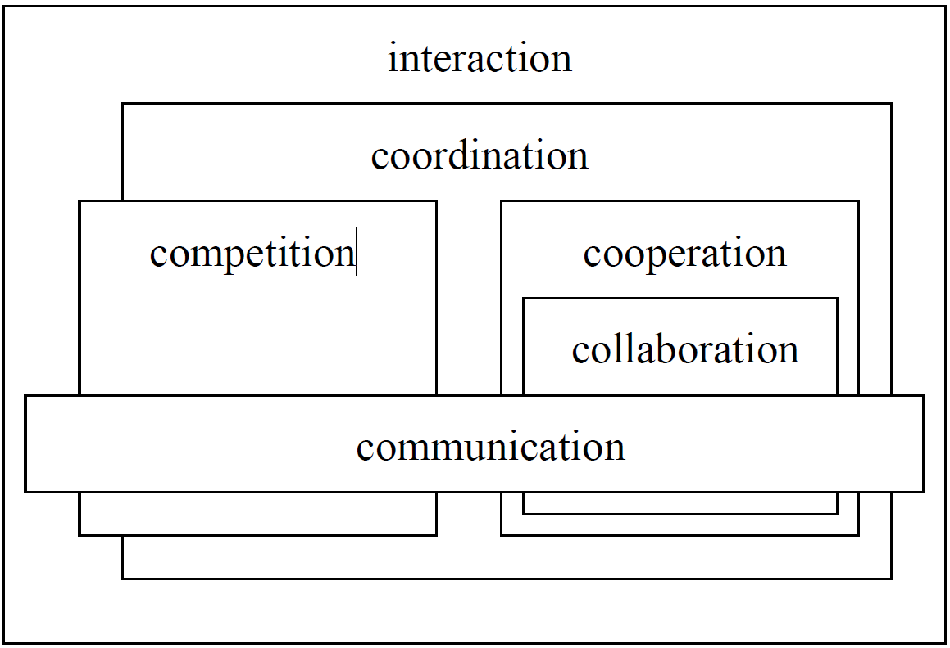
Typology of Interaction

Slide 22
Specifying Agents
Introduction to Multiagent Systems

Slide 23
Agent Behavior
Agent’s behavior is described by the agent function that maps percept sequences to actions
The agent program runs on a physical architecture to produce f
Key questions: What is the right function? Can it be implemented in a small agent program?

Slide 24
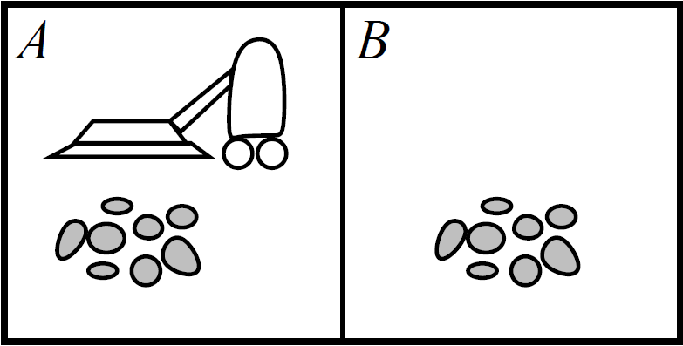
Example: Vacuum Cleaner World
Percepts: location and contents, e.g. [A, Dirty]
Actions: Left, Right, Suck, NoOp

Slide 25
Vacuum Cleaner Agent
Percept sequence | Action
[A,Clean] | Right
[A, Dirty] | Suck
[B,Clean] | Left
[B, Dirty] | Suck
[A,Clean], [A,Clean] | Right
[A,Clean], [A, Dirty] | Suck
… | …
[A,Clean], [A,Clean], [A,Clean] | Right
[A,Clean], [A,Clean], [A, Dirty] | Suck
… | …

Slide 26
Rational Behavior
Definition (Russell & Norvig)
Rational agent chooses whichever action maximizes the expected value of the performance measure given the percept sequence to date and whatever bulit-in knowledge the agent has.
Rationality is relative and depends on four aspects:
performance measure which defines the degree of success
percept sequence (complete perceptual history)
agent’s knowledge about the environment
actions available to the agent
Rational ≠ omniscient, rational ≠ clairvoyant => rational ≠ successful
Notes:
What is the right behavior?

Slide 27
Specifying Task Environments
To design a rational agent, we must specify the task environment (PEAS)
Performance measure
Environment
Actuators
Sensors
Task environments define problems to which rational agents are the solutions

Slide 28
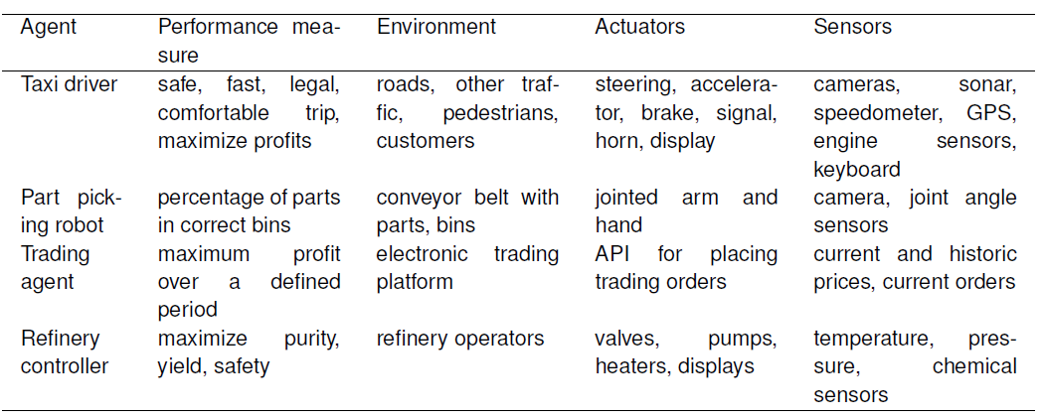
PEAS Examples

Slide 29
Properties of Environments
Fully observable vs. partially observable – can agents obtain complete and correct information about the state of the world?
Deterministic vs. stochastic – Do actions have guaranteed and uniquely defined effects?
Episodic vs. sequential – Can agents decisions be made for different, independent episodes?
Static vs. dynamic – Does the environment change by processes beyond agent control?
Discrete vs. continuous – Is the number of actions and percepts fixed and finite?
Single-agent vs. multi-agent – Does the behavior of one agent depends on the behavior of other agents?

Slide 30
Example Environments
 | Solitaire | Backgammon | Internet shopping | Taxi
Observable | No | Yes | No | No
Deterministic | Yes | No | Parly | No
Episodic | No | No | No | No
Static | Yes | Semi | Semi | No
Discrete | Yes | Yes | Yes | No
Single-agent | Yes | No | Yes (except auctions) | No
Notes:
Backgammon ~ vrhcáby

Slide 31
Agent Architectures
Introduction to Agents

Slide 32
Implementing the Agent
How should one implement the agent function?
So that the resulting behavior is (near) rational.
So that its calculation is computationally tractable.
Agent
Sensors
Percepts
?
Environment
Actions
Actuators

Slide 33
Hierarchy of Agents
Four basic types of agent in the order of increasing capability:
simple reflex agents
model-based agents with state
goal-based agents
utility-based agents

Slide 34
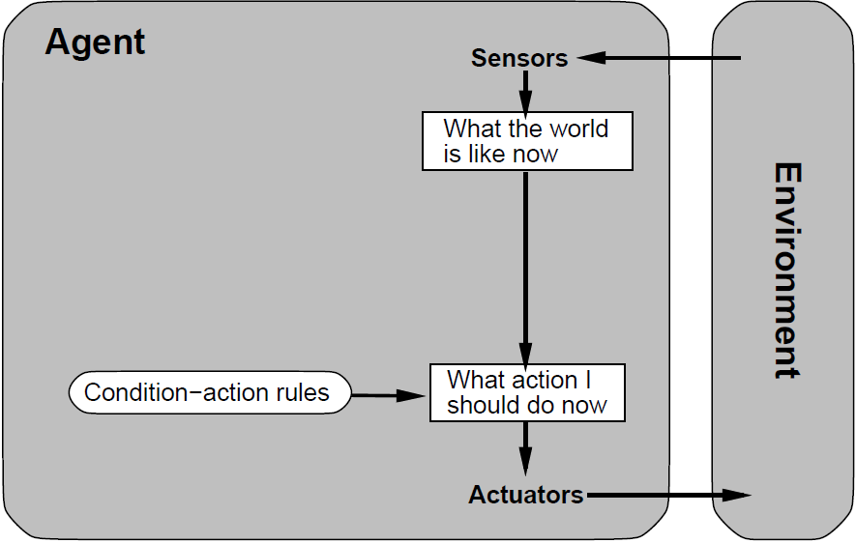
Simple Reflex Agents
Simple reflex agent chooses the next action on the basis of the current percept
Condition-action rules provide a way to present common regularities appearing in input/output associations
Ex.: if car-in-front-is-braking then initialize-braking

Slide 35
Adding State / Model
Reflex agents are simple but of limited intelligence
Only work if environment is fully observable and the decision can be made based solely on the current percept
If not the case => suboptimal action choices, infinite loops
=> It can be advantageous to store information about the world in the agent
Notes:
Decision making is seldom possible based on the basis of a single percept
the choice of action may depend on the entire percept history
sensors do not necessarily provide access to the complete state of the environment

Slide 36
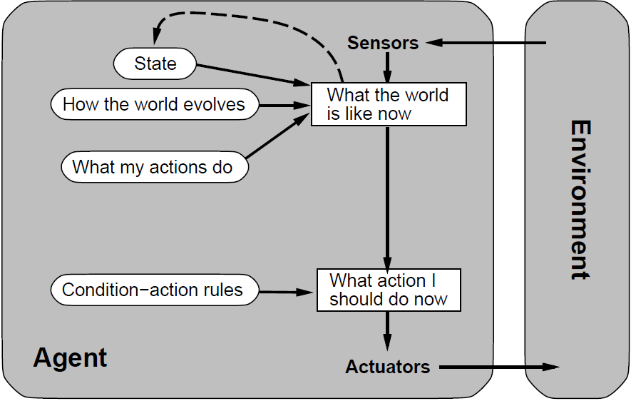
Model-based Reflex Agent
Keeps track of the world by extracting relevant information from percepts and storing it in its memory
models: (1) how the world evolves, (2) how agent’s actions affect the world

Slide 37
Telling the Agent What to Do
Previous types of agents have the behavior hard-coded in their rules – there is no way to tell them what to do
Fundamental aspect of autonomy: we want to tell agent what to do but not how to do it!
We can specify:
action to perform – not interesting
(set of) goal state(s) to be reached → goal-based agents
a performance measure to be maximized → utility-based agents

Slide 38
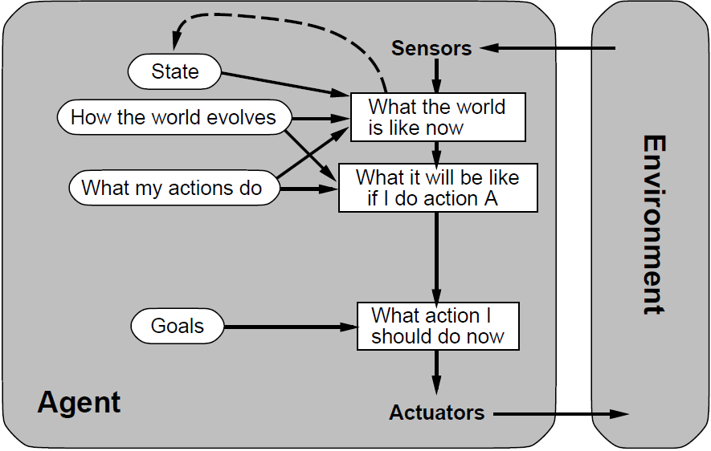
Goal-based Agents
Problem: goals are not necessarily achievable by a single action:
→ search and planning are subfields of AI devoted to finding actions sequences that achieve the agent’s goals
Notes:
Goal-based agent utilizes goals and planning to determine which action to take.
Goal-based agent = agent řízený cíli

Slide 39
Towards Utility-based Agents
Goals only a very crude (binary) distinction between “happy” and “unhappy” states
We introduce the concept of utility:
utility is a function that maps a state onto a real number; it captures “quality” of a state
if an agent prefers one world state to another state then the former state has higher utility for the agent.
Utility can be used for:
choosing the best plan
resolving conflicts among goals
estimating the successfulness of an agent if the outcomes of actions are uncertain
Notes:
Utility-based agent is a generalization of goal-based agent
Goals alone are not sufficient for decision making:
there may be multiple ways of achieving them;
agents may have several conflicting goals that cannot be achieved simultaneously.

Slide 40
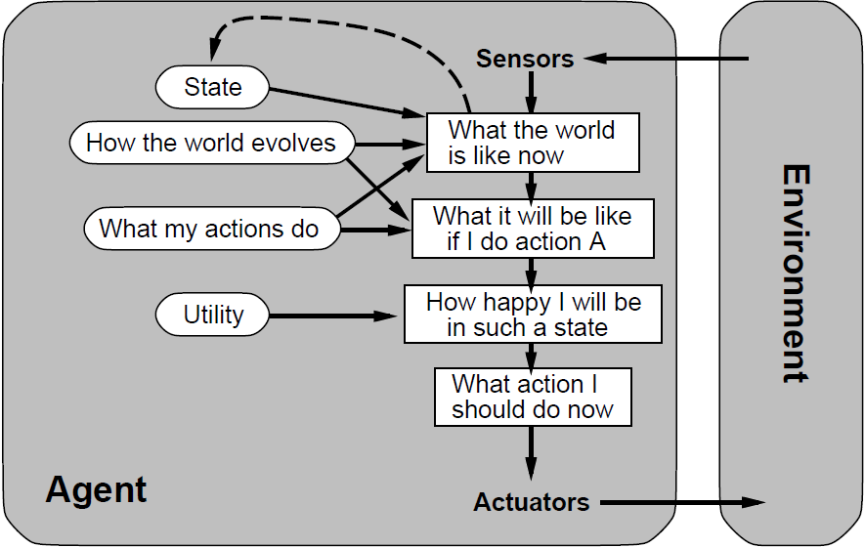
Utility-based Agents
Utility-based agent use the utility function to choose the most desirable action/course of actions to take
Notes:
Utility-based agent -> agent řízený užitkem

Slide 41
Summary
Multiagent systems approach ever more important in the increasingly interconnected world where systems are required to cooperate flexibly
“socially-inspired computing”
Intelligent agent is autonomous, proactive, reactive and sociable
Agents can be cooperative or self-interested (or combination thereof)
There are different agent architectures with different capabilities and complexity
Related reading:
Russel and Norvig: Artificial Intelligence: A Modern Approach – Chapter 2
Wooldrige: An Introduction to Multiagent Systems – Chapters 1 and 2

