Slide 1
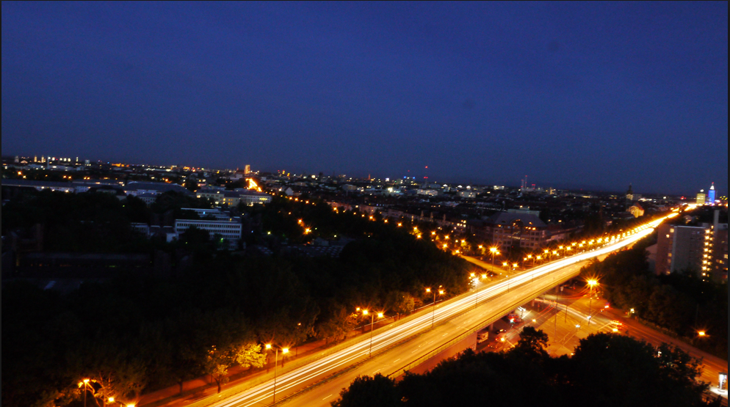
MATMASSim
Multi-Agent Transportation Simulation Using MASS
CSS595 SUMMER 2014
Zach ma
ADVISOR: MUNEHIRO FUKUDA

Slide 2
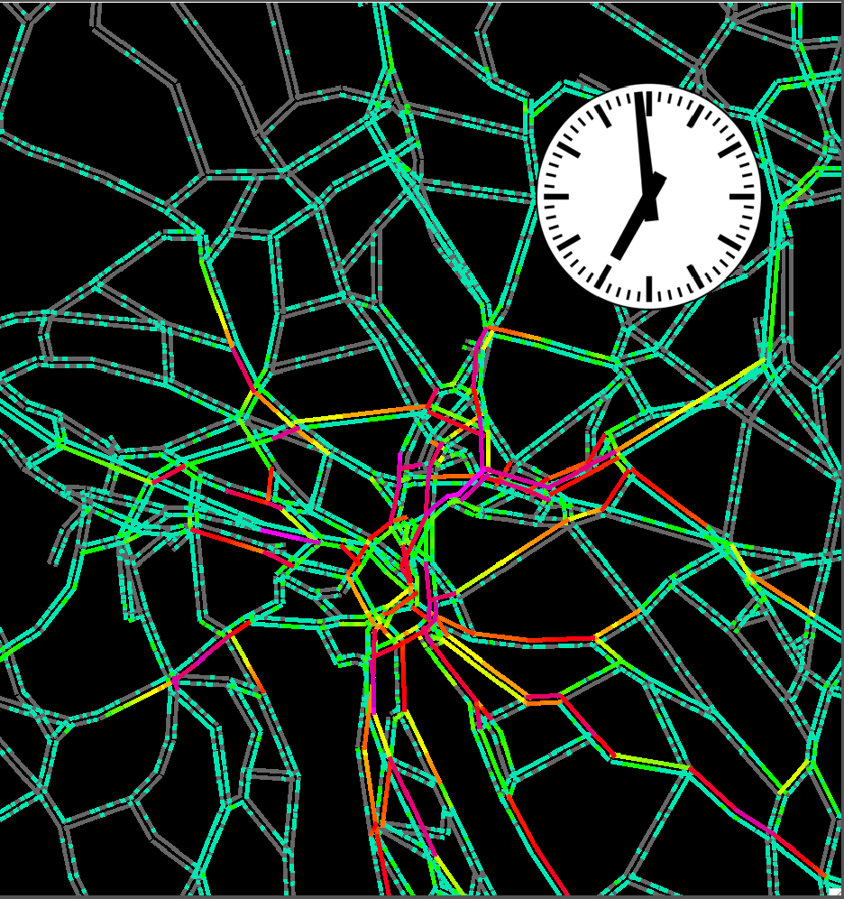
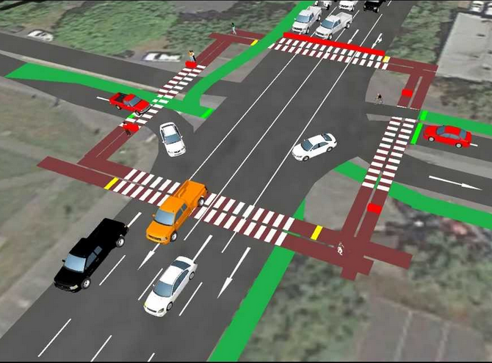
What Is Transportation Simulation?
Microscopic
Car-following model
Macroscopic
Traffic flow model
Notes:
Micro-simulation: Models track individual vehicle movements on a second or subsecond basis.
Driver behavior: changing lanes, turning, accelerating
Car-following model
Macro-simulation (from larger perspective)
Overall traffic flow within certain time period

Slide 3
What Is MASS?
Parallelization library for multi-agent spatial simulation
Focus on Multi-entity interaction in physical, biological, social, and strategic domains
Y-axis
A Bag of Agents
Agents
Agents
Agents
Application
(x,y)
Places
X-axis
Thread 0
Thread 1
Thread 1
Thread 2
Thread 0
Thread 2
Thread 3
Thread 2
Thread 1
Thread 3
Thread 0
Thread 3
Process Rank 0
socket
Process Rank 1
socket
Process Rank 2
Platform Library
CPU Core 0
CPU Core 1
CPU Core 2
CPU Core 3
CPU Core 0
CPU Core 1
CPU Core 2
CPU Core 0
CPU Core 3
CPU Core 3
CPU Core 1
CPU Core 2
Chuang, Timothy, and Munehiro Fukuda. "A Parallel Multi-agent Spatial Simulation Environment for Cluster Systems." Computational Science and Engineering (CSE), 2013 IEEE 16th International Conference on. IEEE, 2013.
System Memory
System Memory
System Memory
mnode0.uwb.edu
mnode1.uwb.edu
LAN
mnode2.uwb.edu
Notes:
Developed and maintained by Professor Fukuda and distributed systems lab

Slide 4
Motivation
Strong interest in parallel & distributed computing techniques
Found agent-based simulation very promising
Want to apply in traffic domain
Notes:
Agent-based:
- Simulation for wave, molecular dynamics
Pedestrain simulation (Professor in UW Seattle)
Trunk simulation for amazon
Traffic domain
- Little familiar with the domain because of my father and his collegues

Slide 5
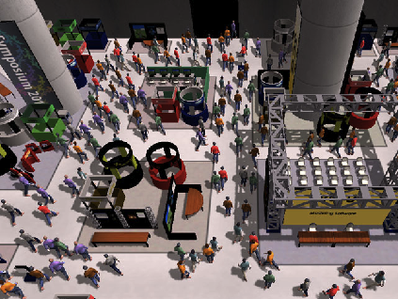
Why Multi-Agent Based?
“Intelligent” Agent
Dynamic environment
Much more similar to those in the real world
Two key aspects in transportation simulation
Transport planning
Traffic flow simulation model
Notes:
People are “intelligent”, which means they are capable and expected to adapt and to learn
Instead of simulate with traditional mathematical or traffic flow models which just apply to the input data statically, multi-agent simulations provide a dynamic environment in which each individual agent, in particular the travelers will keep taking actions based on their internal rules.
Therefore, this approach can simulate scenarios much more similar to those in the real world.

Slide 6
Transport Planning
Static Traffic Assignment
Disaggregation by individual travelers
Temporal dynamics
Dynamic Traffic Assignment(DTA)
Add consideration of departure time
Con: Still is an aggregated model
Agent-based
On individual level
OD pair is replace by individual particles(agents)
Notes:
Transport Planning:
- Distribution of traffic demand
Static Traffic Assignment:
Trip generation
Trip distribution
Mode choice
Route Assignment
Consider the traffic flow remain constant during the entire simulation
- Maybe suitable for planning for very long time period

Slide 7
Traffic Flow Simulation Model
Cellular Automata
Roads are divided into cells
Each cell can be either empty or occupied by a car
Drawback: Impractical for large numbers
Queue Based
Links are represented as queues
Performance increases by a factor of 10 to 100
Currently used by MATSim
Event-Driven Queue Based
Extends the Queue-based model
Imitates backwards traveling gaps
Notes:
According to the actual simulation, including all kinds of the behaviors of travelers
Event-driven is kind of similar to agent-based
Leads to more realistic dynamics of congested links
Performance scales nearly linearly with # of processors, implying that in 8 CPUs, the 50 minutes are reduced to less than 7 minutes

Slide 8
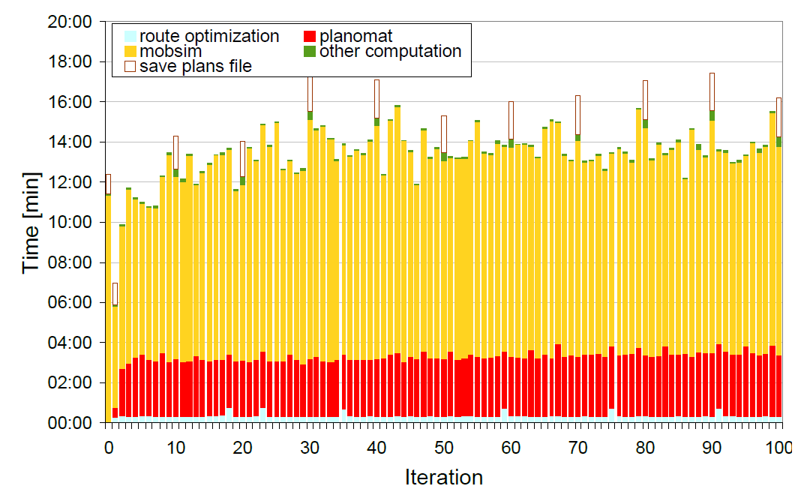
Bottleneck
Performance:
Execution Module(mobsim)
Balmer, M., K. Meister, and K. Nagel. Agent-based simulation of travel demand: Structure and computational performance of MATSim-T. ETH, Eidgenössische Technische Hochschule Zürich, IVT Institut für Verkehrsplanung und Transportsysteme, 2008.
Notes:
Average 15min for iteration, because the current implementation haven’t using any parallelization with multiple computing nodes
Just using multi-threading on single computing node
Runs on a single CPU
Greater Zurich Area:
Over 10,000 links
190,000 agents

Slide 9
MATSim Overview
Iterative process between execution, scoring, and replanning
Ultimate Goal --> User Equilibrium
Hard to achieve in dynamic model
input
config
execution
replanning
controler
scoring
analyses
output

Slide 10
Overall Architecture
Distribute computation of execution model into multiple nodes

Slide 11
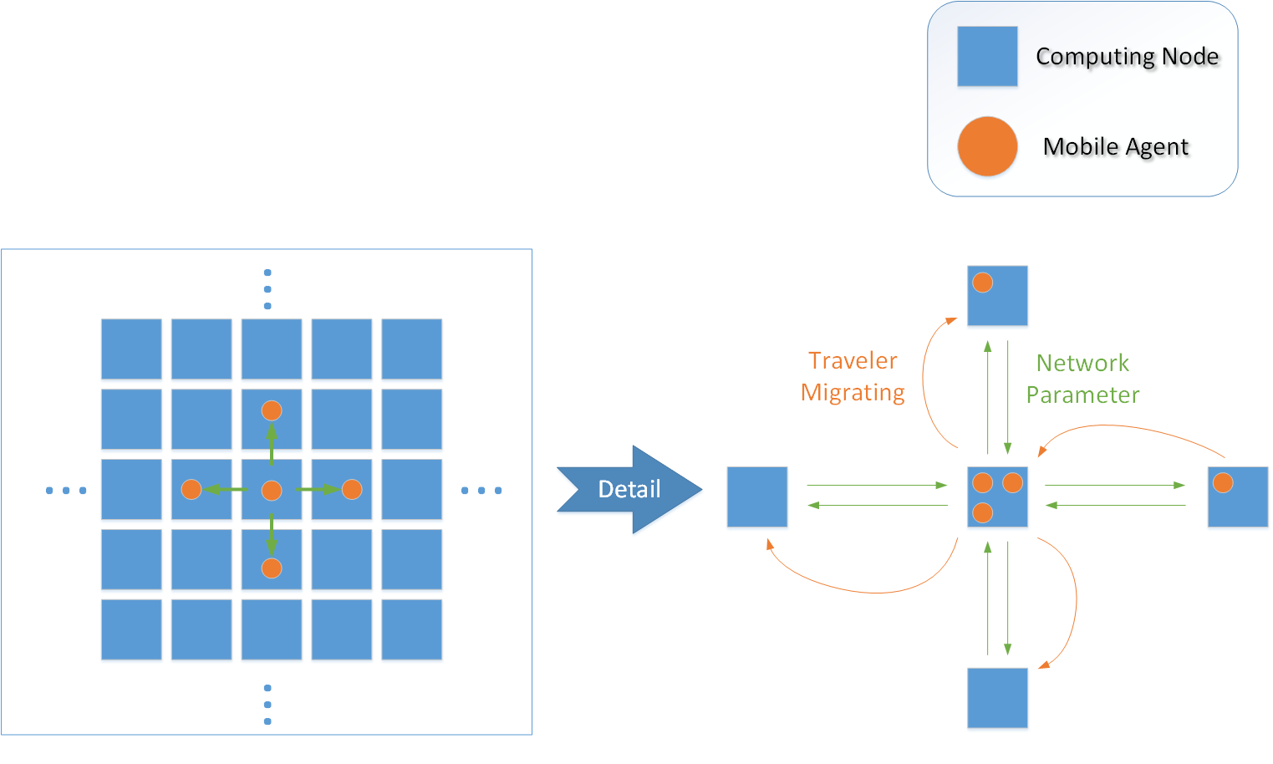
Design & Data Flow
Map --> Network (Places)
Intersections --> Nodes (Place)
Roads --> Links (Place)
Population --> (Agents)
Travelers --> Persons (Agent)

Slide 12
Activity Diagram
For single node

Slide 13
Current Progress
MATSim Code Repository
Has been set up and tested under Eclipse and Subversion
Partial class logic converted(20%)
Literature research (Concepts)
Traffic assignment model (DTA, agent-based with its implementation)
Traffic flow simulation model (Queue-based, extension to event-driven QE)
Design and review of
Data Flow logic
Process Flow within each node

Slide 14
Next Steps
MATSim implementation internal logic fully converted
Detail design and implementation of
Class Structure
Message Exchange & Boundary limit
Testing and benchmark
Simple scenario within MATSim
Greater Zurich Area

Slide 15
Key Resources
Computing resources
UW1-320 linux machines
MASS library (Java Version)
MATSim code repository
Domain resources
Dr. Yinhai Wang
Professor and Director, Smart Transportation Applications and Research Laboratory (STAR Lab)
Department of Civil and Environmental Engineering, University of Washington
Dr. Kai Nagel
Co-founder of MATSim
Assistant Professor for Computer Science at the Swiss Federal Institute of Technology (ETH)
Notes:
MATSim
Code Repository
Related research
Dr. Yinhai Wang
Professor and Director, Smart Transportation Applications and Research Laboratory (STAR Lab)
Department of Civil and Environmental Engineering, University of Washington
Dr. Kai Nagel
Co-founder of MATSim
Assistant Professor for Computer Science at the Swiss Federal Institute of Technology (ETH)

Slide 16
Appendix A: Bibliography
[1] Cetin, Nurhan, et al. "Large-scale multi-agent transportation simulations."Computer Physics Communications 147.1 (2002): 559-564.
[2] Nagel, K. and M. Schreckenberg (1992) A cellular automaton for freeway traffic, Journal de Physique I, 2 (1992) 2221–2229.
[3] Nagel, Kai. "Multi-agent transportation simulation." Traffic 2.2 (2007).
[4] Charypar, David, and Michael Balmer. A high-performance traffic flow microsimulation for large problems. Eidgenössische Technische Hochschule, Institut für Verkehrsplanung und Transportsysteme, 2008.
[5] C. Gawron. Simulation-based traffic assignment. PhD thesis, University of Cologne, Cologne, Germany, 1998. available via www.zaik.uni-koeln.de/˜paper.DTA)
[6] Balmer, M., K. Meister, and K. Nagel. Agent-based simulation of travel demand: Structure and computational performance of MATSim-T. ETH, Eidgenössische Technische Hochschule Zürich, IVT Institut für Verkehrsplanung und Transportsysteme, 2008.

Slide 17
Appendix A_Continued
[7] Cetin, Nurhan, Adrian Burri, and Kai Nagel. "A large-scale agent-based traffic microsimulation based on queue model." IN PROCEEDINGS OF SWISS TRANSPORT RESEARCH CONFERENCE (STRC), MONTE VERITA, CH. 2003.
[8] Nagel, Kai, and Gunnar Flötteröd. "Agent-based traffic assignment: going from trips to behavioral travelers." 12th International Conference on Travel Behaviour Research (IATBR), Jaipur. 2009.
[9] Peeta, Srinivas, and Athanasios K. Ziliaskopoulos. "Foundations of dynamic traffic assignment: The past, the present and the future." Networks and Spatial Economics 1.3-4 (2001): 233-265.
[10] Chiu, Yi-Chang, et al. "Dynamic traffic assignment: A primer." Transportation Research E-Circular E-C153 (2011).
[11] Balmer, Michael. Travel demand modeling for multi-agent transport simulations: Algorithms and systems. Diss. ETH Zurich, 2007.

Slide 18
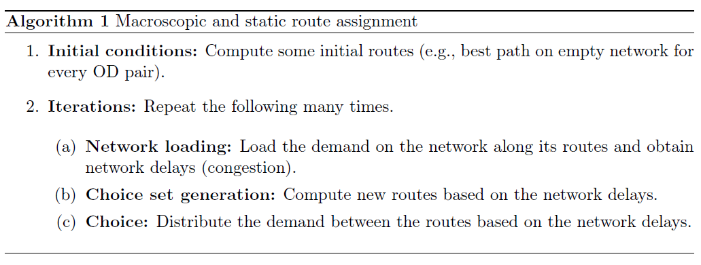
Appendix B: Algorithms
Static Traffic Assignment

Slide 19
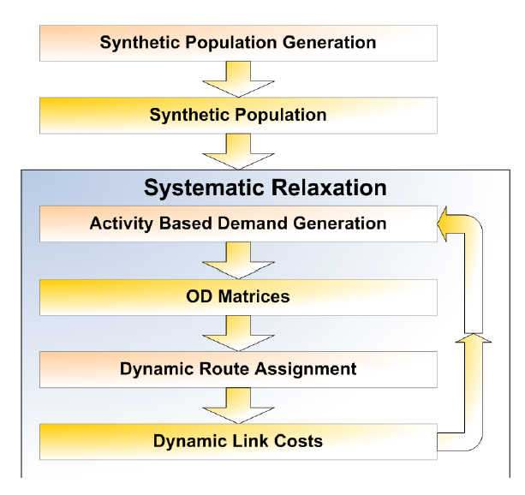
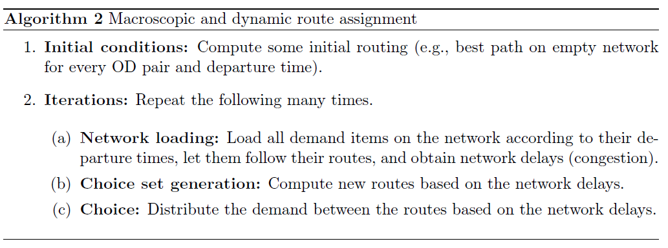
Appendix B_Continued
Dynamic traffic assignment

Slide 20
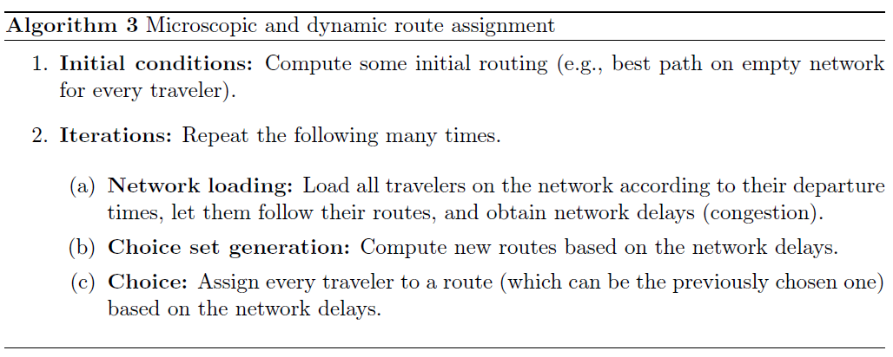
Appendix B_Continued
Agent-based - Individual Traveler

