Slide 1
Wavelets and Filter Banks
4C8 Integrated Systems Design

Slide 2

Recall the 1D Haar Xform

Slide 3
Now consider as filtering
a
b
a
b
FIR Filter H0
FIR Filter H1
Downsample by 2

Slide 4
Hence Analysis Filter Bank
Low Pass Filter
High Pass Filter

Slide 5
Reconstruction
To do the inverse transform to apply the satges in reverse
Upsampling
Filtering (the filters are not necessarily the same as before)
Upsampling means that there are zeros at odd n when compared to their values before downsampling in the analysis stage.

Slide 6
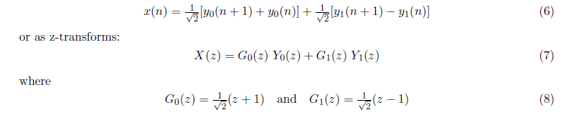
So combine into single equation
y₀ and y₁ are zero at odd n
Not the same as y₀ and y₁ output from analysis stage
Because they have 0’s in them!

Slide 7
To avoid confusion….

Slide 8
So how is this modeled?

Slide 9
Hence 2 band filter bank
Normal filter outputs
Downsample by 2 then upsample by 2 by putting 0’s inbetween

Slide 10
Perfect Reconstruction
We want the output from the reconstruction to be the same as the input i.e. a Perfect Reconstruction Filterbank so …

Slide 11
PR

Slide 12
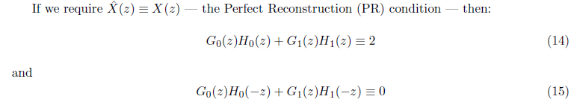
PR
H are analysis filters
G are synthesis/reconstruction filters

Slide 13
Can now extend analysis to more stages .. A binary tree
Lo
Not that Hi
Quite Hi
Not quite so Hi
Level 1
Hi
Level 2
Level 3
Level 4

Slide 14
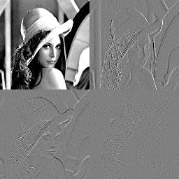
2D Wavelet Transform
LoLo
LoHi
HiLo
HiHi
Downsample Rows
Downsample Columns

Slide 15
The Multilevel 2D Discrete Wavelet Xform
Downsample Rows
Downsample Columns
Downsample Rows
Downsample Columns

Slide 16
2D DWT of Lena
COARSE Levels
Fine Levels

Slide 17
What does this do to a signal?
Need to work out the impulse response of each equivalent filter output
Can do this by shifting the downsample operation to the output of each stage
Lo
Not that Hi
Quite Hi
Not quite so Hi
Hi
Level 1
Level 2
Level 3
Level 4

Slide 18
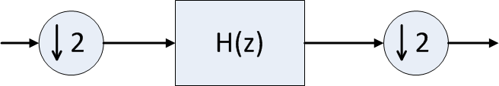
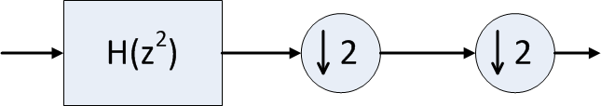
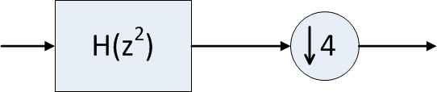



Multirate Theory
$$≡$$
$$H\left(z\right)=1+z^{−1}+z^{−2}$$
$$H\left(z^{2}\right)=1+z^{−2}+z^{−4}$$

Slide 19
What does this do to a signal?

Slide 20
So now we can examine impulse responses
Process of creating y₁, y₀₁ etc is the Wavelet Transform
“Wavelet” refers to the impulse response of the cascade of filters
Shape of impulse response similar at each level .. Derived from something called a “Mother wavelet”
Low pass Impulse response to level k is called the “scaling function at level k”

Slide 21
Good wavelets for compression
There are better filters than the “haar” filters
Want PR because energy compaction stages should be reversible
Wavelet filter design is art and science
  Won’t go into this at all in this course
  You will just be exposed to a couple of wavelets that are used in the literature
There are very many wavelets! Only some are good for compression and others for analysis

Slide 22
Le Gall 3,5 Tap Filter Set
A TRICKY THING!
Note how filter outputs (H₁,G₁) shifted by z, z⁻¹
So implement by filtering without shift but select ODD outputs
(H₀,G₀) select EVEN outputs

Slide 23
Le Gall 3,5 Tap Filter Set

Slide 24
Le Gall Filters
Pretty good for image processing because of the smooth nature of the analysis filters and they are symmetric
But reconstruction filters not smooth .. bummer
It turns out that you can swap the analysis and reconstruction filters around
Known as the LeGall 5,3 wavelet or inverse LeGall wavelet

Slide 25
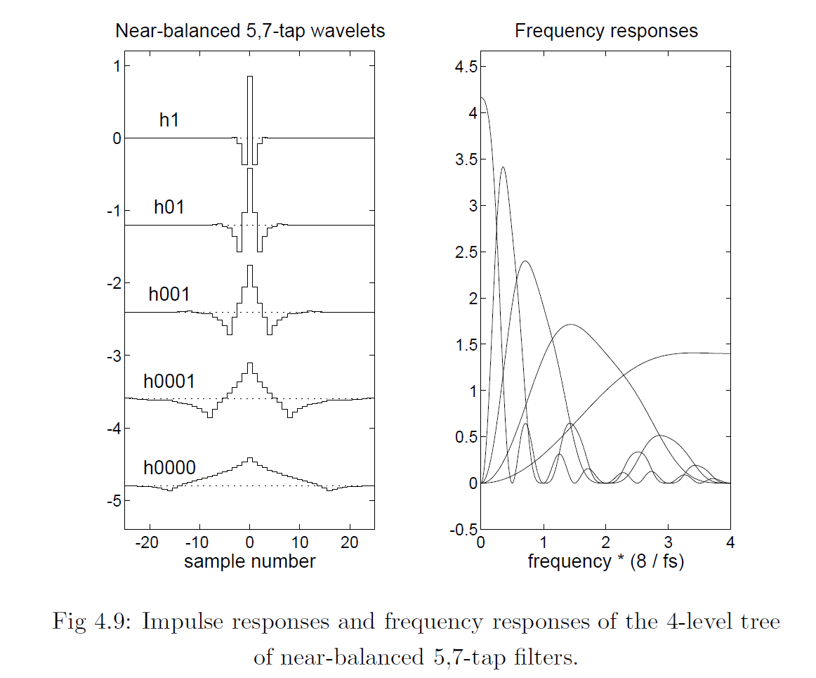
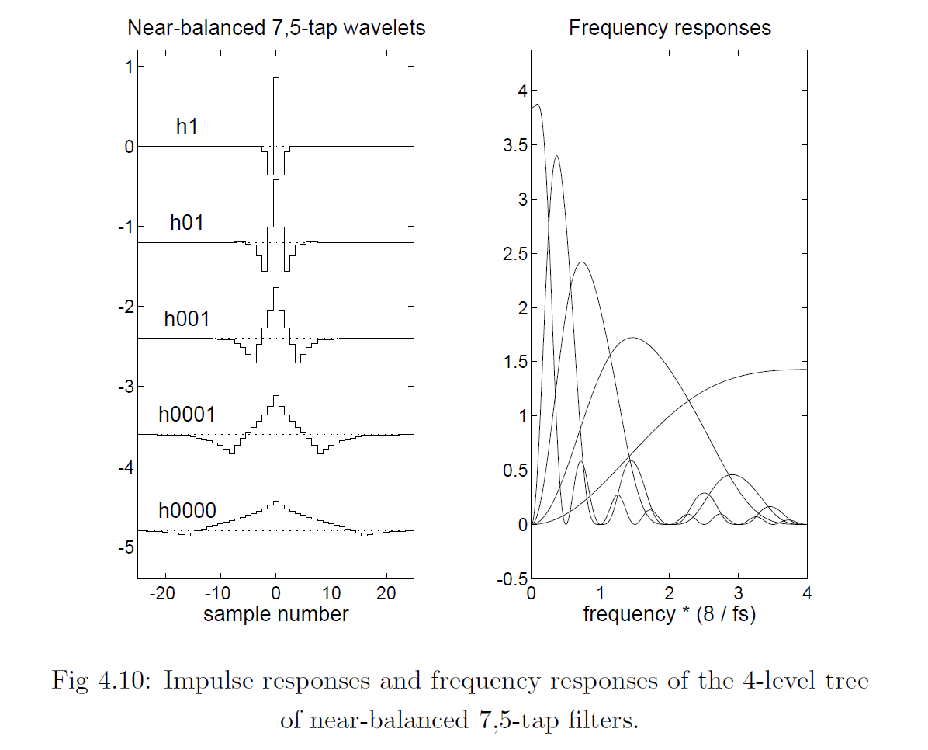
Near-Balanced Wavelets (5,7)
Analysis Filters
Reconstruction Filters

Slide 26
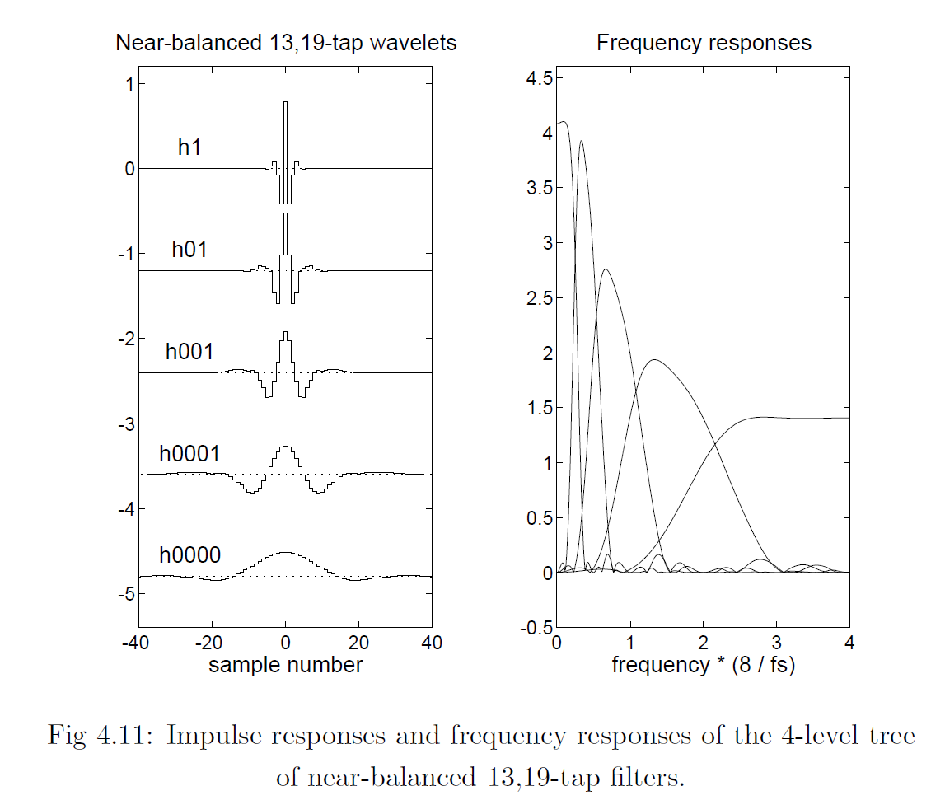
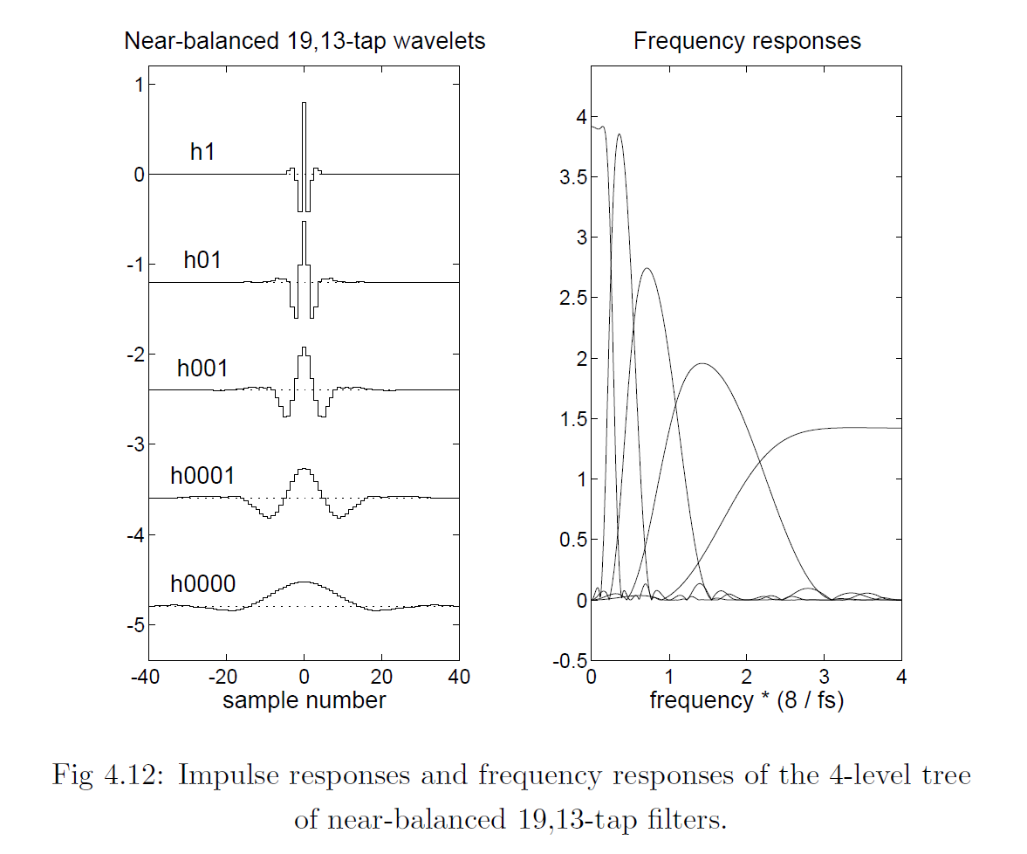
Near-Balanced Wavelets (13,19)
Analysis Filters
Reconstruction Filters

Slide 27
2D Impulse responses of the separable filters

Slide 28
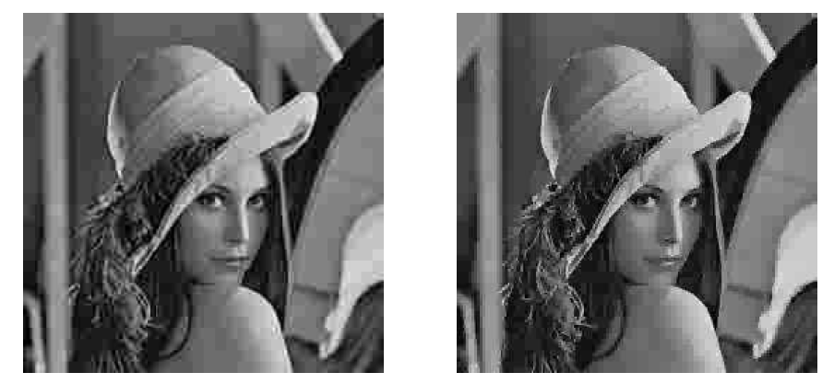
Coding with Wavelets
Quantise the Coarse levels more finely than the Fine levels
Large Q_{step} at Fine levels and Small Q_{step} at low levels
HAAR
DCT

Slide 29
Coding with Wavelets

Slide 30
Entropies with RLC

Slide 31
Rate-Distortion Curves

Slide 32
Wavelets for Analysis: Noise Reduction

Slide 33
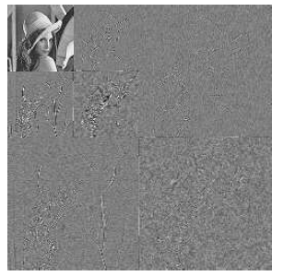
Wavelets for Analysis: Noise Reduction
Note that true image detail is represented by Large value Coefficients
So perform noise reduction by setting small coefficients to 0.
What is small?
Wavelet Coring

Slide 34
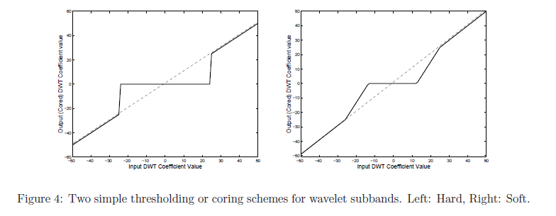
Wavelets for Analysis: Coring

Slide 35
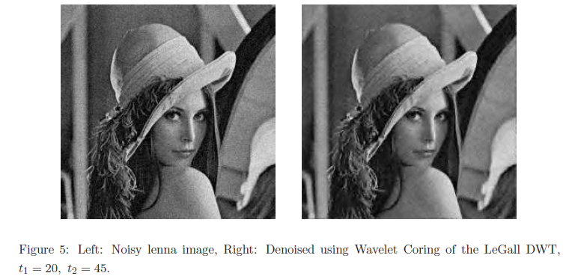
Wavelet Noise Reduction

Slide 36
Noise Reduction
Important in video for compression efficiency
Important for image quality
SONY, Philips, Snell and Wilcox, Foundry, Digital Vision all use wavelet noise reduction of some kind

Slide 37
The price for decimation
Is aliasing
Wavelets work because of the very clever filter frequency response designs that cancel aliasing by the end of reconstruction
High Pass output is aliased!

Slide 38
Shift Variant Wavelets
This means that decimated wavelets are shift variant!
If you move the signal the DWT coefficients change!
This means that they are not so good for analysis .. And definitely not good for motion estimation

Slide 39
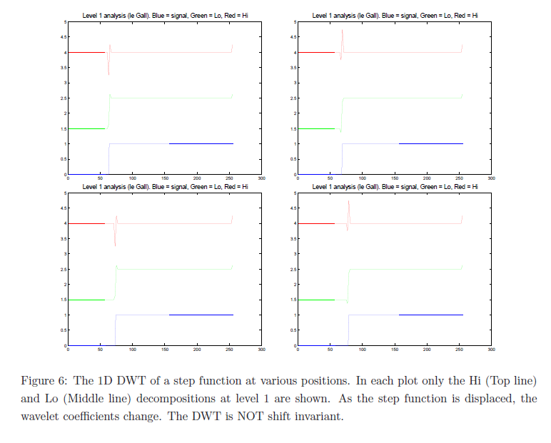
A tricky example..

Slide 40
Can get around this …
By NOT downsampling .. “Algorithme a-trous”
Yields loads of data
OR use Nick Kingsbury’s Complex Wavelets

Slide 41
Summary
Matlab has a good wavelet package .. Useful for development
Wavelets have made their way into compression
Powerful idea for analysis but data explosion is a problem
JPEG200, MPEG4 define methods for using DWT in compression

