Slide 1
Performance Evaluation of Scheduling Algorithms for Database Services with Soft and Hard SLAs
Hyun Jin Moon, Yun Chi, Hakan Hacıgümü¸s
NEC Laboratories America
Cupertino, USA
DataCloud 2011
Best Paper Award Finalist

Slide 2
Introduction
Service Level Agreement(SLA) is a part of a service contract where the level of service is formally defined.
In this paper, service latency, or response time.
Two types of SLA
Soft SLA:
describe SLA profit as a function of response time.
Hard SLA:
species a single firm deadline objective for each job.

Slide 3
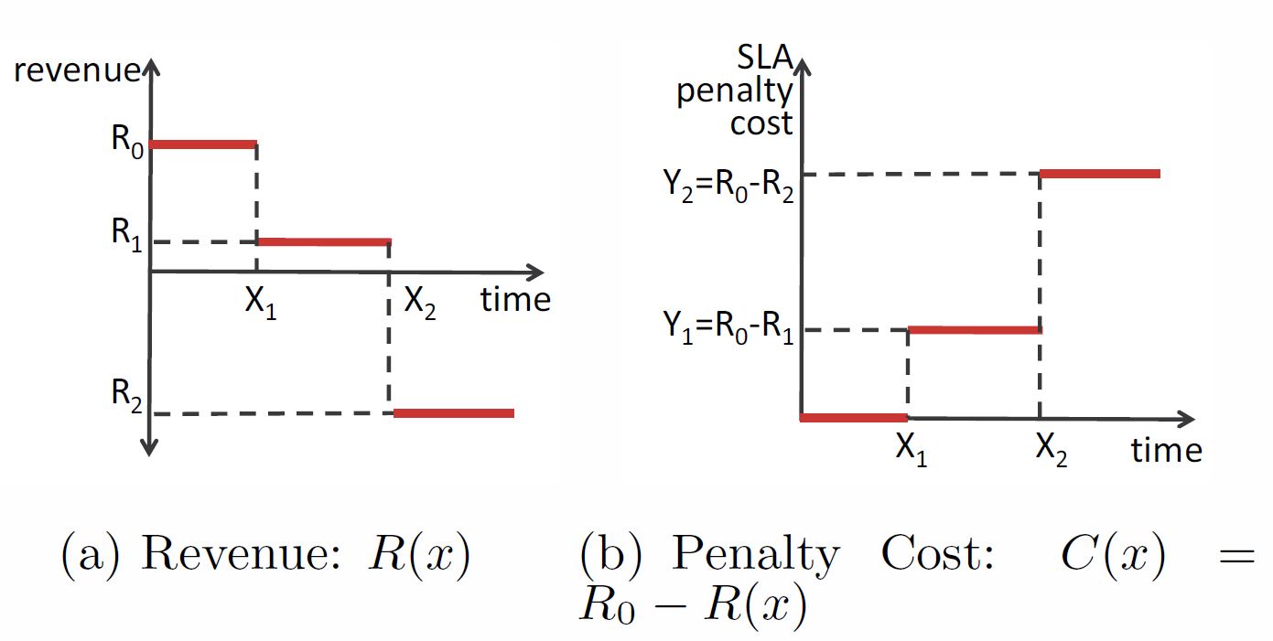
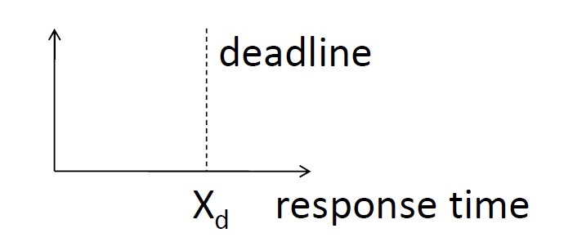
SLA
Soft SLA
Hard SLA

Slide 4
This Paper
Rigorously evaluate a comprehensive set of scheduling methods and present how they perform with respect to the full requirement list.
Propose an effective extension to the most promising method, iCBS.

Slide 5
Requirement List
Service providers' profit should be the main metric of optimization.
Consider both soft and hard SLA.
Manage the SLAs at the finest granularity level, i.e., per job basis.
Multiple SLA definitions corresponding to different job classes.
The complexity of the scheduling framework should be very small to cope with a high job arrival rate or bursts in the real system.

Slide 6
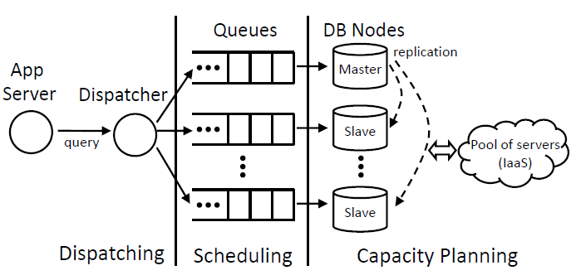
Architecture
Notes:
RDB
Hadoop
HPC-jobs

Slide 7
Scheduling Algorithms
Cost- and Deadline-unaware Scheduling
FCFS: First-Come First-Served.
SJF: Shortest Job First.

Slide 8
Scheduling Algorithms(Cont.)
Cost- and Deadline-unaware Scheduling
FCFS: First-Come First-Served.
SJF: Shortest Job First.
Deadline-aware Scheduling
EDF: Earliest Deadline First.
AED: Adaptive EDF.
Avoid the domino effect under the overload situation, where all jobs misses the deadline.
Notes:
AED將每個新加入的transaction隨機給定一個獨特整數值I_T, 然後插入key-ordered的list中的pos_T.
如果pos_T小於等於HITcapacity => HIT group, 反之MISS group
[Priority] HIT group => EDF, MISS group => random
All transactions in the HIT group have a higher priority than transactions in the MISS group
(1) HITcapacity := HitRatio(HIT) * HITcapacity * 1.05;
(2) if HitRatio(ALL) < 0.95 then
HITcapacity := Min (HITcapacity, HitRatio(ALL) * NumTrans * 1.25 );

Slide 9
Scheduling Algorithms(Cont.)
Cost- and Deadline-unaware Scheduling
Deadline-aware Scheduling
Cost-aware Scheduling
BEValue2
A modified version of EDF.
FirstReward
Highly sophisticated scheduling policy with high overload of O(n²).
iCBS
Notes:
BEValue2 starts with a deadline-ordered sequence of the available processes, which is then sequentially checked for its probability of overload.
At any point in the sequence in which the overload probability passes a preset threshold, the process prior to the overload with the lowest value density will be removed from the sequence,
repeating until the overload probability is acceptable.
value density (V/C, in which V is its value and C is its processing time)
overload probability-> EDF判斷

Slide 10
CBS
a heuristic-based cost-based scheduling policy.
The idea is to pick the query with the highest priority, which in turn maximizes the expected global total profit.
iCBS incrementally maintains CBS priority score with lower complexity.
Notes:
O(n) -> O(log²n)
a(t) = 1/B * e^(-t/B) , B = 1ms
CBS:全部看一次，取最大 => O(n)
iCBS: incrementally maintain a convex hull that supports adding and deleting points dynamically.
A dynamic convex hull algorithm for points in a 2-D plane that has O(log^2 N) time complexity

Slide 11
Scheduling Algorithms(Cont.)
Cost- and Deadline-unaware Scheduling
Deadline-aware Scheduling
Cost-aware Scheduling
Cost- and Deadline-aware Scheduling
iCBS-DH
”DH” stands for “Deadline Hint”

Slide 12
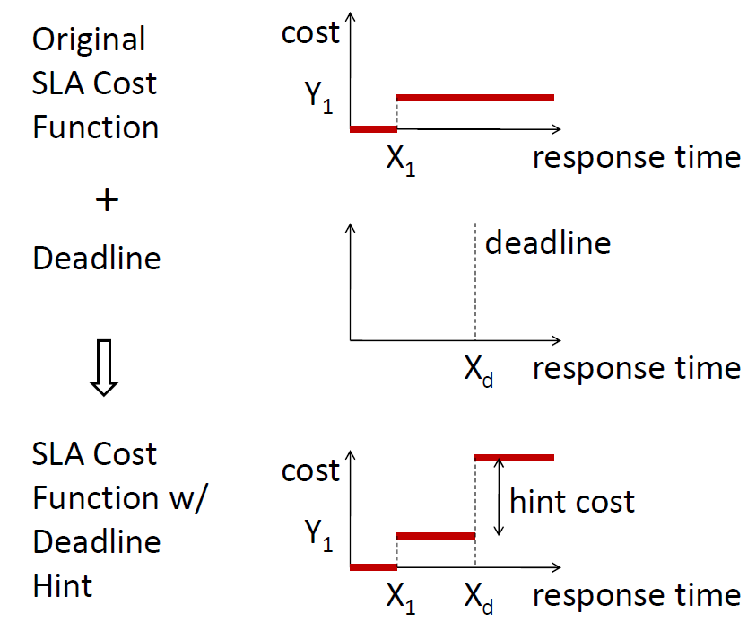
iCBS-DH
Extend iCBS into iCBS-DH by shift the SLA cost function.
Make it deadline-aware.

Slide 13
Experiment Setup
Server, database
Intel Xeon 2.4GHz, Two single-core CPUs, 16GB memory.
MySQL 5.5, InnoDB 1.1.3, 1GB bufferpool.
Dataset, query
TPC-W 1GB dataset.
6 query templates chosen from the TPC-W workload.
Open-system workload, Poisson arrival.

Slide 14
Experiment Setup(Cont.)
Runs
5 seconds per run (>10K queries finished).
Each data point: the average of five repeated runs.
Query execution time estimate
SJF, FirstReward, BEValue2, iCBS, iCBS-DH need it.
Estimate from history: Mean+StandardDeviation.
Notes:
Queries are shorter than 1 ms.

Slide 15
SLA Design
DTH code
CostDensity, CostStepTime, HardDeadlineTime
E.g. DTH = 112

Slide 16
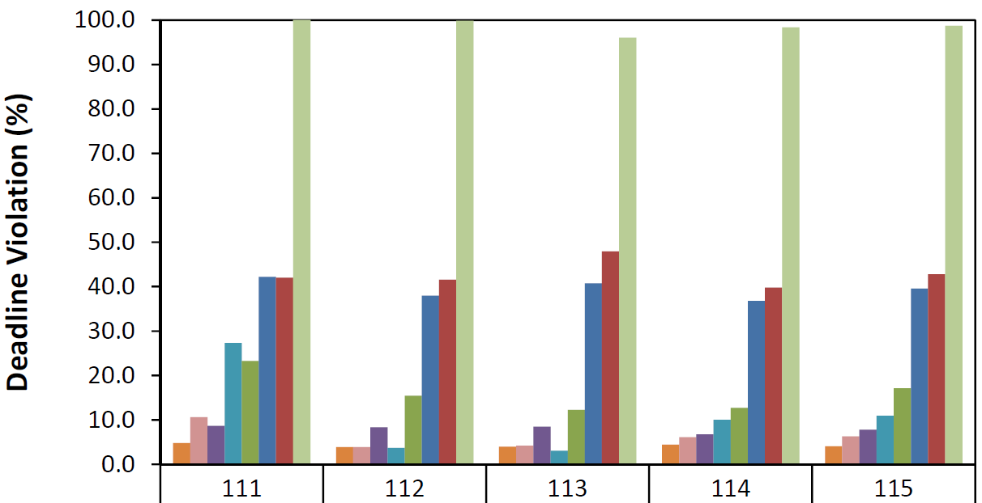
Varying SLA and Deadlines
DTH = 11x
iCBS-DH performs the best.
iCBS: low violation when deadline is the same as or later than cost step(112,113), but high violation if not(111)
Notes:
Hint cost: $1000

Slide 17
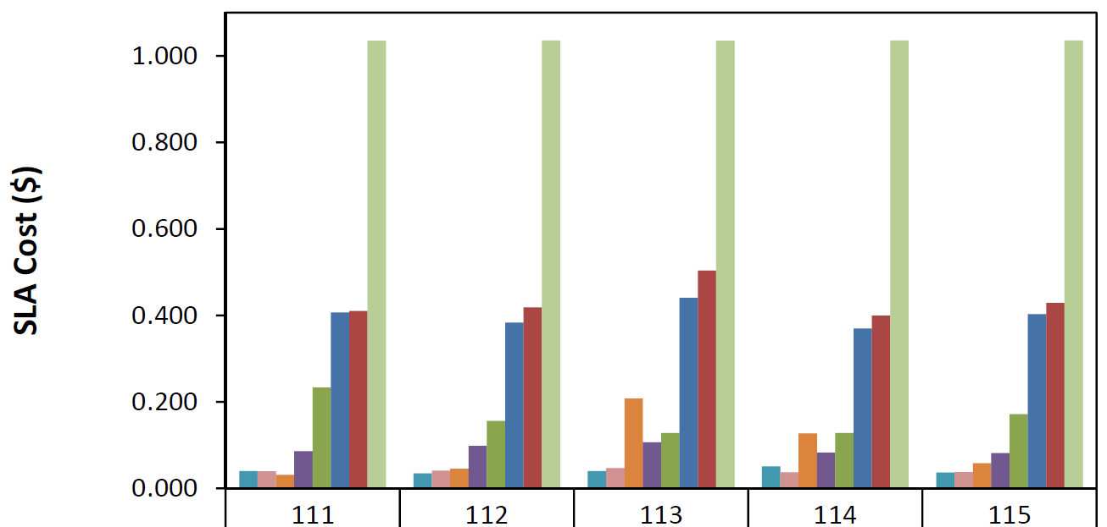
Varying SLA and Deadlines(Cont.)
DTH = 11x
iCBS-DH has high cost when cost step is eariler than deadline(113).
Hint cost: $1,000

Slide 18
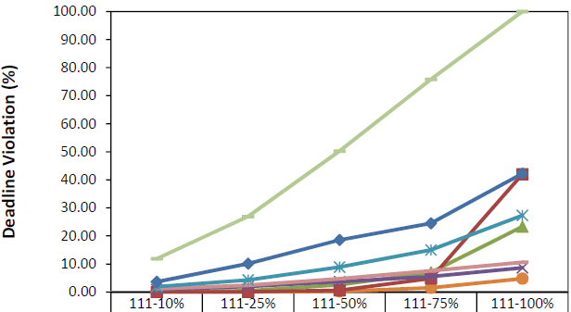
Varying Portion of Deadline-Having Queries
DTH = 111
iCBS-DH perform the best.
EDF sees domino effect with high portion of queries with deadlines.

Slide 19
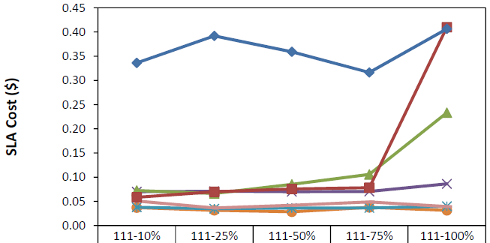
Varying Portion of Deadline-Having Queries(Cont.)
DTH = 111
(FirstReward not shown)
iCBS-DH perform the best.

Slide 20
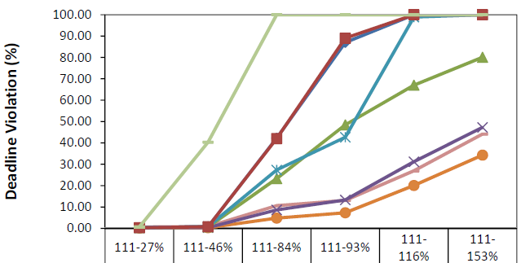
Varying Load
Load=arrival rate*average execution time
iCBS-DH perform well under overload.

Slide 21
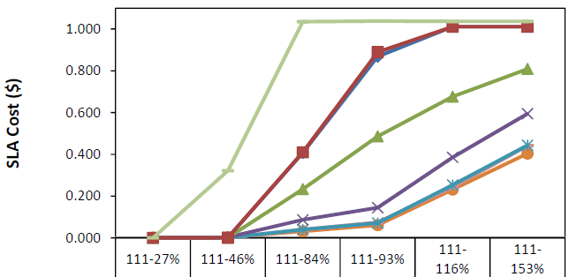
Varying Load(Cont.)
Load=arrival rate*average execution time
iCBS-DH performs well on cost.

Slide 22
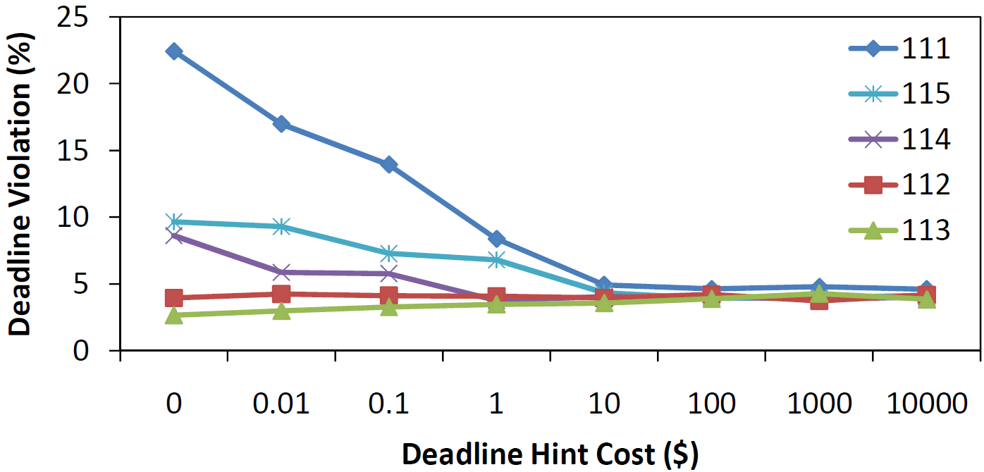
Varying Deadline Hint Cost
High hint cost reduce violations.
When deadline is earlier than cost step(111,115), DeadlineHint-to-Violation effect becomes more sensitive.

Slide 23
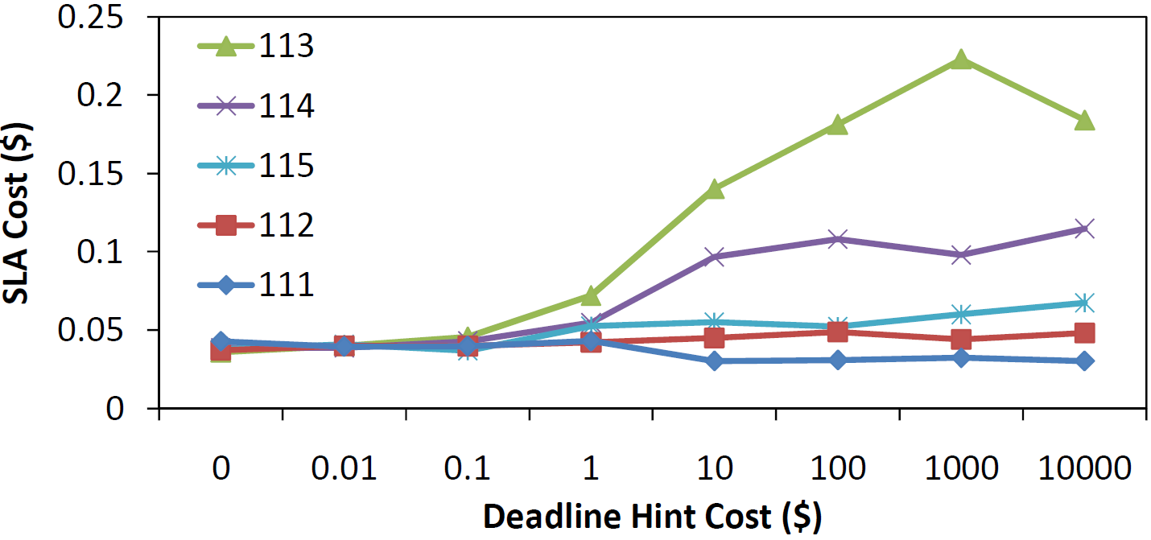
Varying Deadline Hint Cost(Cont.)
Cost performance gets worse with higher hint cost value.
Emphasis on deadline(113) => less attention on the cost step, leading to high SLA cost

Slide 24
Conclusion
Presented workload scheduling under two different types of SLAs, soft and hard SLA.
Proposed a deadline- and cost-aware scheduler called iCBS-DH.
Evaluated deadline and cost performance of various scheduling policies under a large range of SLA cost function and deadline types.

